Slide 1
Photo-excited carrier dynamics revealed with terahertz pump-probe spectroscopy for opposite travelling direction of excitation pulse and terahertz pulse
Ashida Lab・M1
Masahiro Yoshii

Slide 2
Contents
Introduction
terahertz wave
characters of Si
observation of carrier dynamics
opposite arrangement
Previous Work & Purpose
Experimental Setup
THz time domain spectroscopy (THz-TDS)
THz pump optical probe spectroscopy
Result & Discussion
Summary & Future Plan

Slide 3
terahertz wave
Introduction
300km
300m
300mm
300μm
300nm
300pm
300fm
Wavelength
microwave
THz region
visible
X-ray
Frequency(Hz)
10³
10⁶
10⁹
10¹²
10¹⁵
10¹⁸
10²¹
3cm
3mm
300μm
30μm
3μm
300nm
Wavelength
FIR
MIR
NIR
THz region
Frequency(Hz)
0.01THz
0.1THz
1THz
10THz
100THz
1000THz
1THz = 300μm =4.1 meV=48K
gap of low-T_{c} superconductor
mode of collective oscillation of macromolecule

Slide 4
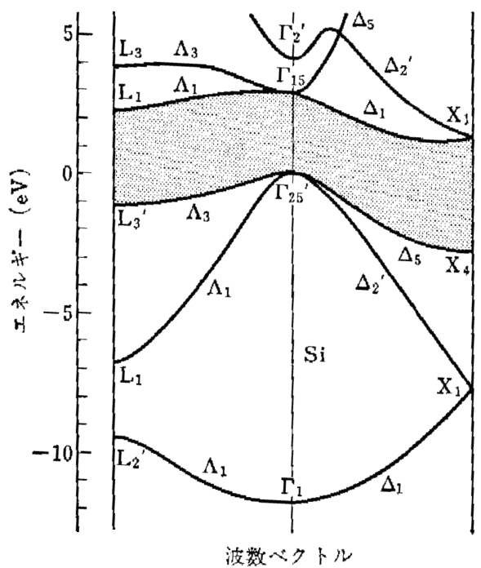
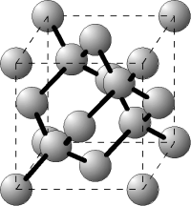
characters of Si
Introduction
光物性ハンドブック , P42
indirect band gap semiconductor
diamond structure
E_{g}
5.43Å
band gap energy : E_{g} : 1.12eV
Г₂₅’-X₁ : 1.2eV
Г₂₅’-L₁ : 2.0eV
Г₂₅’-Г₁₅ : 3.4eV
Г₂₅’-Г₂’ : 4.2eV
α₀ at 800nm : 942cm⁻¹
↕
penetration depth : 10.6μm

Slide 5
observation of carrier dynamics
Introduction
thickness of sample < penetration depth
⇒transmission arrangement
excitation light
thickness of sample > penetration depth
⇒reflection arrangement
excitation light

Slide 6
opposite arrangement
Introduction
reflection arrangement
ω
reflectivity
intrinsic characters of carriers
spatial distribution of carriers
excitation light
reflectivity of Drude model
R
carrier density
opposite arrangement
ω
ω/ω_{p}
excitation light
reflectivity
intrinsic characters of carriers
phase shift
spatial distribution of carriers

Slide 7
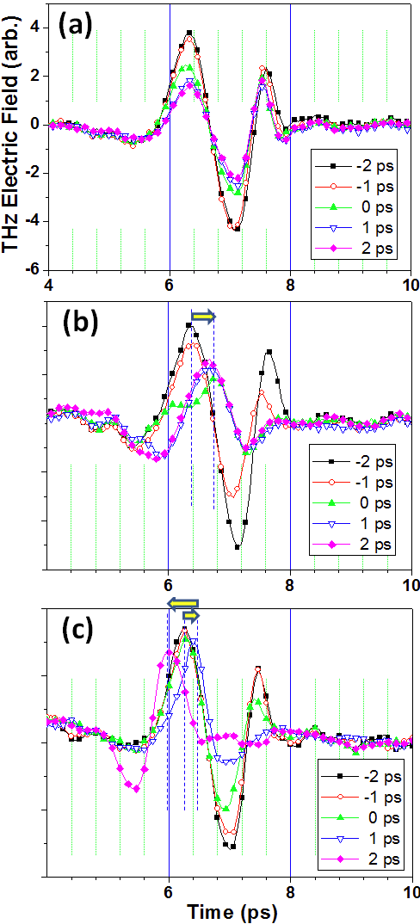
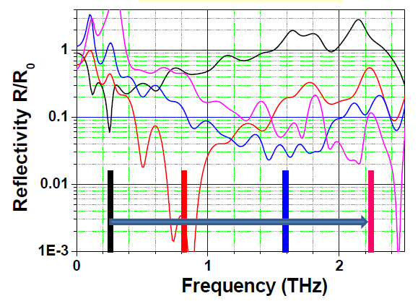
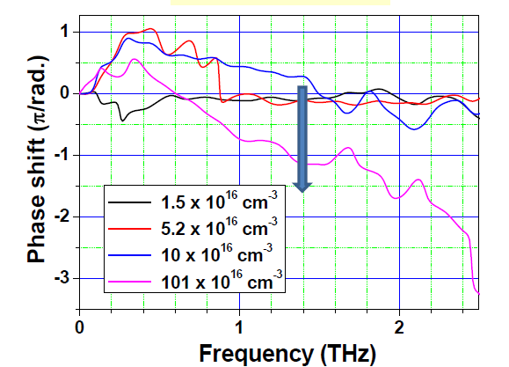
Previous Work & Purpose
GaAs ：PHYSICAL REVIW B 70, 125205 (2004)
Si：Tsubouchi, Yokoyama, Nagai, Oshima, 応用物理学会 2011秋 2a-F-2
reflectivity
phase shift
Tsubouchi observed carrier dynamics of Si up to 2THz.
○phase shift
×reflectivity
⇓
I did this work over 2THz.

Slide 8
THz time domain spectroscopy
Experimental Setup
EO sampling
GaAs
Si
λ/4
ND
WP
sample
BD
BBO
λ/2
REGEN

Slide 9
THz pump optical probe spectroscopy
Experimental Setup
THz-TDS
EO sampling
GaAs
Si
λ/4
ND
WP
sample
BD
BBO
prism
λ/2
REGEN
TOPAS
ND
BPF

Slide 10
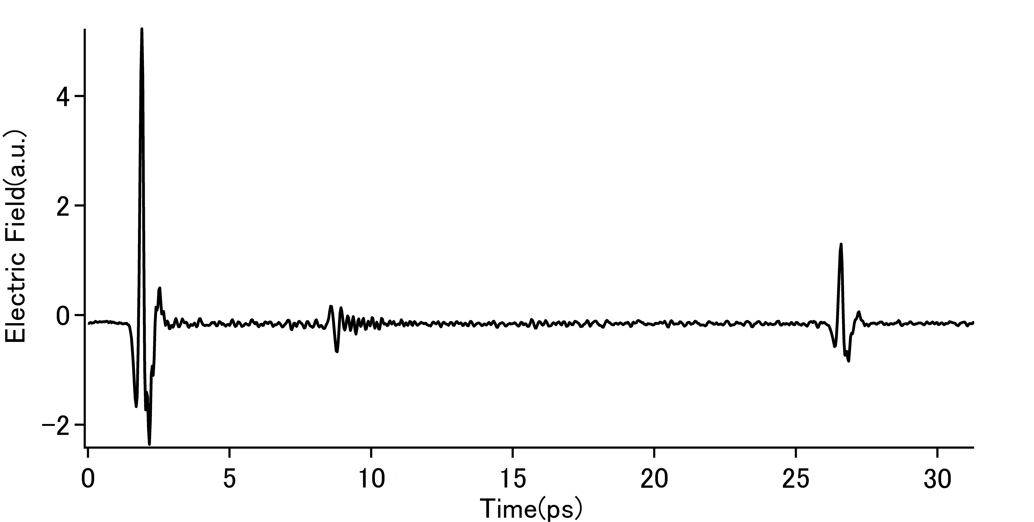
opposite arrangement
Experimental
Setup
(a)
ω
traditional reflection arrangement
complex reflectance
spatial distribution
intrinsic characters
通常の 反射配置
対向配置
(b)
Pump光
opposite arrangement
complex reflectance
intrinsic characters
phase shift
spatial distribution
(c)
t
THz光
Pump光

Slide 11
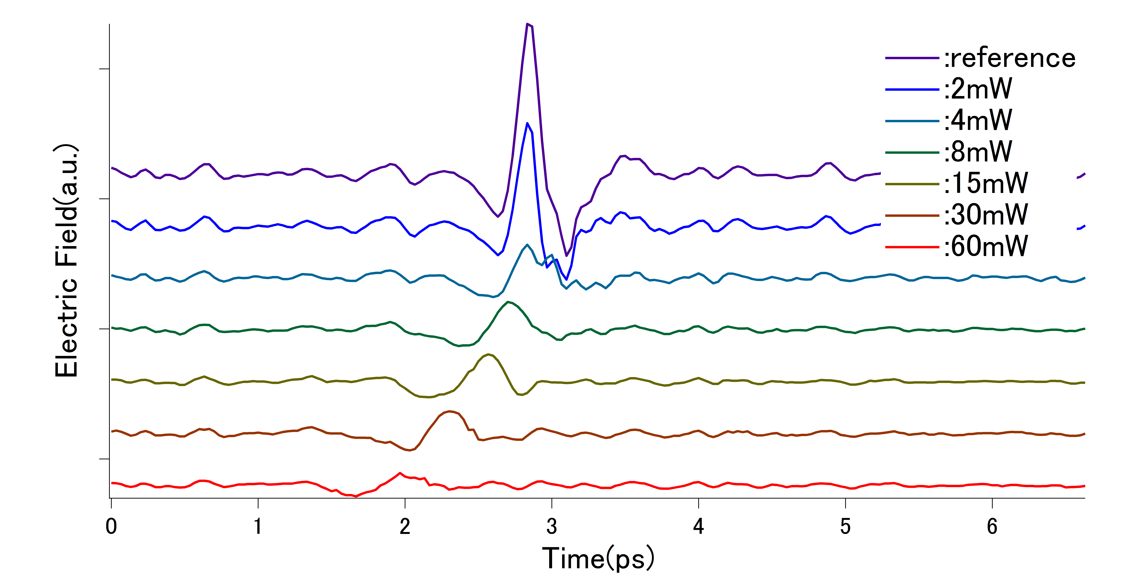
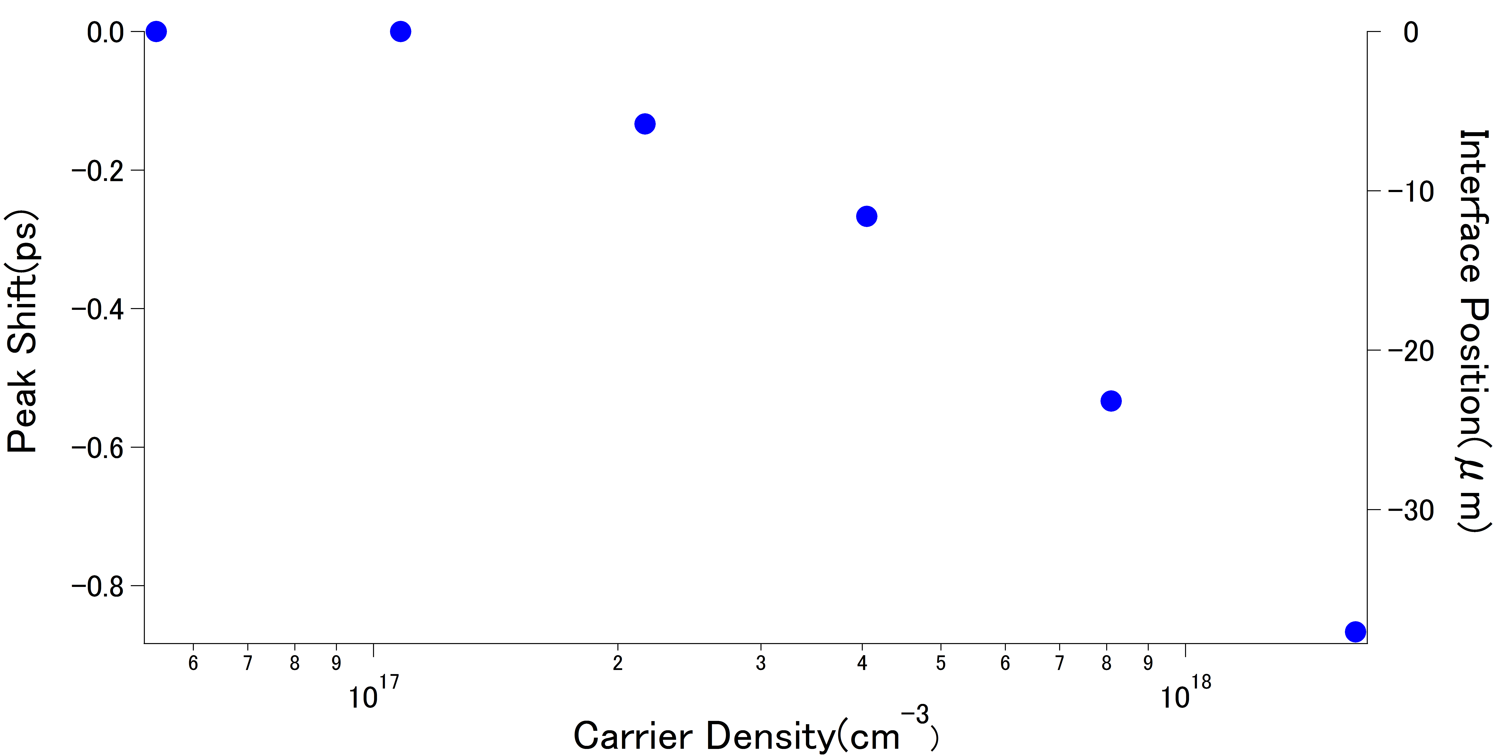
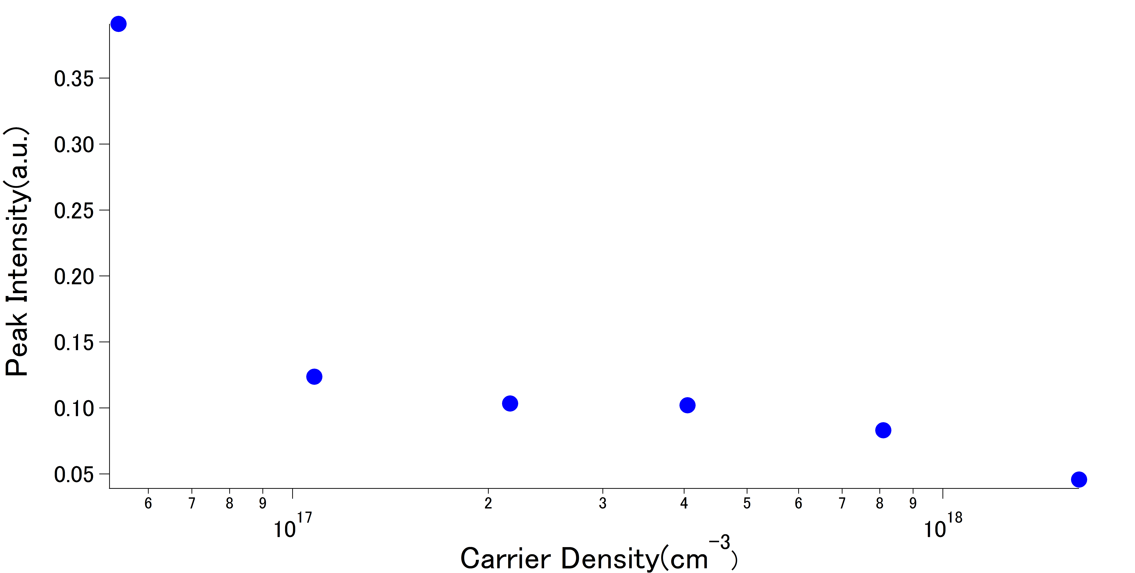
measured waveforms
Result
temporal advance of the waveform
→ shift of the reflective interface
decrease of the electric field amplitude
→ absorption by the photo-excited
carriers

Slide 12
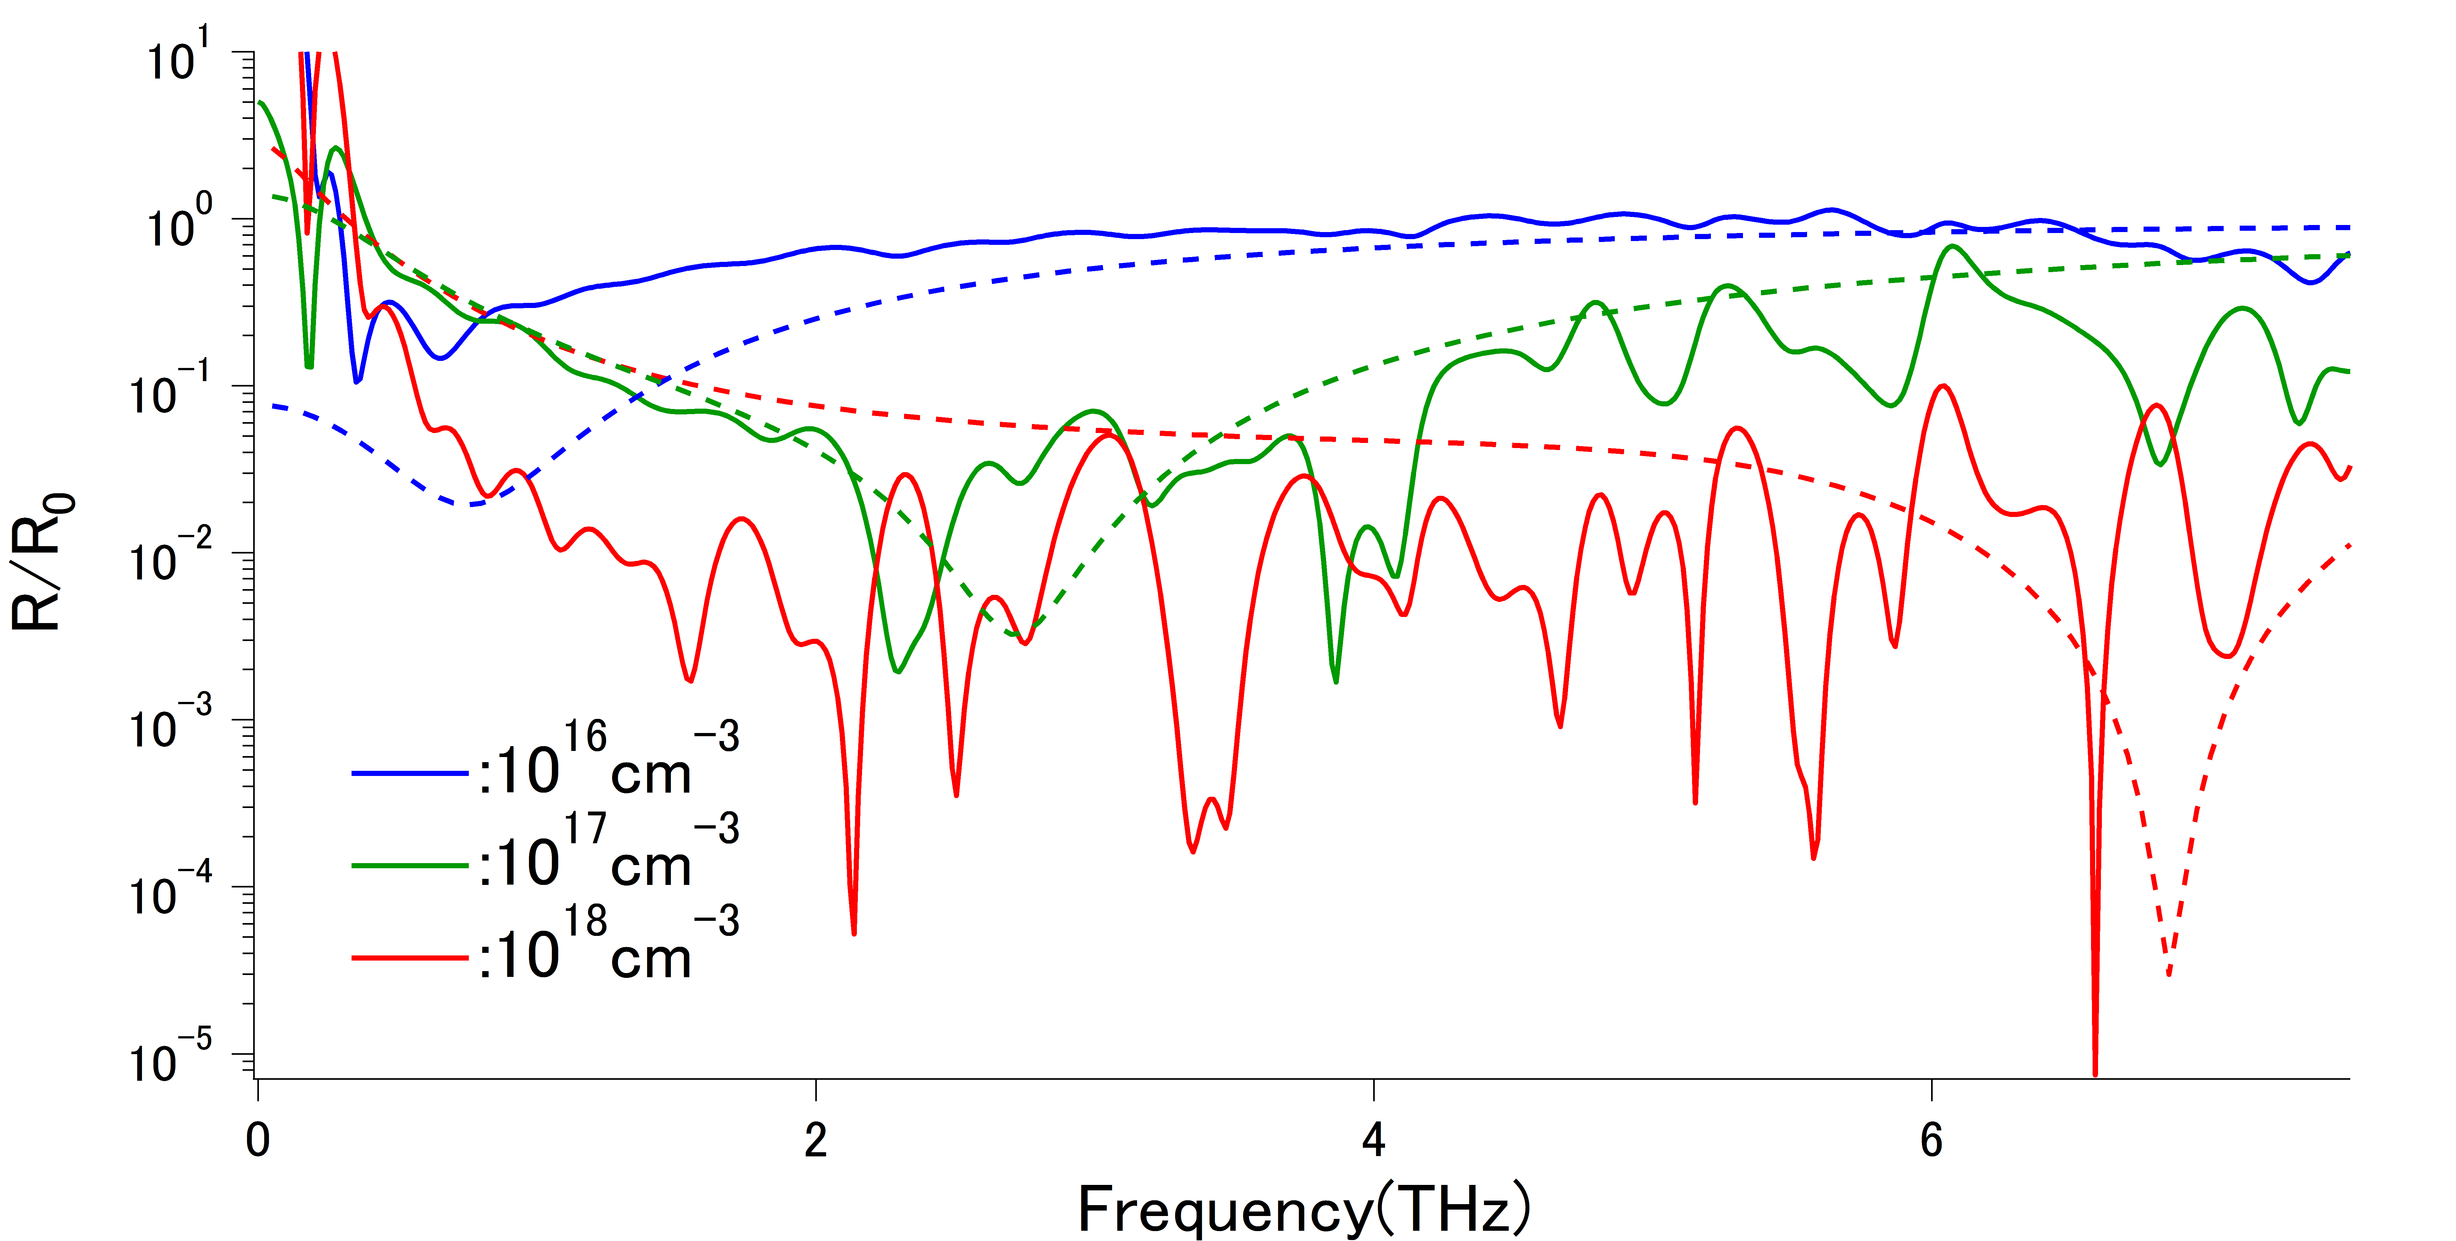
reflectivity
Result
carrier density dependence of reflectivity
・・・: calculated data (τ=100fs)
Plasma absorption shift to higher
frequency side.
The position of plasma absorption
gives close agreement with the
calculated data.

Slide 13
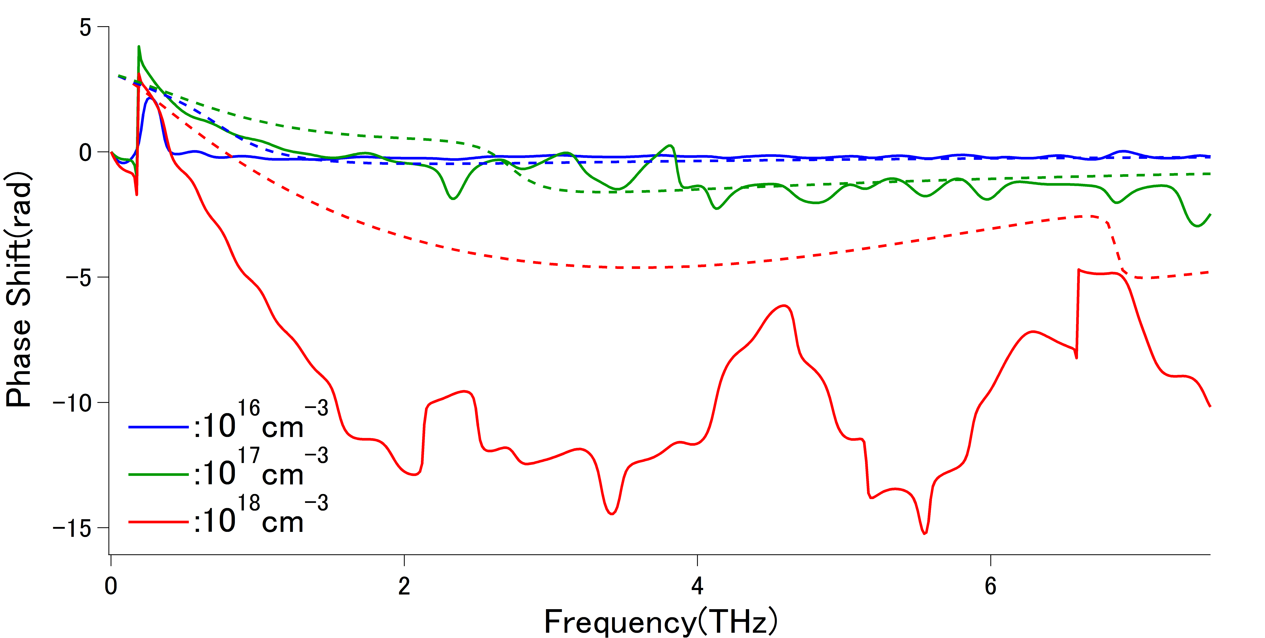
phase shift
Result
carrier density dependence of phase shift
・・・: calculated data (τ=100fs)
Phase shift increase.
The spectrums are not same with
the calculated date.
data mismatching of spatial
distribution

Slide 14
difference from calculated data
Result
PHYSICAL REVIEW B 75, 233202 (2007)
When we calculated, we assumed that the relaxation time of carriers does not depend on the carrier density.
but
We find that the relaxation time of carriers changes when the carrier density is over 10¹⁷cm⁻³.

Slide 15
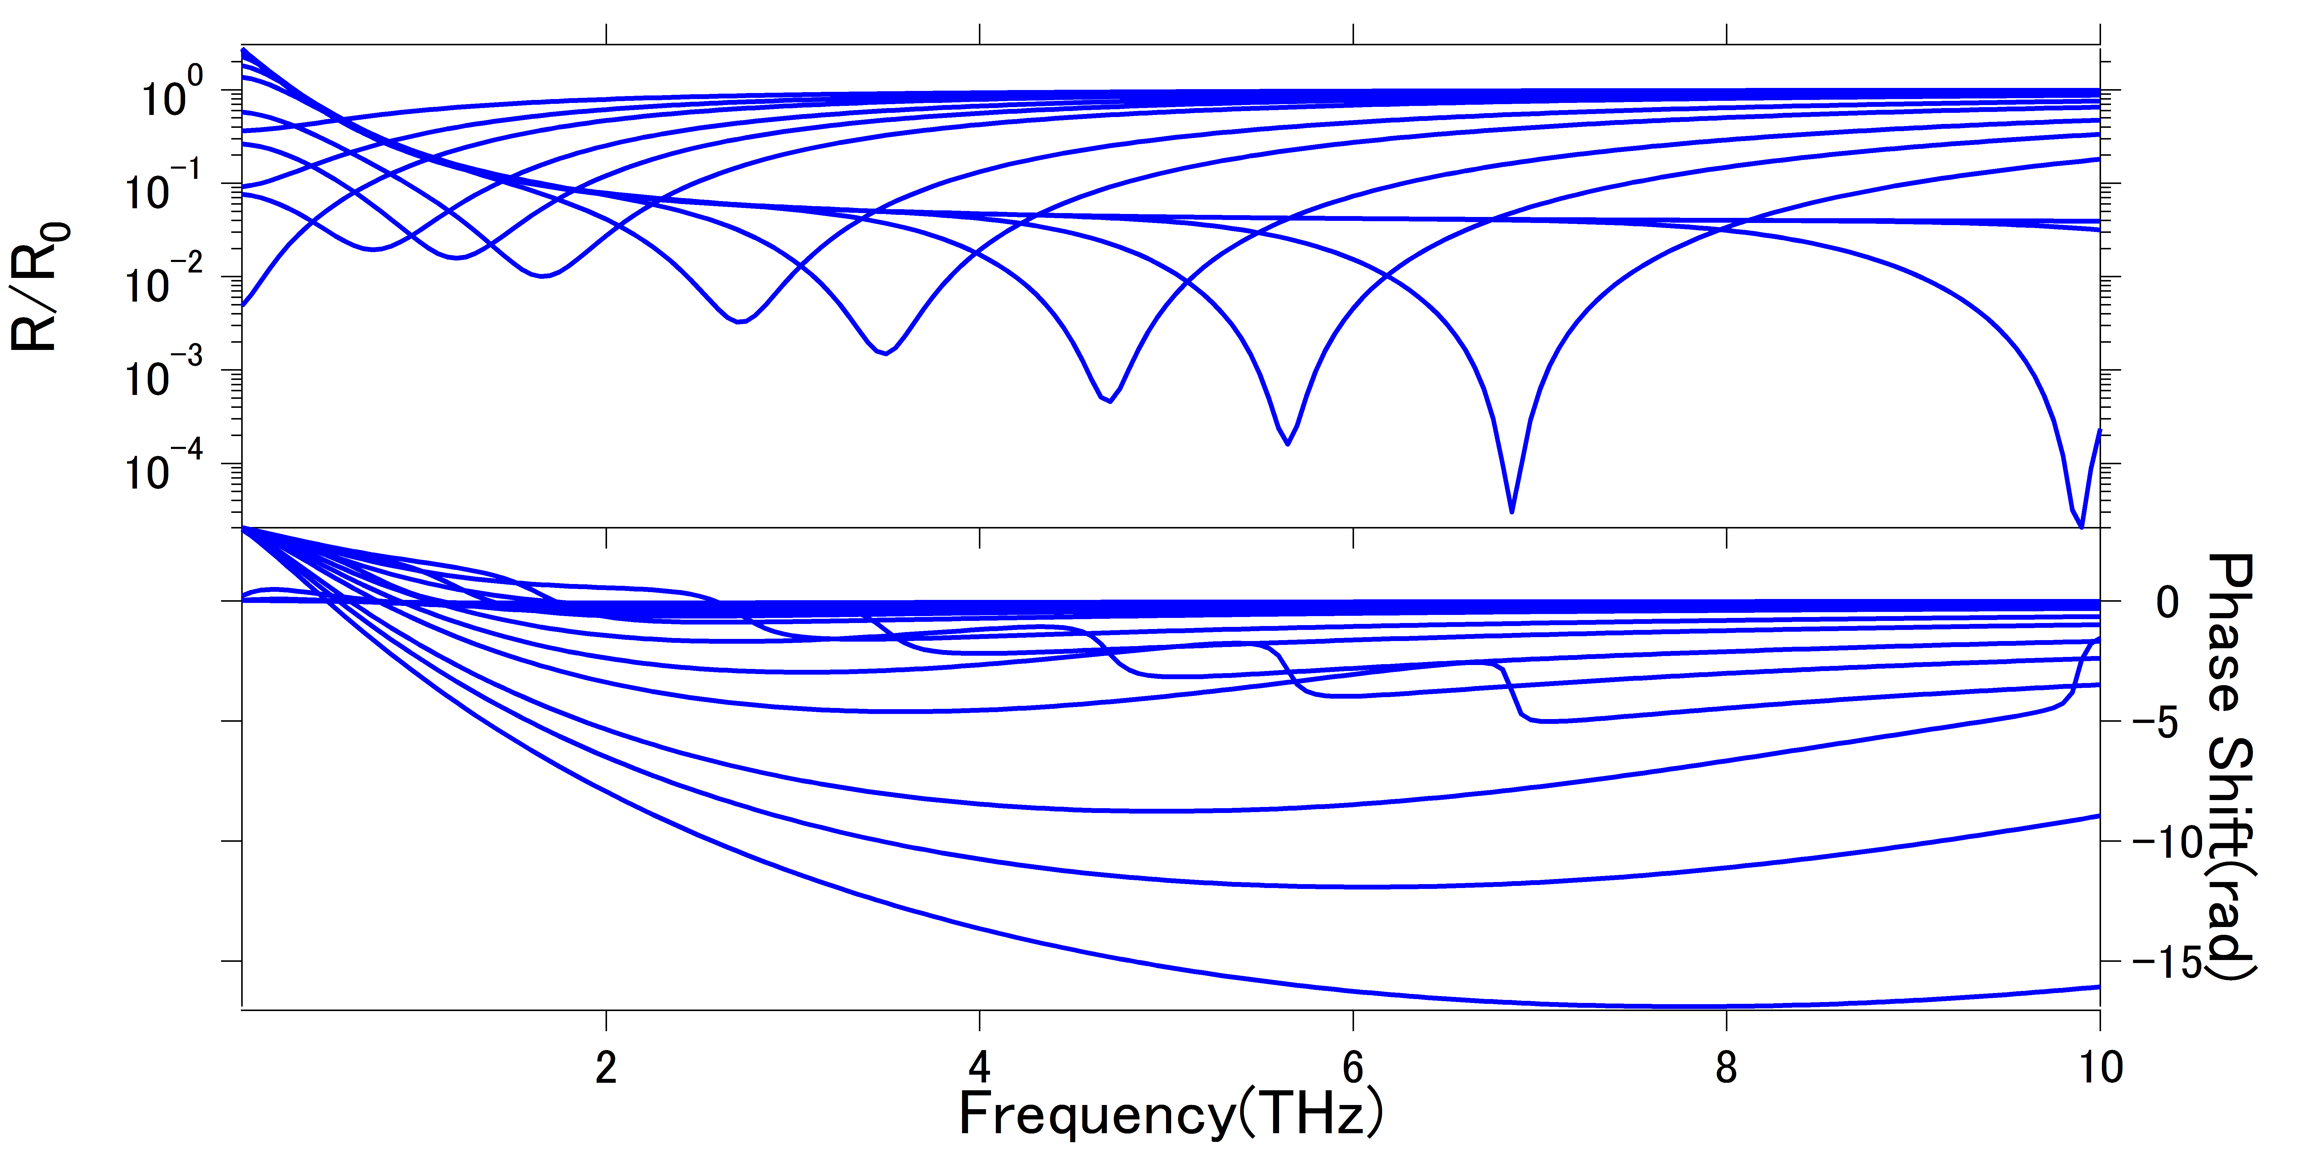
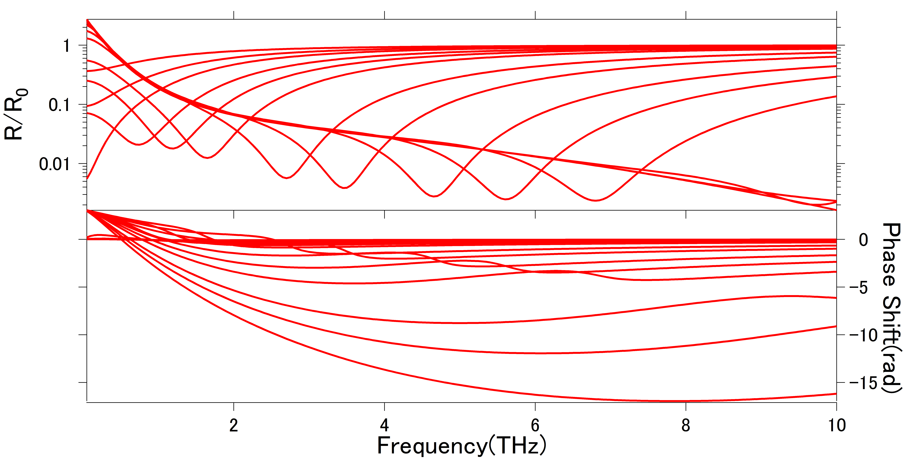
correction of calculated model
Result
PHYSICAL REVIEW B 75, 233202 (2007)
τ : constant

Slide 16
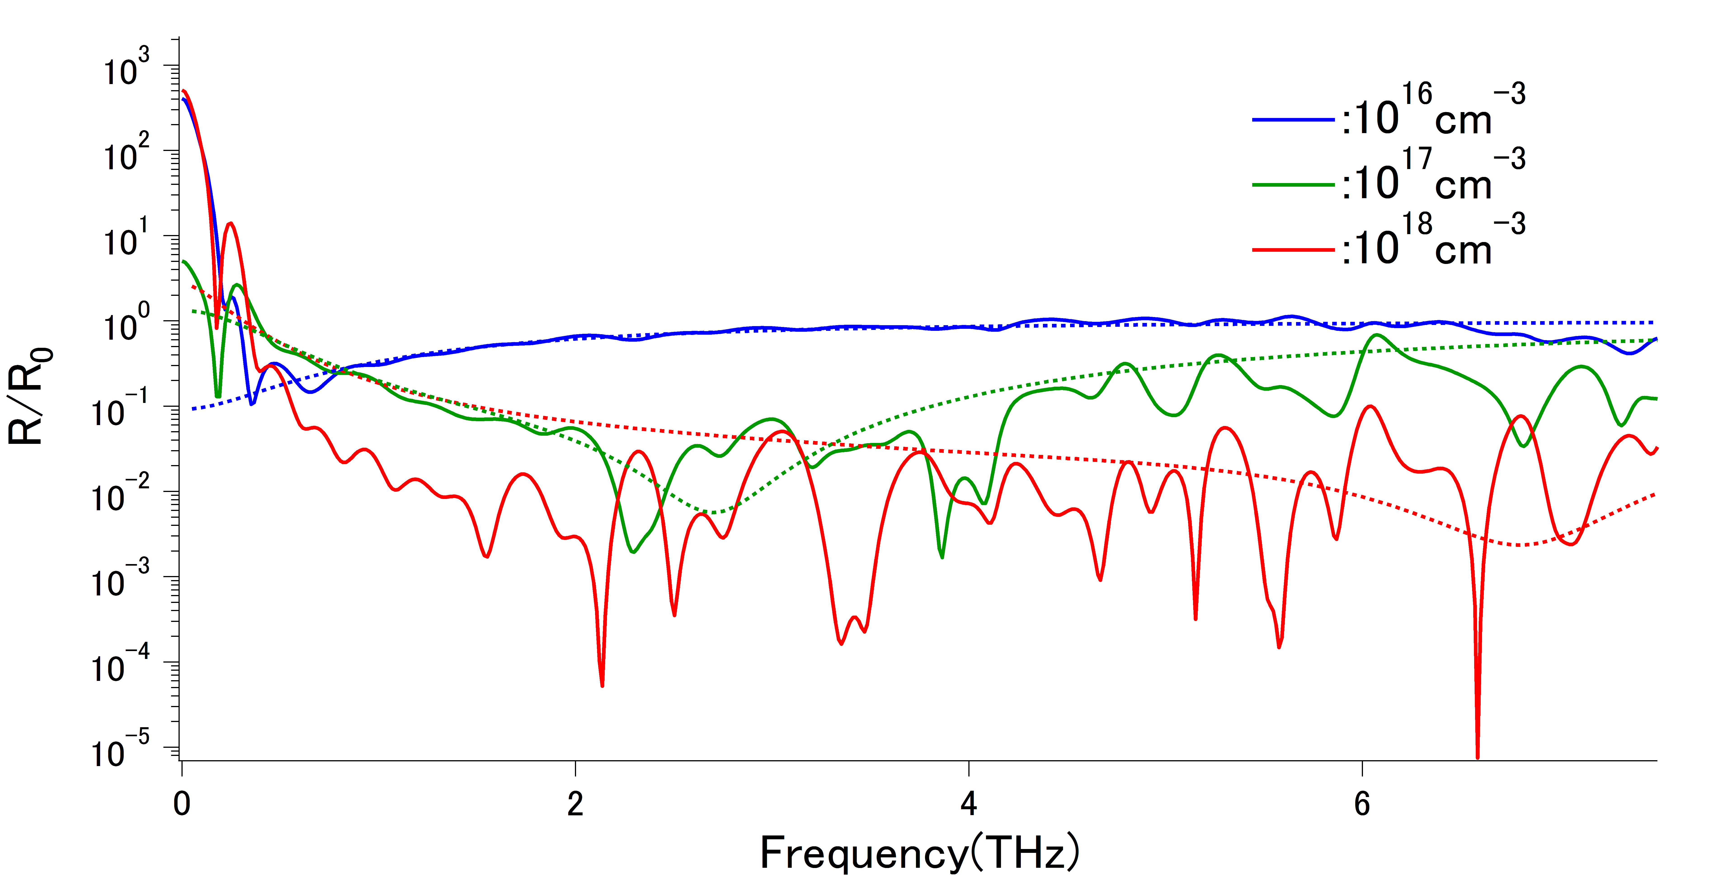
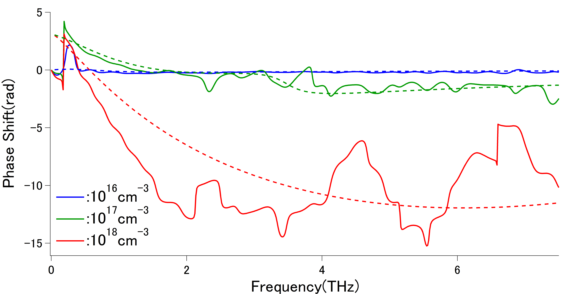
reflectivity and phase shift
Result
reflectivity
phase shift

Slide 17
Conclusion
I constructed a novel experimental setup of THz pump-probe
spectroscopy.
(the opposite arrangement of the excitation light and the probe light)
I observed the THz wave reflected at the rear surface of the sample.
I distinguished the information on spatial distribution and that on
intrinsic characters of photo-excited carriers. (>2THz)
I determined that the scattering time of carriers is about 100fs.
But, the SN of observed spectrums are too bad to discuss about the
results of reflectance and phase shift.

Slide 18
Future Plan
I’ll understand why the relaxation time
changes by carrier density.
I try to change the wavelength excitation light.
(wavelength dependence)

Slide 19
補助スライド

Slide 20
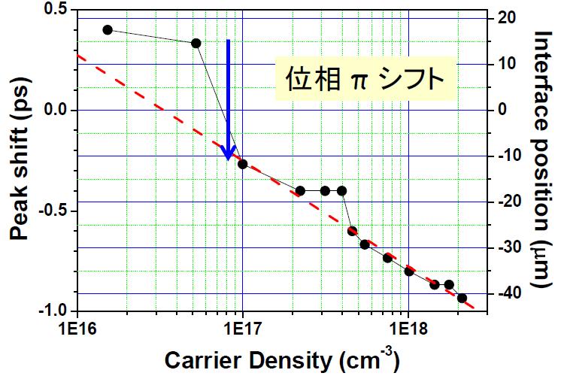
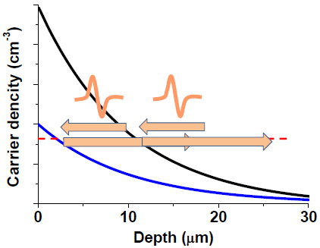
坪内さんによる先行研究
carrier density dependence of peak position
π shift

Slide 21
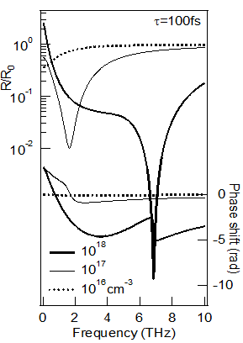
永井先生による理論結果

Slide 22
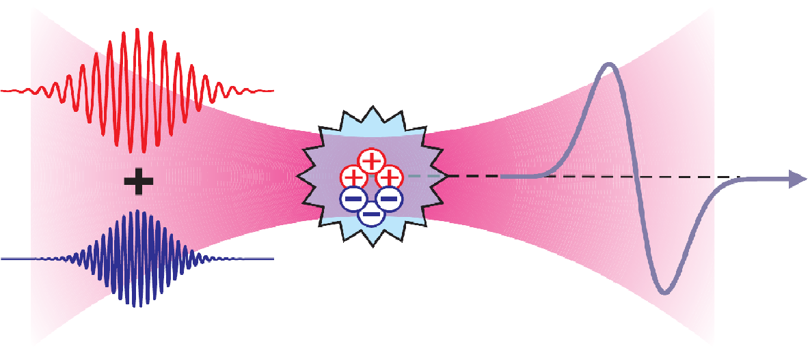
大気プラズマからのテラヘルツ発生
Laser & Photon. Rev. 1, No. 4, 349–368 (2007) / DOI 10.1002/lpor.200710025
破壊閾値が存在しない
位相整合条件などによる帯域の制約がない
⇒高強度・広帯域のテラヘルツ発生
大気プラズマにωと2 ωの光を入射する
⇓
電荷分布に非対称性が生じる
⇓
双極子として振る舞い、テラヘルツ発生

Slide 23
EOサンプリング

