Slide 1
Distinct Fermi Surface Topology and Nodeless Superconducting Gap in a (Tl_{0.58}Rb_{0.42})Fe_{1.72}Se₂ Superconductor
D. Mou et al
PRL 106, 107001 (2011)
Kitaoka Lab.
Keisuke Yamamoto

Slide 2
Contents
Introduction
  Iron based superconductor
    Electronic structure
  A_{x}Fe_{2-y}Se₂ (A = K,Tl,Cs,Rb,etc.)
    Characteristic
Experiment and result (Tl_{0.58}Rb_{0.42})Fe_{1.72}Se₂
  ARPES(角度分解光電子分光）
  Fermi surface
Summary
Future work

Slide 3
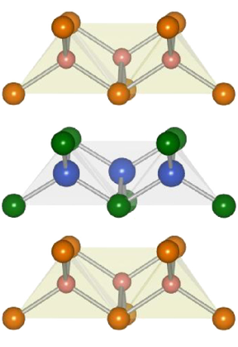
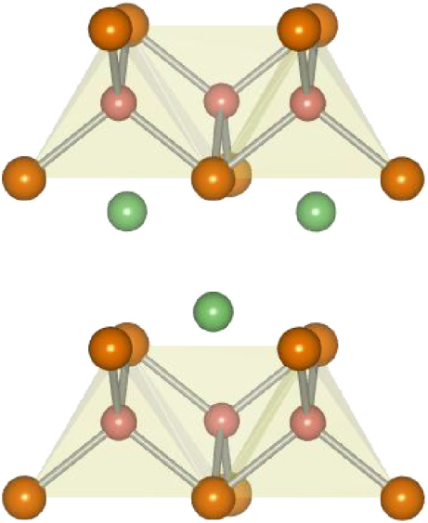
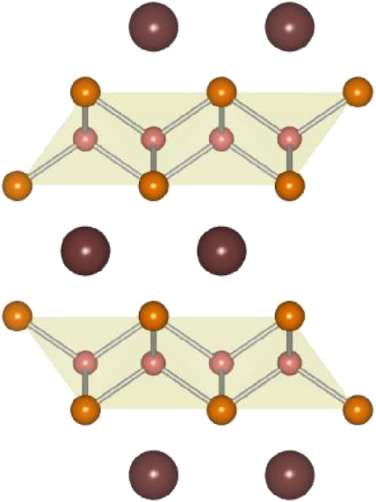
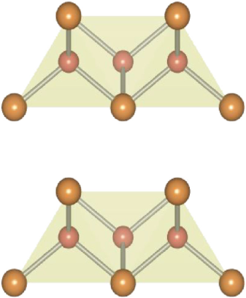
Iron-based superconductor
Introduction
1111 system
122 system
111 system
11 system
As
Fe-Pnictide layer
Fe
Se
LaFeAsO
BaFe₂As₂
LiFeAs
FeSe
T_{c max} = 55K
T_{c max} = 38K
T_{c max} = 18K
T_{c max} = 8K
Pnictgen(15族元素)

Slide 4
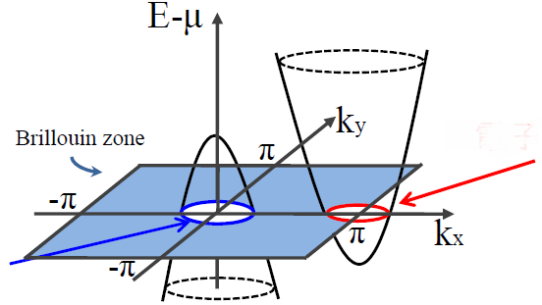
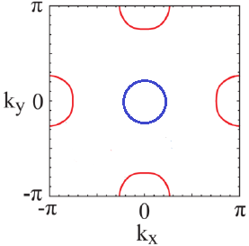


Iron-based superconductor
Introduction
Band structure
Phase diagram
electron
hole
Fermi suface
electron
electron scattering
$$Γ$$
$$Μ$$
hole
nesting

Slide 5
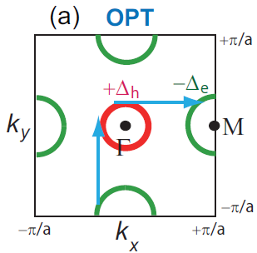
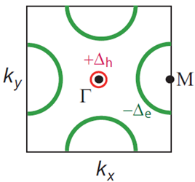
Electron-dope
Introduction
Band structure
E
electron
hole
Electron-dope
ε_{F}
k
Fermi suface
Electron-dope
nesting

Slide 6
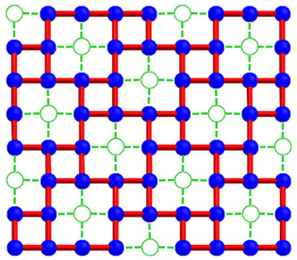
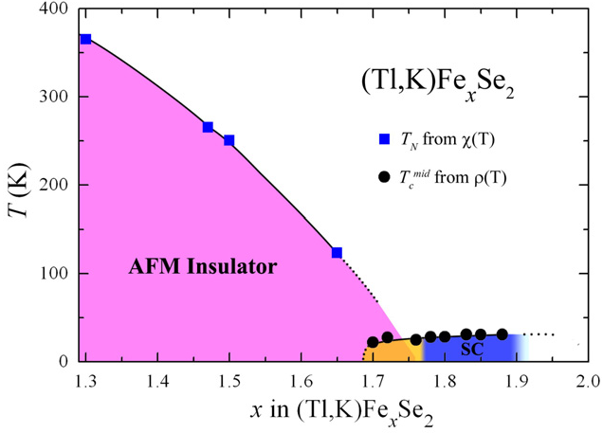
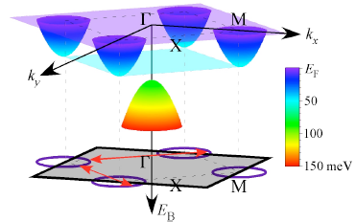


A_{x}Fe_{2-y}Se₂
Motivation
Fe vacancy
Phase diagram
Fe-atom
vacancy
M.H.Fang et al , EPL, 94 (2011) 27009
M.H.Fang et al , EPL, 94 (2011) 27009
Band structure
Fermi surface
electron
$$Μ$$
$$Γ$$
hole
Absence of the hole band
Qian et al , arXiv:1012.6017v1 Dec (2010)
Notes:
Blue solid circle: Fe-atom; green hollow circle: vacancy

Slide 7
A_{x}Fe_{2-y}Se₂
Motivation
Many differences from previous Iron-superconductor
  Existence of Fe vacancies
  Impossible for the electron scattering
Why the T_{c} is high (over 30K) ?
Observe the electron structure of this sample by ARPES

Slide 8
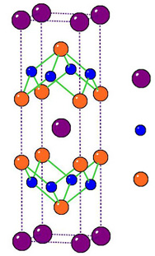
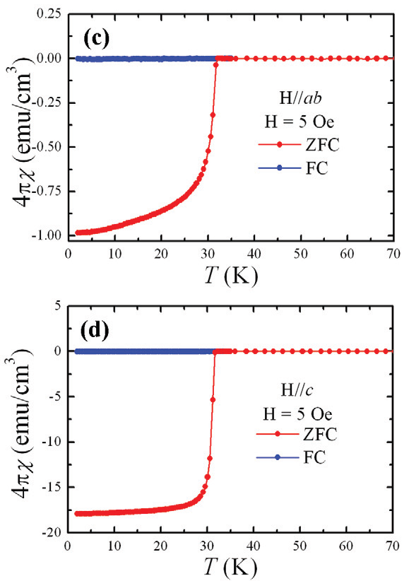
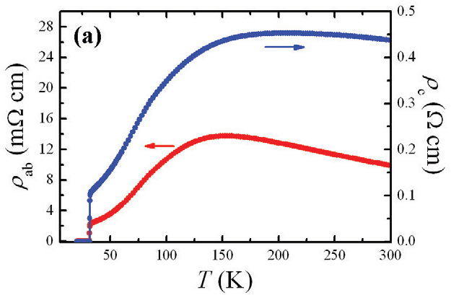
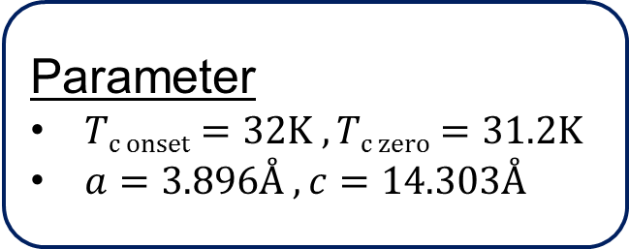
(Tl_{0.58}Rb_{0.42})Fe_{1.72}Se₂
Experiment
Tl,Rb
Fe
Se
M.H.Fang et al , EPL, 94 (2011) 27009
Parameter
$Tc onset=32K , Tc zero=31.2K$
$a=3.896Å , c=14.303Å$
H.D.Wang et al , EPL, 93 (2011) 47004

Slide 9
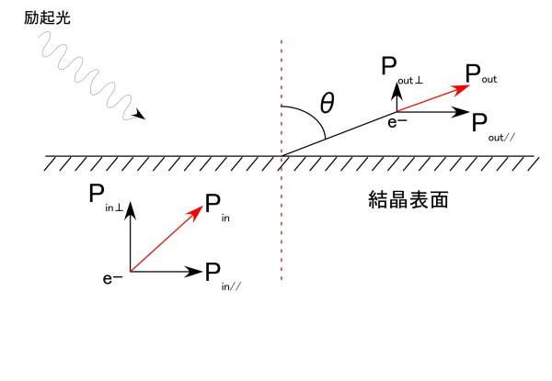
ARPES(angle-resolved Photoemission Spectroscopy)
Experiment
exiting light
crystal surface
P_{in//} = P_{out//}
measure both momentum and kinetic energy of the electrons photo emitted from a sample
one of the most direct and powerful methods of studying the electronic structure dispersive with the crystal momentum in strongly anisotropic systems

Slide 10
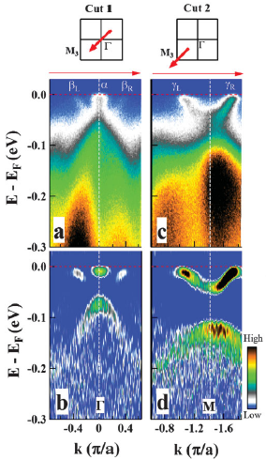
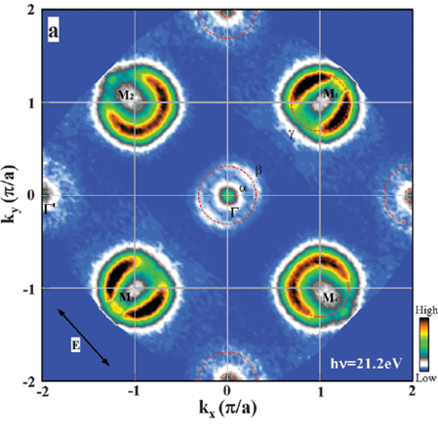
Fermi surface
Result
D. Mou et al PRL 106, 107001 (2011)
Two electronlike Fermi suface sheets, α and β around Γ
D. Mou et al PRL 106, 107001 (2011)

Slide 11







Fermi surface
Result
Early report on KFeSe
In this paper (Tl,Rb)FeSe
electron
electron
g
$$Μ$$
g
$$γ$$
$$Μ$$
$$β$$
$$α$$
$$Γ$$
hole
$$Γ$$
hole
Question : What is origin of the electronlike β band around Γ ?
3 possibilities
Whether it could be a surface state
Whether the β band can be caused by the folding of the electronlike γ surface near M
Whether the measured β sheet is a Fermi surface at a special k_{z} cut

Slide 12
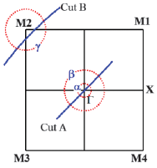
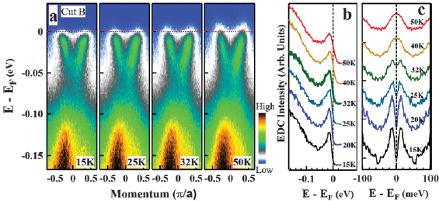
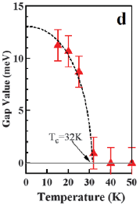
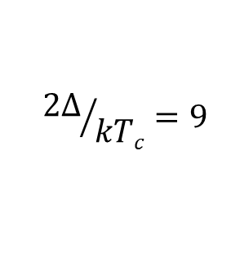
Fermi surface
Result
Gap size
D. Mou et al PRL 106, 107001 (2011)
$${2Δ}/{kTc}=9$$
Superconducting gap
Dash line is a BCS gap form
The temperature dependence of the gap size roughly follows the BCS-type form
Notes:
To visually inspect the Possible gap opening and remove the effect of the Fermi distribution function near the Fermi level, we have symmetrized these original EDCs

Slide 13
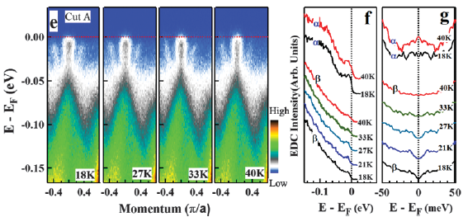
Fermi surface
Result
D. Mou et al PRL 106, 107001 (2011)
β Fermi surface displays a clear superconducting gap
The peculiar tiny α pocket near Γ, we do not find signature of clear superconducting gap opening

Slide 14
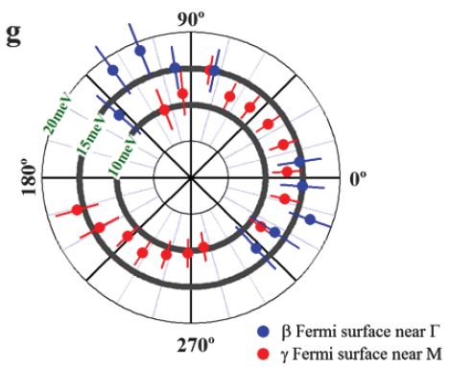

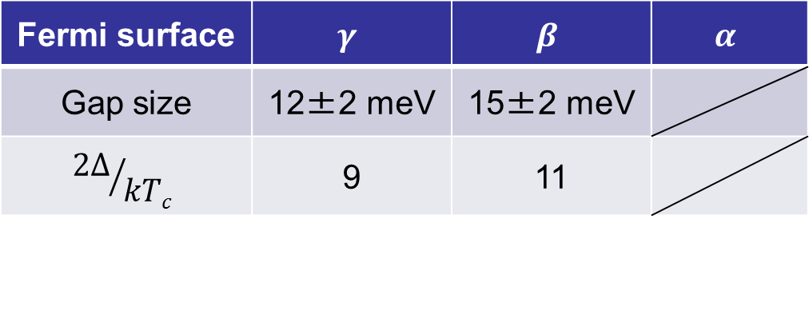
Super conducting gap
Result
T =15K
Nearly isotropic gap
Without gap nodes
D. Mou et al PRL 106, 107001 (2011)
Fermi surface | $$γ$$ | $$β$$ | $$α$$
Gap size | 12±2 meV | 15±2 meV
$${2Δ}/{kTc}$$ | 9 | 11
$$≫$$
3.52 (BCS)

Slide 15


Summary
We have identified a distinct Fermi surface topology in the new (Tl_{0.58}Rb_{0.42})Fe_{1.72}Se₂ superconductor
Near the Γ point, two electronlike Fermi surface sheets are observed
electron
electron scattering
g
$$Μ$$
$$Γ$$
hole
Interband scattering between the electronlike Fermi surface sheet near Γ and electronlike Fermi surface sheet near M gives rise to electron pairing and superconductivity
Interband scattering : バンド間散乱

