Slide 1


M1 colloquium
Property of PAH(polycyclic aromatic hydrocarbon) under pressure
G. A. Samara and H. G. Drickamer, J. Chem. Phys., 41, 1856-1864 ( 1964 )
Shimizu-group
M1 Daiki Hayashi

Slide 2
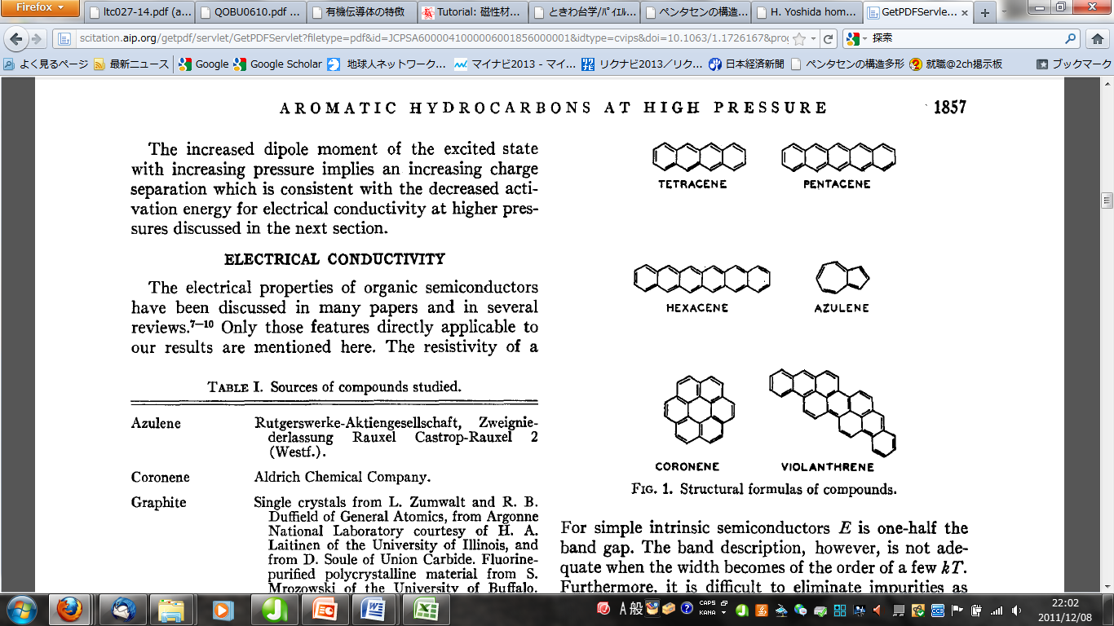
Contents
Introduction
- About PAH (a group of organic conductor) ; what is PAH? what property they have? And especially pick up pentacene
- Property and applied technology of pentacene ; similar material industrially attracting attentions
Experiment
Metallization & Polymerization of pentacene under high pressure
from electrical resistance and optical absorption
[G. A. Samara and H. G. Drickamer, J. Chem. Phys., 41, 1856-1864 ( 1964 )]
Summary & Future
summarize with the future outlook
Notes:
in this presentation, as the title, I introduce materials which are collectively called PAH, the group of organic conductor. Naphthalene, anthracene, and phenanthrene are the example of PAH. for main topic, I focus at pentacene today, which is industrially hot.
after these introduction, I will talk about previous experiment under high pressure from two paper. electrical resistance and its temperature dependence were measured, and optical absorption experiment was done. then, as a result, metallization and polymerization was observed.
I will explain the detail of these experiments and summarize with the future outlook!

Slide 3
Property of organic conductor
・narrow bandwidth ; <1eV in usual
(strongly-correlated system)
TTF
closed-shell structure and small overlapping of orbit
・pseudo-low dimension （擬低次元物質）
・effected a great deal by pressure
BEDT-TTF
connect by week van der Waals' force , and large interstice
insulator - metal transition
progress of dimensionality
Phthalocyanine
Notes:
at first, about property of organic conductors.
usually, organic materials are insulator mainly because of two reasons. first, they have closed-shell structure and the gap between HOMO and LUMO is large.
second, HOMO are localized in molecular bond and small overlapping formed between molecular.
and, some of them are an isotropic.
but, each molecular connect by week van der Waals' force. then their interstice are large.
so, they effected a great deal by pressure
under pressure, insulator-metal transition or progress of its dimensionality are sometimes observed.
有機伝導体の特徴
通常の有機物はよく知られているように絶縁体です．では，何故有機物は絶縁体なのでしょうか？ これには大きく分けて二つの理由があります．まず一つ目はほとんどの有機分子が閉殻構造を とっており，かつHOMOとLUMOのギャップが大きいということ．二つ目は有機分子のHOMOが 分子内結合に局在化しており，分子間での軌道の重なりが非常に小さいということです． まず最初の点についてですが，HOMOとLUMOのエネルギー差が大きいということは，HOMOの 作るvalence band (VB)と，LUMOの作るconduction band (CB)とのギャップが大きいという ことを意味します． このため，通常の有機物ではVBとCBには重なりが無く，独立したバンドとなっています． ここにほとんどの有機分子が閉殻である＝HOMOに2つの価電子を持つことを合わせると， VBにはバンドがちょうど埋まるだけの電子が存在し，CBには一つも電子が存在しない状態 となり，絶縁体となる事がわかります．

Slide 4

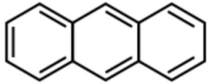
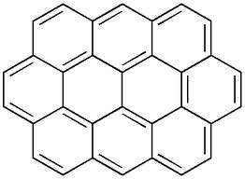
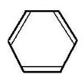
About PAH
PAH; Polycyclic Aromatic Hydrocarbon
anthracene
phenanthrene
number of fused-ring
n=3
n=4
n=5
・・・
・・・
・・・
and etc…
n=7
Ovalene
huge variety!
Definition； potent atmospheric pollutants consist of fused aromatic rings and do not contain heteroatoms or carry substituent
＝
combination of benzene ring
・・・ CnHm
Notes:
I should explain what is PAH. PAH is abbreviated name of polycyclic aromatic hydrocarbon.
it is definitely potent atmospheric pollutants consist of fused aromatic rings and do not contain heteroatoms or carry substituent. in other words, combination of benzene ring. and simply written like this formula
although the number of fused-ring is same, there are deferent materials like anthracene and phenanthrene.
such huge variety is one of the character of PAH.

Slide 5
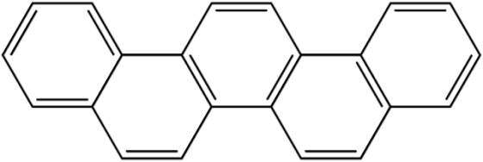
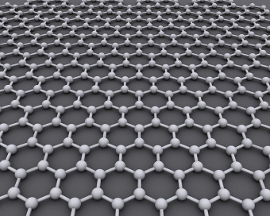
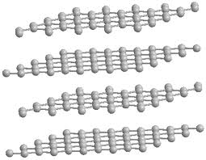
Study of PAH
Superconductivity
K doped picene
K doped phenanthrene
Tc = 5K (2011)
Tc = 18K (2010)
picene
phenanthrene
K doped graphite also express superconductivity ; Tc = 0.14 K (1965)!!
・・・
Ovalene
n=∞
n= 10
May be a step of study for graphene or graphite
Notes:
recently, superconductivity is observed for alkali doped PAH.
potassium doped picene transit to superconductor at 18K,which is the highest superconducting transition temperature as organic conductor.
and this year, it is revealed that phenanthrene also transit to superconductor.
if other alkali metals like Rb are doped to these material, they also transit to superconductor.
now, just take back the topic, about the number of fused ring.
there are huge kind of PAH depending on the number of fused ring.
anthracene and phenanthrene has three fused rings. they are the structural isomer. tetracene has four, and pentacene has five.
when the number approach infinity, that material became near to graphene. and layered one is equal to graphite.
so, the study of PAH may be a approach for graphene and graphite.
in fact, K doped graphite also transit to superconductor. it is a similarity with PAH.

Slide 6
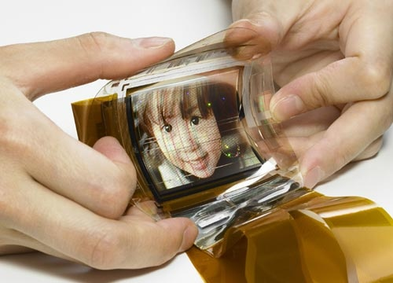
About pentacene
・P-type organic semiconductor
・high mobility
amorphous silicon
pentacene
>1.0 cm²/Vs
>1.5 cm²/Vs (1997)
Now, highest mobility as organic semiconductor (5.5 cm²/Vs)
for organic TFT and organic EL
・insoluble in organic solvent
substituted pentacenes are used for flexible display!
From of old, but getting ahead material!!
Notes:
among such PAH materials, I pick up pentacene, the structural isomer of picene.
pentacene is p-type organic semiconductor. and its high mobility has exceeded that of amorphous silicon at 1997.
now, it remarks highest organic conductor.
so, pentacene is expected to be used for organic TFT and organic EL.
on its own, pentacen is insoluble in organic solvent. then substituted pentacenes are used for industrially.

Slide 7
Experiment
[G. A. Samara and H. G. Drickamer, J. Chem. Phys., 41, 1856-1864 ( 1964 )]
Electrical resistance under high pressure
- isotherm of 78K and 296K
- temperature dependence
Irreversible effect
Absorption spectra

Slide 8
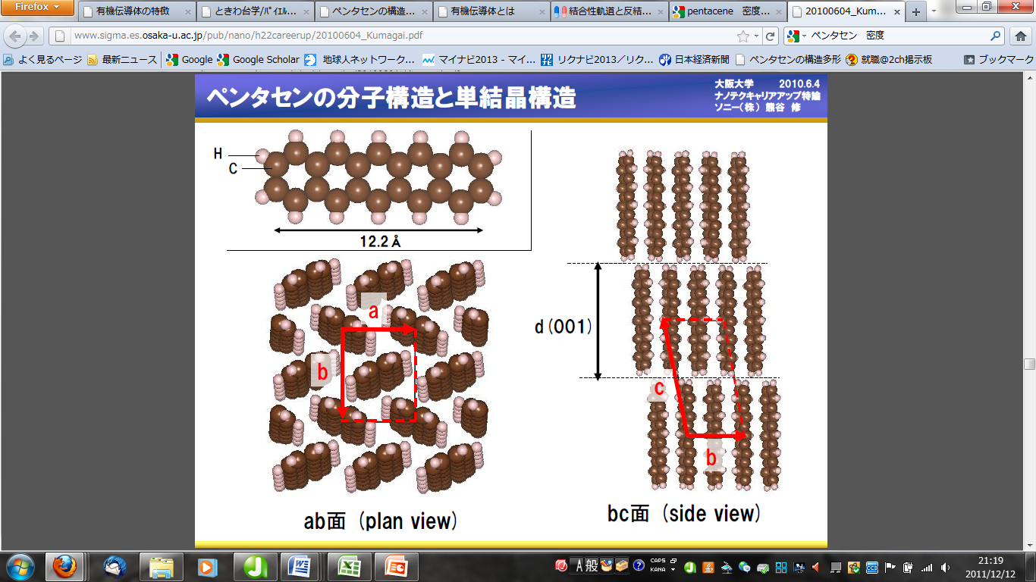
Crystal structure of pentacene
Pentacene ; triclinic structure (the long axis of molecules parallel)

Slide 9
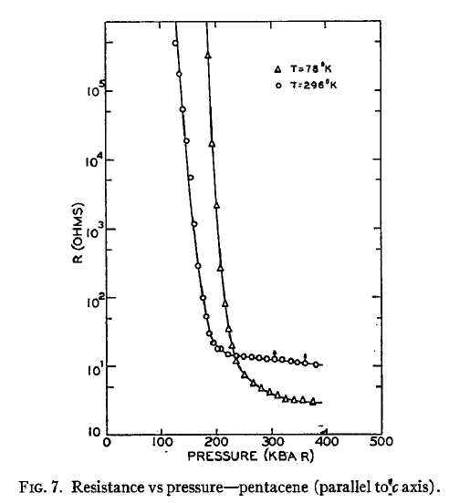
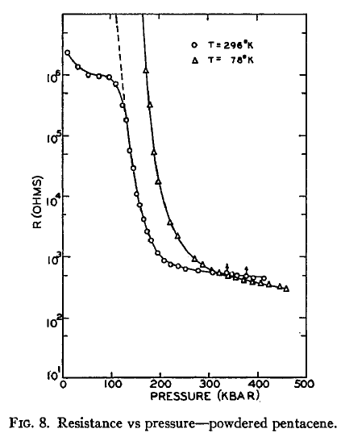
Electrical resistance
isotherms – at 296 K and 78 K
single crystal sample (left) and powdered sample (right)
296K
296K
78K
78K
qualitatively the same result

Slide 10
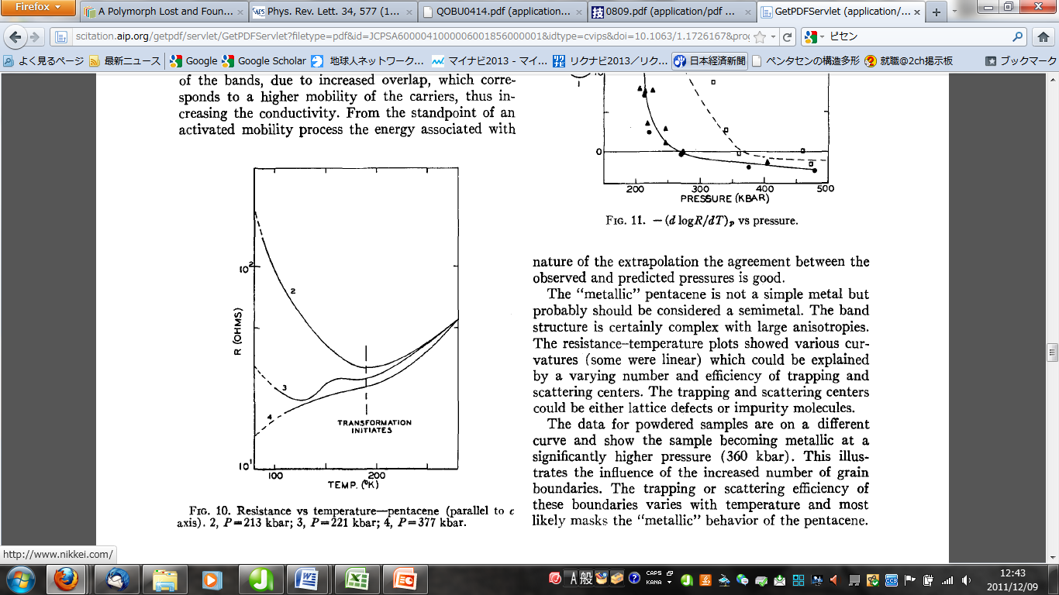
Temperature dependence
single-crystal pentacene for c direction
a’ and b’ direction
- not differ significantly
21GPa
heated and measured after compressed at 78K
22GPa
78K～180K ; reversible
180 K～ ; irreversible
38GPa
metalized?

Slide 11
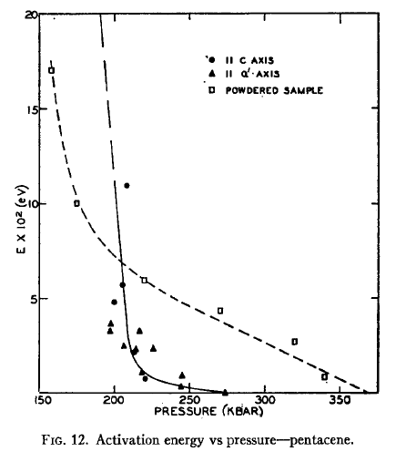
Activation energy
Obtained from logR – 1/T plot
logR = ε/kT + logA
ε ; activation energy
A ; const
The activation energy eventually goes to zero
(270 kbar for the single-crystal samples)
“metallic”
with a positive coefficient

Slide 12
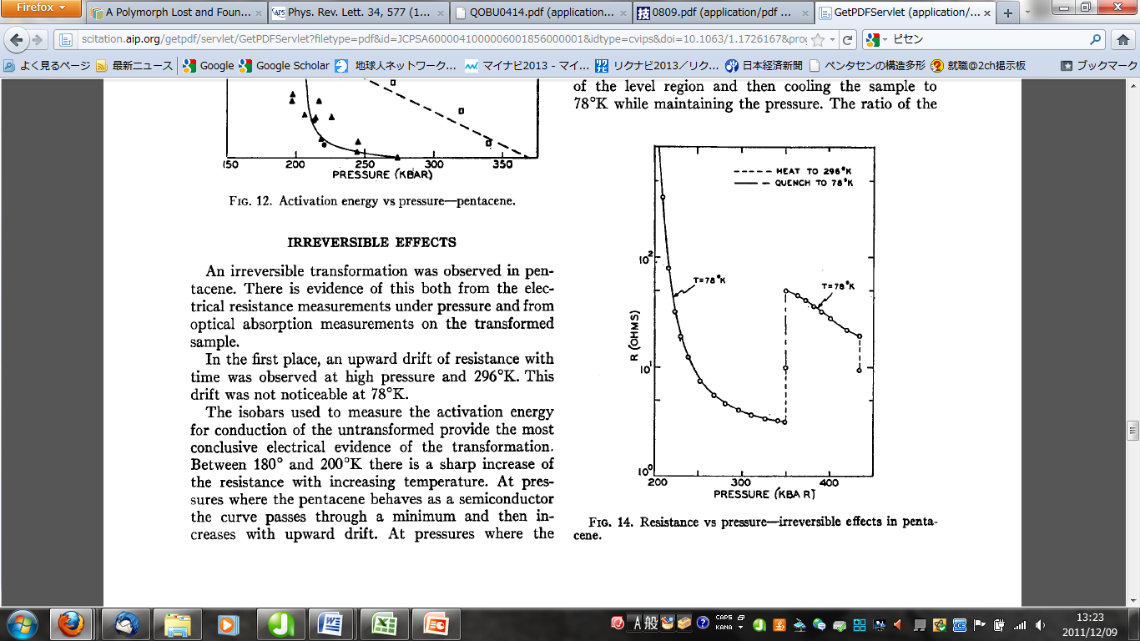
Irreversible effects
irreversible transformation
(around 180 K)
- did not duplicate over 180 K
cooling
compress to35 GPa (78 K)
heat to 296 K ; metallic
transformed?
296 K
reheating
cooling to 78K;
semiconducting
heating
35 GPa ～ 43 GPa
reheat to 296 K ;
keep semiconducting

Slide 13
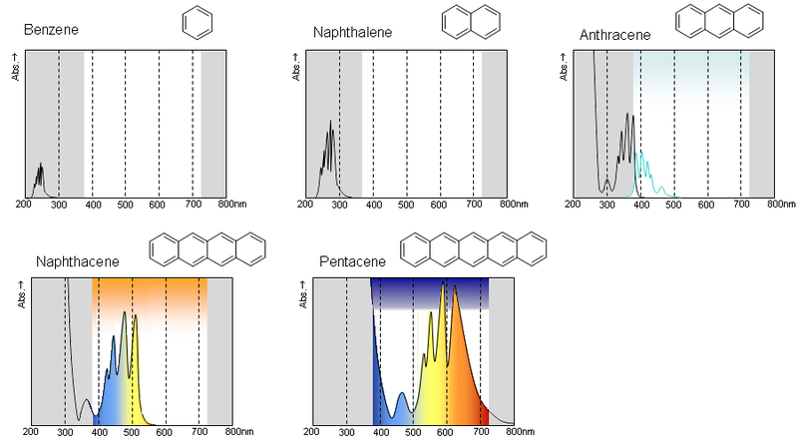
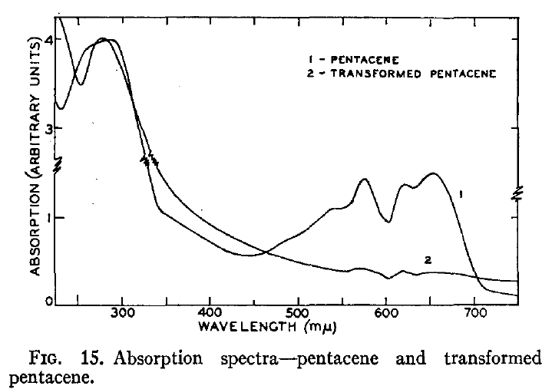
Absorption spectra
room temperature
pentacene
transformed material

Slide 14
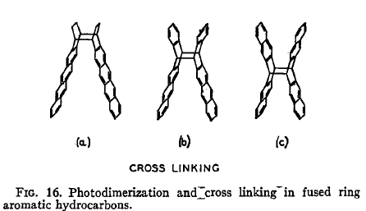
Cross linking
after transformed
the density ; greater
1.30 → 1.32
the color ; black (refer last slid)
cross linking between neighboring pentacene molecules
predicted like (b) and (c)
or
higher order polymerization
cross linking disturbs the π-electron distribution
; cause the change of electrical property?

Slide 15
Phase diagram
T [K]
metallic behavior needs to
keep monomer phase
296
semi conductive
(polymerized)
200
insulator
irreversible transition
metallic
78
keep semiconducting
keep monomer phase
?
P [GPa]
20
27
35
Superconductivity may be observed?

Slide 16
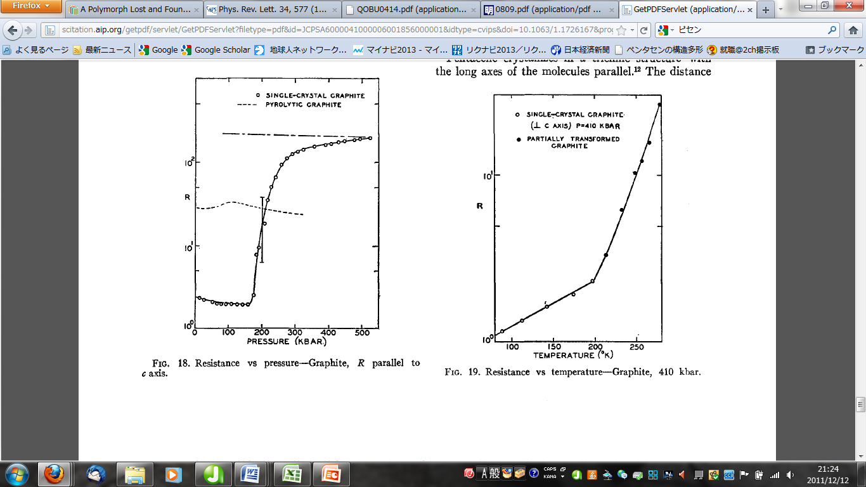
Similarity with graphite
Pentacene ; triclinic structure (the long axis of molecules parallel)
Pentacene and graphite
・the π electron in both system are strongly affected
・temperature ; initiation of transformation corresponds
・distance of closest approach of carbon atom
transformed pentaene ; 2.7 – 2.8 Å
h – diamond ; 5.545/2Å
If compressed under low temperature – keeping graphite phase (<200K)
Graphite also have three-dimensionally metallic behavior?

Slide 17
Summary & Future
Pentacene and its precursor are industrially attractive material.
Under high pressure
→ metalized at 27 ~ 35 GPa
→ polymerized at over 20GPa and over 180K - semiconducting again
Metallic behavior is observed at monomer phase
- How about under higher pressure & lower temperature
→Superconductivity?
Consider graphite
- compress keeping graphite phase(<200K)
→ Three dimensionally metallic phase?
T [K]
296
semi conductive
(polymerized)
200
insulator
irreversible transition
metallic
78
?
20
27
35
P [GPa]
Notes:
now, summarize with future outlook
the property of pentacene under high pressure, which is industrially attractive material
pentacene is metalized at around 27 to 35 GPa. this value depends on the crystal size, single crystal or powdered sample
though pentacene is once metalized, it seems to be polymerized at 35 GPa and over 180K,and then transform to semiconductor
it should be studied under higher pressure and lower temperature.
then, I want to know re metallization and superconductive would be observed?
if superconductive observed, it is second to Polysulfur Nitride as a superconductive polymer.
and it may be considered relating with the property of graphite or graphene

Slide 19
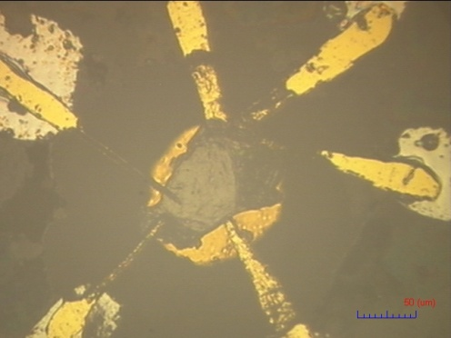
High pressure experiment
Example – my work for graphite ; electrical resistance measurement
Ruby ball
graphite
(Pt, Au)
setting
・culet of diamond φ500 μm
・sample room φ150 ×60 μm^{t}
・electrode Au (thickness ; 5 μm)
・pressure medium NaCl
c-BN
(SUS310S)
NaCl
500µm
V
I
I
Usually smaller scale than top of automatic pencil lead we treat!!
V
V
eyelash is used to set electrode
I
150 μm
V
I
Notes:
for experiment under high pressure, we use DAC and setting like this. this is my work for graphite to measure electrical resistance.
insulator layer over metal gasket and make a hole there. then, take pressure medium, sample, and ruby ball into hole. and set electrode after them.
now, please look at your pencil lead, its diameter is about 500 μm. this hole is about 150 mm, and we set more than 4 electrode with eyelash over this scale, which is smaller than diameter of top of pencil lead. when we aspire to compress over 100 GPa, we sometimes use 100mm or much smaller culet diamond, and sample room become about one third scale of it.
this is outline of high pressure experiment with DAC. and next section, I will introduce present experiment, electrical resistance measurement under high pressure and absorption spectroscopy for pentacene.

Slide 20
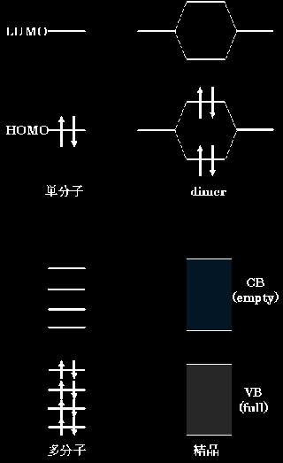
バンド形成の模式図．単分子のHOMOとLUMOからVBとCBが作られるが，両者は有機物では 重ならずに，かつ構成要素の有機分子が閉殻であるために，出来上がるバンドは空のCVと 埋まったVBになる

Slide 22
