Slide 1
The DFT-calculation of Potassium doped Picene
Kotaro Yamada
Kusakabe labolatory

Slide 2
Contents
Introduction .
・experimental article
・what I can do
・How to
Main part. ・・・As a result
・output datum of K3Picene.
・output datum of K2Picene
Summary & Future work

Slide 3
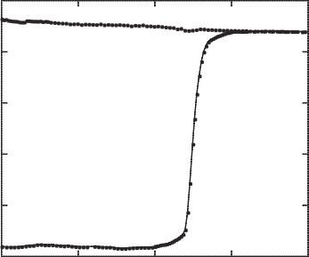
Experimental article
introduction
Pristine Picene
Tc = 18K
Kx-Picene (x=3.3)
R. Mitsuhashi, et. al. Nature 464 (2010) 76.

Slide 4
Image of pristine and doped Picene
introduction
Picene
Potassium
organic
semiconductor
Superconductor
G. Giovanetti et al.: Phys. Rev. B 83 (2011) 134508.

Slide 5
A contraversy
Kubozono group
“K3Picene is superconductor ”
Vs
Sawa group
“most of samples are K2Picene and semiconductor by Xray observation”
Each statement can’t be denied

Slide 6
introduction
What can I do for this subject??
・Logical calculation.
・To interpret the datum
・To state a hypothesis.

Slide 7
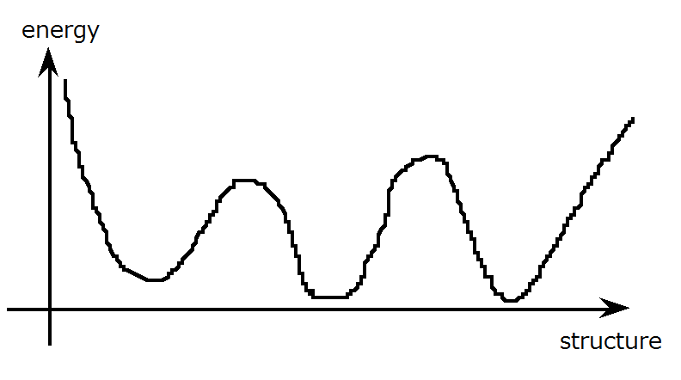
Logical calculation
introduction
possible model in meta stable state .

Slide 8
How to

Slide 9

Quantum espresso
input
data
Based on
the density functional theory.
・Relax calculation
Atomic structure
・band calculation
band structure
Fermi surface
Output
data

Slide 10
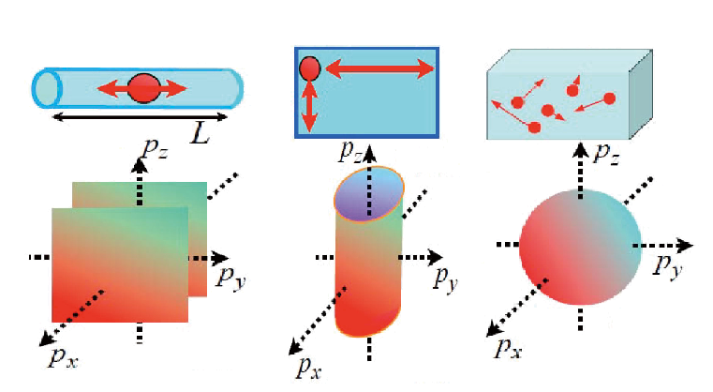
Dimensionality of Fermi surface
1dimension
2dimension
3dimension

Slide 11
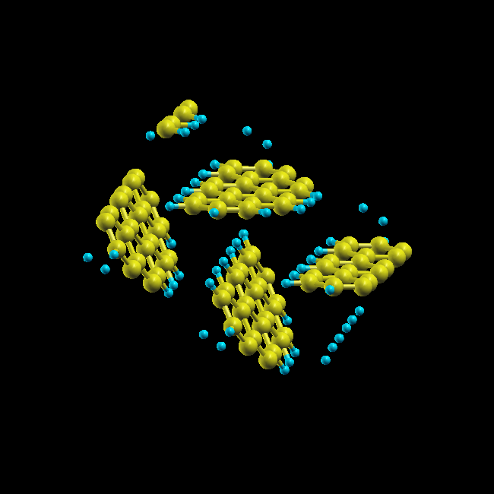


Example of atomic structure
Herring bone structure
b
c
a
carbon
hydrogen

Slide 12
Condition

Slide 13
Unit cell parameter for K3Picene
5.035
Kubozono group presented
Unit cell parameter
a=8.480,b=6.154,c=13.515inÅ
13.515
6.154
8.480
Cell parameter 1
monoclinic
R. Mitsuhashi, et. al. Nature 464 (2010) 76.

Slide 14
Unit cell parameter for K2Picene
Unit cell parameter
a=7.9302,b=7.6386,c=12.9655 inÅ
12.9655
7.6386
7.9302
Cell parameter 2
orthorhombic
＊2;T. satou et al.:物理学会(2011秋). 24aTD-4

Slide 15
Unit cell parameter for K2Picene
Sawa group presented
Unit cell parameter
a=7.9302,b=7.6386,c=25.931 inÅ
25.931
7.6386
7.9302
Cell parameter 3
orthorhombic
＊2;T. satou et al.:物理学会(2011秋). 24aTD-4

Slide 16
as a result

Slide 17
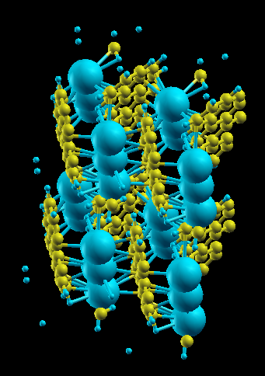
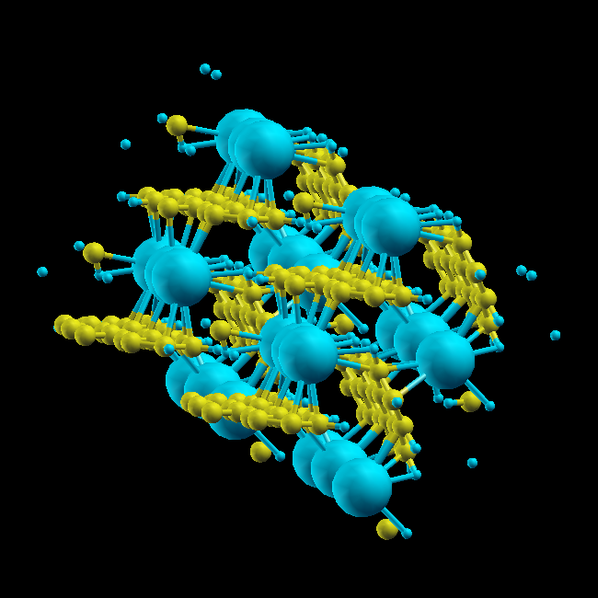
The structure of K3Picene with cell parameter 1
potassium
hydrogen
c
a
b
c
b
a
Carbon
(Picene)

Slide 18
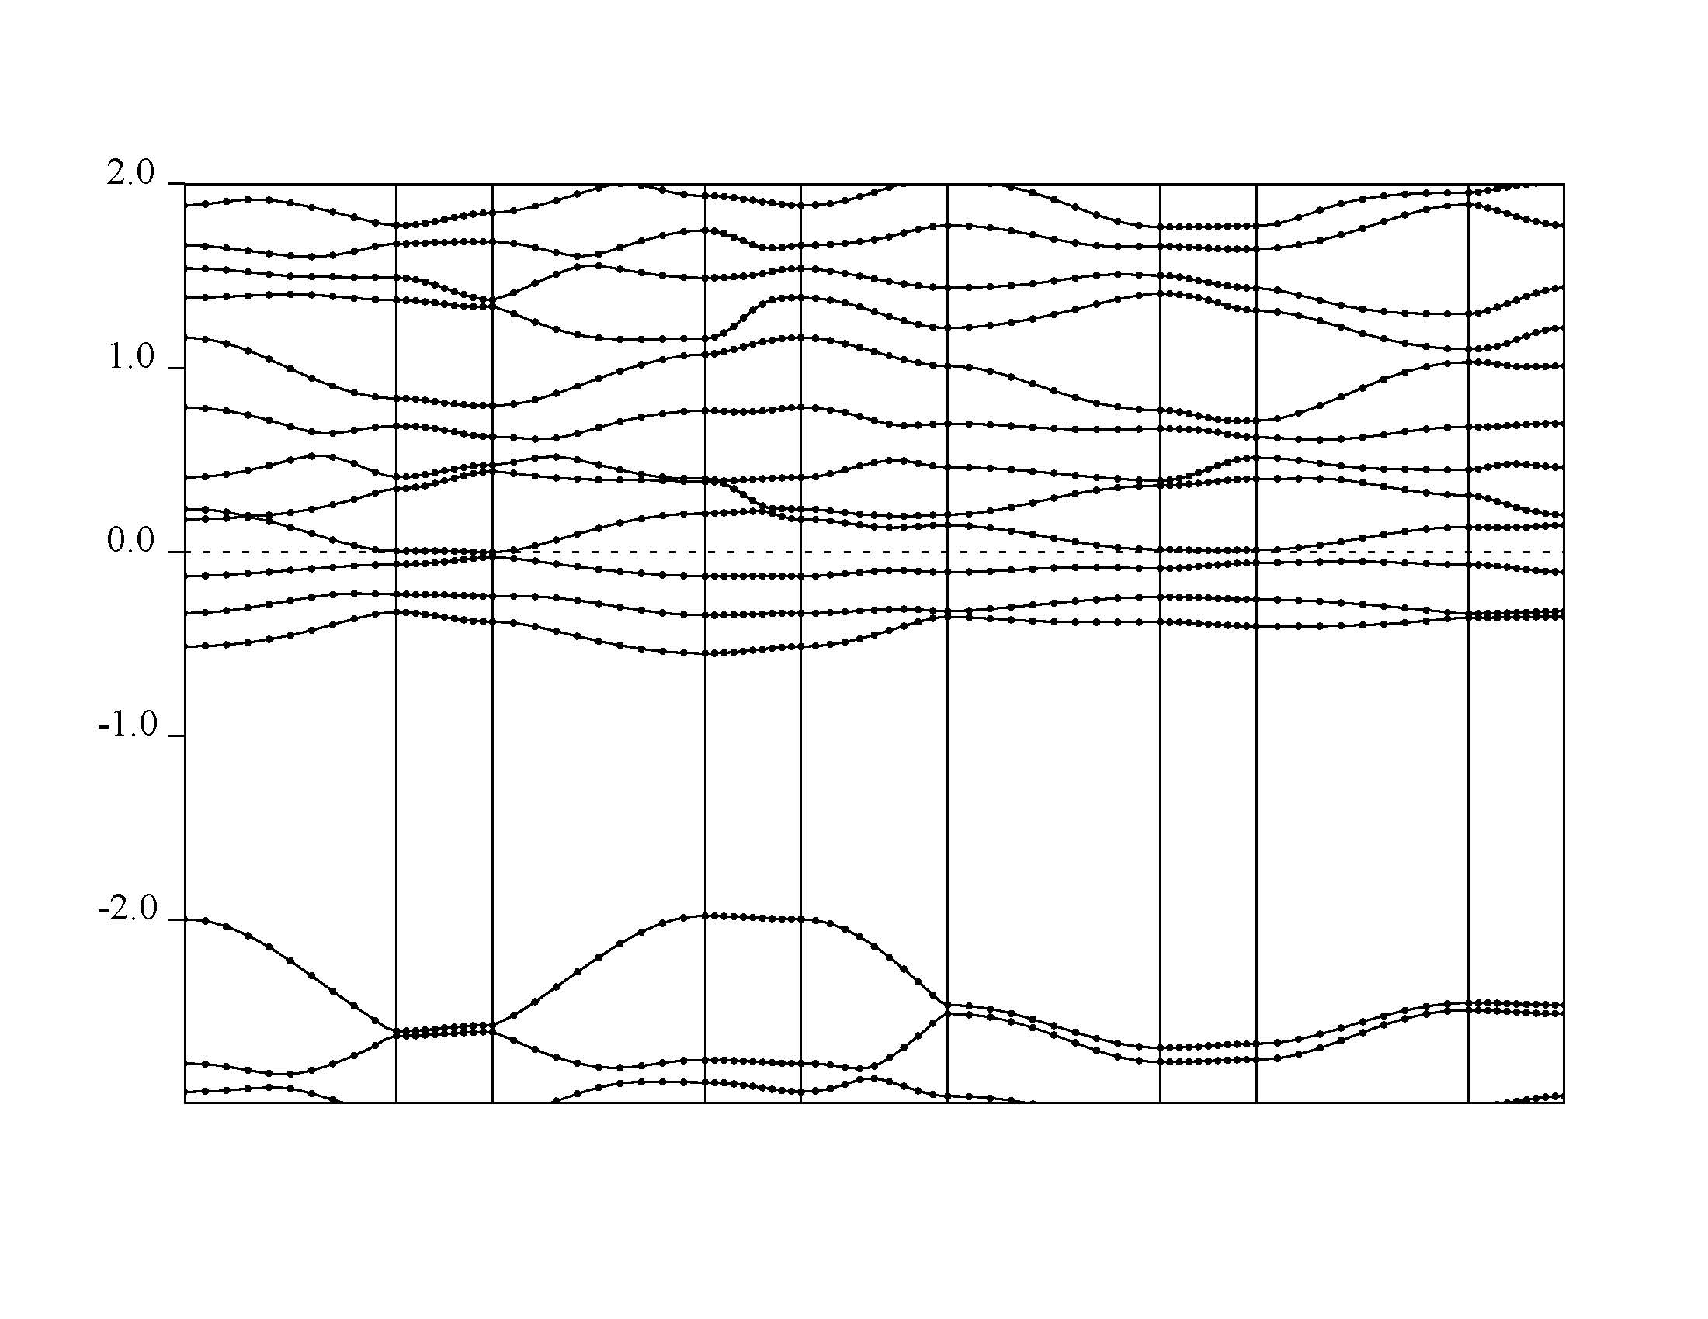
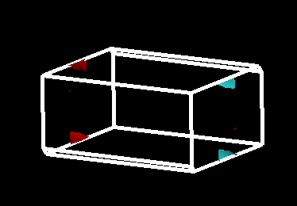
eV
c*
b*
a*
6.7453 eV
6.7453 eV
Γ Y T Z Γ X S R U X

Slide 19
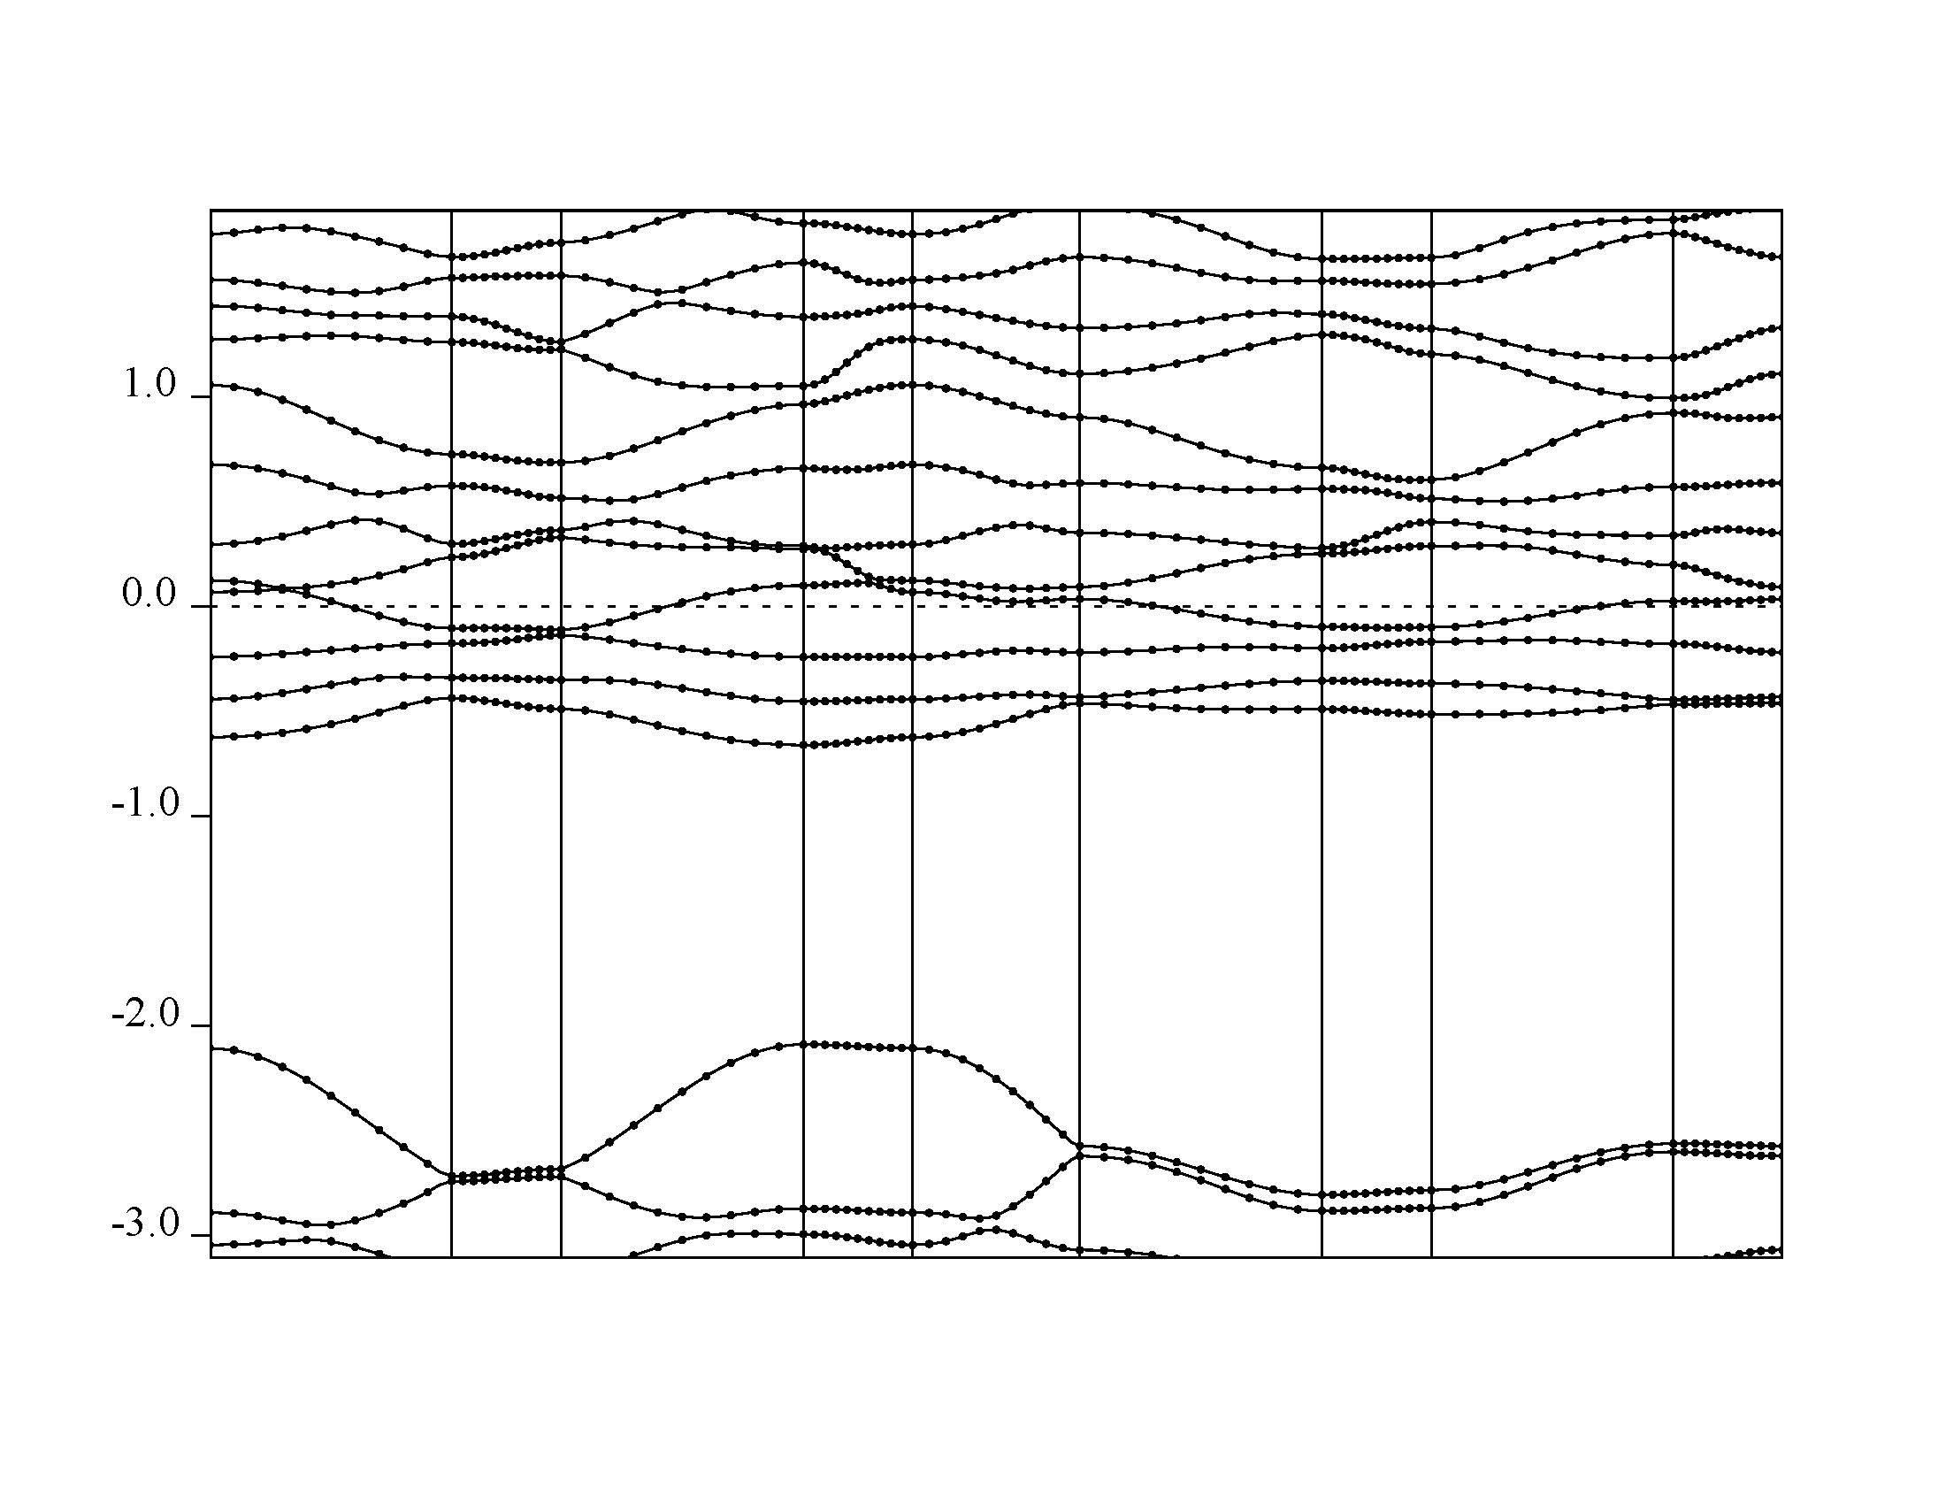
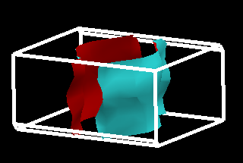
c*
b*
a*
6.9453 eV
b
Γ Y T Z Γ X S R U X
a

Slide 20
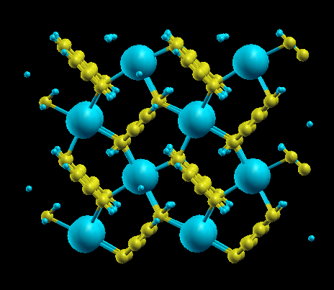
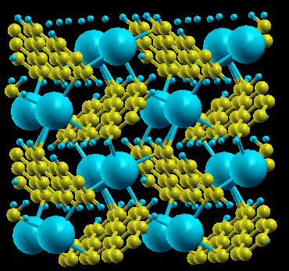
The structure of K2Picene with cell parameter2
c
b
a

Slide 21
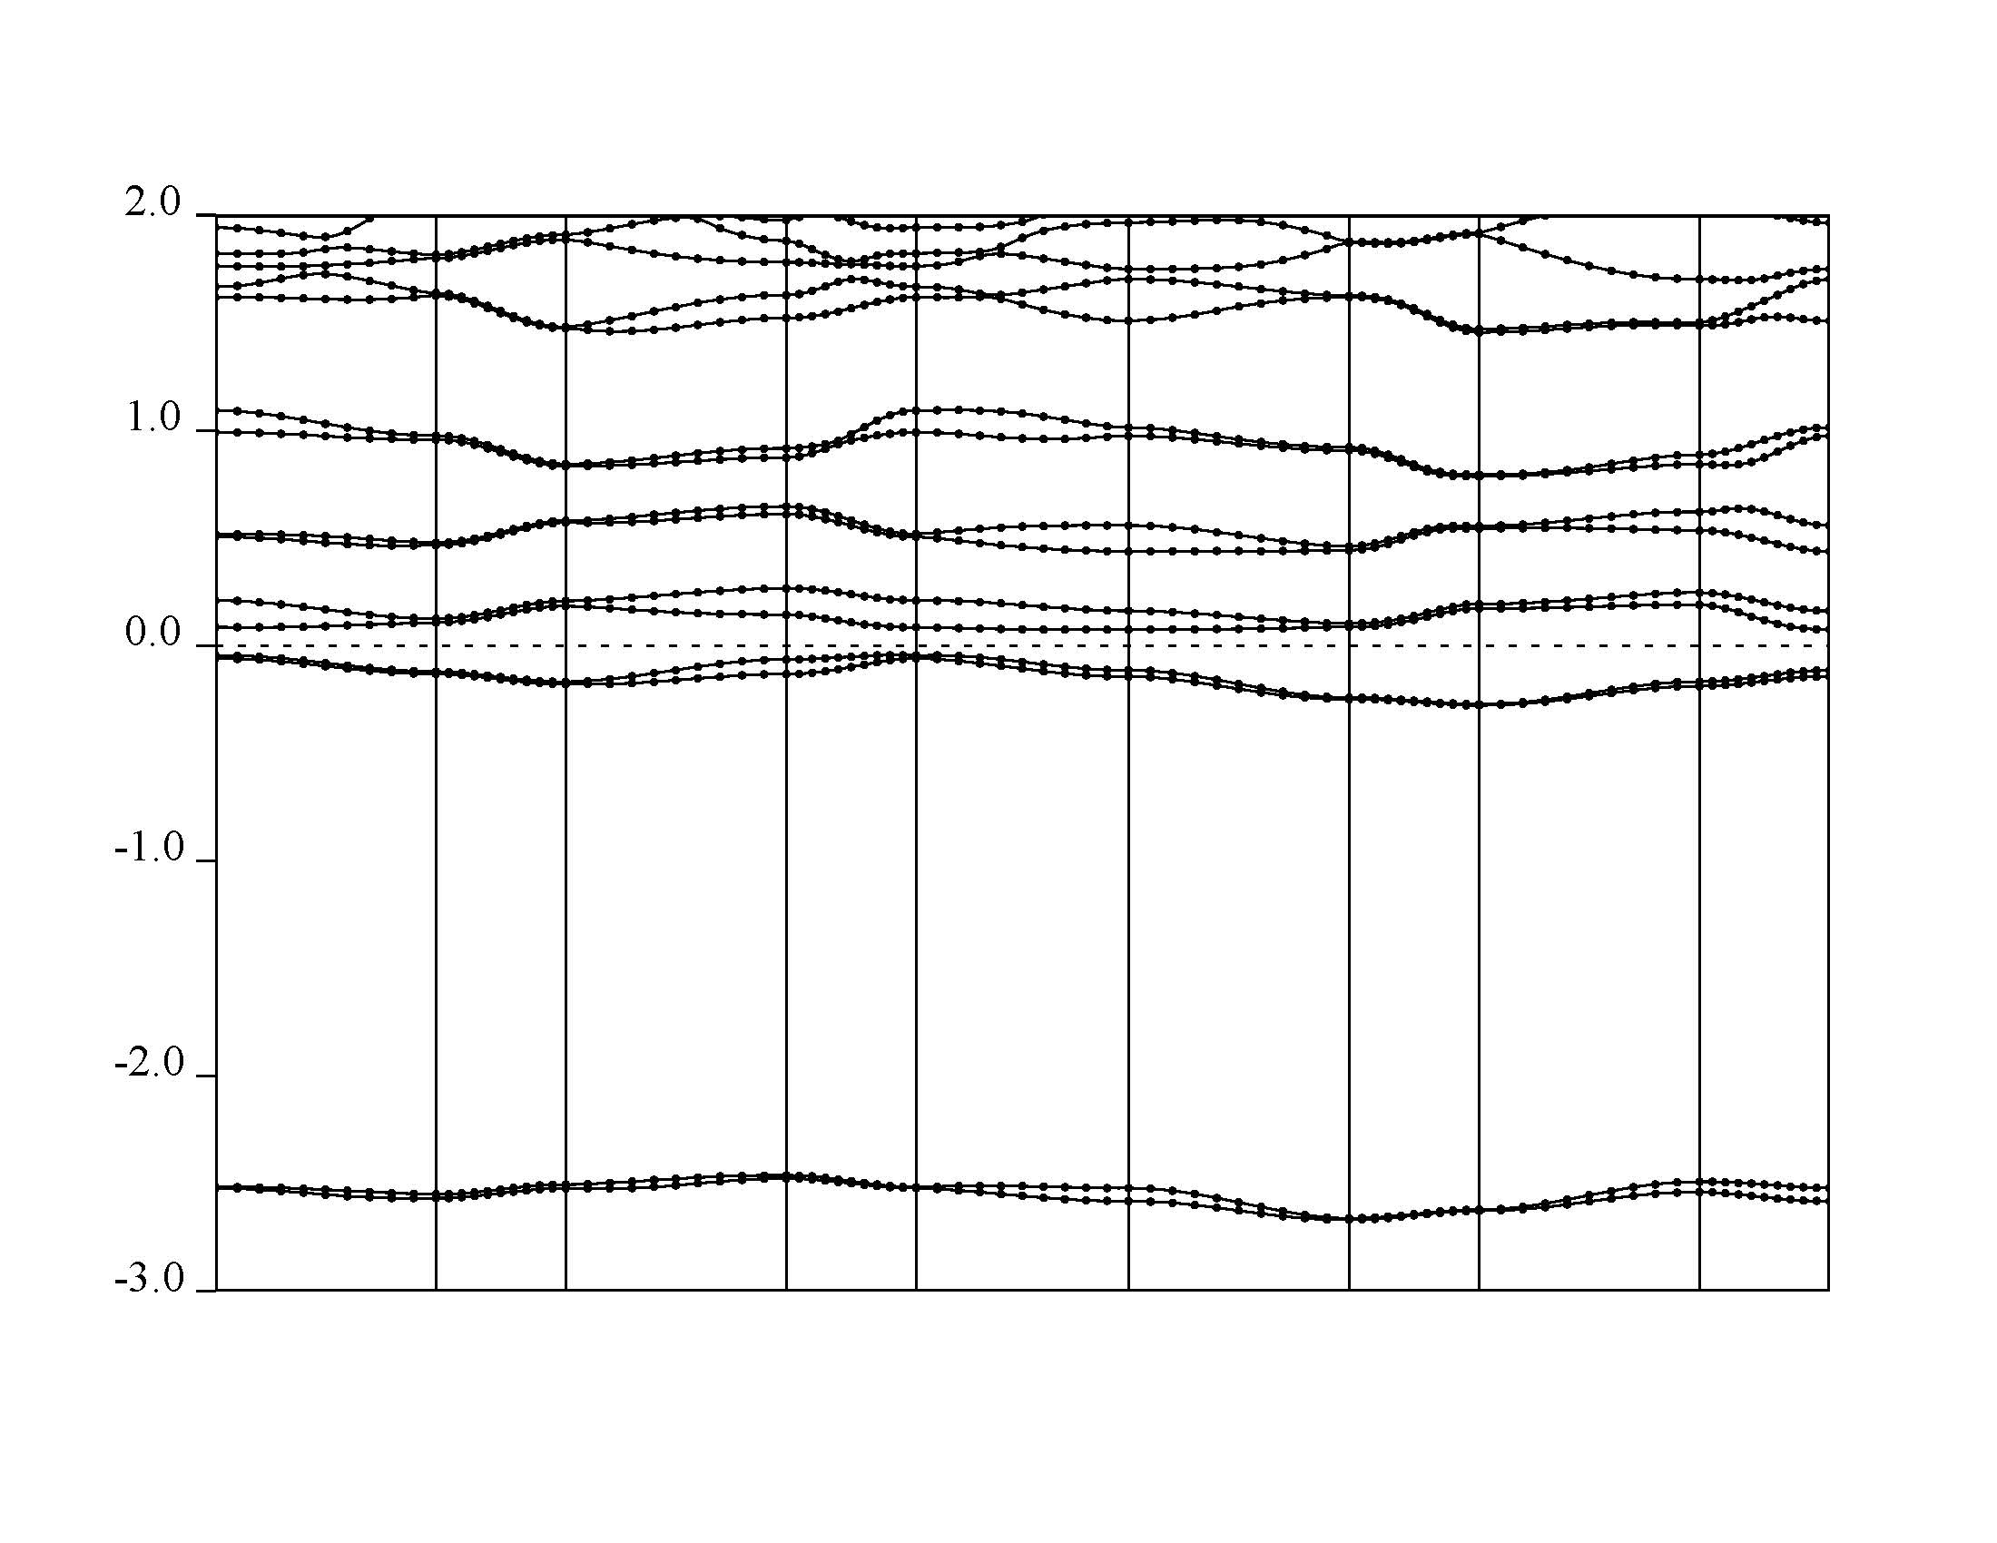

c*
b*
a*
4.9779 eV
Γ Y T Z Γ X S R U X

Slide 22
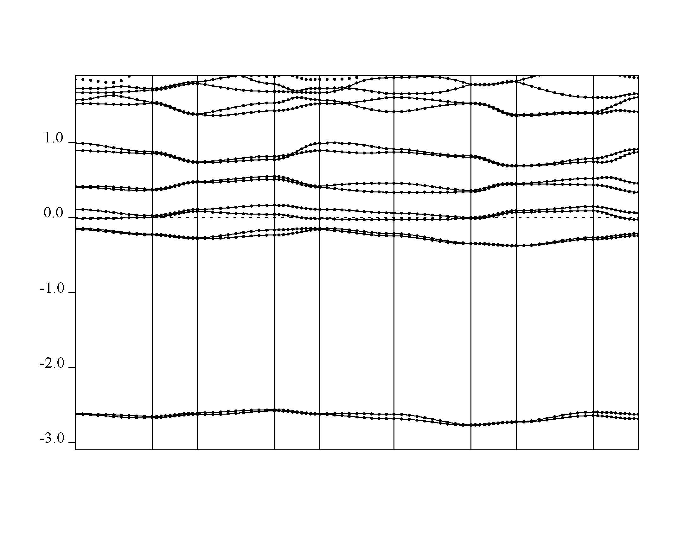
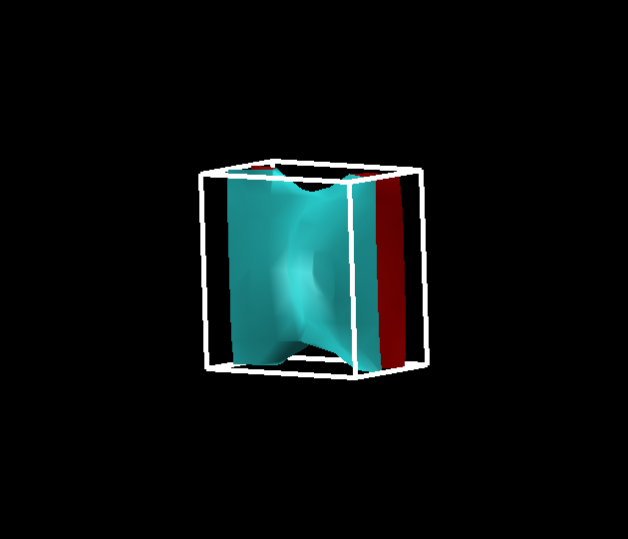
c*
b*
a*
5.0779 eV
Γ Y T Z Γ X S R U X

Slide 23
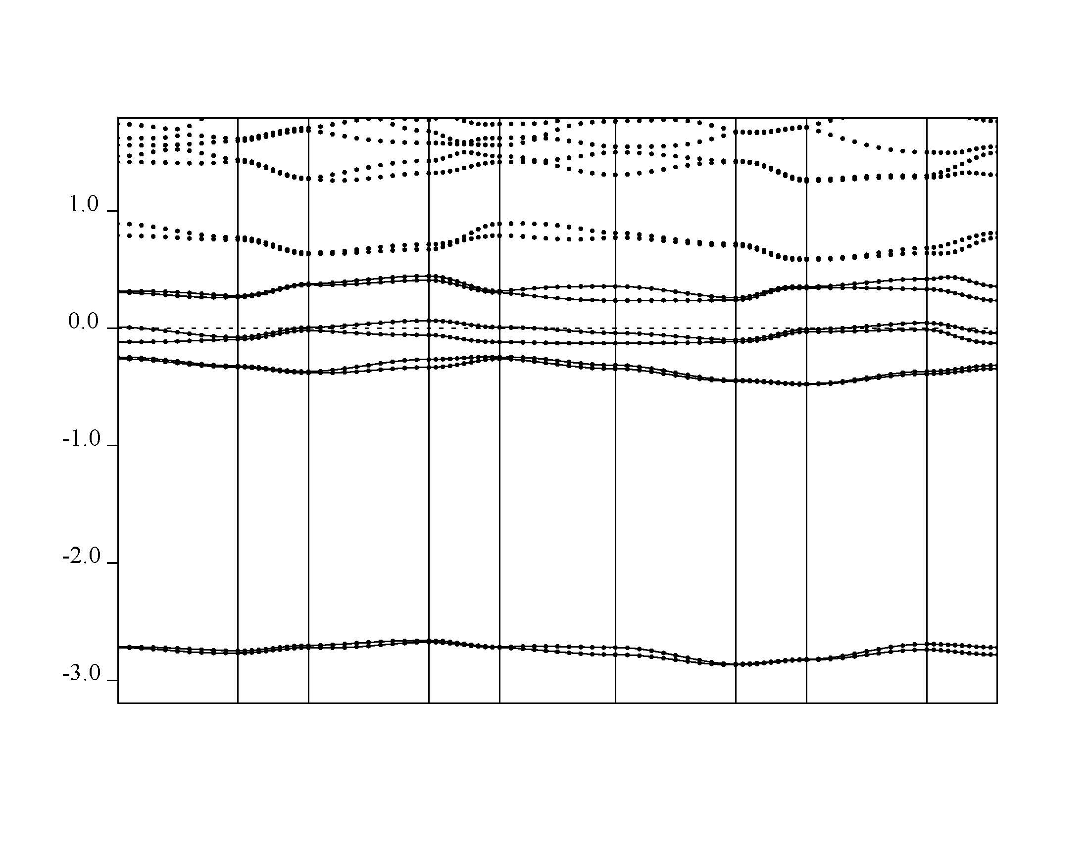
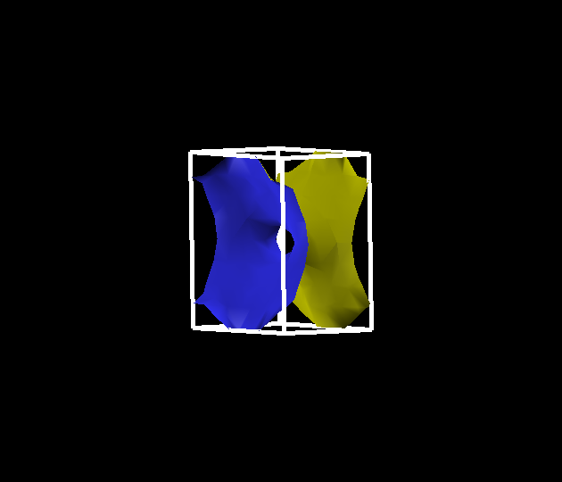
c*
b*
a*
5.1779 eV
Γ Y T Z Γ X S R U X

Slide 24
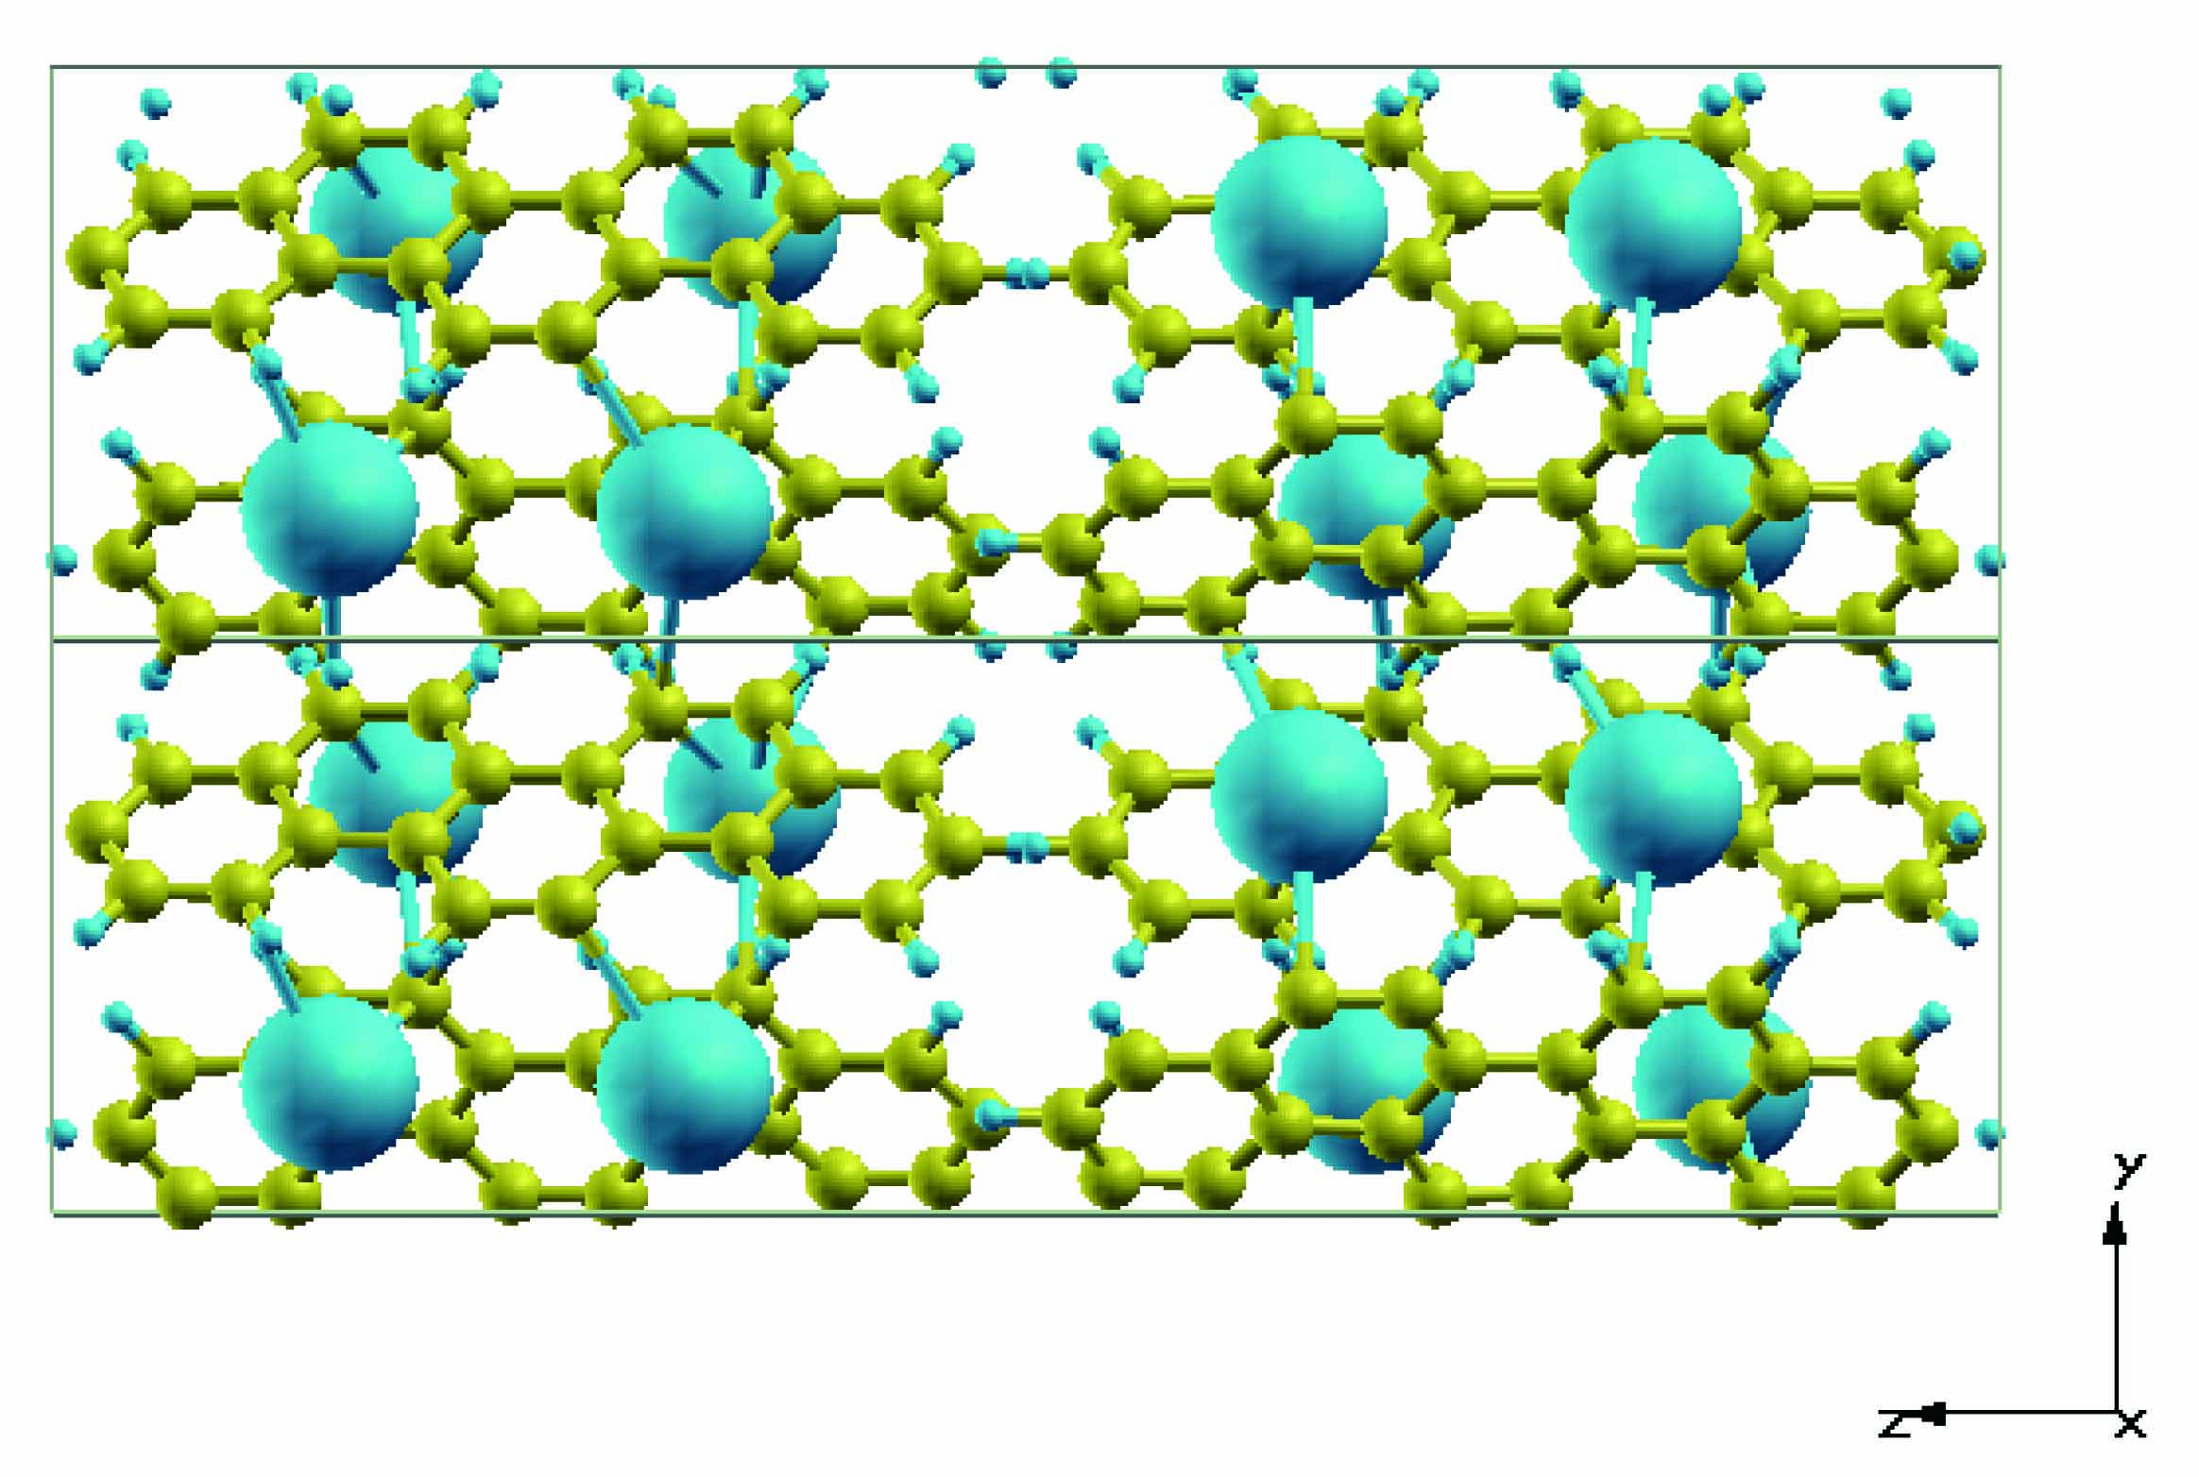
The structure of K2Picene with cell parameter3

Slide 25
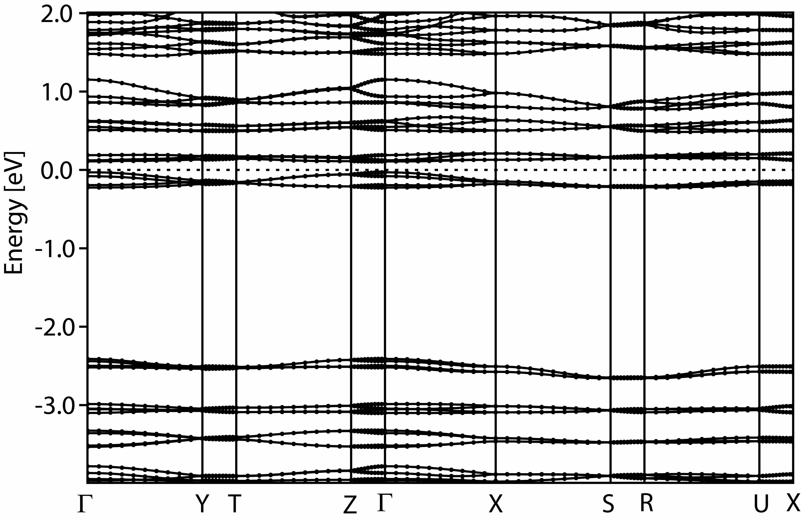
Cell parameter 3
Γ Y T Z Γ X S R U X
Cell parameter 2
Γ Y T Z Γ X S R U X

Slide 26
summary
・K2Picene has narrow band gap
・K2Picene has different band structure in cell parameter
・in fact potassium atoms may be localized in some layer
・a slightly doped semiconductor may become a superconductor
・Find any other possible meta stable state.
・Find Fermi surface becomes the factor of superconductivity.
Future work

