Slide 1
2011/12/14
2nd term M1 colloquium
Creation of huge metal-insulator domain
and its electrical conduction property
in VO2 thin film on TiO2(001) substrate
Tanaka Laboratory
Kenichi Kawatani
Notes:
Hello, everyone.
I’m Kenichi Kawatani from Tanaka Laboratory.
Today, I talk about my research.
The Title is ‘creation of huge metal-insulator domain and its electrical conduction property in VO2 thin film on TiO2(001) substrate’

Slide 2
contents
Background
・strongly correlated electron system
・vanadium dioxide (VO2)
・phase separation (domain)
My research
・experimental method
・optical microscope images
・temperature dependence of resistivity
conclusion
Notes:
This is the contents of my talk.
First, I talk about Strongly Correlated Electron system.
My target material vanadium dioxide VO2 is one of this system.
So I explain about VO2.
And in this system, phase separation is very important phenomenon.
This is purpose of my research, so I explain about phase separation.
Then I talk about my research, experimental method, optical microscope images, and temperature dependence of resistivity.
Finally, I summarize my talk.

Slide 3
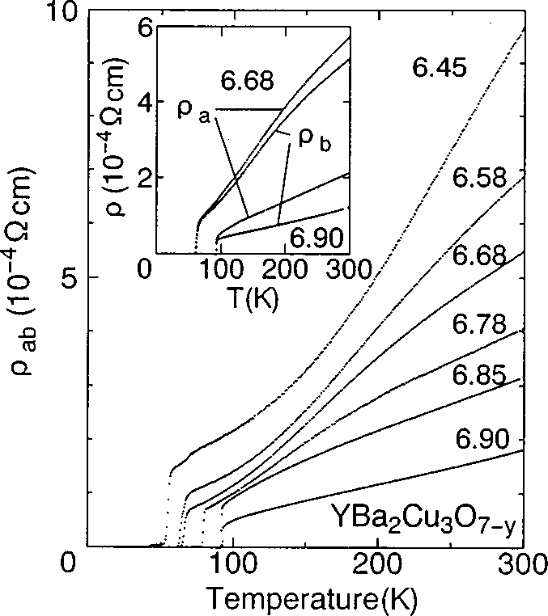
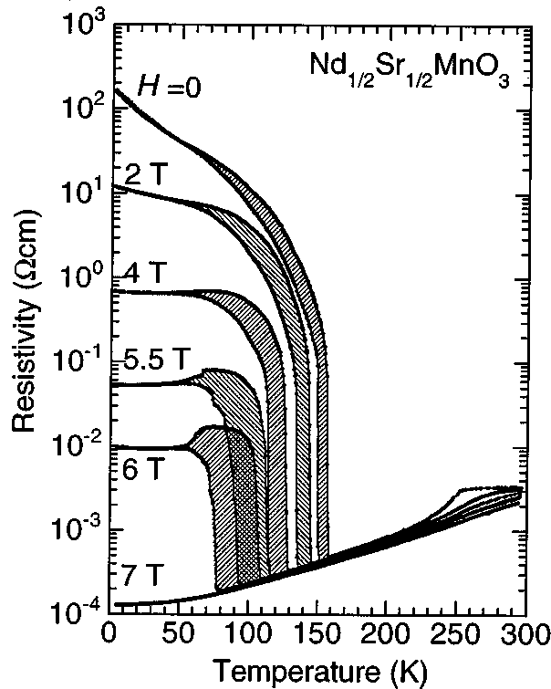
Strongly Correlated Electron System
High-temperature superconductivity
Colossal Magnetoresistance
Masatoshi Imada et al.
Reviews of Modern Physics,
Vol. 70, No. 4, October 1998
They have very attractive physical properties.
Notes:
Recently, many researchers pay attention to strongly correlated electron system.
In this system, electrons effects each other by coulomb repulsion.
And thanks to this interaction, they have very attractive properties.
For example, this is the temperature dependence of resistance in high-temperature superconductivity.
Transition temperature of superconductivity is very high.
And this is the temperature dependence of resistance in manganite.
As you can see, if we apply magnetic field, resistance change so large.
So material in this system is very interesting.

Slide 4
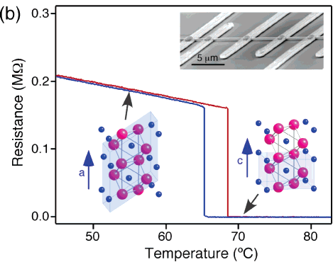
Metal-insulator transition in VO2
Temperature dependence of resistance in VO2 nanowire
heating
Cooling
Junqiao Wu et al.
Nano Lett., Vol. 6, No. 10, 2006
Resistance change so large (about 3 orders of magnitude)
Notes:
And my target vanadium dioxide, VO2 is one of this strongly correlated electron system.
The feature of VO2 is metal-insulator transition.
This is the temperature dependence of resistance in VO2 nanowire.
As you can see, when we heat VO2, resistance change rapidly at around 70C.
And if we cool VO2, resistance become high, it means VO2 turn from metal to insulator.
This is caused by strongly correlated electrons.
And resistance changes 3 order of magnitude, very large.
It’s very interesting.

Slide 5
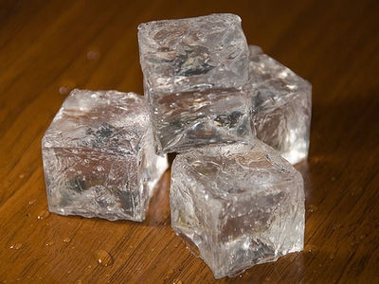
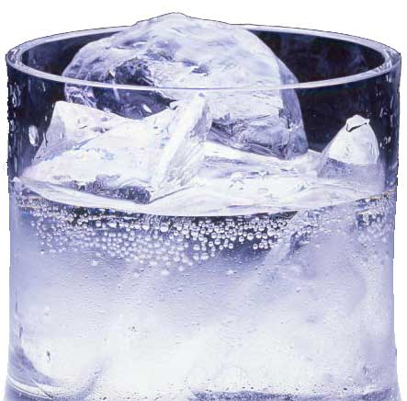
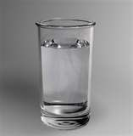
Phase transition ~water~
ice + water
heating
ice
water
0℃
temperature
Phase separate around transition temperature.
Notes:
And next, I explain about phase separation.
Phase separation is very important keyword in the strongly correlated electron system.
And this is my purpose.
Phase transition like VO2 also occurs in another materials.
Please imagine phase transition in water.
Water has 3 phases, solid, liquid, and air.
When we heat ice, then ice melt and become water.
But in the transition, phase doesn’t change at a breath.
I mean that when ice turn to metal, some part of ice melt gradually, and finally, become water.
So around transition temperature, ice phase and water phase separated.

Slide 6
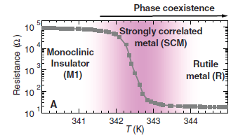
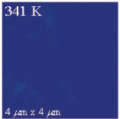
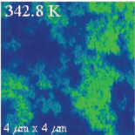
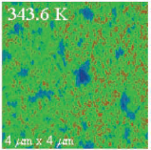
Phase transition ~VO2~
SNIM images of VO2 around transition temperature
M. M. Qazilbash et al.
Science 318, 1750 (2007)
lnsulator
Metal
In the nano-scale region,
insulator and metal phases separated around transition temperature.
Notes:
In VO2, phase transition also occurs.
So same phenomenon like water may occurs.
But these phenomenon haven’t been observed for a long time.
And thanks to the progress in nano-scale measurement, recently we can observe phase separate phenomenon in VO2.
This is the SNIM images of VO2 around transition temperature.
With SNIM, we can observe nano-scale region.
And we can distinct between insulator and metal phases by the difference of reflectivity.
When temperature is low, VO2 is insulator.
And when temperature is high, VO2 is metal.
And this is the SNIM image around transition temperature.
As you can see, insulator and metal phases separated.
This phenomenon is same with water.
So in the nano-scale region, insulator and metal phases separated around transition temperature.

Slide 7
Purpose of my research
Insulator
Metal
I research about phase separation in VO2.
I want to observe each electronic phase’s behavior.
Notes:
And this phase separated region is purpose of my research.
I research about phase separation in VO2.
In past investigation, these each electronic phase is too small.
So we can’t observe this each domain’s behavior.
So I want to observe each electronic phase’s behavior.
If we can, we may observe new physical phenomenon.
It’s very interesting.
So this is my purpose.
And today, I talk about the result of my research about phase separation.

Slide 8
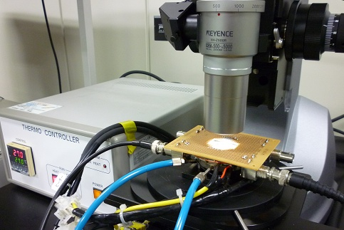
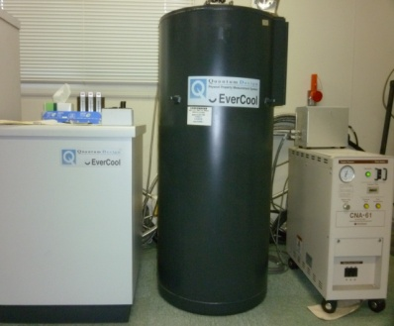
Experimental condition
Sample condition
Equipment
Optical microscope
observe domain
Cr/Pt
VO2
Substrate
Film thickness 30nm
Film size 50×50μm²
Substrate TiO2(001)
Temperature controller
PPMS
(Physical Property Measurement System)
temperature dependence
of resistance

Slide 9
Temperature dependence of resistivity
Phase
coexistence
VO2 turn from insulator to metal around 300K.

Slide 10
Huge metal-insulator domain
Optical microscope images at heating VO2 (290K to 310K)
VO2 color changed.
VO2 turned from insulator to metal.

Slide 11
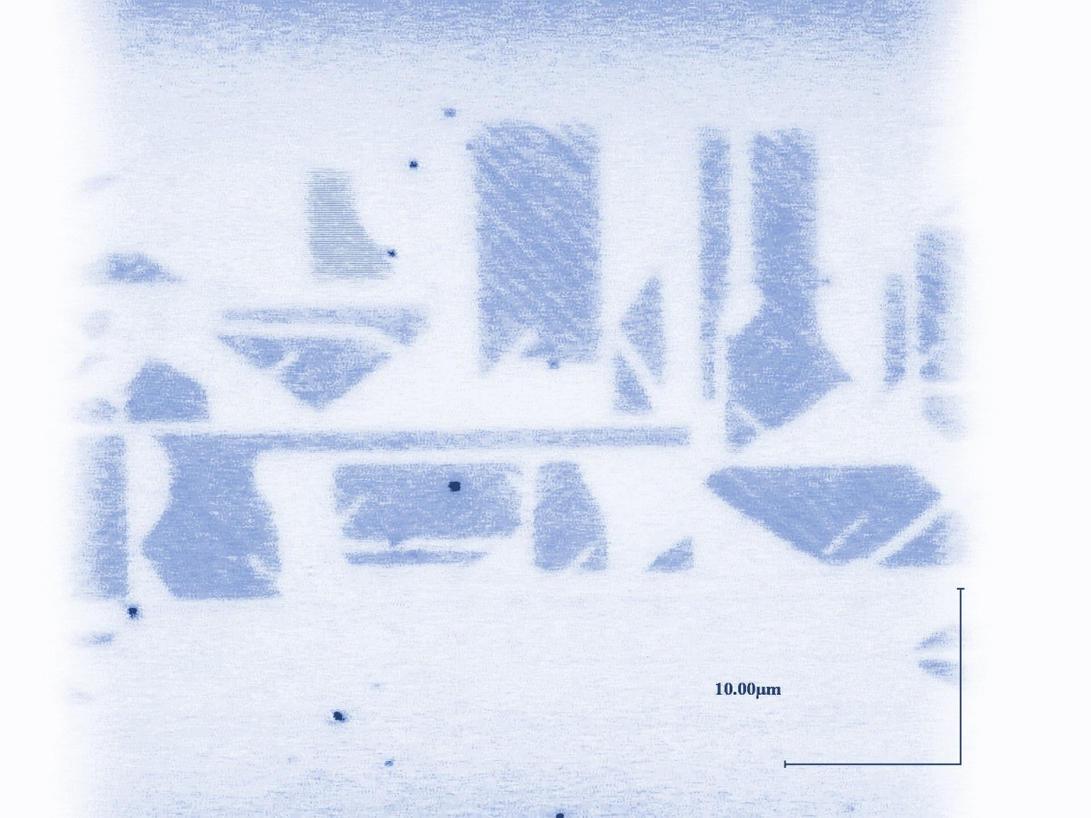
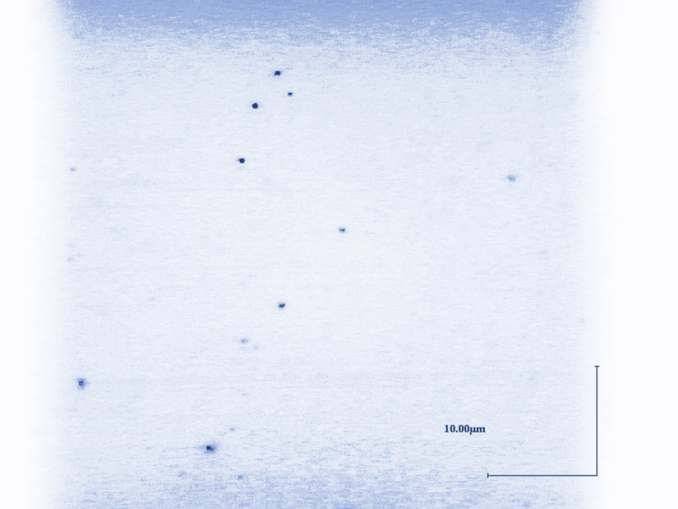

Huge metal-insulator domain
Optical microscope image of VO2
293K
past one
290K
Insulator
10μm
10μm
Metal domain
Metal-insulator domain size is so large.

Slide 12
Strain from substrate
Lattice parameter of each material
crystal | VO₂ | _{TiO2}
a-axis length | 0.455 | 0.459
Lattice mismatch(%) | - | 0.863
VO2 on TiO2(001) is affected by strain from substrate.
Huge domain was caused by strain.

Slide 13
Resistivity jumps
Temperature dependence of resistivity in detail (heating)
Resistivity change discretely.

Slide 14
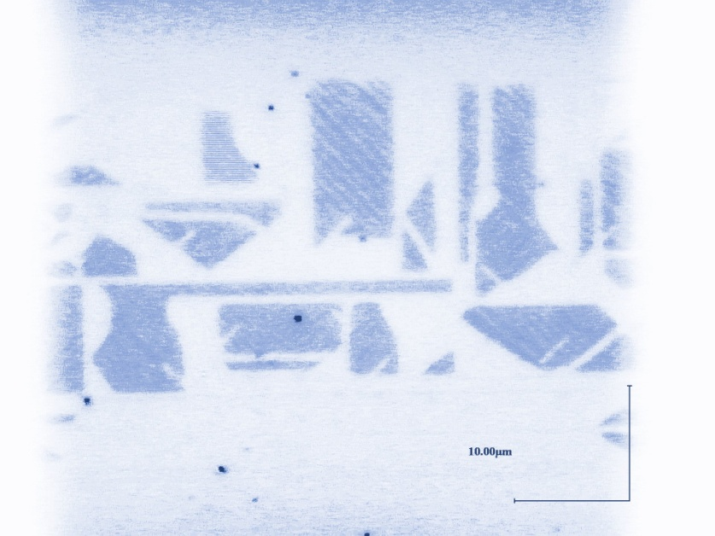
Jumps meaning
Resistivity changes.
Insulator domain turn to metal.
290K
293K
10μm
Metal domain
10μm
What do jumps means?

Slide 15
One domain’s behavior
To evaluate domain size,
R(T)
R(T+ΔT)
RA
Metal
A
d× d μm²
B
Insulator
RB
L × L μm²
Relation between
resistivity jump and domain size
Same with optical microscope image

Slide 16
One domain’s behavior
Resistivity jumps
Each domain’s behavior
293K
10μm
I could observe one domain’s behavior as resistivity jumps.

Slide 17

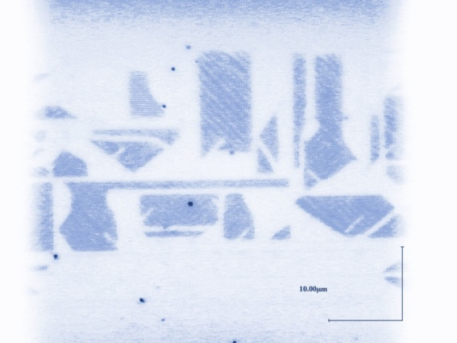
Control of each electronic phase
Voltage dependence of resistance
290K
10μm
293K
10μm
We want to control each electronic phase by electric field.

Slide 18

Conclusion
I fabricated VO2 thin films on TiO2(001).
・huge domain
caused by strain
・resistivity jumps
one domain’s behavior
293K
10μm
Notes:
Lastly, I summarize my talk.
I fabricated VO2 thin films on TiO2(001).
First, I succeeded in observing huge domain of VO2 on TiO2(001) substrate,
and this is caused by strain from substrate.
Second, thanks to this huge domain, I could observe resistivity jumps.
This means that I could observe one domain’s behavior.
That’s all and thank you for your attention.

Slide 19
Resistivity jump
Temperature dependence of resistivity in detail (heating)
TiO2(001)
Al2O3(0001)
Resistivity in VO2 on TiO2(001) change discretely.
Notes:
Then I show the temperature dependence of resistivity in detail.
This is the results.
As you can see, there’re apparently difference between two sample’s data.
In Al2O3 one, resistivity change gradually.
But in TiO2 one, resistivity change discretely like stairs.
We can see resistivity jumps.

Slide 20
Resistance susceptivity
Change rate
TiO2(001)
Al2O3(0001)
Change rate of VO2 on TiO2(001) is 30 times bigger than Al2O3(0001) one.
Notes:
To see this difference more clearly, I use this value, Change rate.
This value was calculated by this formula.
If this value is large, it means that resistivity change rapidly.
Compared with two samples, this value is quite different between two samples.
In Al2O3 one, the value is about 0.4.
But the value of TiO2 is 5 to 12, 30 times bigger than Al2O3 one.

Slide 21
Title

