Slide 1
Optical fabrication and
Optical manipulation of semiconductor nanoparticles
Ashida lab. Nawaki Yohei

Slide 2
Contents
Introduction
  Optical fabrication and manipulation
  Advantage of particles
  Photo Induced force
  Resonant force
Purpose
  Previous study
  My study
Experimental setup
  Ablation and Manipulation
  Scanning electric microscopy
Optical fabrication
  Tablet of GaN
  Crystal of GaN
Optical manipulation
  Zinc oxide
Summary

Slide 3
Ablation and manipulation
Introduction
Ablation laser
Ablation
Fabrication method of particles
using laser sputtering
Manipulation laser
Si substrate
Manipulation
Transporting method by the resonant radiation force

Slide 4
Low-dimensional structures
Introduction
Bulk
Thin film
Quantum wire
Nano particle
DOS
DOS
DOS
DOS
E
E
E
E
enhancement of oscillator strength

Slide 5
Photo induced force
Introduction
Scattering and Absorption pressure
Optical axis
Gradient Force
Photo induced force
Gradient force
Scattering and Absorption pressure
Photo induced force: 光誘起力
Gradient force: 勾配力
Scat. And abs. pressure: 散逸力

Slide 6
Gradient force
Introduction
The force pushing objects to the focal point
Electrical gradient
Stabilization point
Gaussian beam

Slide 7

Scattering and Absorption force
Introduction
The force arising from the momentum transfer from the light
power
$$ℏν$$
absorption
scattering

Slide 8
Manipulation in various scale
Introduction
It’s difficult
for optical manipulation.
Atom
Nanoparticle
Microparticle
~1nm
1nm~1μm
1μm~
No Structural dependence
Structural dependence
Structural dependence
resonance
resonance
or
No resonance
No resonance
Laser cooling
Optical tweezers

Slide 9


Resonant or Non-resonant light
Introduction
Non resonant
Resonant
Resonant
Resonant
E
$$E=E_{g}−E_{b}+∆E$$
Energy of applied light
≠
Energy of exciton level
Energy of applied light
=
Energy of exciton level
$$∆E=\frac{π^{2}ℏ^{2}}{2Ma^{2}}$$
a

Slide 10
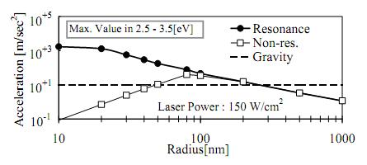
Enhancement by resonant light
Introduction
Numerical calculation example (CuCl)
Using resonant light
Ref: T.Iida and H. Ishihara Phys. Rev. Lett. 90, 057403 (2003)
Photo induced force is drastically enhanced.
100 times of gravitational acceleration

Slide 11
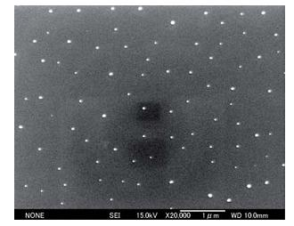
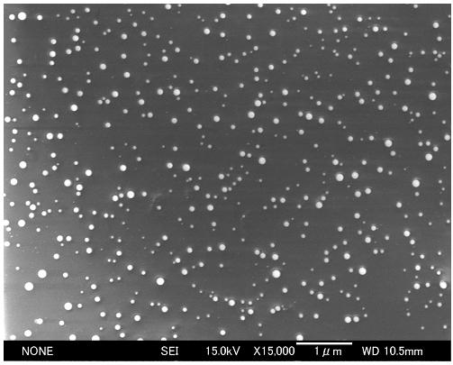
Previous study
Purpose
Our group has succeeded manipulation of nanoparticles
Wide-gap semiconductor
CuCl
ZnO
K. Inaba phys.stat.sol. (b)243, No.14, (2006)
S. Okamoto master thesis (2011)

Slide 12
My study
Purpose
GaN bulk
ablation
GaN particles
manipulation
Manipulated GaN particles

Slide 13
Fabrication method
Experimental setup
ablation laser
Nd:YAG
cryostat
wavelength :525nm
pulse duration :10ns
Si substrate
manipulation laser
sample
Ti:sapphire
SHG
pulse duration :100fs
Vacuum state (300K)
back substrate
wavelength :726nm
Superfluid He state (2K)
wavelength :718nm
front substrate

Slide 14
Observation method
Experimental setup
Scanning electron microscope
Electron beam
Secondary electron
SEM measurement
To take 2D image
Cathode Luminescence
CL measurement
Character X-ray
Energy Dispersive X-ray Spectrometry
To analyze element
sample
Scanning electron microscope: 走査型電子顕微鏡
Secondary electron: 二次電子
Cathode luminescence :電子線励起による発光
Character X-ray: 特性X線

Slide 15
Optical fabrication

Slide 16
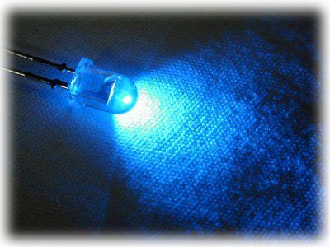
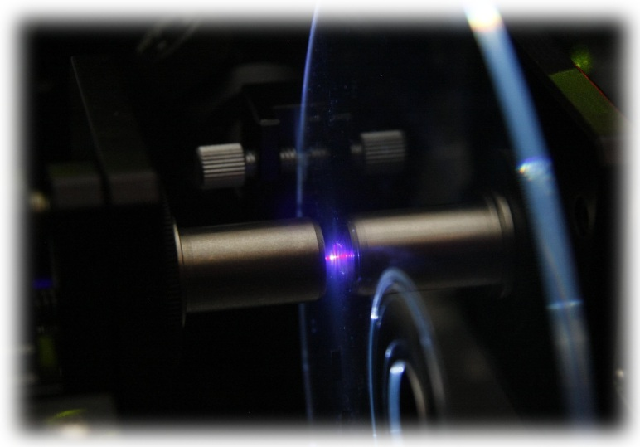
Gallium Nitride
Ablation
Wide-gap semiconductor
GaN: 3.4eV
cf. ZnSe, SiC, ZnO, CuCl
GaN has wide controllable range of bandgap
with ternary crystal semiconductor InN, AlN.
0.7eV~6.1eV
Crystal growth is difficult
Blue- and UV-Light emitting diode and laser

Slide 17
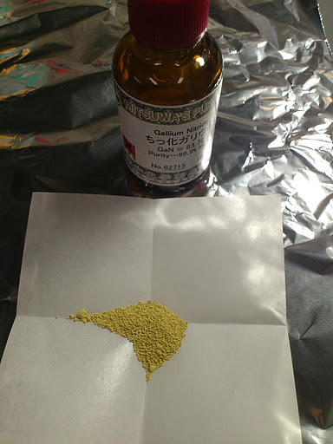
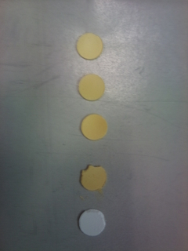
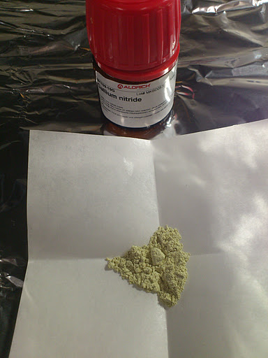
Tablet of GaN
Ablation
Powder
Tablet
Press!

Slide 18
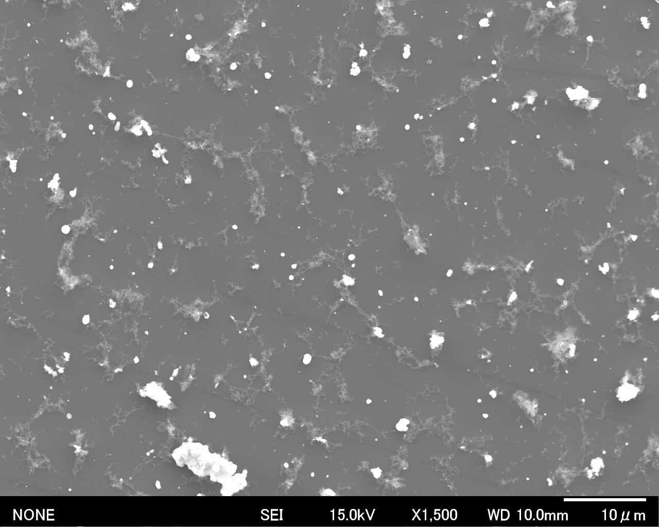
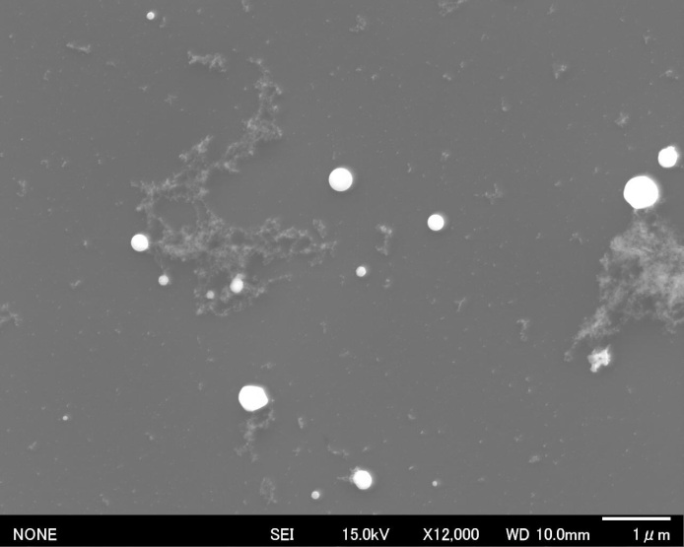
SEM images
Ablation
Ablation conditions
Vacuum state
Nd:YAG power 0.5mJ
I could fabricate particles...

Slide 19
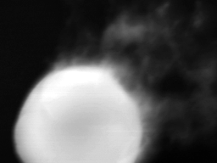
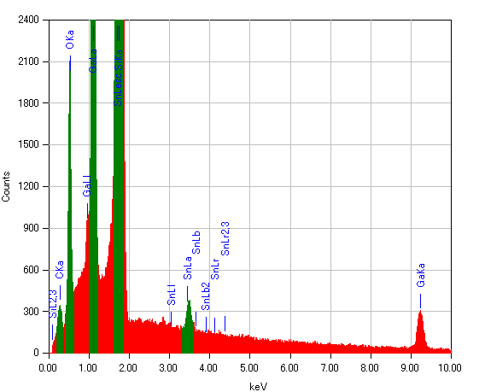
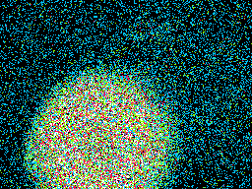
Element analysis
Ablation
EDS data
SEM image
Ga mapping image
Nitrogen peak was expected.

Slide 20
Particles were oxidized.

Slide 21
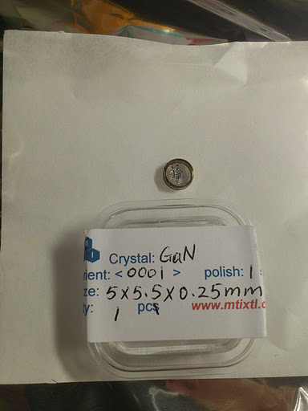
Crystal of GaN
Ablation
The reason why is that oxidized particle were fabricated.
Tablets included many impurity.
The surface of powders were oxidized.
Crystal
I used crystal of GaN

Slide 22
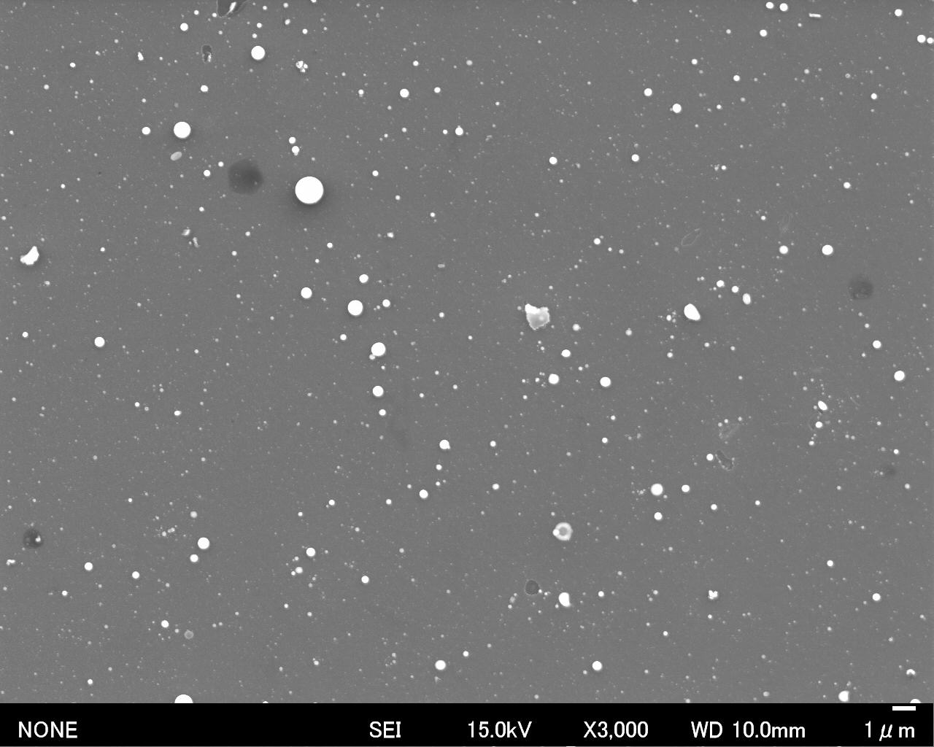
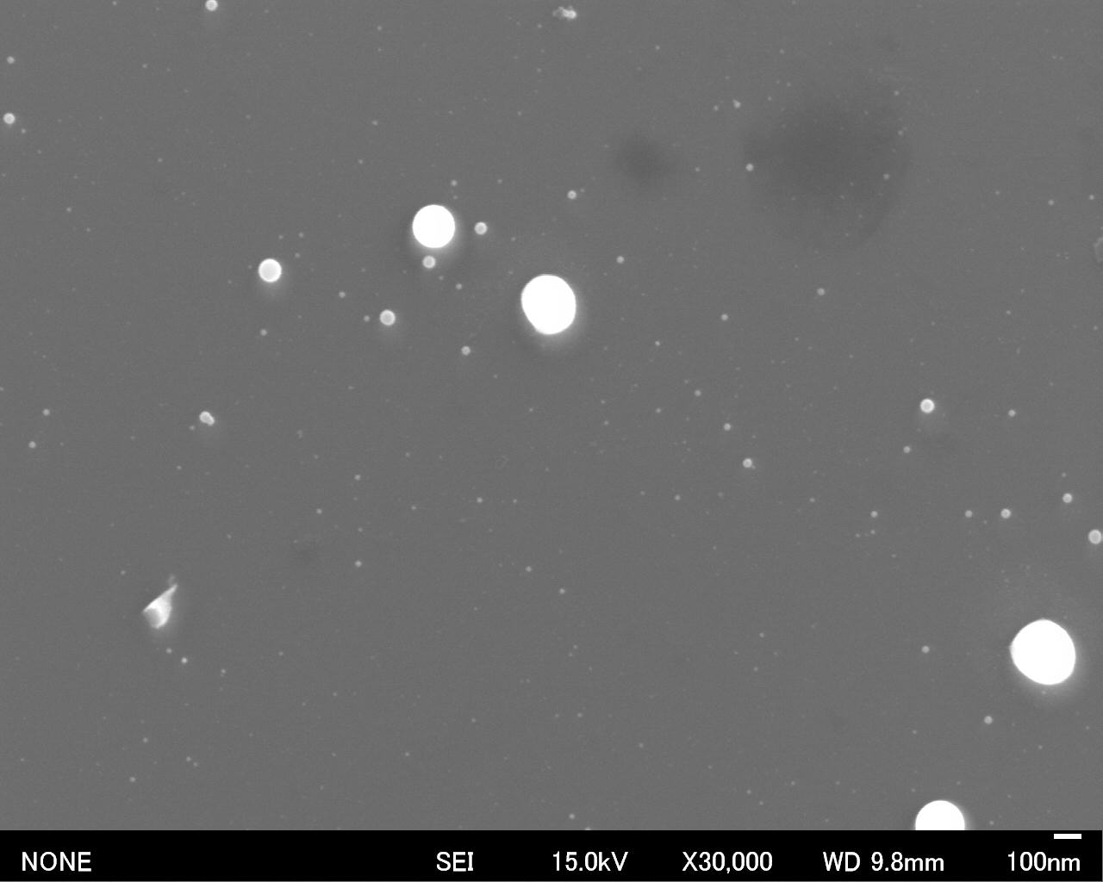
SEM image
Ablation
Ablation conditions
Vacuum state
Nd:YAG power :1.5mJ

Slide 23
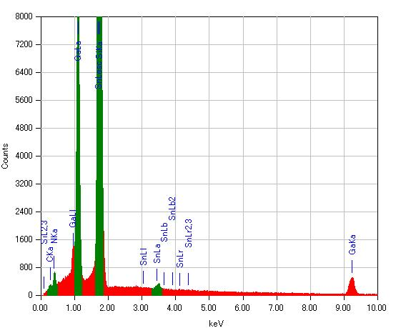
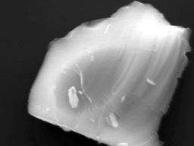
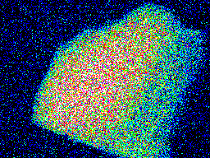
Element analysis
Ablation
A broken piece by ablation
EDS data
SEM image
Ga mapping image
Nitrogen was observed.

Slide 24
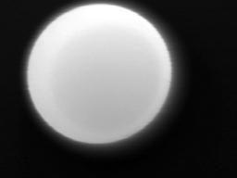
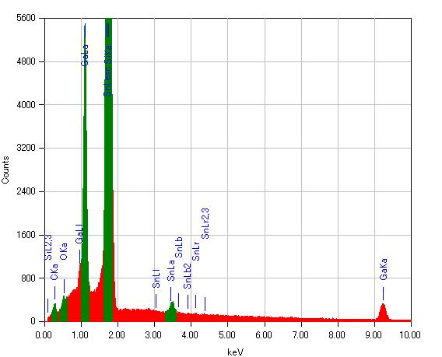
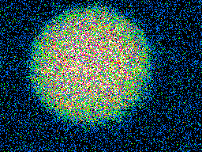
Element analysis
Ablation
Fabricated particle by ablation
EDS data
SEM image
Ga mapping image
Nitrogen peak was expected.

Slide 25
Particles have nitrogen defect.

Slide 26
Superfluid Helium condition
Ablation
Superfluid Helium
Low temperature
For ablation
Resonant energy very sharp
Viscosity becomes zero.
Small destabilizing effect
Suitable for optical manipulation
The particles can be cool rapidly.

Slide 27
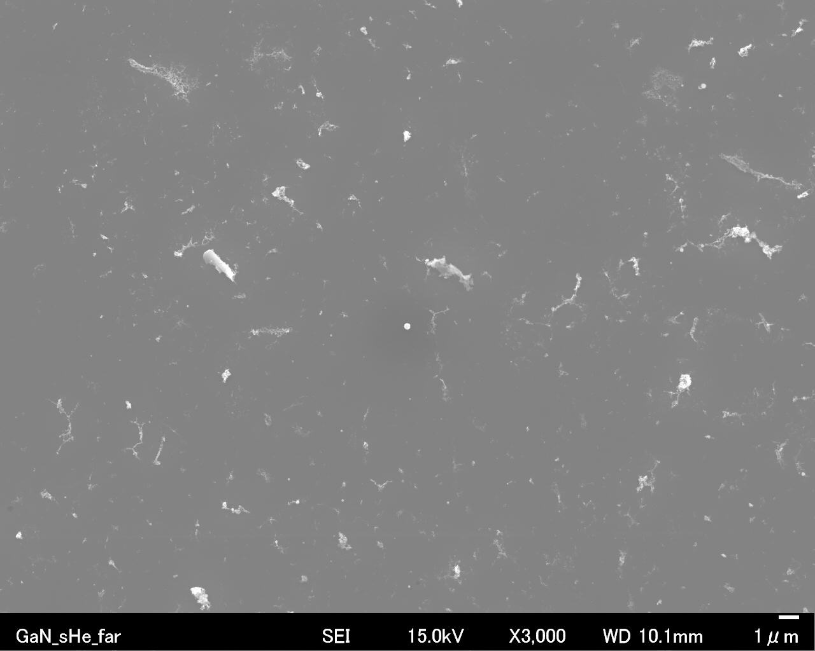
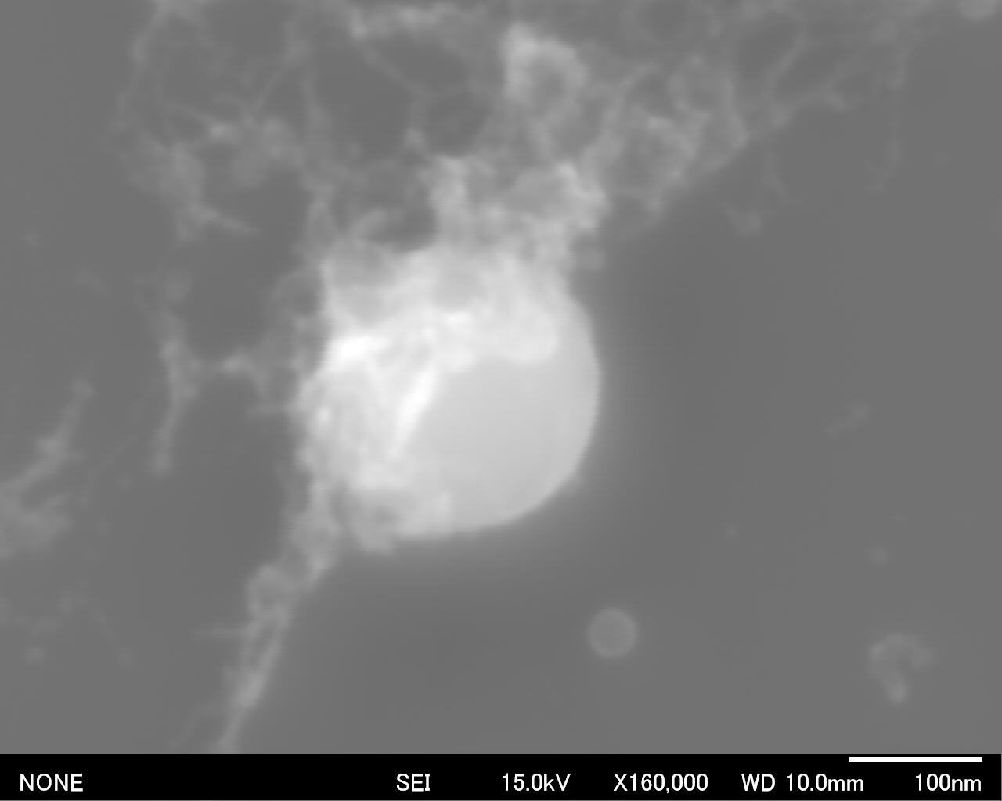
Crystal of GaN
Ablation
Ablation conditions
Superfluid He state
Nd:YAG power 0.5mJ

Slide 28
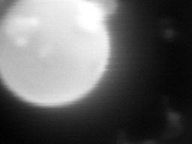
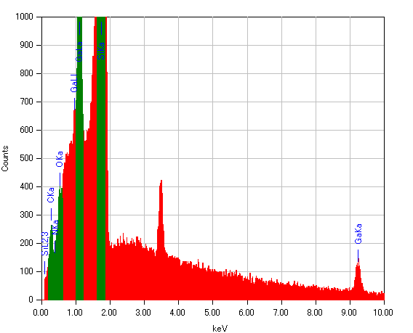
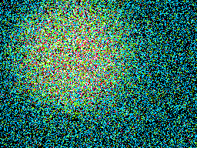
Crystal of GaN
Ablation
EDS data
SEM image
Ga mapping image
Nitrogen peak was expected.

Slide 29
Particles have nitrogen defect.

Slide 30
Results
Ablation
The particles had nitrogen defect and contained oxygen.
Tablet from powder
Vacuum condition
superfluid He condition
In such condition
Crystal
Vacuum condition
superfluid He condition

Slide 31
Optical manipulation

Slide 32
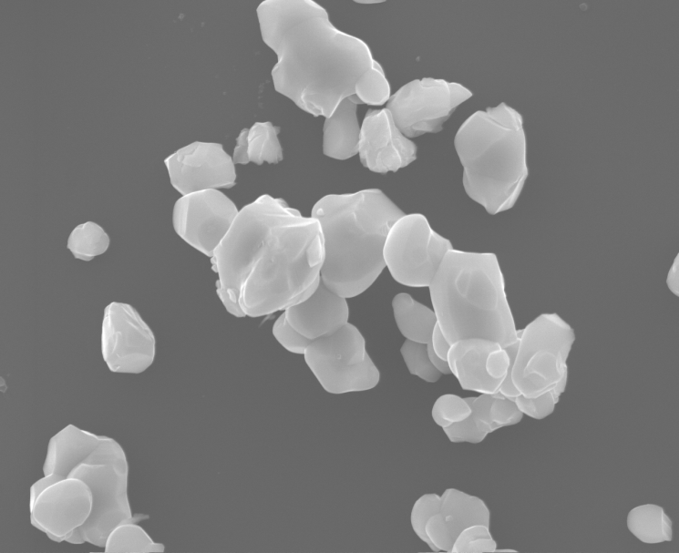
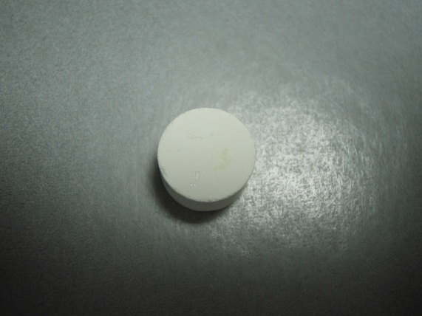
Zinc Oxides
manipulation
Wide-gap semiconductor
Band-gap energy of ZnO is 3.4eV.
ZnO is very stable material, because It’s oxidation products.
1 cm
1μm
Polygonal shape

Slide 33
Problem of size distribution
manipulation
Advantage of particle
Density of state
Density state become sharply.
Size distribution
Density of state becomes cloudy.

Slide 34
Pulse laser spectra
manipulation
fs pulse laser
ps pulse laser
Y. Saito Master thesis (2009)
100fs
Pulse duration
1ps
3.38eV
Peak energy
3.38eV
20meV
Spectrum width
2meV
Resonance radius
under 100nm radius
specific radius

Slide 35
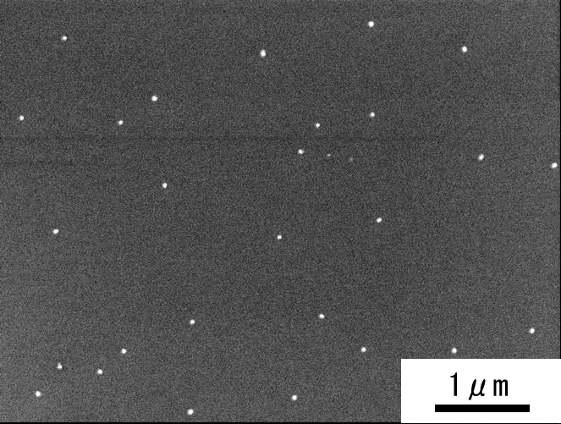
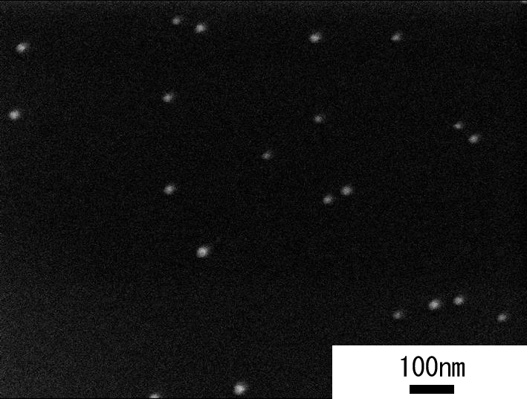
Decrease of size distribution
manipulation
fs pulse laser
ps pulse laser
Y. Saito Master thesis (2009)
The Size distribution reduced in response to spectrum width.
I try to measure size distribution from spectrum width of photoluminescence.

Slide 36
Summary
Optical fabrication
I can’t fabricate GaN particles
The particles fabricated by ablation
have nitrogen defect and contained oxygen.
Optical manipulation
I try to measure size distribution from spectrum width
of photoluminescence.

Slide 37
Appendix

Slide 38
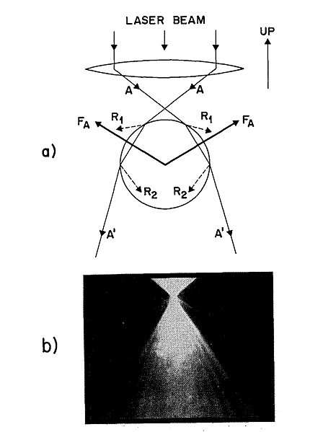
Photo induced force
Appendix
Gradient force
Radiation pressure
Optical letters vol.11, No. 5, 288 (1986)

Slide 39
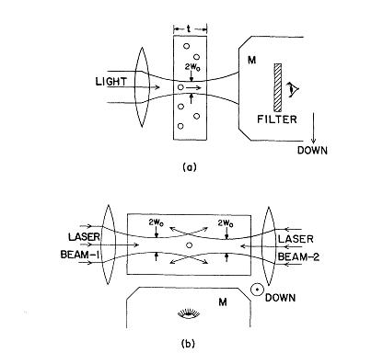
First experiment
Appendix
samples
material
transparent latex spheres
size
0.59, 1.31, 2.68μm
laser
CW argon laser
TEM₀₀
λ = 0.5145μm
ω₀= 6.2μm
Power 19mW
The author measured sphere moved at 26±5μm/sec

Slide 40
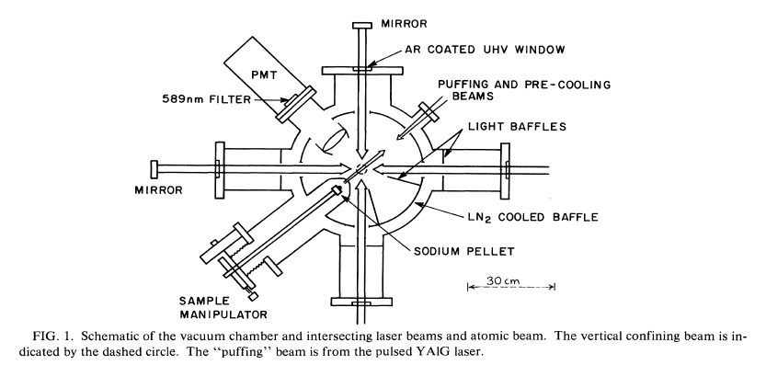
Laser cooling

Slide 41

Quantum confinement
Appendix
弱閉じ込めモデル
強閉じ込めモデル
a > a_{b}
a_{b} > a
2a_{b}
2a
2a_{b}
2a
a :ドット半径
a_{b} :励起子ボーア半径
CuCl
励起子ボーア半径
0.68nm
弱閉じ込めモデル
ドット半径
数nm
ドット内に励起子が閉じ込められる
励起子の重心運動が量子化
ΔE
量子サイズ効果によりエネルギーレベルが変化
2a
$$∆E=\frac{ℏ^{2}π^{2}}{2M_{ex}a^{2}}$$

