Slide 1
Anisotropic Spin Fluctuations
and Superconductivity in ‘115’
Heavy Fermion Compounds :
⁵⁹Co NMR Study in PuCoGa₅
S.-H. Baek et. al.
PRL 105,217002(2010)
Kazuhiro Nishimoto
Kitaoka lab.
1
Notes:
Hello everyone. I’m Kazuhiro Nishimoto from Kitaoka laboratory.
Today, I will talk about Anisotropic spin fluctuations and superconductivity

Slide 2
Contents
Introduction
- History of superconductivity
- Heavy fermion system
- Transuranic HF compounds
- Motivation
Measurement
- NMR (Nuclear Magnetic Resonance)
Experimental Results (PuCoGa₅)
Summary
2

Slide 3
History of Superconductivity
introduction
200
1911
metal
heavy fermion system
Discovery of superconducting phenomenon
163
high-T_{c} cuprate
Hg-Ba-Ca-Cu-O
150
iron-based system
（
under high pressure
）
Hg-Ba-Ca-Cu-O
Tl-Ba-Ca-Cu-O
1979
Bi-Sr-Ca-Cu-O
Heavy fermion superconductor
100
Transition temperature (K)
Y-Ba-Cu-O
77
1986
50
SmO
0.9
F
0.11
FeAs
High-T_{c} cuprate superconductor
MgB₂
La-Ba-Cu-O
Nb
Nb
Ge
PuCoGa₅
LaO
0.89
F
0.11
FeAs
2006
Pb
NbN
CeCu₂Si₂
0
Hg
NbC
LaOFeP
Iron-based high-T_{c} superconductor
1900
1920
1940
1960
1980
2000
2020
Year
3

Slide 4
Heavy Fermion System
introduction
What does “Heavy” mean?
Normal metal
Heavy Fermion system
f
f
f
＋
＋
＋
＋
＋
＋
f
f
f
＋
＋
＋
＋
＋
＋
c-f hybridization
( c-f 混成）
Strong electron correlation makes effective mass large.
“Heavy” ⇒ large effective mass
4

Slide 5
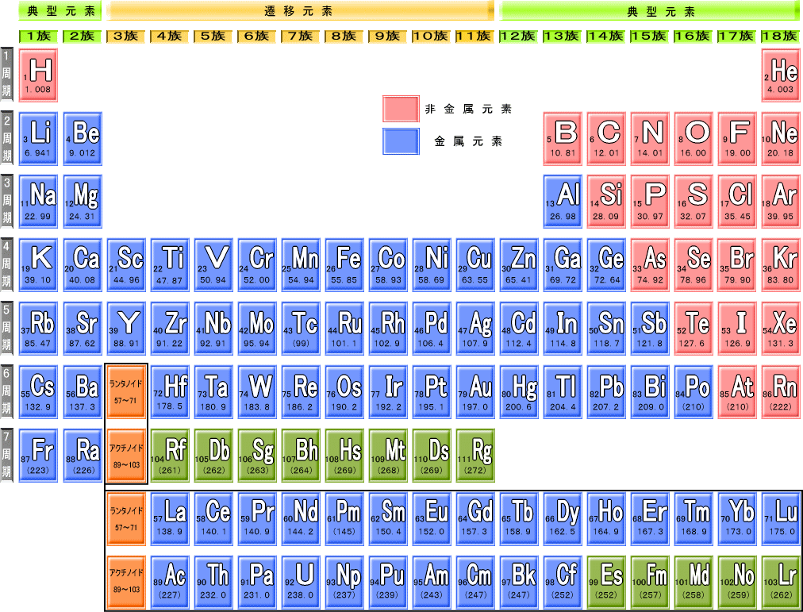
Heavy Fermion System
introduction
Example of heavy fermion superconductor compounds
CeCu₂Si₂ CePd₂Si₂ CeRh₂Si₂ CeIn₃ CeRhIn₅
PrOs₄Sb₁₂
lanthanide compounds
⇒some 4f electrons
UPt₃ UPd₂Al₃
PuCoGa₅
actinide compounds
⇒some 5f electrons
All of HF compounds have f-electrons.
5

Slide 6
Transuranic HF Compounds
introduction
transuranium elements (超ウラン元素)
don’t exist in nature
Handling is difficult because of
strong radioactivity
example : PuCoGa₅ , PuRhGa₅ , NpPd₅Al₂
6
Notes:
超ウラン化合物の物性研究の例は少なかった。２００２年と２００３年にプルトニウム化合物PuCoGa5とPuRhGa5において超伝導が発見された

Slide 7
Motivation
introduction
iso-structural superconductor
PuCoGa₅ : Pu-115 compounds
CeCoIn₅ : Ce-115 compounds
5f-electron : 5個
T_{c} = 18.5 K
4f-electron : 1個
T_{c} = 2.3 K
Amazingly high T_{c}
in HF 115 compounds
NMR study (PuCoGa₅ in normal state)
Spectra
K (Knight shift)
1/T₁T
7

Slide 8






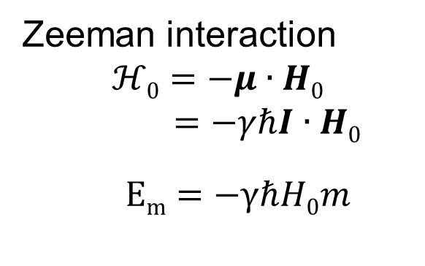
measurement
NMR spectra
Introduction
I =1/2
m=-1/2
γℏ H₀
m=+1/2
Zeeman splitting
NMR Intensity
ω
8

Slide 9


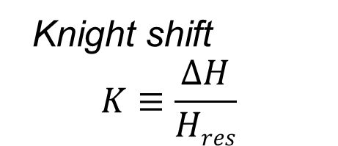

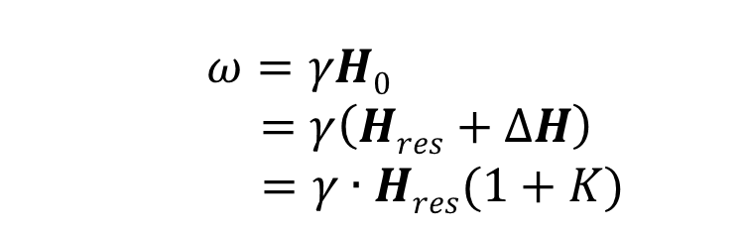

Knight shift
measurement
$$ΔH$$
$$H0$$
NMR Intensity
$$I$$
H
electron
$$ℋZeeman=−γℏI∙\left(H0+ΔH\right)$$
$ω=γH0$
$$=γ\left(Hres+ΔH\right)$$
$=γ∙Hres(1+K)$
Knight shift
$$K≡\frac{ΔH}{Hres}$$
9

Slide 10
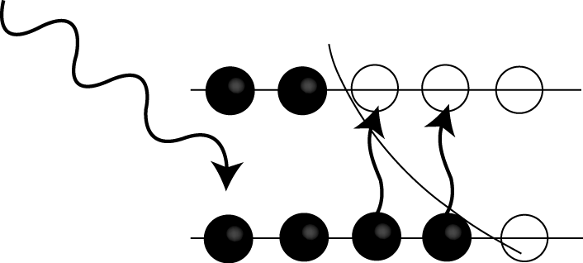
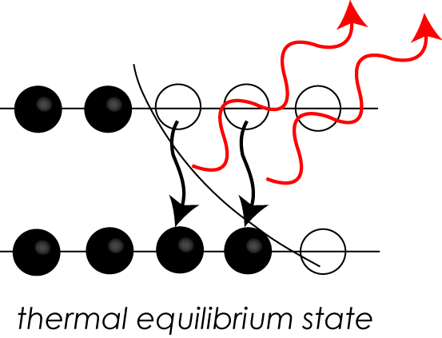
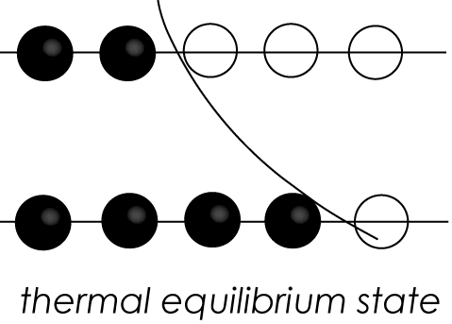
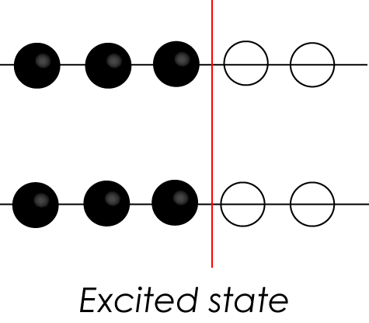
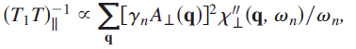
T₁~spin-lattice relation time
measurement
Excitation energy
Release the energy
I=-1/2
I=+1/2
nuclear spin
electronic spin
spin-lattice interaction
Energy-
transfer
1/T₁ is quite sensitive to spin fluctuations
10

Slide 11
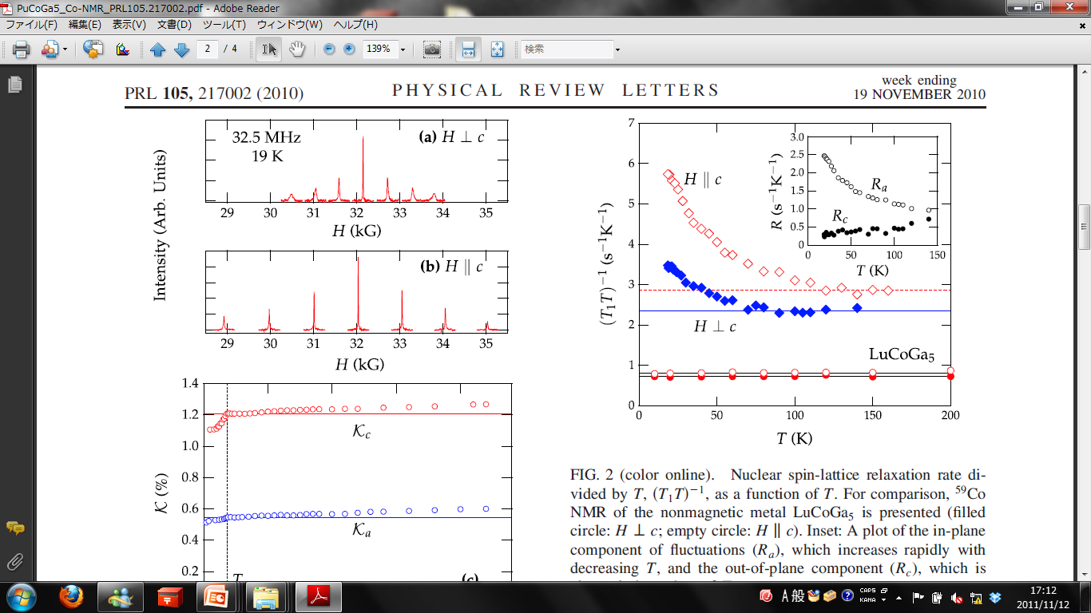
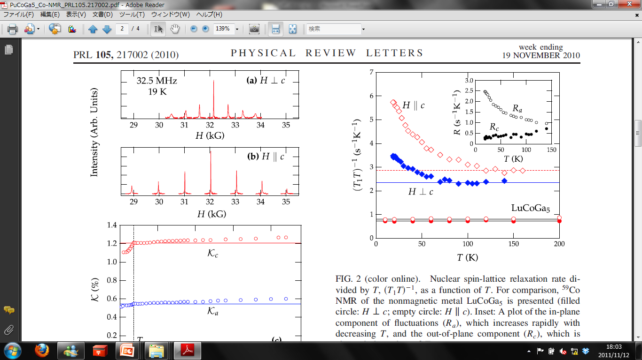
⁵⁹Co NMR Spectra at 19 K
result
Co : I =7/2
γ = 10.103MHz/T
Spectra
Quadrupole Interaction : I >1
（電気四重極相互作用）
ν_{Q} = 1.02 MHZ
ν_{Q}
11
Notes:
Quadrupole Interaction （電気四重極相互作用）
(interaction between quadrupole moment and electrical gradient)
1T=10000G=10*4G

Slide 12
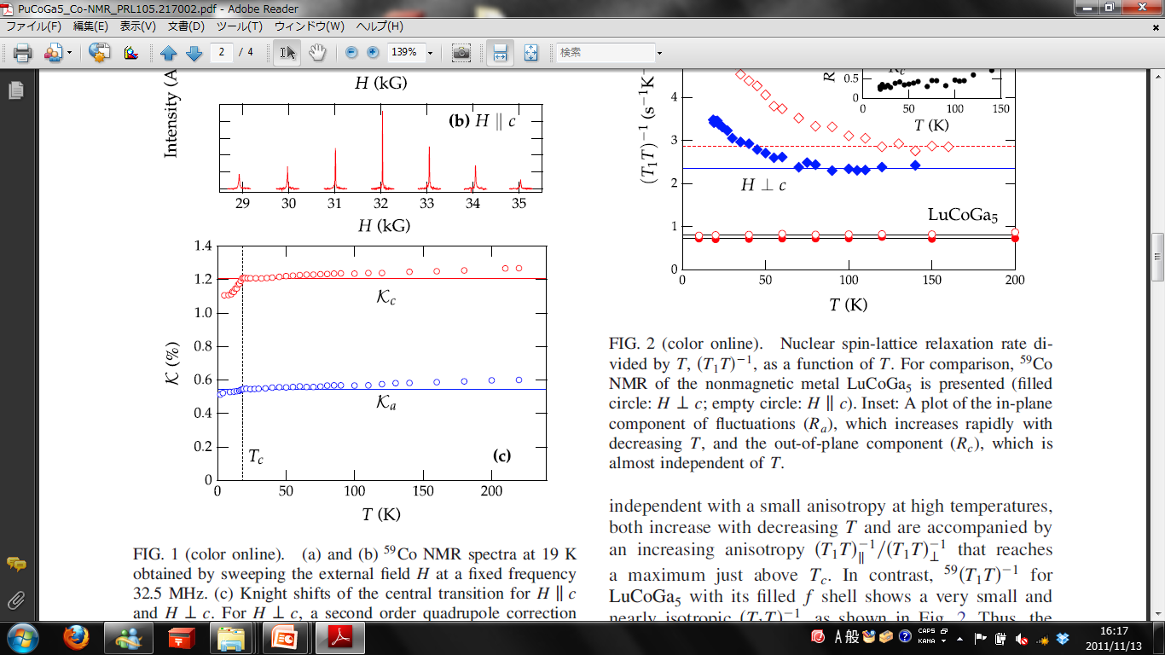
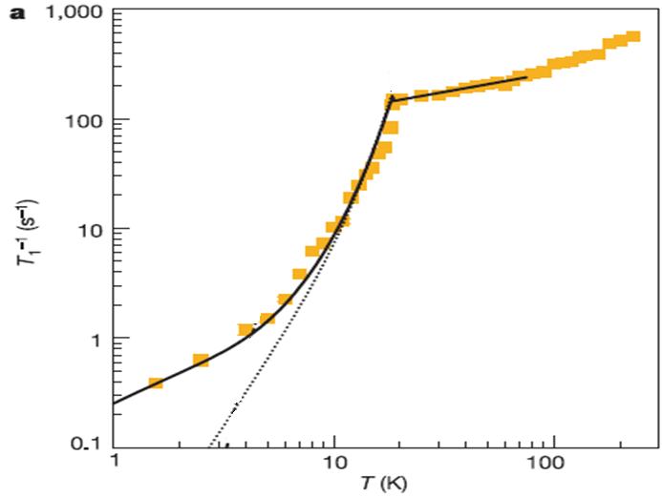
Knight shifts and 1/T₁
result
～T³
Knight shifts show strongly anisotropic behavior.
At T_{c} both sifts drop sharply , indicating spin-singlet pairing.
1/T₁⇒d-wave superconductor
Spin singlet
S=0
anisotropic : 異方性
12

Slide 13
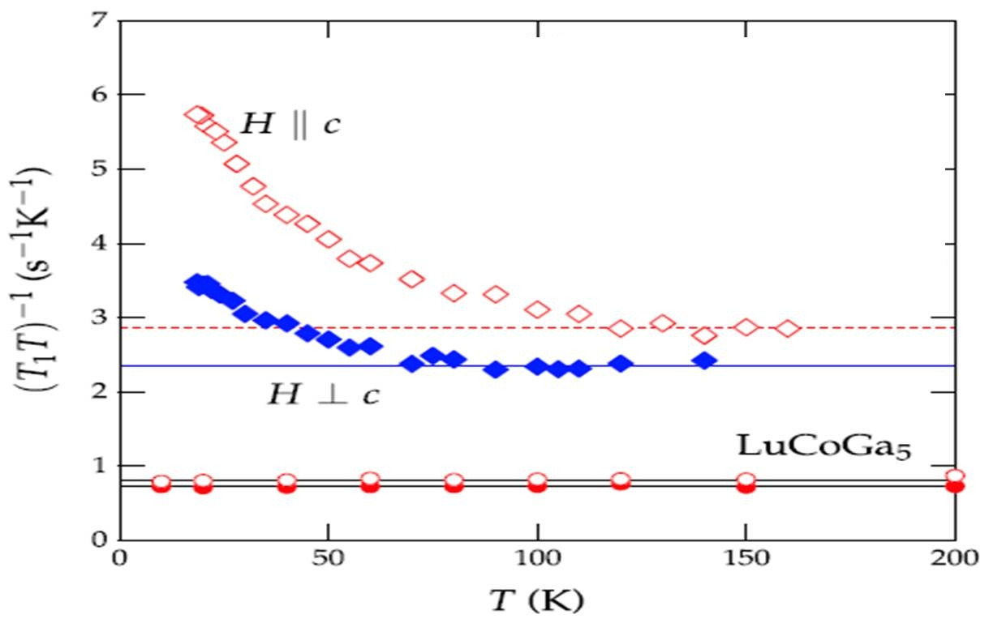
1/T₁T in 115 compounds
result
 | PuCoGa₅ | LuCoGa₅
5f-electrons | 5個 | 0個
LuCoGa₅
1/T₁T = const
conduction electrons ⇒ metallic
PuCoGa₅
conduction electrons + 5f-electrons
⇒heavy fermion state
PuCoGa₅
LuCoGa₅
Spin fluctuations develop as temperature decrease.
Anisotropy (T₁T)∥⁻¹ / (T₁T)⊥⁻¹ reaches a maximum just above T_{c .}
13

Slide 14
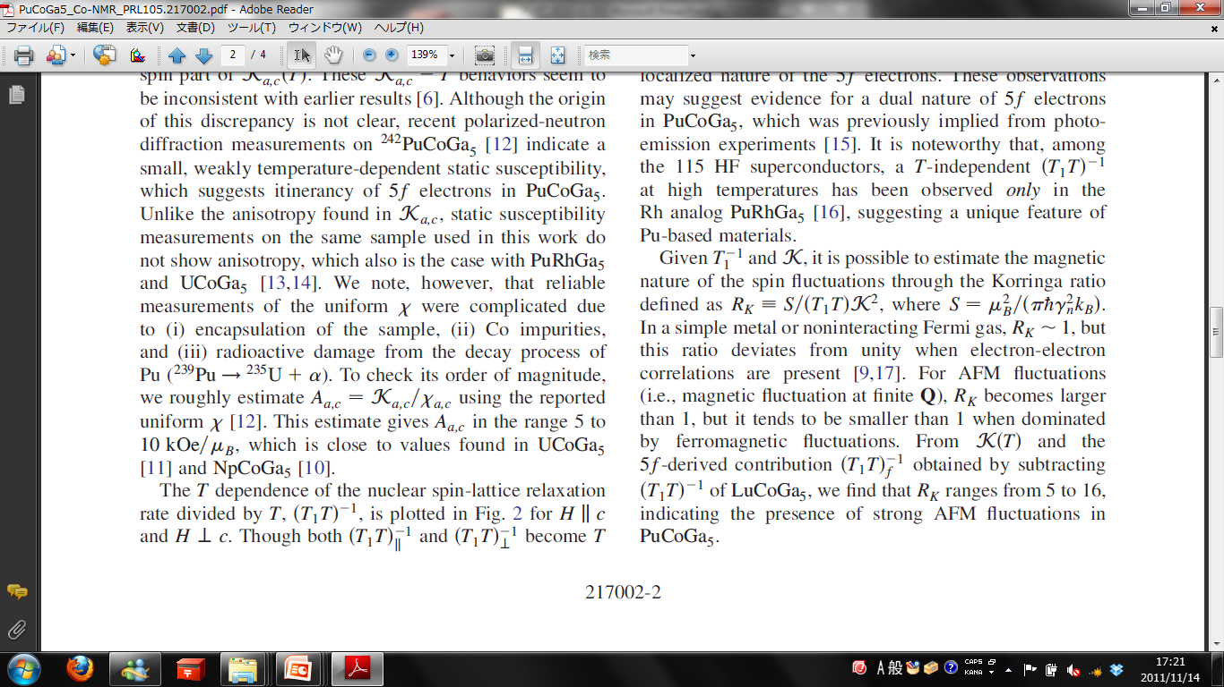
Korringa ratio
result
Korringa ratio
R_{K} > 1 ⇒ antiferromagnetic
R_{K} ～ 1 ⇒Fermi gas
R_{K} < 1 ⇒ ferromagnetic
From K(T) and 1/T₁T ,
R_{k} ranges from 5 to 16
Strong AFM fluctuations
in PuCoGa₅
14

Slide 15
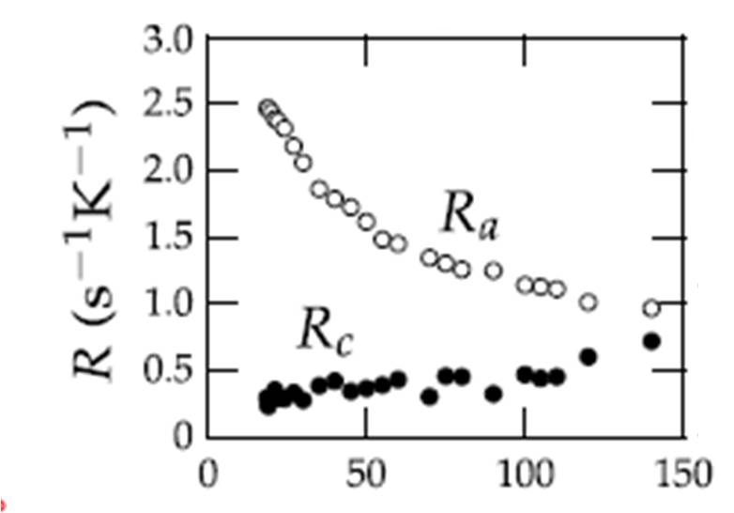
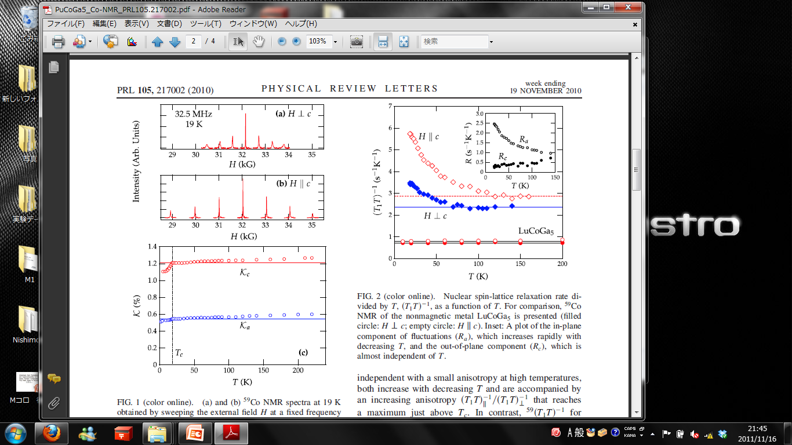
Anisotropic nature
result
PuCoGa₅ : tetragonal structure (a=b≠c)
new spin-lattice
relaxation rate
in-plane component : R_{a}
out-of-plane component : R_{c}
(1/T₁T )_{H∥c} = 2R_{a} (1/T₁T )_{H⊥c} = R_{a}+R_{c}
AFM spin fluctuation is strong
In XY-plane.
15

Slide 16
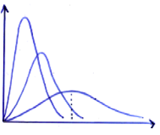
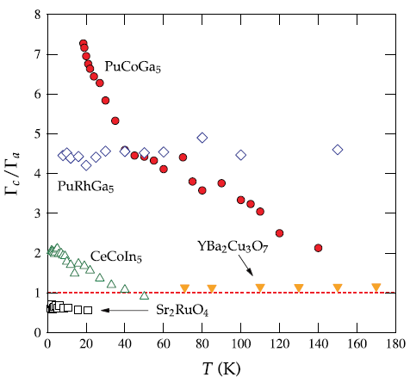
Ratio of spin fluctuation energy : ρ
result
χ″(q=Q,ω)
Spin fluctuation energy :
Γ
Magnetic order
ratio :
ω
115 HF compounds
ρ > 1 ⇒ XY-like anisotropy
Cuprates : YBa₂Cu₃O₇
ρ ⋍ 1 ⇒ isotropic
16

Slide 17
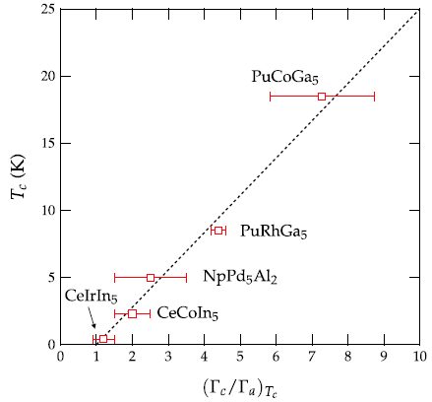
T_{c} versus Γ_{a}/Γ_{c} for 115 HF superconductors
result
Reduced dimensionality could enhance T_{c} .
Anisotropy Γ_{c}/Γ_{a} is a good parameter for determining T_{c} .
17

Slide 18
Summary
PuCoGa₅ : ⁵⁹CoNMR study in the normal state
Spin fluctuations promote d-wave superconductivity in the
iso-structural 115 HF compounds.
Both the Knight shift K and the spin-lattice relaxation rate 1/T₁
are strongly anisotropic.
The ratio Γ_{c}/Γ_{a} (spin fluctuation energy) is a characteristic
quantity in 115 HF compounds. This suggest the possibility
that anisotropic spin-fluctuations enhance T_{c} .
18

Slide 20
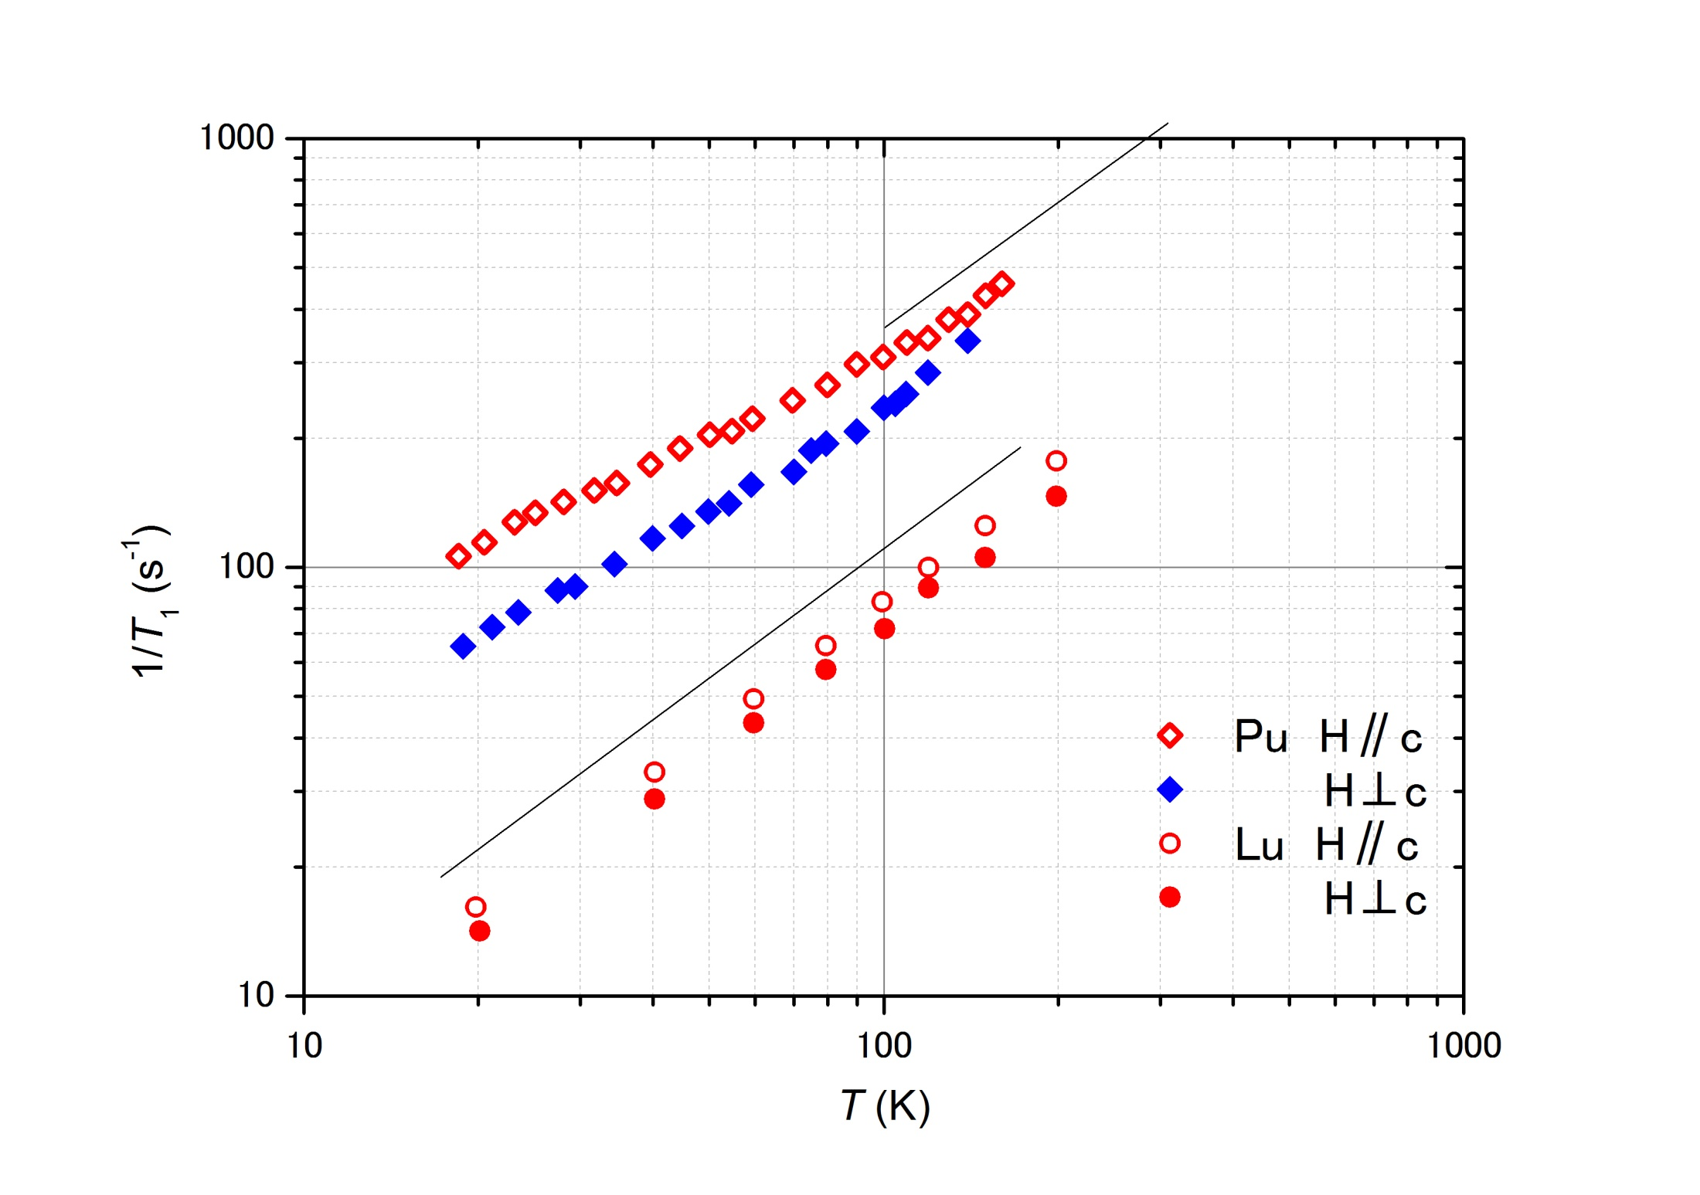

Slide 21
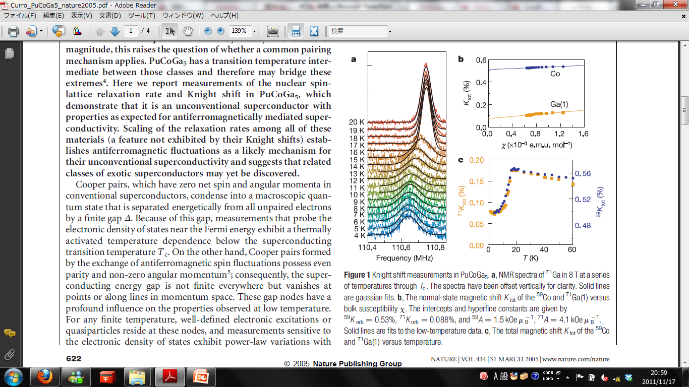

b : The normal-state magnetic shift K tot of the
⁵⁹Co and ⁷¹Ga(1) versus bulk susceptibility x.
a : ⁷¹Ga NMR spectra in 8T
c : The total magnetic shift K tot of the ⁵⁹Co
and ⁷¹Ga(1) versus temperature.

Slide 22
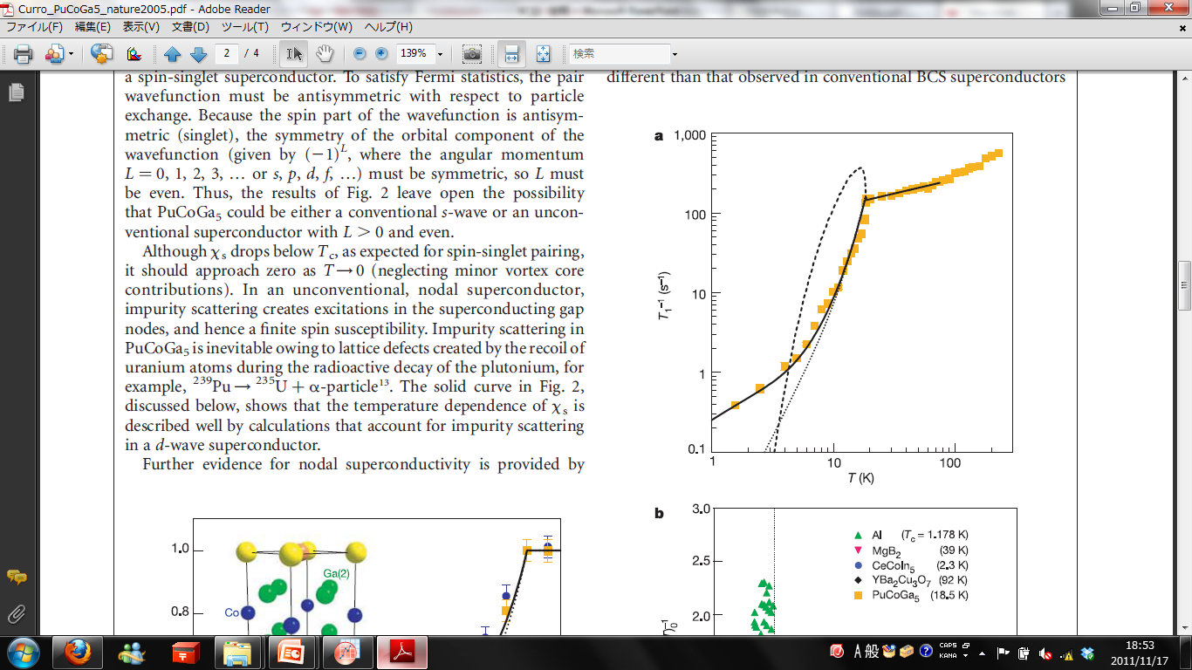
1/T₁ 温度依存性
～T^{0.35}
～T³

Slide 23
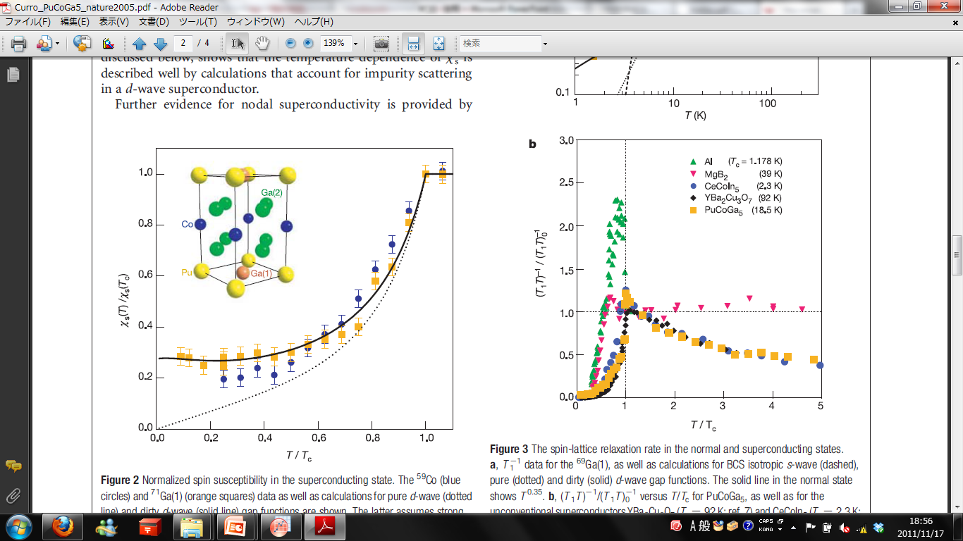
Normalized spin susceptibility in the superconducting state.
⁷¹Ga
⁵⁹Co

Slide 24
(T ₁T )⁻¹/(T ₁T )⁻¹₀ versus T/T_{c}
(T ₁T )⁻¹₀ is given by the value of (T ₁T )⁻¹ at 1.25T_{c}

Slide 25
T_{c} versus the characteristic spin fluctuation energy T₀
T₀ = Γq_{B}²/2π

Slide 26
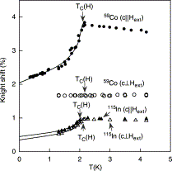

Slide 27
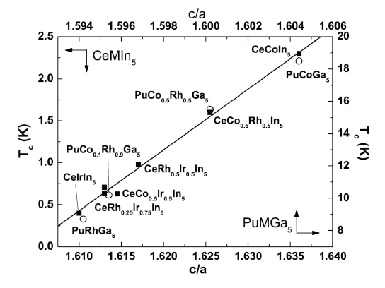
c/a ratio of tetragonal structure parameter versus T_{c}

Slide 28
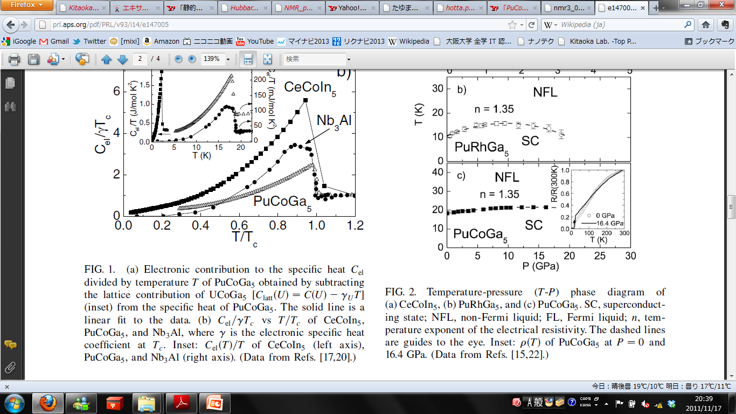
Temperature - pressure phase diagram

Slide 29
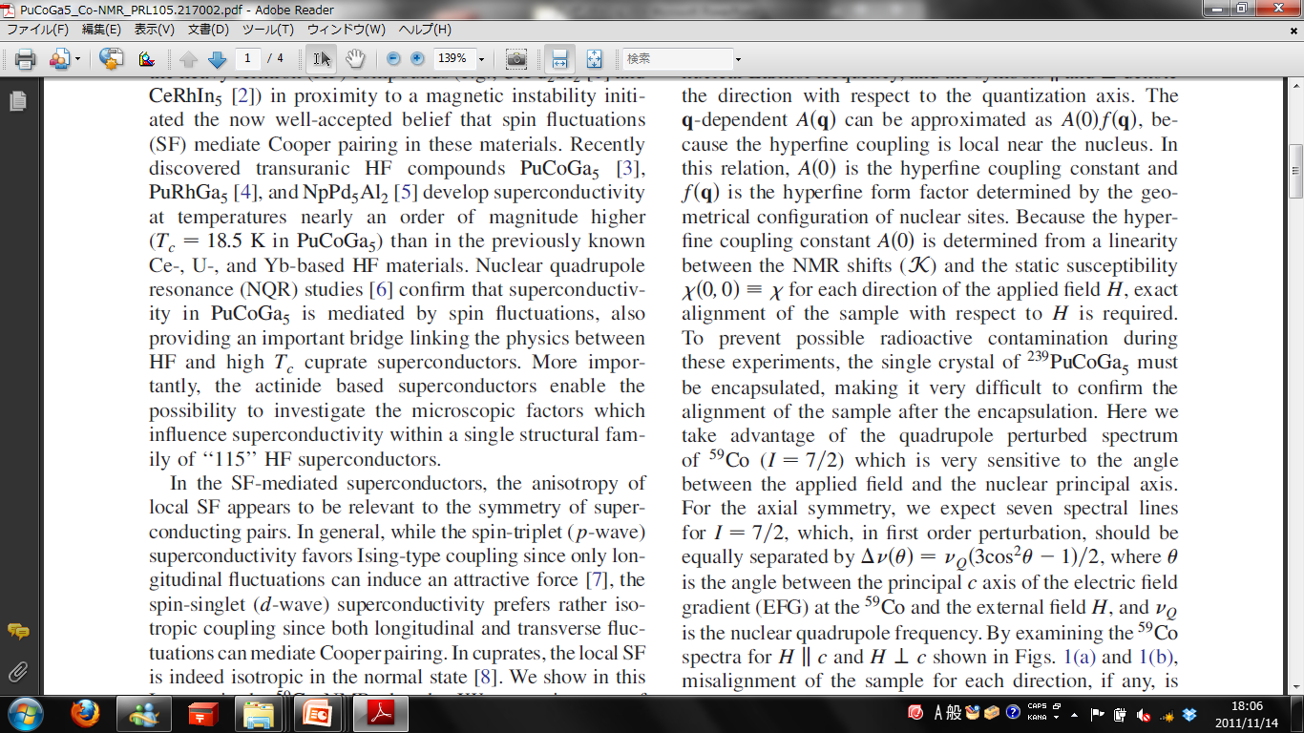
電気四重極相互作用
C軸となす角度
H∥c θ=0°
H⊥c θ=90°

Slide 30
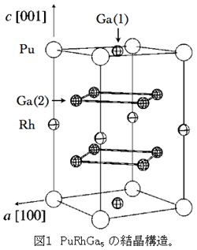
Crystal structure in 115 compounds

Slide 31
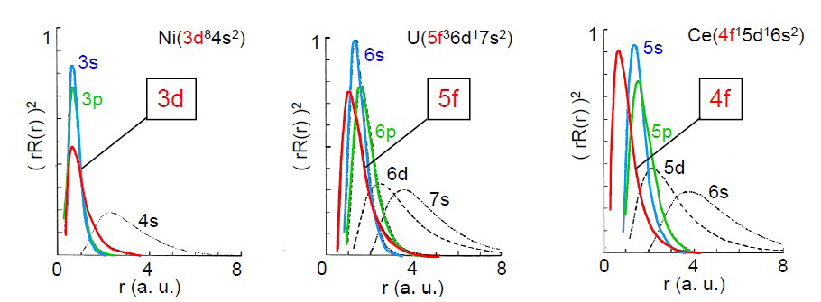
遍歴的
局在的

Slide 32
What can we know from Knight shift ?
~Symmetry of Cooper pair~
Cooper pairing state
ψ(r₁-r₂;s₁,s₂) = Φ(r₁-r₂) σ (s₁,s₂)
orbital
spin
orbital part
spin part
even function (s, d wave)
Φ (-(r₁-r₂)) =Φ (r₁-r₂)
spin-singlet
σ (s₂,s₁) = -σ (s₁,s₂)
S=0
s-wave
d-wave
odd function (p wave)
Φ (-(r₁-r₂)) = －Φ (r₁-r₂)
spin-triplet
σ (s₂,s₁) = σ(s₁,s₂)
S=1
p-wave
Notes:
電子がフェルミ粒子であるゆえにクーパー対のペアの組み方にしばり

Slide 33
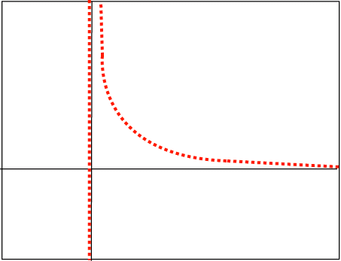
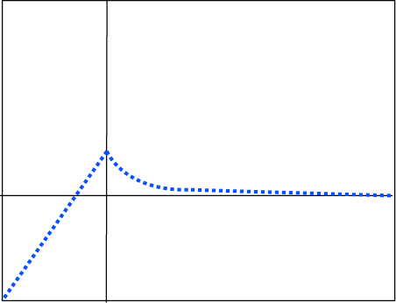
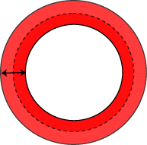
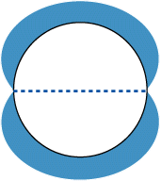
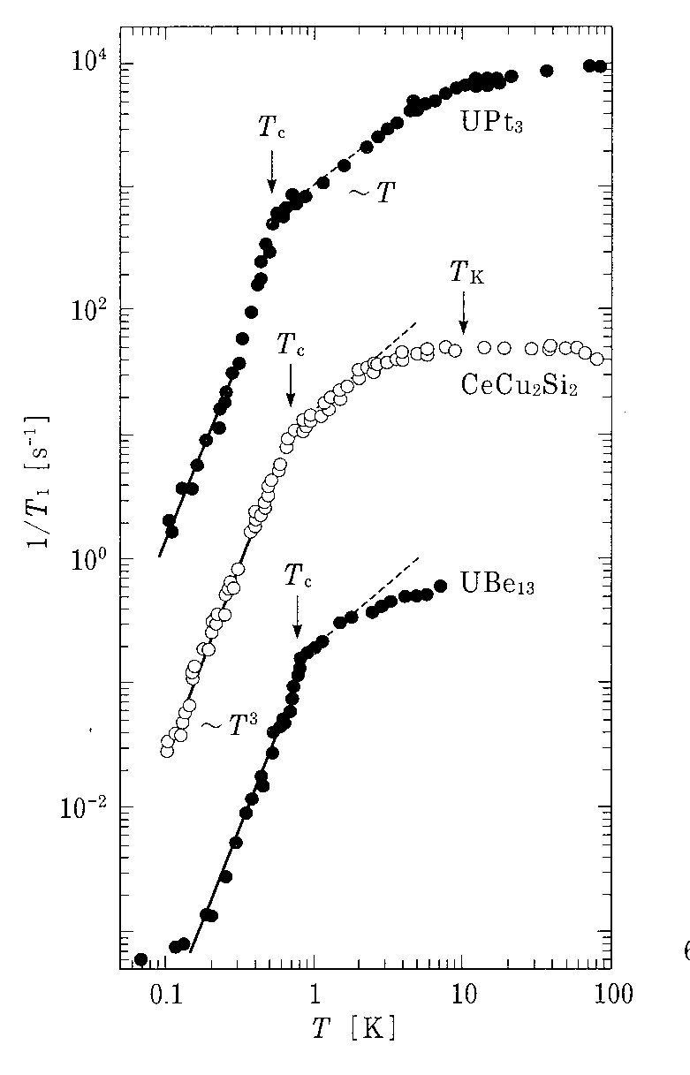



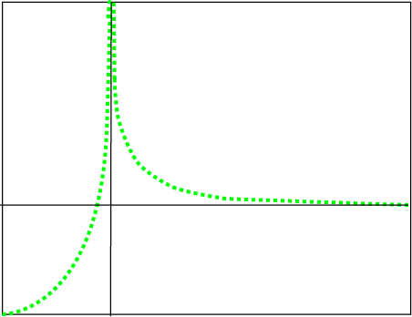
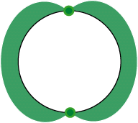
1/T₁ in various superconductors
Conventional type (BCS)
unconventional superconductors (non BCS)
N_{S}(E)
N_{S}(E)
Line nodes
N₀
N₀
s-wave
E_{F}
E_{F} +Δ₀
E_{F}
E_{F} +Δ₀
d-wave
p-wave
Point nodes
E_{F}
E_{F} +Δ₀

