Slide 1

Preparation of (Fe,Mn)₃O₄ nanoconstriction for magnetic memory application
M1 colloquium 11/16/2011
( 磁気メモリ応用を目指した(Fe,Mn)₃O₄ナノ狭窄構造の作製)
Tanaka lab
Takayoshi Kushizaki
Notes:
Hi, everyone.
I’m Takayoshi Kushizaki from Tanaka group.
In this presentation, I would like to introduce my experimental approach for realizing high-performance memory devices.
The memory is based on magnetic transport phenomena in ferromagnets.
A number of research has been conducted to improve the device performance.
Here I would like to show my challenging study to drastically enhance the performance using iron oxide and special nanostructure, nanoconstriction.
Through this presentation, I would like to convince you that the combination of oxide and nanostructure has great potential for future magnetic device application.

Slide 2
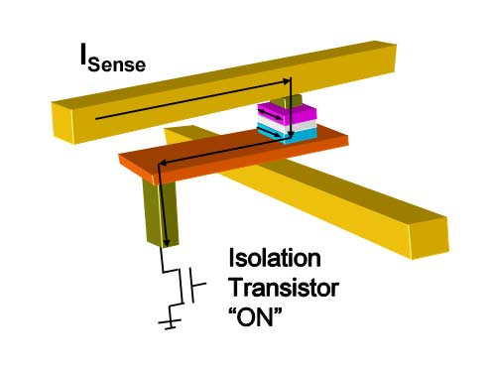
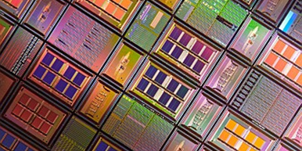
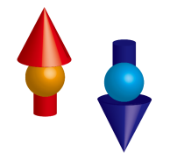
Introduction
For ubiquitous information technology
Highly integrated memory devices
Magnetic memory (MRAM)
Magnetoresistance (MR) effect plays the key role in the operation.
We aim to realize large MR using (Fe,Mn)₃O₄
Notes:
As you know well, the cost of Flash memory chips has recently decreased very rapidly with increasing the performance.
This has been promoted by the strong demand in market and the extremely serious competition between Flash and newly developed memories.
What is the best memory for the future information technology? This is the hottest issue in the field.
The memory that I will be focusing on today is one such memory called magnetic random access memory.
In the memory operation, magnetoresistance effect, called MR in short, plays the key role.
The final goal of this study is to realize a large MR at room temperature for high-performance MRAM design.
I believe that an iron oxide, FeMnO is very promising for this purpose.
Before explaining the reasons, I should briefly introduce the physics of MR effect.

Slide 3
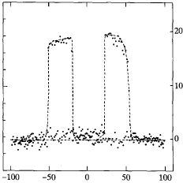
Introduction
Magnetoresistance effect (磁気抵抗効果)
Resistance change induced by magnetic field (H)
MR (%)
Fe/Al₂O₃/Fe
High “0”
20
10
0
Law “1”
H (Oe)
Notes:
The MR is given by the following definition, the resistance change induced by magnetic field.
For example, when the resistance becomes the half of the original resistance by the application of magnetic field, the MR is -50%.
The right panel shows relatively large MR observed in such layer structure.
The horizontal line represents magnetic field and vertical line represents MR.
You can see, by controlling the magnitude of magnetic field, two distinct MR values can be obtained, thus applicable as memory operating principle.
For stable memory operation, large window between two memory states should be obtained.
The spin polarization of magnetic materials often dominates the magnitude of MR.

Slide 4
Introduction
Spin polarization (スピン偏極率)
The degree to which the spin is aligned with a given direction
P=0
P=0.5
P=1
E
E
E
E_{F}
E_{F}
E_{F}
Notes:
The spin polarization P is given by the following definition.
Ds represent the density of state of up and down spin at fermi level.
These pictures show the band states having different P values.
Roughly speaking, it means how many sites at Fermi level are occupied by the red spin.
For nonmagnet where the same number of up and down spin exist at fermi level, P is 0.
If the band splits due to the exchange interaction like this, P=0.5.
In an ideal case, P becomes 1.

Slide 5
Introduction
Example : Tunneling magnetoresistance (TMR)
Basic structure: magnetic tunneling junction
H
Ferromagnet
insulator
Ferromagnet
Julliere equation
Notes:
To understand the relation between MR and P, I here show an example, TMR in magnetic tunneling junction.
This illustration represents magnetic tunneling junction.
MTJ has the sandwich structure of ferromagnet and nonmagnetic insulator barriers.
In this structure, the conduction of electrons is affected by the alignment of two magnetic layers.
When the direction of magnetization between two ferromagnetic layers is the same, electrons can flow via tunneling process like this.
In contrast, in such antiparallel configuration electrons are strongly scattered at the interface.
If the P is close to 1, the situation becomes ideal as illustrated here.
Indeed, as shown in the theoretical expression, the magnitude of MR is governed by P.
Therefore, the selection of material with high P is very important for large MR effects.
In the other MR structures, P also plays the dominant role although the expression is different.

Slide 6
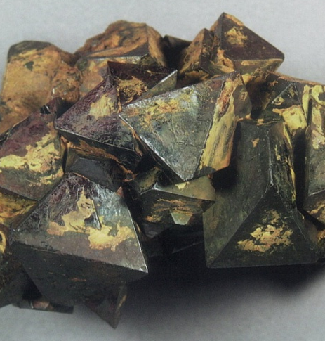
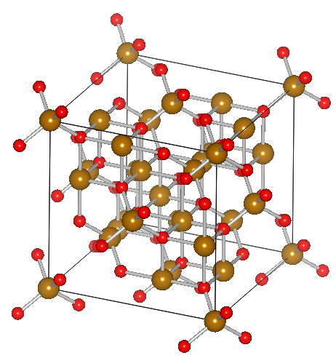
Introduction
(Fe,Mn)₃O₄: Mn-doped Fe₃O₄
H, E, hν
✓High spin polarization (P = 0.6-1.0)
✓High Curie temperature (T_{c} = 800K)
✓Physical properties can be tuned via external fields
large MR at RT
Notes:
The most widely known magnetic oxide, Magnetite, and its derivatives have high spin polarization close to 1.
In addition, the Curie T is much higher than RT.
So, large MR at room temperature can be expected if these materials are successfully patterned to device structures.
Mn doping gives us an additional degree of freedom, as a result, the transport and magnetic properties can be tuned as you like.
Moreover, semiconducting character appears with the doping. This gives us an interesting and useful opportunity to optically control the states.
From these reasons, many research groups including us have attempted to observe large MR with these materials.

Slide 7
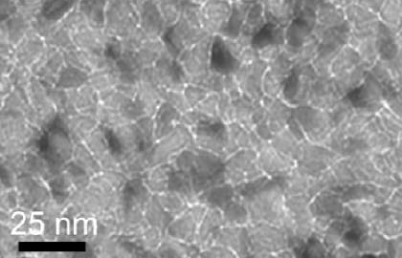
Introduction
Attempts towards large MR effect
TMR structure
Granular structure
Pseudo-spin-valve
Fe₃O₄
AlO_{X}
CoFe
Ni₈₀Fe₂₀
Cu
Fe₃O₄
Fe₃O₄-SiO₂
J. Appl. Phys. 41, 387 (2002)
J. Appl. Phys. 95, 5661 (2004)
J. Appl. Phys. 103, 07D702 (2008)
MR @RT
14% 5% 1%
The spin coherence is lost at the heterointerface.
（ヘテロ界面・複合界面）
Notes:
However, the large MR has not yet been observed at room temperature despite a number of device structures were tested.
For example, TMR structure, granular structure having a natural tunnel barrier at the grain boundary, and spin valve structure.
In all structures, the MR values are much lower than expected and those with usual metal ferromagnets.
As recently pointed out in the field of oxide interface physics, the fabrication of clean interface with transition metal oxides is quite difficult.
And in such interfaces, the reconstruction of magnetic properties can occur and reduce the spin coherence.
You may feel, if so, the realization of large MR with oxide is impossible, but no, here I propose another route toward the large MR.

Slide 8
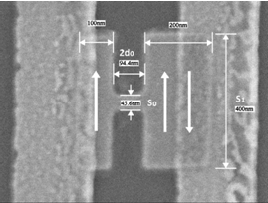
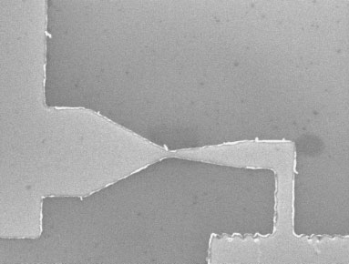
Introduction
Strategy
Realization of large MR using (Fe,Mn)₃O₄
Preparation of a ferromagnetic nanoconstriction
(ナノ狭窄構造)
Ni
Ni
50 nm
Only one material!!
No heterointerface
60 nm
Appl. Phys. Lett. 97, 262501 (2010)
Phys. Rev. B 75, 220409 (2007)
Notes:
The answer is nanoconstriction.
Constriction is a bottle-neck structure having such a very narrow region.
The big advantage of this structure is using only one material.
Therefore we can escape from the heterointerface problem.
How and why MR appears in this structure?

Slide 9
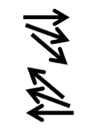
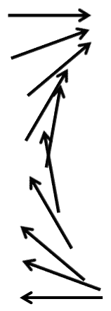
Introduction
Mechanism of “domain wall” MR
Constricted structure
Wire structure without constriction
Anti-parallel
magnetic wall (磁壁)
Parallel
Notes:
Magnetic wall plays the key role.
In conventional magnetic nanowire, magnetic domain wall dose not affect the electric conduction, because conduction electron can follow the change of localized magnetic moment.
In contrast, in such a constricted bottleneck structure, domain wall becomes much shorter than that of wire structure.
Therefore, roughly speaking, electrons feel strong spin scattering at the domain wall interface in such antiparallel configuration.
As a result, MR is induced between parallel and antiparallel configurations.

Slide 10
Introduction
Estimation of “domain wall” MR
Phys. Rev. Lett. 83, 2425 (1999) J. Magn. Magn. Mater. 310, 2058 (2007)
FMO nanoconstriction
MRAM
d
S
S_{C}
P = 0.9
With downscaling (d and S_{C}), the MR is greatly enhanced!
Notes:
The magnitude strongly depends on the dimensions of constriction.
The right panel shows the simulation result based on the theories.
I used two parameters, one is the channel length of nanoconstriction and the other one is the ratio of
Cross-section between the constriction part and the other part.
You can see that, with reducing the channel length and increasing the cross-section ratio, the MR is increased.
This is a very positive message that the properties are not only maintained in future downscaling but also greatly enhanced.
For MRAM application, MR over 150% is required, so we have to fabricate sub 100 nm-scale devices.

Slide 11
Towards FMO nanoconstriction
However, it is difficult to pattern oxide nanostructure,
especially, the narrowest part (< 100 nm).
electrode(電極)
substrate
In this work,
we have attempted to fabricate the FMO nanowire as the first step.
Notes:
However, as you know, oxide is a kind of rock, so it is quite difficult to pattern it to nanostructure.
In addition, the nanoconstriction has a strange H-shape structure.
In order to obtain this complicated nanostructure, we first focus on the narrowest part, nanowire region.
Once we succeed in fabricating the nanowire part, the nanoconstriction can be obtained just by attaching two additional pads.
Therefore, I have devoted myself to the fabrication of FMO nanowire.
This is the purpose of this work.

Slide 12
Recipe for FMO nanoconstriction
1. FMO nanowire
Fabricate and evaluate
step by step
2. Au/Ti electrode
3. FMO magnetic domain pad
Notes:
Let me start the experiment part.
We used three-steps-recipe for patterning the FMO nanoconstriction.
At first, fabricate FMO nanowire, and then attach electrode,
In future, FMO regions will be added for the bottleneck structure.
The second step is important to check the quality of nanowire.
From now, I’d like to show my achievement for these two steps.
FMO nanowire is successfully fabricated by our special fabrication technique.

Slide 13
Fabrication of nanowires using sidewall deposition
Pulsed laser
Target
Pulsed Laser Deposition (PLD)
Resist
Nanowires
Controlling the height
Controlling the width
Transferring the thickness of film deposited, which can be controlled in Å-scale, to the width of nanowire pattern
Notes:
We first grown FMO nanowires by a sidewall deposition method.
This unique method is a kind of film deposition from a tilted angle.
Wall structure made by organic resist was patented on substrate.
Then, we deposited FMO using Pulsed Laser Deposition method on the side face of the wall pattern.
After the lift-off process, we obtained nanowire structures.
The great advantage of this method is transferring the thickness of film deposited to the width of nanowire pattern.
Due to the capability of controlling the film thickness in deposition, the nanowire can be controlled in A-scale, in principle.
In addition, by adjusting the deposition time and angle, we can control the height and width.

Slide 14
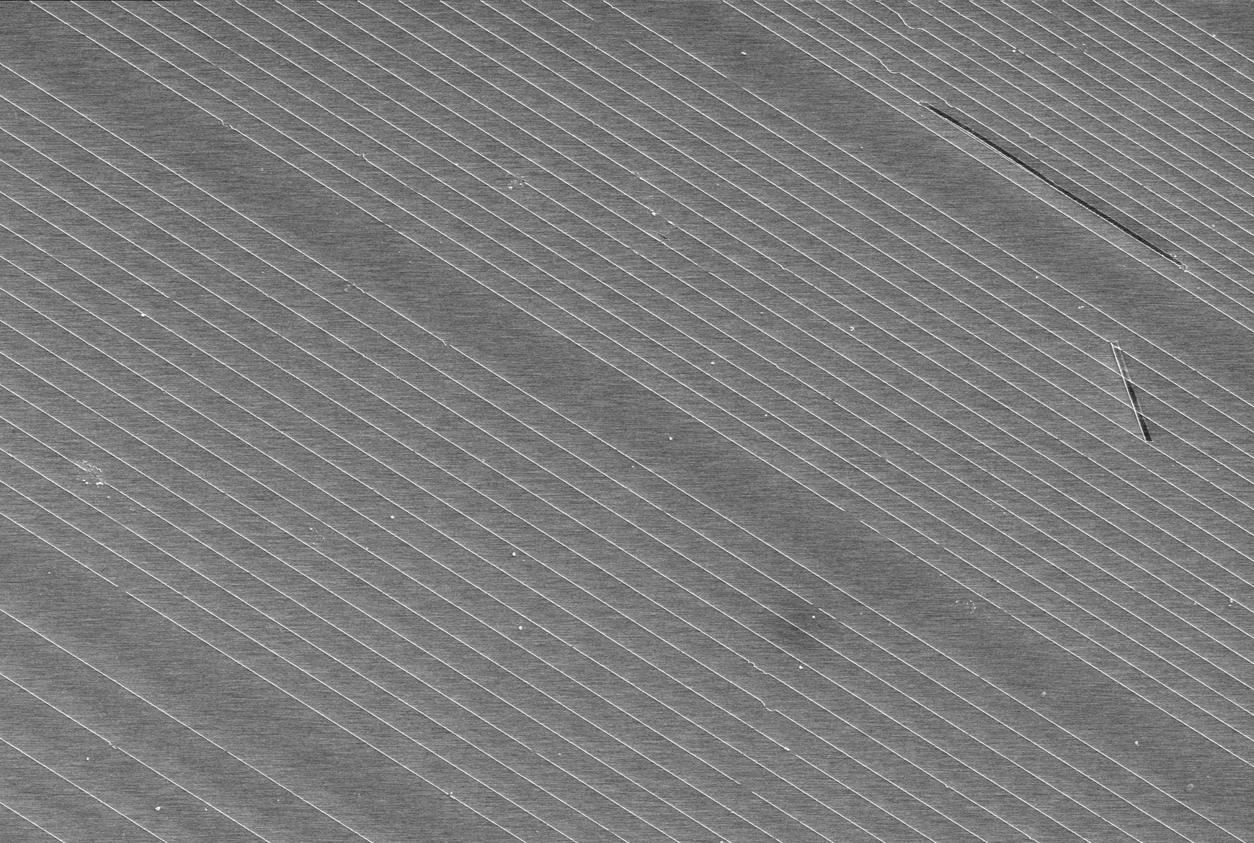
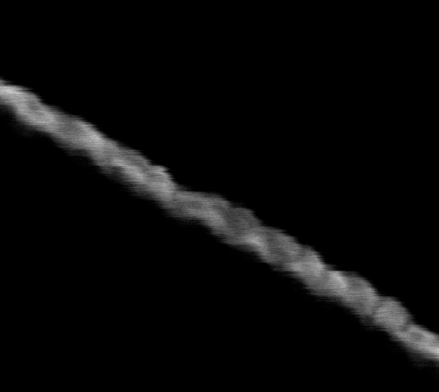
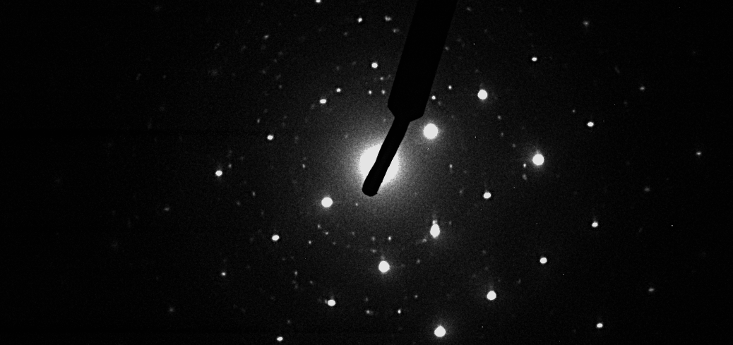
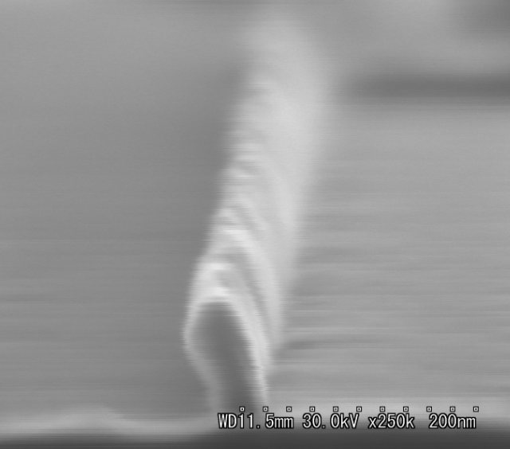
Large area formation of FMO nanowires
Top view (SEM)
50 μm
40 nm
TED: FMO wire + Al₂O₃
[1014] Al₂O₃
×
[1210]
100 nm
(220) FMO
(311) FMO
(440) FMO
[1012]
Cross-section
100 nm
Size controllability
width：30 - 150 nm
height：50 - 150 nm
length：100 μm -
140 nm
40 nm
Notes:
This SEM image shows the array of the fabricated nanowires.
I adopted nanoimprint method for the wall pattering as introduced in the previous seminar.
Since it is like a printing, lots of nanowires can be patterned simultaneously in large area.
As clearly seen in the main panel, the shape of nanowires is well controlled.
In this cross-section image, you can see that the width is 40 nm and height is 140 nm.
These values satisfy the requirement for the observation of large MR effect in nanoconstriction.
The nanowire has a polycrystalline grain-like structure as shown in the right panel.
This was also confirmed from the detailed cross-sectional TEM analysis.

Slide 15
Road to FMO nanoconstriction
1. Polycrytalline FMO nanowire (sub-100 nm scale)
2. Au/Ti electrode
Notes:
The first step was achieved.
Although the crystallinity was confirmed, the magneto transport properties are unclear.
To evaluate it, in the next step, I attached electrodes to the single nanowire.

Slide 16
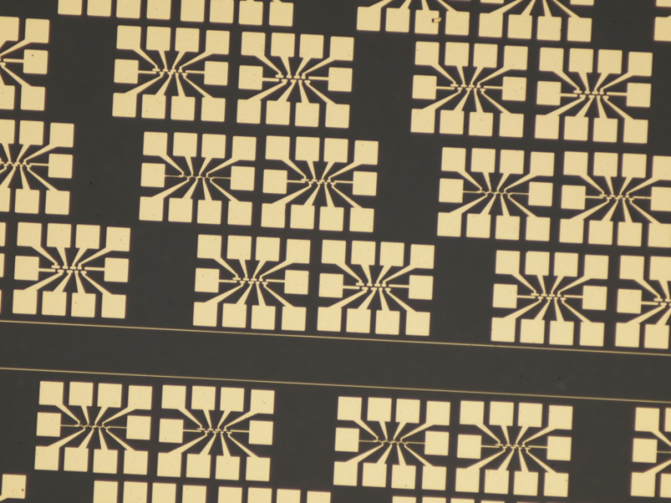
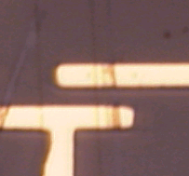
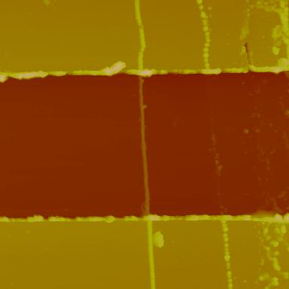
Capture a single nanowire for the characterization
Au/Ti electrode
Electrode gap: 4 μm
Au/Ti
1 μm
Au/Ti
Notes:
Photo lithography was used to capture the single nanowire.
Nanowire captured between two gold electrodes were checked by optical microscope and atomic force microscopy before the transport measurements.
In the lowest panel, AFM image of a FMO nanowire with a channel length of 4 um is displayed.

Slide 17
Capture a single nanowire for the characterization
MR measurement
Ⓐ
H
FMO polycrystalline NWs were successfully fabricated with my recipe!!
Notes:
This is the result of MR measurements.
Here I should stress that this MR is not the my final goal but just to check the ferromagnetic character of the fabricated FMO nanowire.
So, don’t be disappointed about the small MR value.
This good agreement in the MR values between the fabricated nanowire and epitaxial thin film indicates that the ferromagnetic property of FMO
is well maintained in sub 100 nm scale.
My recipe worked very well.
This result encourages me to fabricate the nanoconstriction using these nanowires.

Slide 18

Summary
Fabrication
FMO polycrystalline nanowires
Width: 30-150 nm
Height: 50-150 nm
Length: over 100 μm
Characterization
Confirmed the ferromagnetic character of FMO nanowires
from MR measurements
The final step: FMO magnetic domain pad
ongoing
Notes:
In summary, I succeeded in fabricating FMO polycrystalline nanowires.
The width, height, and length can be well controlled by adjusting deposition conditions.
From MR measurements, the ferromagnetic properties of the fabricated nanowire was confirmed.
Based on these results, I would like to advance my nanowire to nanoconstriction and demonstrate the large MR.
That’s all.
Thank you for your attention.

Slide 20
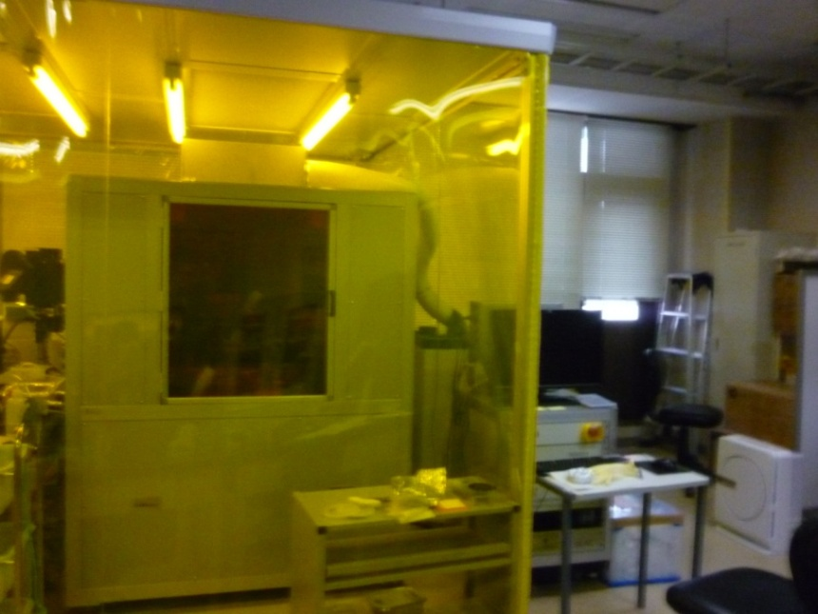

Capture a single nanowire for the characterization
Photo lithography system
Electrode pattern
100 μm
nanowires
64 unit/cm²
Notes:
The electrode pattern is like this.
To capture only one wire in many wires, we fabricated a lot of electrode like this.
This advantage is capturing various wire pattern.
For example, narrow pitch wire pattern, wide pitch wire pattern and tilted wire pattern.

Slide 21
直観的解釈(スピン蓄積・ΔRの起源)
磁化平行
磁化反平行
スピン蓄積
※電荷は蓄積しない
電子注入方向
ΔV
スピン蓄積とスピン緩和
の結果生じる界面電圧
μ
μ
V-
V+
電流一定より、ΔVがΔRになる

Slide 22

FMO狭窄構造で予想される磁気抵抗値
理論1：磁壁の圧縮
理論2： ”スピン蓄積誘起”磁気抵抗
207%
J. Appl. Phys. 103, 07D702 (2008)
40 nm
1 μm
2d=50 nm
10 nm

Slide 23
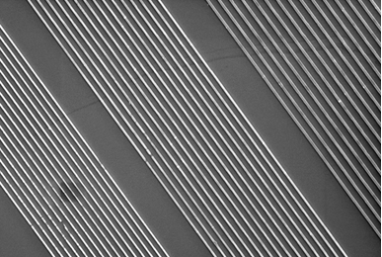
作製プロセス①
パターン作製
(ナノインプリント)
基板面出す
(エッチング)
UV
CF₄,O₂plasma
モールド
レジスト2
レジスト1
基板
10μm
基板: Al₂O₃(0001)
レジスト1:熱硬化レジスト(nanonex NXR-2030)
レジスト2:UV硬化レジスト(nanonex NXR-3032)
高い端面平坦性
大面積・一括
CF₄: 10sccm 50W 2min 2.0Pa
O₂: 10sccm 50W 2min 1.0Pa

Slide 24
作製プロセス②
サイドウォール蒸着
レジスト除去
形状を整える
(イオンミリング)
結晶化
(ポストアニール)
FMO
Ar plasma
FMO ナノワイヤー
ターゲット:Fe_{2.5}-Mn_{0.5}-O
P _{base} :～10⁻⁶Pa
P_{O2}：10⁻⁴Pa
基板温度 : 室温
蒸着角度：60°
浸漬:6h、90℃
(1-メチル-2ピロリドン)
ECR 3min
P _{base} :～10⁻⁶Pa
P_{O2}：10⁻⁴Pa
温度：400℃
時間：5h

Slide 25
Final step: AFM lithography
AFM tip
electrode
Mo
MoO₃
Mo
Deposition of Mo
Oxidation of Mo
(AFM lithography)
Pulsed laser
FMO
Lift off MoO₃
Deposition of FMO
Lift off Mo
Notes:
At first, we deposit Mo on nano pattern using sputtering.
Secondly, we oxidize Mo to MoO3 in the pad region by flowing current using AFM.
This is AFM lithography.
Thirdly, we lift off MoO3 by immersing in water.
Next, we deposit FMO on the pattern.
Next, we lift off Mo mask by immersing in H2O2.
At last, the nano structure complete.

Slide 26
狭窄構造作製可能寸法
パッド幅
100 nm～
狭窄長さ
50 nm～
狭窄(ワイヤー)幅
20～200 nm

Slide 27
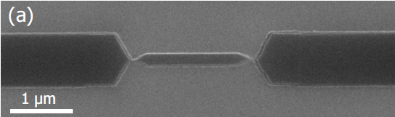
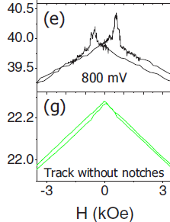
予想される磁気抵抗特性
LSMO狭窄構造
Phys. Rev. B 75, 220409 (2007)
抵抗
8K
狭窄有
狭窄無
0
外部磁場

