Slide 1
Terahertz spectroscopy of electromagnons in Multiferroics
Ashida lab.
Saito Tadtaka

Slide 2
Contents
Introduction
---Multiferroic materials
---The mechanism of Electromagnon’s excitation
Experiment
---Experimental set up
---Sample
Results
Summary

Slide 3
Introduction ---Multiferroic materials
Multiferroics
Multiferroics are materials where ferroelectricity and
ferromagnetism are inherently coupled.
E
P
Magnet Electric effect
(ME effect)
H
M
The magnetization can be controlled by electric field of light.
The polarization can be controlled by magnetic.

Slide 4
Magnet Electric effect
Introduction ---Multiferroic materials
Antisymmetry Dzyaloshinskii-Moriya interaction
Spiral-spin-order
らせんスピン磁性
c
P_{total} //c
b
a
bc-spiral

Slide 5
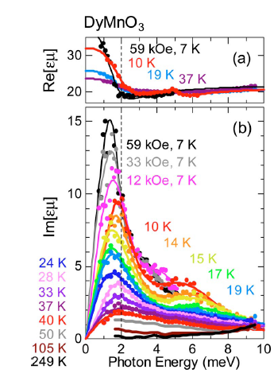
Electromagnon
Introduction ---electromagnon’s excitation
Magnon
Spin wave
Magnon is exited by magnetic field.
Multiferroics…
Magnon can be excited
by electric field of light.
Electromagnon(2006)
RMnO₃ R; rare-earth metal
Low temperature, High H
N.Kida. et al Opt. Soc 26 108794(2009)

Slide 6
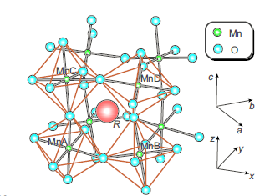
Introduction ---electromagnon’s excitation
RMnO₃
Rare-earth-metal perovskite magnites
R; rare earth elements(Y, Eu, Tb, Dy, ・・・)
M. Mochizuki, et al Phy. Rev. Lett.104.177206(2010).

Slide 7
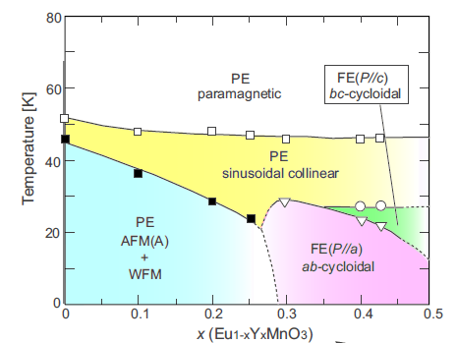
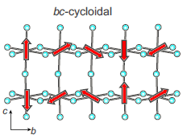
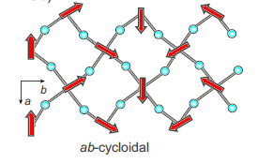
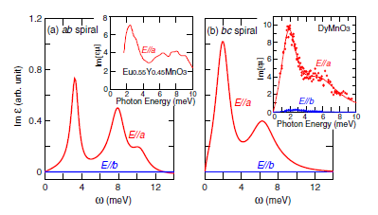
Introduction ---electromagnon’s excitation
Phase Diagram of Eu_{1-x}Y_{x}MnO₃
Spiral spin phase
At ab-cycloidal…
Spin chirality
Spontaneous polarization

Slide 8
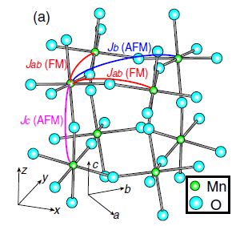
Introduction ---electromagnon’s excitation
Introduction
Super Exchange Interaction
The modulation of this interaction results in
electromagnon’s excitation.

Slide 9
Mechanism of Electromagnon
Introduction ---electromagnon’s excitation
b
E//a
a
E//b

Slide 10
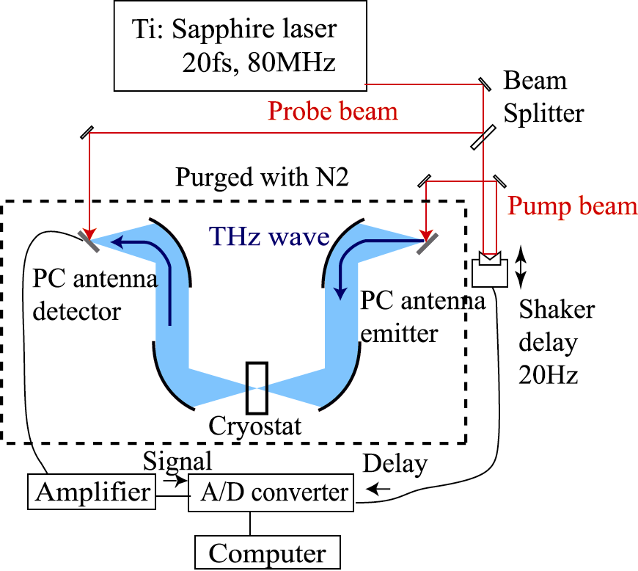
Experimental set up
Experiment
THz-TDS enables us to observe
a waveform of ”E(t)” directly.
By using THz-TDS ,
both amplitude and phase of ”E(t)” are directly obtained.

Slide 11
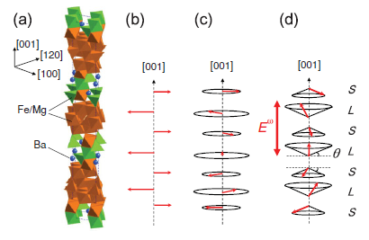
Sample
六方晶フェライト
Y-type hexaferrite Ba₂Mg₂Fe₁₂O₂₂
Ferri magnetic
proper screw
Conical spin
Room temperature
T<195K
T<50K
S. Ishiwata et al Science 319, 1643 (2008)

Slide 12
Sample
Transition of spin phase by weak magnetic field
Proper screw
Longitudinal conical spin
Ferrimagnetic
θ
H(>3T)
Weak magnetic field(～1T)
H//[001]
Transverse conical spin
Ferrimagnetic
(001)
(120)
(100)
H//[100]
H(＞4T)

Slide 13
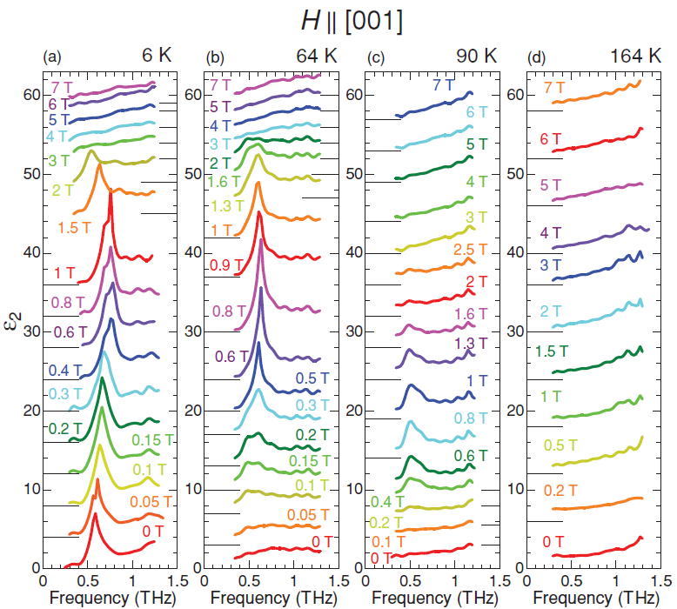
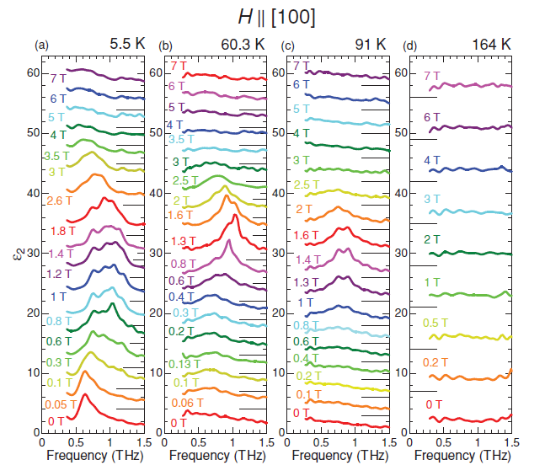
Spectra change
Sample
E//(001)
F
F
F
F
F
Electromagnon’s excitation
was observed in
conical spin order.
F
C
C
C
C
Spectra change by weak H
Conical
Proper-screw
Ferri
Conical
Proper-screw
Ferri
N. Kida et al Phy Rev B 83, 064422 (2011)

Slide 14
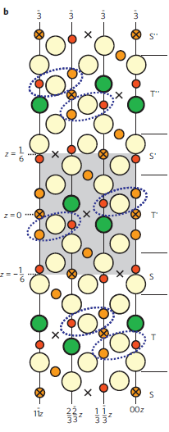
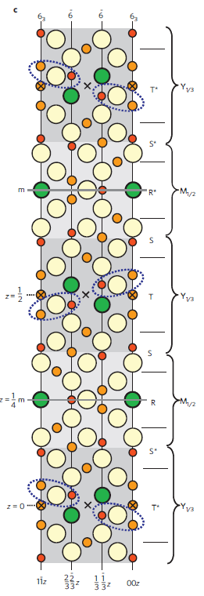
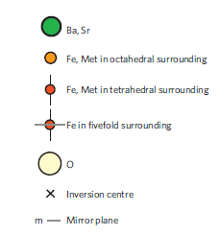
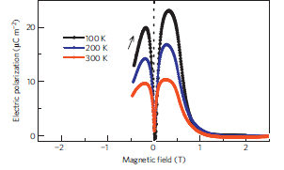
Z-type hexaferrites Sr₃Co₂Fe₂₄O₄₁
Sample
c
Polarization by ME effect
at room temperature.
Y-type
Z-type
Y. Kitagawa, etc Nat. Mat. 9, 797(2010).

Slide 15
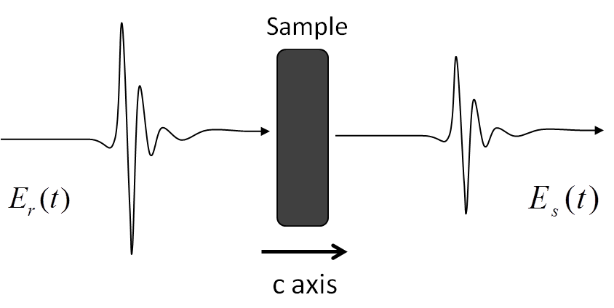
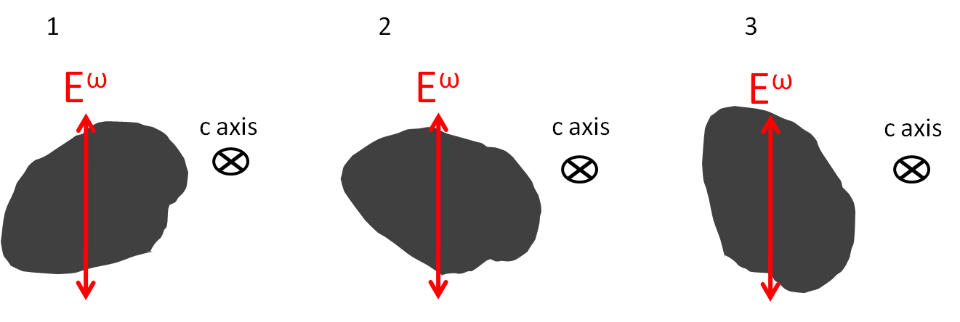
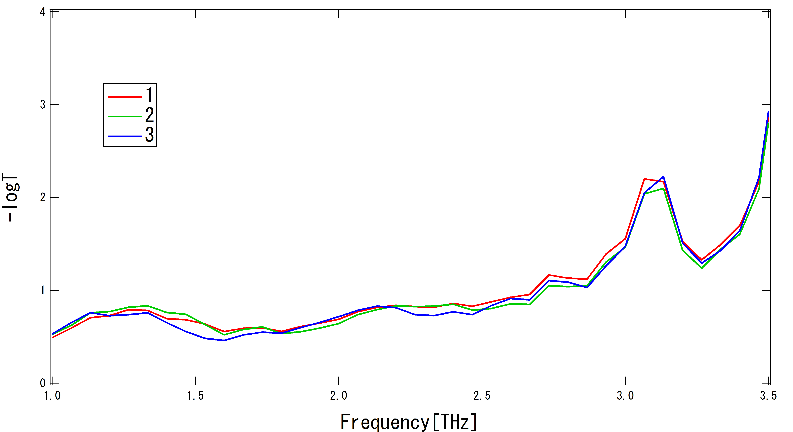
Results
Results

Slide 16
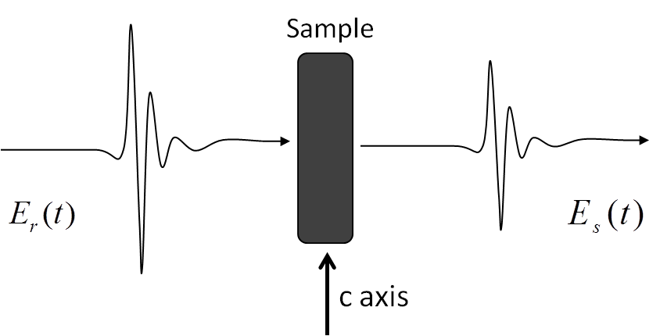
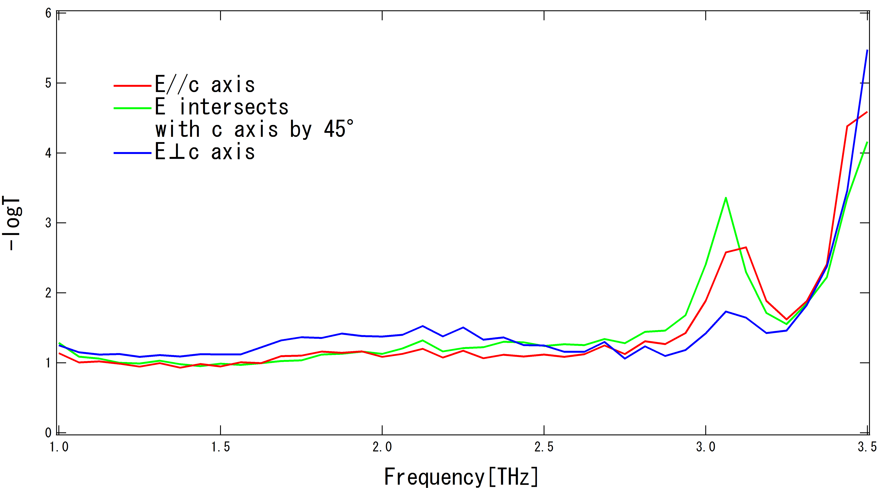
Results
Results

Slide 17
Summary
Summary
I introduced to my study toward observation of electromagnon’s excitation at room temperature.
We observed the change of spectrum by the direction of light polarization in Z-type hexaferrites Ba3Co2Fe24O41 at room temperature.

