Slide 1
Chemical Wiring and Soldering toward All-Molecule Electronic Circuitry
Masakazu Aono et al., J. Am. Chem. Soc., 2011, 133 (21), 8227
Tobe Lab.
Daichi Ando

Slide 2
Contents
Introduction
Single-molecule electronics
Linear chain polymerization
Purpose of this work
Result and discussion
Adsorption of CuPc
Chemical Sodering
Conclusion

Slide 3
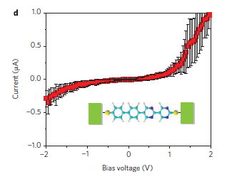
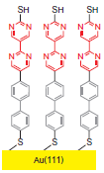
Single-Molecule Electronics
Rectification
= 整流性
Díez-Perez, I.; Tao, N. Nat. Chem. 2009, 1, 635–641.
Barner, J.; Rabe, J. P. Macromol. Rapid Commun. 2010, 31, 362–367.

Slide 4
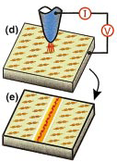
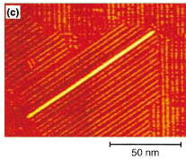
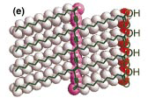
Linear chain polymerization
Okawa, Y.; Aono, M. J. Chem. Phys. 2001, 115, 2317–2322.

Slide 5
Purpose of This Work
Monomer molecules of the diacetylene
form a self-assembled monolayer (SAM).
Stimulation from the STM tip initiates the chain polymerization of the diacetylene (PDA).
The lifted-up structure of PDA enables the reactive end to approach the adsorbed molecule.

Slide 6
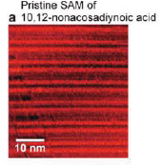
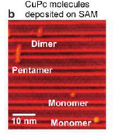
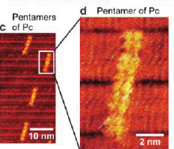
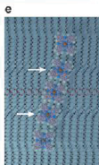
Adsorption of CuPc
10, 12-nonacosadiynoic acid
(diacetylene molecule)
Cupper Phthalocyanine (CuPc)

Slide 7
Chmical Soldering
About 70% of the STM images showed type A.

Slide 8
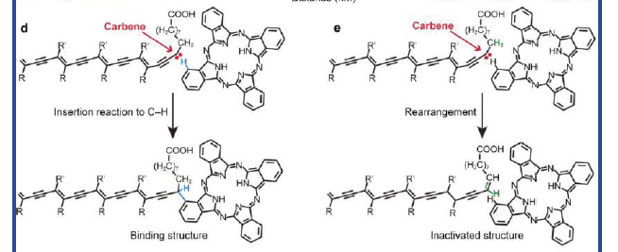
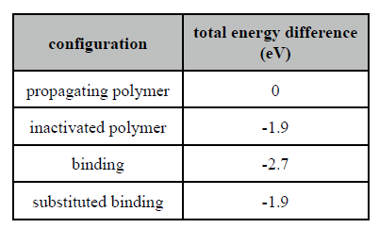
The Density-functional First-Principles Method

Slide 9
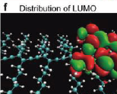
The Calculated Distribution
sp³
sp
sp
sp
sp
sp
sp²
sp²
sp²
sp²

Slide 10
Polarons and Bipolarons
unpaired electron
positive charge
polaron
bipolaron

Slide 11
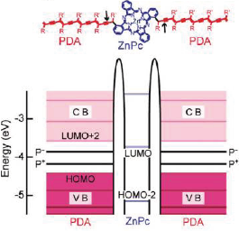
PDA-ZnPc-PDA System

Slide 12
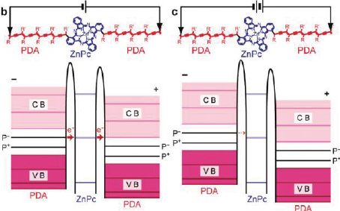
Contents

Slide 13
Conclusion
・Conductive polymer nanowires connect to
a functional molecule via covalent bonds.
・Polymer connection to phthalocyanine
(chemical soldering) is the main reaction.
・This method represents a key step in
advancing the development of future
single-molecule circuits.

