Slide 1
Three-dimensional-nanopatterned MgO substrates for the fabrication of epitaxial transition metal oxide nanowires
Tanaka Lab. Yasushi Fujiwara
Notes:
Hello, every one.
I am Yasushi Fujiwara from Tanaka laboratory.
This presentation title is three-dimensional-nanopatterned MgO substrates for the fabrication of epitaxial metal oxide nanowires.

Slide 2
Contents
Introduction of keywords
  Strongly correlated electron system
  Merit of Nanostructures
  Nano processing procedure for metal oxides
My research
  Results of first semester
  Sidesurface of 3D-MgO
  Wulff’s theorem
  Approach to fabricate MgO(100) side surface
  Fabrication of MgO nanostructure
Conclusion
（強相関電子系酸化物）
（ウルフの定理）
Notes:
At first, I introduce some keywords.
Strongly correlated electron system
Merit of Nanostructures, and nano processing procedure for metal oxides
Second, I will talk my research.
Results of first semester
Sidesurface of 3D-MgO
Wulff’s theorem
Approach to fabricate MgO(100) side surface, and Fabrication of MgO nanostructure
At Last, I will conclude my talk.

Slide 3
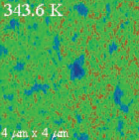
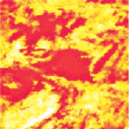
Strongly correlated electron system
Strongly correlated electron system oxide have multi domains.
The phase separation occur due to strong electronic interaction.
（強い電子間相互作用）
VO₂
(La,Ca)MnO₃
Ferromagnetic(metal)
Insulator
metal
Paramagneic(insulator)
400nm
100nm
Science 318 14 (2007)
Science 285 1540 (1999)
Notes:
First keyword is strongly correlated electron system.
Strongly correlated electron systems, such as transition metal oxide, show remarkable electronic phase separation and consist of mixed-phases.
The phase separate occur due to strong electronic interaction.
Left figure is VO2. This green region is metal phase, and blue region is insular phase.
Right figure is La, Ca, Mn, oxide.
This system has phase separation between red region ferromagnetic metal and yellow region insulator.
Strongly correlated electron system have mixed-phases whose domain size is a few tens to a few hundred nm.
Strongly correlate electron system have multi domain structure each phase.
These domains can be controlled, that is insulator domain change to metallic domain by applying external field.

Slide 4
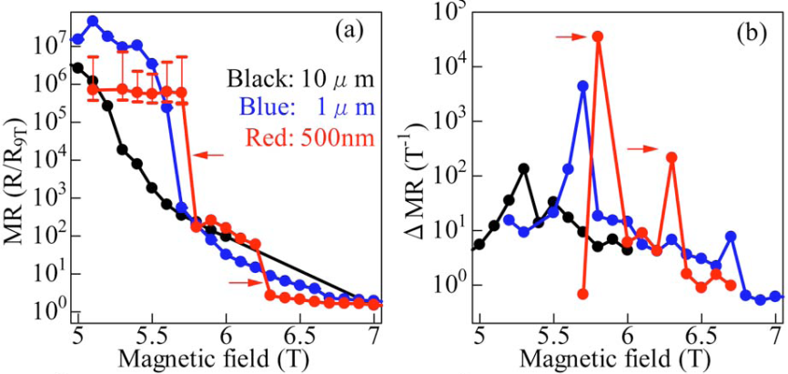
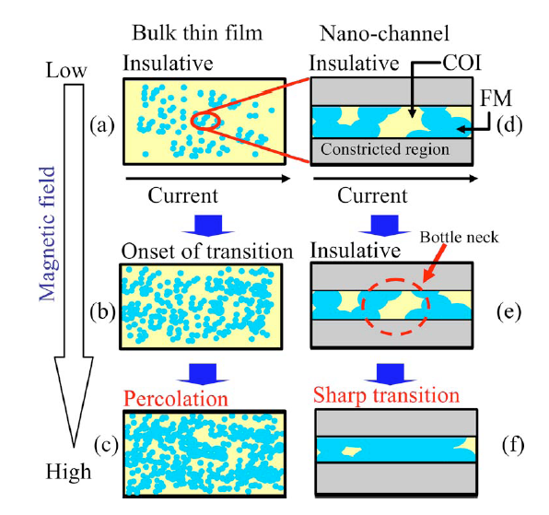

Merit of nanostructures
(La, Pr, Ca)MnO₃
electrode
（磁気抵抗）
10μm~500nm
electrode
Nonlinear
response
APL. 89 253121 (2006)
The nonlinear response by controlling single domain.
Notes:
Second keyword is nanostructures.
As I showed previous slide, the average domain size is about a few hundred nm.
This implies that the each phase can be trapped in the nanostructures, and this nanostructure expected to exhibit(イグジビット) giant response.
Indeed, it was reported nonlinear response in (La, Pr, Ca) MnO3 nanostructure.
This is a micro-nano channel structure of (La, Pr, Ca)MnO3, and magnetic resistance (MR) was measured with varying the width from ten μm to five hundred nm.
Here, the domain inversion from insulator to ferromagnetic metal was induced by applying magnetic field.
We can see insulator-metal transitions for all size channel structures.
We can see nonlinear response at 500 nm width, while 10 and 1 mm exhibit continuous change.
These figures are nano-channel systems increasing magnetic fields.
The insulator phases inversed to metal-conductive phases by magnetic field.
The sharp transition in the nano-channel structure can be illustrated(イラストレイト) in these schematic(スキマチック) images.
The nanostructure limits the percolative conducting pass of the ferromagnetic metal pass.
This nonlinear response in nanostructure indicates that the nanostructures which confined single domain expected to exhibit(イグジビット) the much giant response.
To achieve such response, the nanostructure whose size is less than the size of single domain is required.

Slide 5
Purpose
Electronic phase transition memory device
Ultrafast speed (80fs)
Lower switching energy
Giant nonliear response (>10⁶)
（電子相転移メモリ）
（巨大非線形応答）
Wire width
10 ~ 100 nm
< single domain size
electrode
External field
High quality nanowire is required to produce the expected advantage.
Notes:
My purpose is to trap and control the strong correlated single domain by the external field and produce giant nonlinearly response.
Then wire width is less than single domain size, about ten nm – one hundred nm.
In the future, this nanostructure will be applied for electronic phase transition memory device, for example.
This device has advantages of ultrafast speed, lower switching energy, and giant nonlinear response.
So high quality nanowire is required to produce the expected advantage.

Slide 6
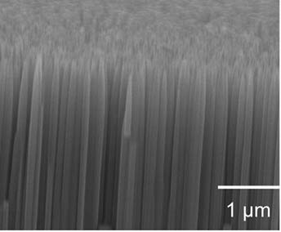
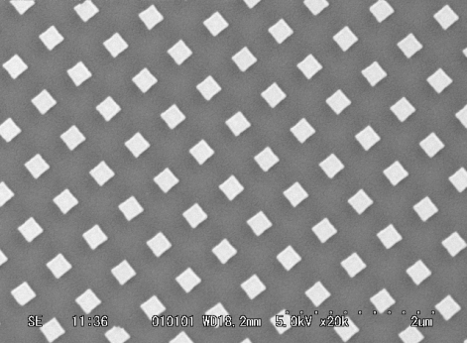
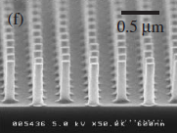
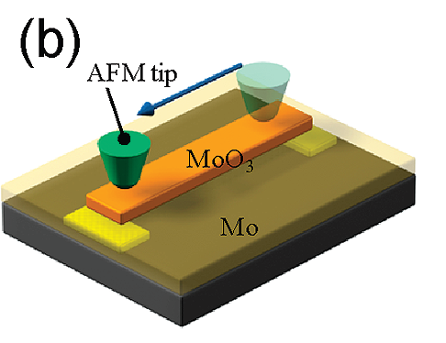
Nano processing procedure for metal oxides
Bottom up
technique
Top down
technique
High
Photo lithography
Nanoimprint
lithography
Pulse laser deposition
productivity
Mid
Appl. Surf. Sci. 253 1758(2006)
2 µm
Nanotechnology 20 395301 (2009)
Low
JJAP. 42 6721(2003)
Electron beam lithography
AFM lithography
1nm
10nm
100nm
1000nm
size
Nano Lett. 9 1962(2009)
Notes:
But metal oxides have high physical hardness and chemical stability.
So it is difficult to fabricate a few tens nanometer patterns with controlling shape and position.
This chart shows correlation chart of size and productivity.
Generally, to obtain nanostructures, top down techniques, for example photo lithography, EB lithography, nanoimprint lithography, and AFM lithography,
and bottom-up techniques, pulse laser deposition and so on, are applied.
Top down technique can control the position, and shape precisely(プレサイスリィ).
But it is difficult to fabricate a few nm size.
Bottom up technique can control size at atomic layer level.
But it is difficult to control position and shape of nanostructures.
I have been tried to fabricate the nanostructure by combining top down technique with bottom-up techniques,
so that the position, shape, and size controlled nanostructures can be fabricated.

Slide 7
Fabrication of well-defined epitaxial nanostructure
Three dimensionally
nanopatterned MgO
(3D-MgO)
Oxide
Resist
substrate
substrate
substrate
Top down technique
Position and shape
Bottom up technique
Size at atomic layer level
The position, shape, and size controlled nanostructures can be fabricated.
Notes:
I will show you three steps for fabrication of well-defined epitaxial nanostructure.
First step is resist nanopatterns by top down nanoimprint lithography.
The resist nanopatterns are high processing accuracy(アキュレイシィ) of side surface and high productivity and High reproducibility(プロデューシビリティ).
Second step is fabrication of MgO replica nanopatterns by bottom up pulse laser deposition and controlling MgO anisotropic growth.
MgO single crystal is used as a typical substrate for various epitaxial oxides.
MgO nanopatterns are enable high temperature deposition, which produce epitaxial oxide nanostructures.
Third step is high quality oxide nanostructures by glancing angle deposition of PLD.
As we deposit target oxide materials on the 3D-patterned MgO substrate by controlling the deposition thickness,
we can obtain the expected size nanostructures while retaining the original position and shape.
In Today’s presentation, I show fabrication of MgO nanopattern substrate.

Slide 8
Detail fabrication procedures
Three dimension MgO nanowire
mold
resist
MgO substrate
MgO substrate
MgO substrate
MgO substrate
1.cleaning substrate
2.spin coating
3.nanoimprint
4.RIE(CF₄,O₂)
（反応性イオンエッチング）
nanowire
MgO
oxide
MgO substrate
MgO substrate
MgO substrate
MgO substrate
8.PLD&ECR
7.annealing
6.removing resist
5.PLD(MgO)@RT
Notes:
This slide show detail fabrication precedures.
First, cleaning substrate.
Second, resist is spin coating.
Third, nanoimprinting to obtain original patterns.
Fourth, removing extra resist by Reactive Ion Etching.
Fifth, MgO deposited by PLD. Here, I should keep the substrate temperature at RT since the resist patterns are broken about two hundred degree Celsius.
Sixth, removing resist.
Seventh, annealing in order to crystalize MgO.
At Last, 3D-MgO substrate is used for the 3D oxide nanostructure.

Slide 9
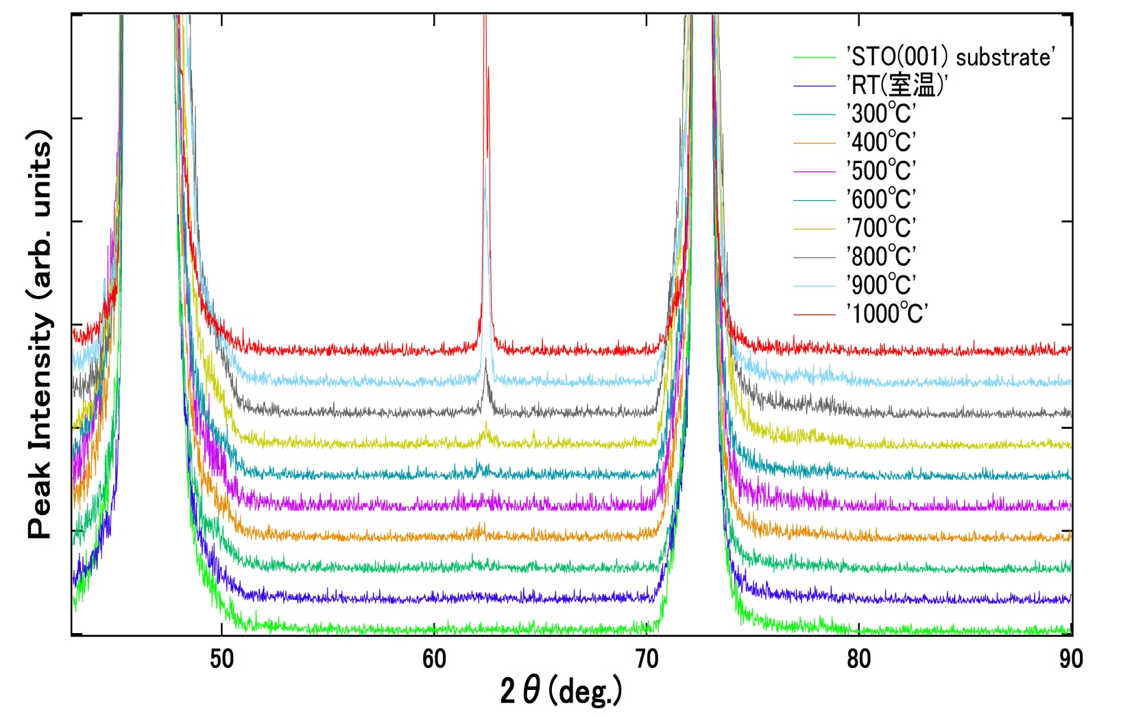
MgO crystallization condition by postanneal
3D-MgO
STO(002)
MgO(022)
STO(003)
STO substrate
STO substrate
MgO was crystallized by postannealing at 1000℃.
Notes:
I will show results.
I studied MgO crystallization temperature on STO(001) substrate using XRD.
Because of room-temperature deposition, as-grown MgO was not crystallized.
This figure show XRD curves for MgO deposited on STO(001) substrate with changing annealing temperature.
Three peaks appeared.
Two peak is STO substrate peak.
This peak is MgO(022) peak.
At seven hundreds degree celsius(セルシウス), this peak is appeared but small.
At one thousand degree celsius, this peak become intense.
This result show that MgO was crystallized by posetannealing above 700 degree Celsius and crystal quality improved with increasing temperature.
I decided the postannealing temperature is 1000 degree Celsius in this study.
9

Slide 10
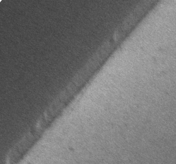
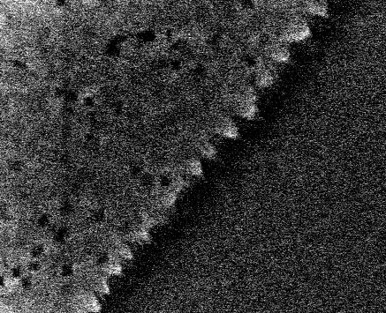
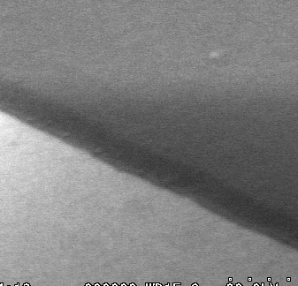
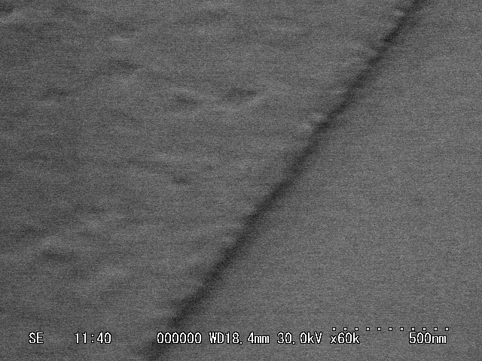
Anisotropic growth of MgO
（異方性成長）
Before anneal
After anneal
(1000℃)
Schematic diagram
3D-MgO
3D-MgO
3D-MgO
Zig-Zag line
substrate
[010]
[010]
[010]
[010]
MgO_{substrate}
MgO_{substrate}
[001]
[100]
MgO_{substrate}
[001]
[100]
500nm
[001]
[100]
500nm
[100]
3D-MgO
3D-MgO
3D-MgO
Parallel line
[110]
[110]
[110]
MgO_{substrate}
MgO_{substrate}
[001]
MgO_{substrate}
[001]
500nm
[001]
[110]
500nm
[110]
[110]
Notes:
It is known that MgO show strong anisotropic growth.
Therefore, I fabricate MgO nanopatterns of different direction against substrate to confirm anisotropic growth of MgO.
Left SEM image is before annealing nanopatterns.
Right SEM image is after annealing nanopattarns.
Although, there are little differences of the sidesueface structures among [010]-parallel and [110]-parallel MgO wires before annealing, quite different sidesurface structures were obtained after annealing.
[100] parallel wire had zigzag edge structures, and [110]-parallel wire had straight flat edge structure.
This difference is caused by MgO anisotropic growth and I will discuss them later.
10

Slide 11
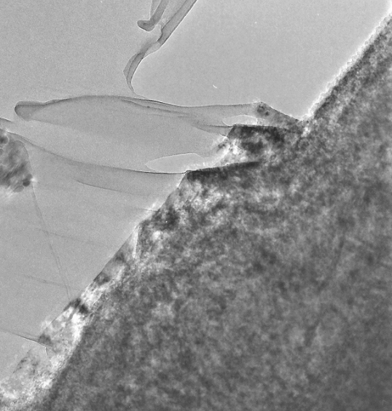

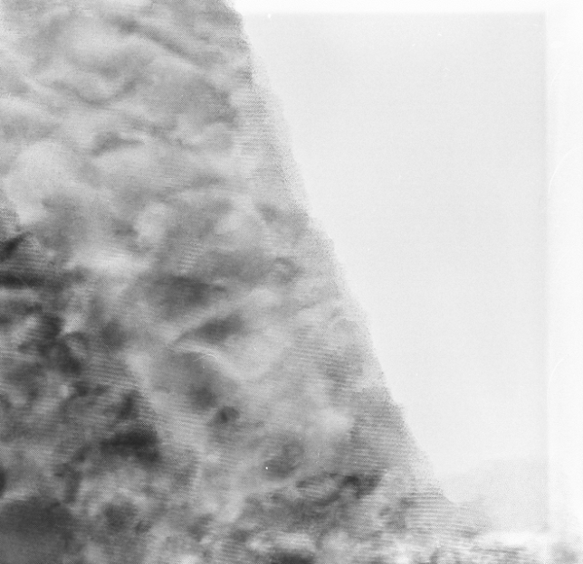

Structure analysis of MgO nanowire (TEM)
（透過型電子顕微鏡）
3D-MgO (FFT)
3D-MgO
MgO_{substrate}
200nm
Fracture
direction
MgO substrate(FFT)
[110]
3D-MgO
MgO_{substrate}
10nm
I confirmed that quality of crystallized 3D-MgO is similar to that of MgO substrates.
Crystal relation: 3D-MgO(001)[100]//MgO_{substrate}(001)[100].
（結晶方位関係）
（FFT : 高速フーリエ変換）
Notes:
I analyzed crystal structure of 3D-patternd MgO substrate by cross-section TEM.
Left figure is TEM image across the wire line
Right figure is magnified(マグニファイト) image of nanopattern edge.
These figures are FFT images 3D-MgO and MgO substrate regions.
The points in MgO substrate are coincident with those in 3D-MgO region.
So I confirmed that crystal quality of 3D-MgO is similar to that of MgO substrates.
TEM image also showed Crystal relation is 3D-MgO(001)face[100]derection//MgO_{substrate}(001)face[100]direction.
11

Slide 12

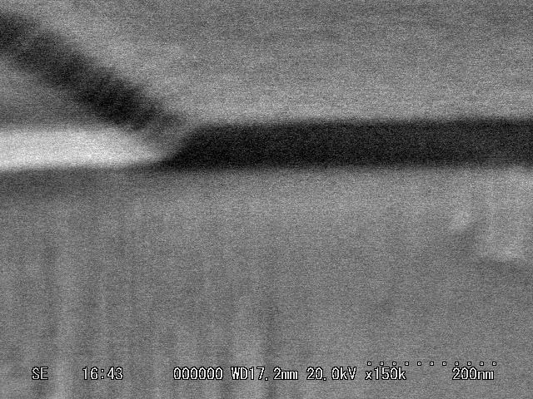
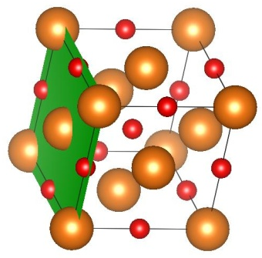
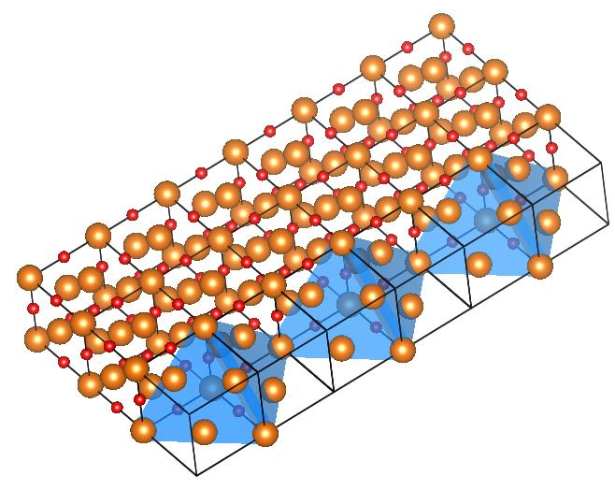
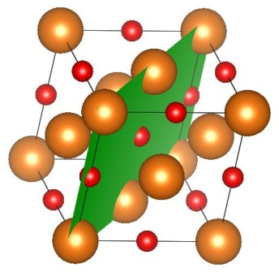
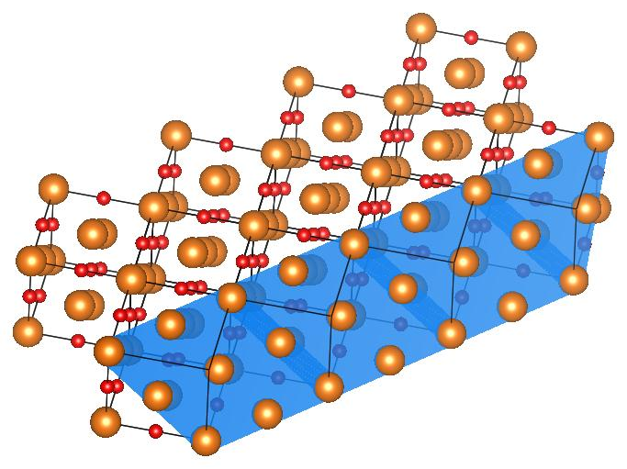
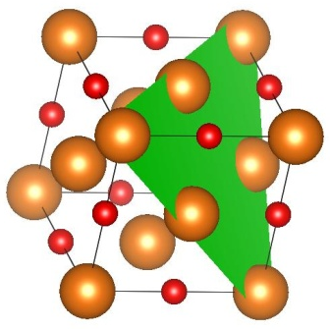
Sidesurfaces of 3D-MgO
Crosssection SEM image
After anneal (1000℃)
(111)
MgO(100)
: Mg
: O
3D-MgO(001)
Zig-Zag line
substrate
[100]
3D-MgO
MgO substrate
[010]
[010]
100nm
MgO(110)
MgO(001)_{substrate}
[001]
[100]
500nm
[100]
The angle between sidesurface and substrate surface is 55º.
Therefore, sidesurface is MgO(111).
3D-MgO(001)
[110]
(111)
Parallel line
[110]
MgO(111)
MgO(001)_{substrate}
[001]
[110]
500nm
To fabricate oxide nanowires, the straight sidesurfade is better,
that is, I want 3D-MgO nanowire with (100) sidesurface.
Notes:
This figure is cross-section SEM image of [110]-parallel wire.
They are schematic MgO (100), (110), and (111) crystal face.
The angle between sidesurface and substrate surface is fifty five degree.
This implies sidesurface is MgO(111) face. The (111) sidesurface consistent with the zig-zag edge on [010]-parallel line.
Therefore, I conclude sidesurface is (111)face.
To fabricate oxide nanowires, the straight sidesurface is better, that is, I want 3D-MgO nanowires with (100) sidesurface.
12

Slide 13
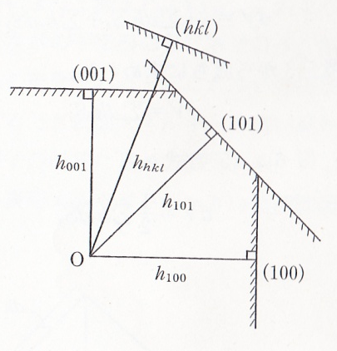

Wulff’s theorem
Wulff’s relational expression
Deposited MgO
Crystallized MgO
MgO substrate
expectation
MgO substrate
Surface energy
distance to surface
（表面エネルギー）
In fact
Bulk MgO (calc.)
Crystal face | Surface energy
(100) | 1.25 J/m²
(110) | 3.02 J/m²
(111) | 3.86 J/m²
Crystallized MgO
MgO substrate
J. Chem. Soc., Faraday Trans. 92 433(1996)
According to crystal surface energy we expected to produce (100) face.
Notes:
I thought the key point in obtaining (100) sidesurface is to control surface energy of MgO face.
The surface stability(スタビリティ) is expressed by Wulff’s theorem. According to Wulff’s relation, surface energy over distance to surface is constant.
σ is surface energy. h is distance to surface.
Equilibrium(イクィリブリアム) crystal shape is decided by surface energy.
This figure is how to illustrate equilibrium crystal shape by wulff’s relational expression.
For MgO crystal faces, surface energy of each surface is reported as shown in this table.
We can see (100) phase is most stable(ステイブル).
According to crystal surface energy we expected to produce (100) surface.
Indeed, sidesurface of crystallized MgO was (111). It was reported (111) surface energy reduces by surface contamination and so on.
In this case, the surface energy of (111) may be close to that of (100) value.
13

Slide 14
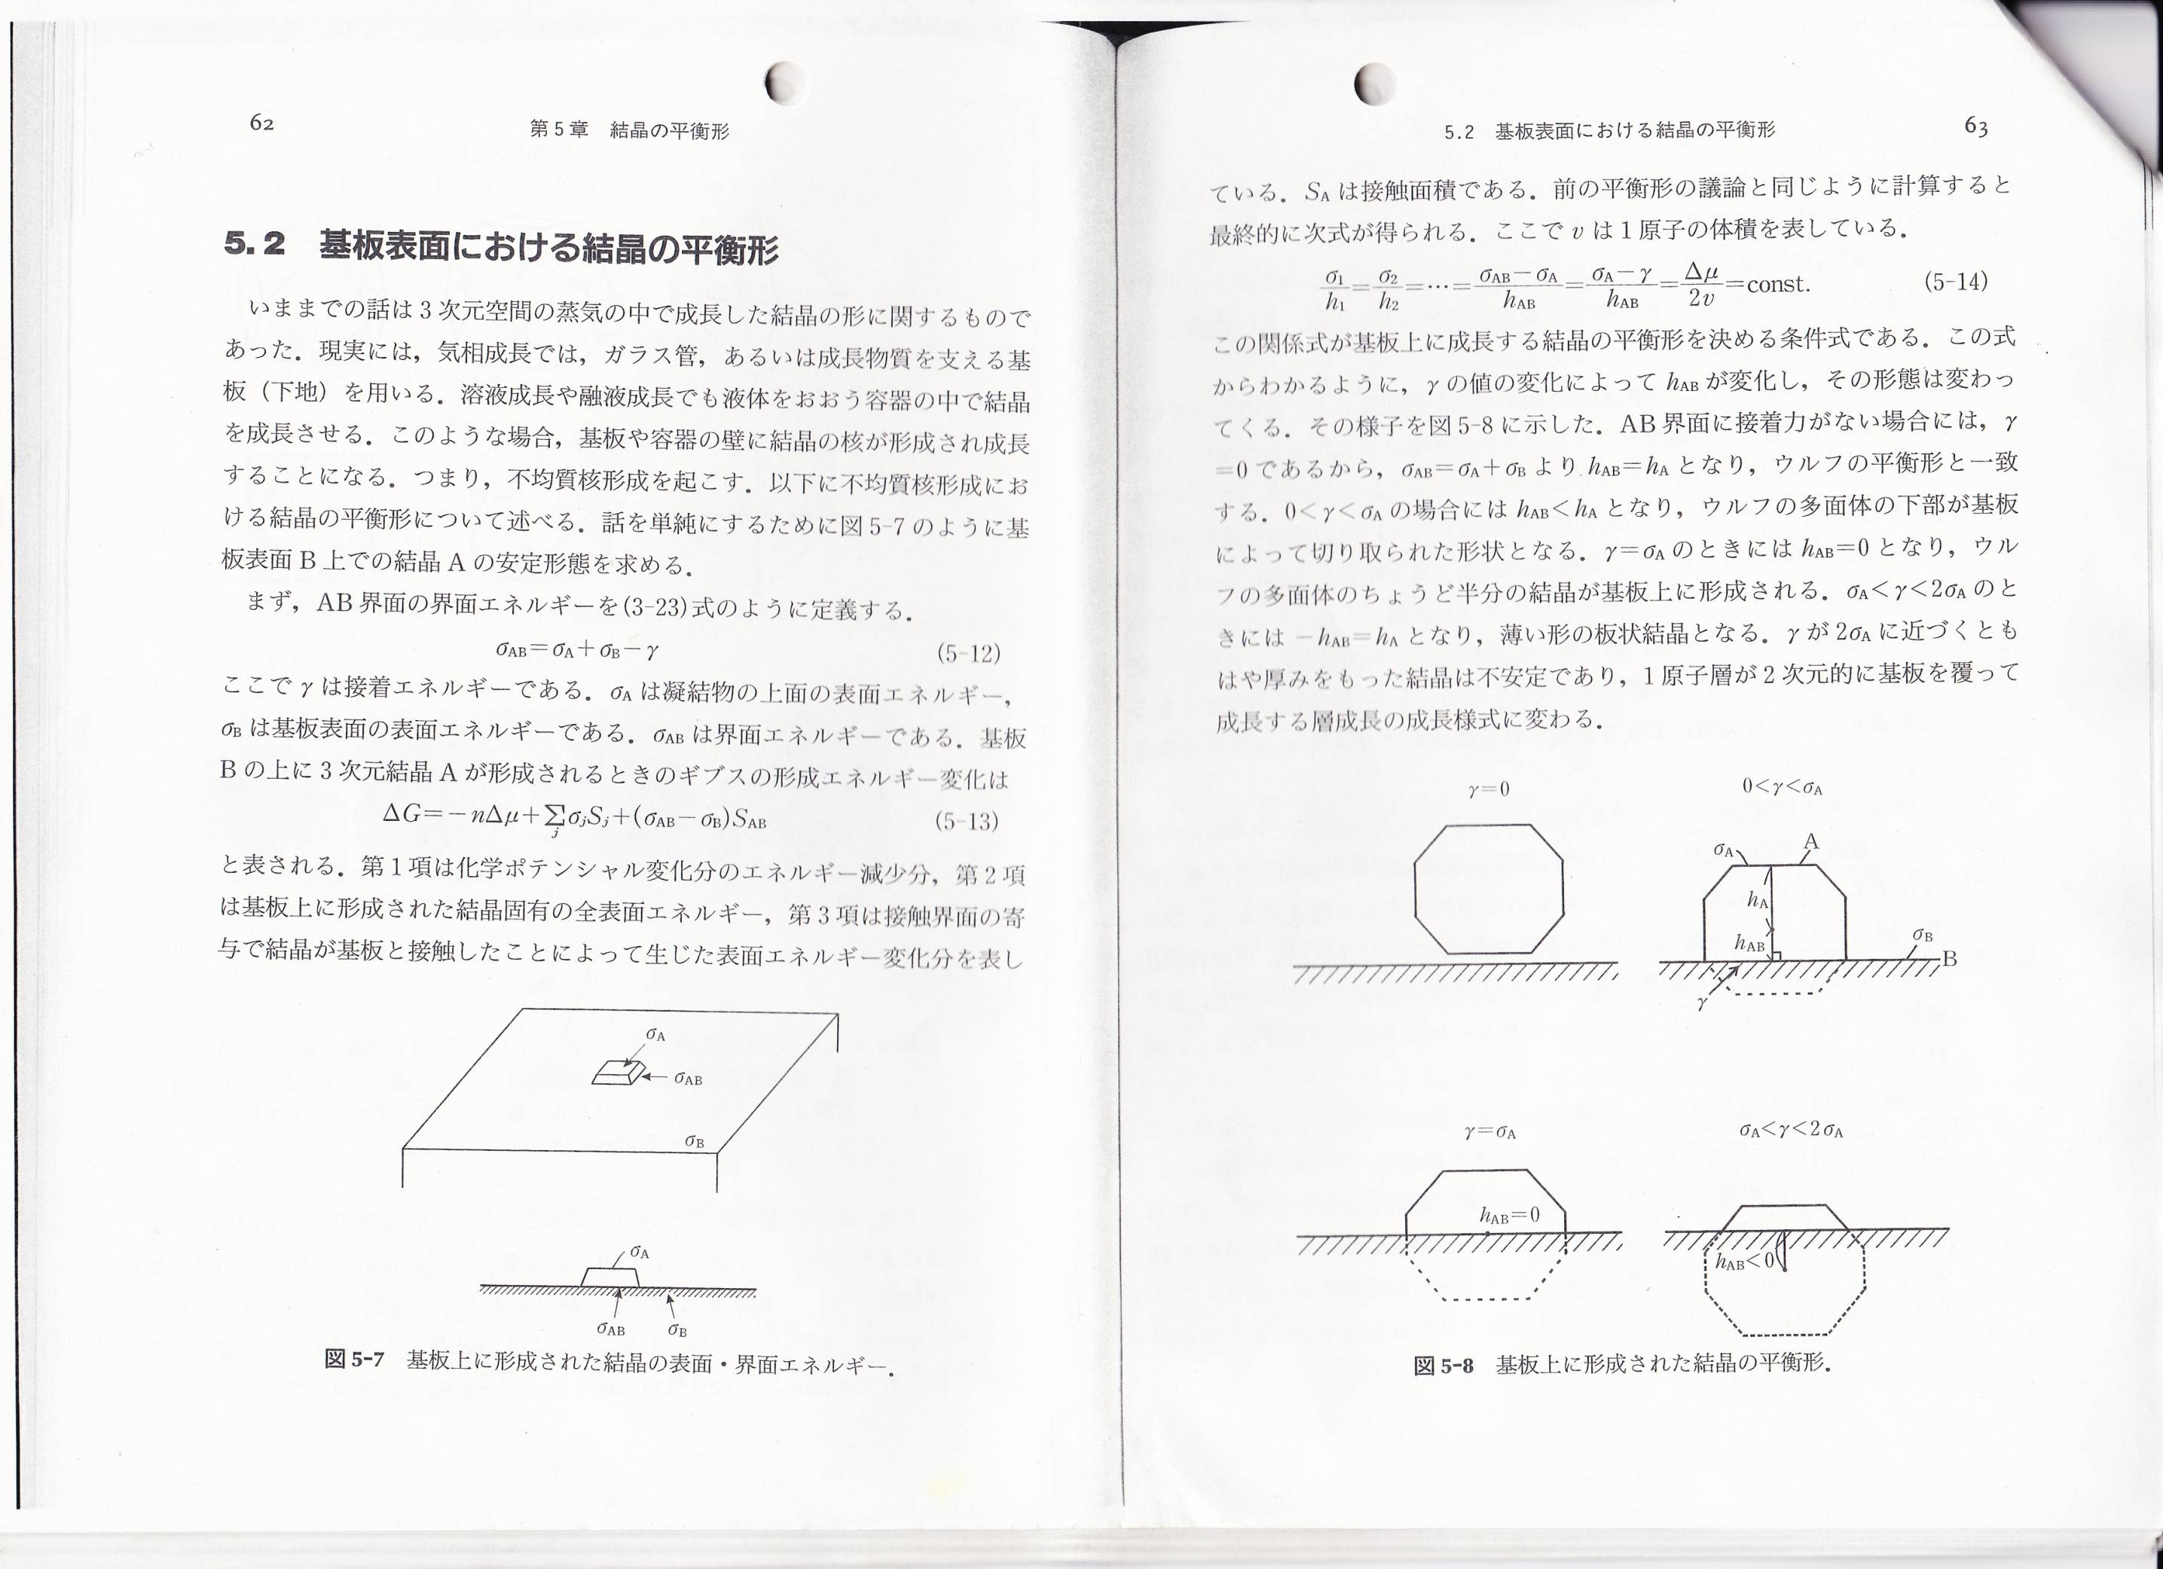
Approach to fabricate MgO(100) side surface
Equilibrium crystal shape
on substrate
Case of low-aspect ratio
σ₍₁₀₀₎ < γ < 2σ₍₁₀₀₎
（接着エネルギー）
(111)
γ = 0
σ_{A} < γ < 2σ_{A}
MgO substrate
expectation
Case of high-aspect ratio
γ = σ_{A}
0 < γ < σ_{A}
0 < γ < σ₍₁₀₀₎
(100)
MgO substrate
「結晶成長（材料学シリーズ）」（丸善） 後藤芳彦
Sidesurface could be changed from (111) face to
(100) face by increasing the aspect ratio.
Notes:
In addition to surface energy(エナジー), Equilibrium crystal shape on substrate is decided by value of adhesive energy between crystal and substrate.
γ is adhesive energy.
This figure shows the relationship between crystal and substrate defined with γ and σ.
Case of γ equal 0, a crystal does not contact on substrate.
Case of γ equal σ, half of crystal is buried(ベリード) in substrate.
Case of γ is less than σ and bigger than 0, a part of crystal is located on substrate.
Case of γ is less than 2σ and bigger than σ, almost all parts of crystal is located on substrate.
This relation provide us one scenario:
Sidesurface could be changed from (111) facet to (100) face by increasing the aspect ratio.
14

Slide 15
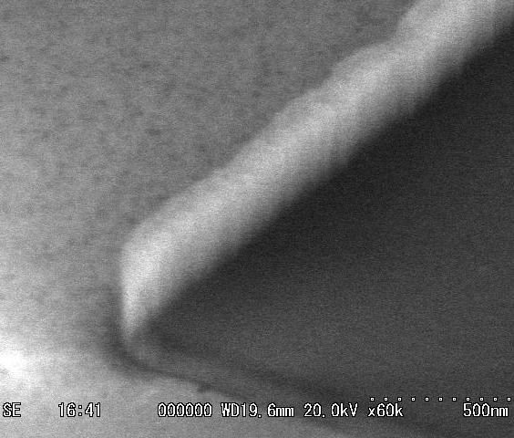
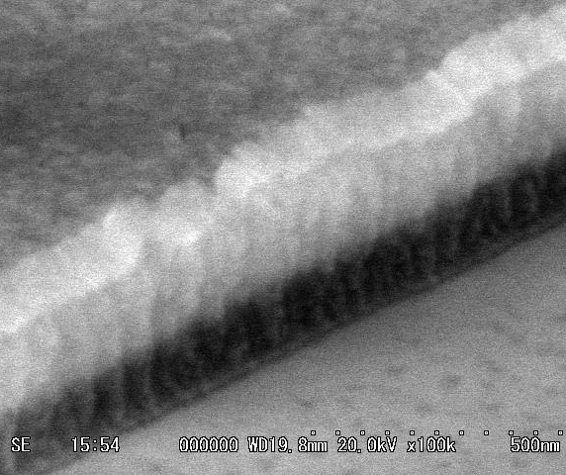
Fabrication of MgO nanostructure
MgO
[100]
[100]
annealing
Temperature:1000℃
O₂ pressure:10⁻⁴Pa
MgO substrate
500nm
MgO substrate
[001]
MgO substrate
5.PLD(MgO)
6.removing resist
7.annealing
[001]
[010]
[010]
300nm
Modify Fabrication process
MgO
MgO substrate
MgO substrate
MgO substrate
Sidewall deposition@RT
Removing resist
Annealing 1000℃
Notes:
To increase the aspect ratio, I modified fabrication process.
Upper is previous process.
Bottom one is modified process.
I modified deposition method from normal deposition to sidewall deposition.
Sidewall deposition produced high aspect ratio MgO nanowires as shown in this figure.
Right figure is after annealing at one thausand degree. We can see the nanowires with flat (100) sidesurface.
I succeed to fabricate the three dimensional nanopatterned MgO substrates.
15

Slide 16
Conclusion
I tried to fabricate the three dimensionally nanopatterned MgO substrates.
I found that sidesurface of MgO nanowire was (111) face at low aspect ratio.
I modified the fabrication process, and succeed in fabrication of the MgO nanowires structure with flat (100) sidesurface.
I have been trying to fabricate nanowire structures on the 3D-MgO nanowire substrate, and study their magnetic properties.
MgO substrate
Future plan
MgO substrate
Notes:
At last, I Conclude my talk.
I tried to fabricate the three dimensionally nanopatterned MgO substrates.
I found that sidesurface of MgO nanowire was (111) face at low aspect ratio.
I modified the fabrication process, and succeed in fabrication of the MgO nanowires structure with flat (100) sidesurface.
In the Future plan.
I have been trying to fabricate nanowire structures on the 3D-MgO nanowire substrate, and study their magnetic properties.
Thank you for your kind attention.
16

