Slide 1
Controlling the thickness of CuCl thin films and improving their quality by means of MBE method
Ashida lab. M1 Kamizono Kenta

Slide 2
Contents
Introduction
All-optical switching devices
Excitons and light in the high-quality system
Background
Previous results
Temperature dependence of DFWM spectrum
Purpose
Experimental results
Summary
DFWM(Degenerated Four Wave Mixing):縮退四光波混合

Slide 3
Introduction
All-optical switching devices 光スイッチ
All-optical switching devices
all-optical information processing
superior performances than electronic communication devices
transmission rate 伝送効率
energy efficiency エネルギー効率
Realization
by nonlinear optical effect
非線形光学効果
Optical switching device
Transient grating
過渡回折格子
Probe pulse
Signals
Pump pulses

Slide 4
Introduction
Exciton and trade-off problem
Exciton
Trade-off problem
high efficient response 高効率応答
available in the micro crystal
Low consumption energy
低消費エネルギー
resonance between light and excitons
+
High response speed 高速応答
nonresonance between light and excitons
-
Means of confining excitons in the micro crystal
can break down this problem.

Slide 5
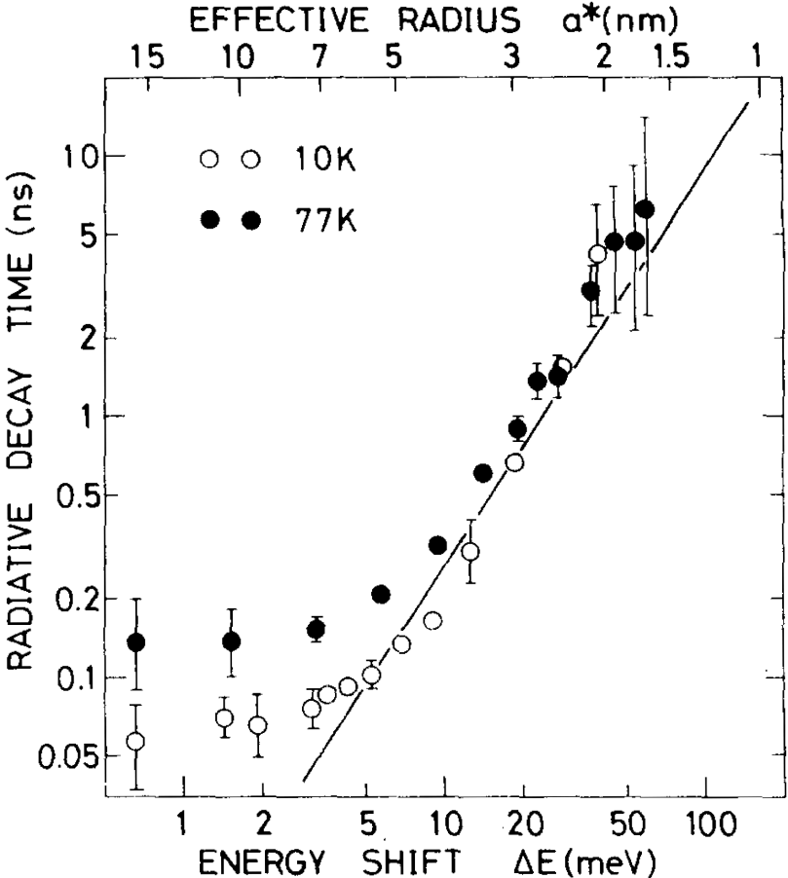
Introduction
Spatial interplay between waves of excitons and light
Ref: T. Itoh, M. Furumiya, and T. Ikehara, Solid State Commun. 73, 271 (1990).
Nanostructure
Long wavelength approximation (LWA) regime 長波長近似領域
Light
n = 4
n = 3
n = 2
n = 1
Exciton
over LWA
size << wavelength of light
dominant interplay between the exciton of lowest state and light
Oscillator strength increases with the system size.
Dependence of the exciton radiative decay time in CuCl microcrystals

Slide 6
Introduction
Excitons and light in the high-quality system
Nanostructure
LWA regime
System where exciton wave functions are coherently extended to the whole volume
Light
Light
n = 4
n = 3
n = 2
n = 1
Exciton
Exciton
Ultrafast response
beyond LWA regime
Coupling of multinode-type excitons with light
The coupling with the size increase is not limited.

Slide 7
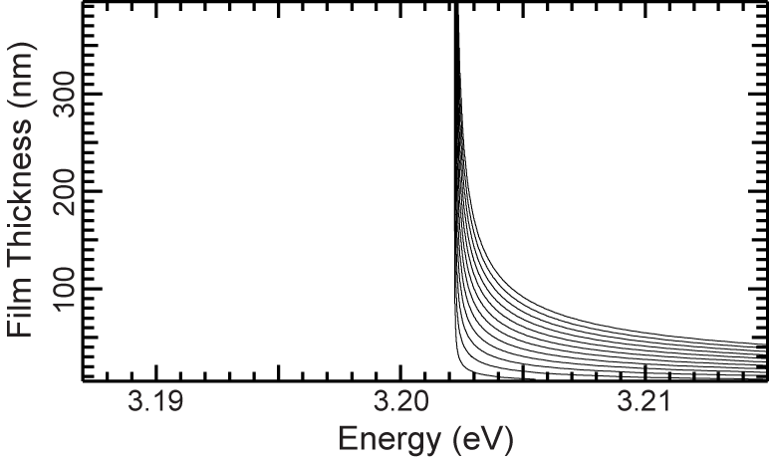
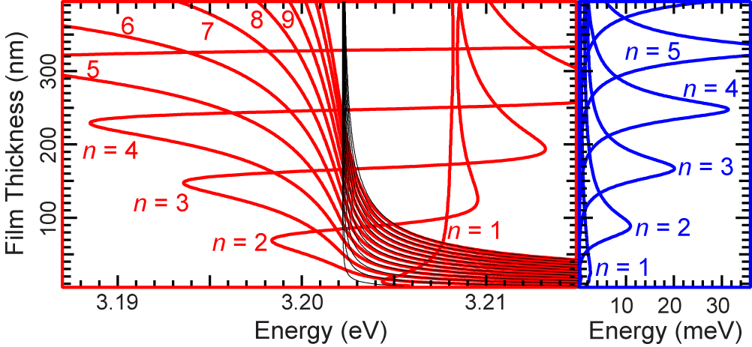
Introduction
Radiative corrections (輻射補正)
in the coupled system of photons and excitons
Ref: H. Ishihara, J. Kishimoto and K. Sugihara, J. Lumin. 108, 343 (2004).
Size dependence of radiative corrections for the CuCl Z3 exciton (theory)
Real part of radiative corrections
Imaginary part of radiative corrections
Uncoupled excitonic modes
Eigenenergy including the radiative shift
Radiative width:Γn
330 nm
τ :radiative decay time
τ = ħ/2Γ_{n}

Slide 8
Background
Property of CuCl
direct transition semiconductor
E
Cu⁺
Cl⁻
Z1,2
Z3
Zinc Blend
ｋ
large exciton binding energy (200 meV)
small exciton Boar radiance （0.7 nm)
The center-of-mass confined effect of excitons is available.
Suitable material
for research of the center-of-mass confined effect of excitons

Slide 9
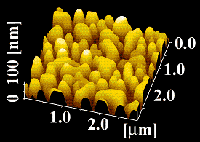
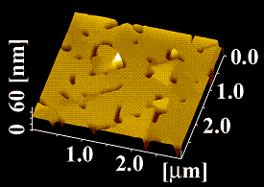
Background
Growth of high-quality CuCl thin films
AFM image of high-quality CuCl thin film (by RHEED)
AFM image of CuCl thin film
Atomic Force Microscope ; AFM
CaF₂ cap layer
40 nm
CuCl layer
CaF₂ buffer layer
40 nm
CaF₂(111) substrate
1 mm
e-beam-exposed
 | Lattice constant
CaF₂ | 0.5463 nm
CuCl | 0.5406 nm
Surface morphology is extremely improved by electron beam irradiation.

Slide 10
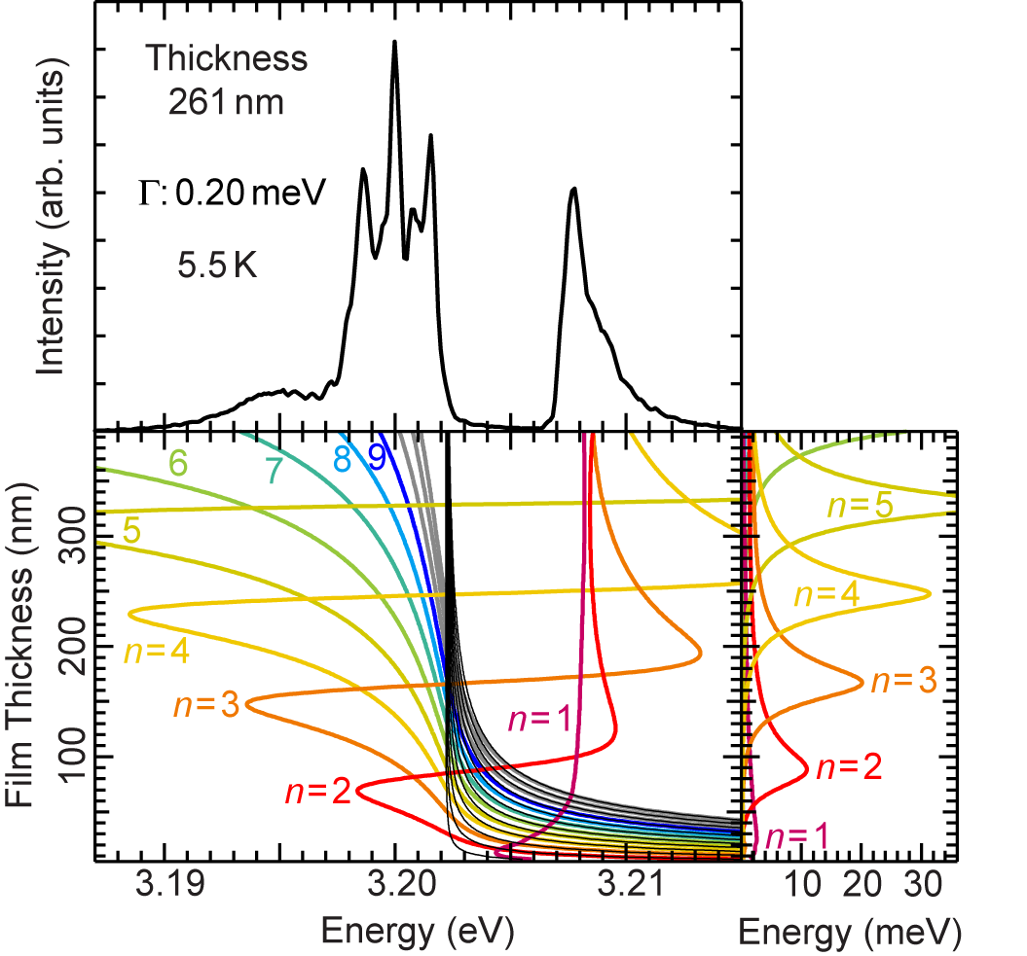
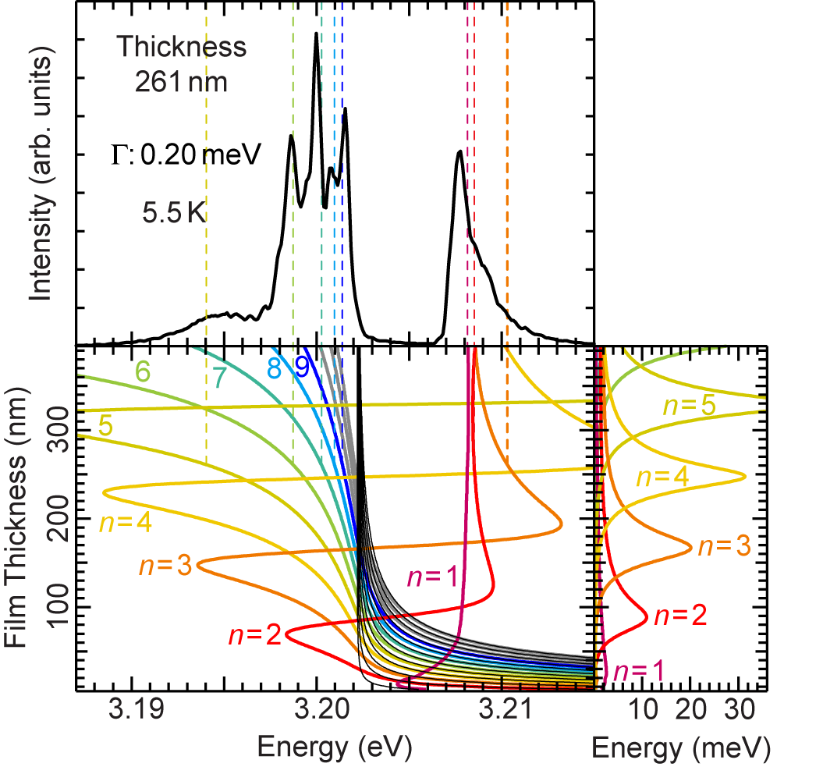
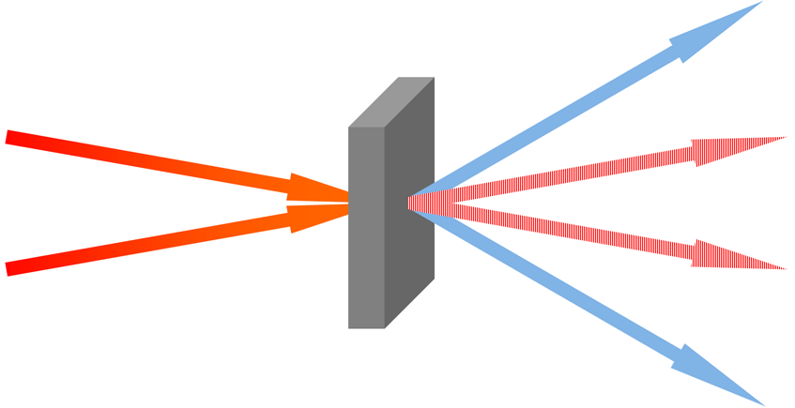
Previous results
Mode structures of DFWM spectrum
in a high-quality CuCl thin film
M. Ichimiya, M. Ashida, H. Yasuda, H. Ishihara, and T. Itoh, Phys. Rev. Lett. 103, 257401 (2009)
Degenerated Four Wave Mixing（DFWM）
2k₂ｰ k₁
k₁
k₂
2k₁ｰ k₂
261 nm
Several peak structures appear.
Good agreement with eigenenergy including the radiative shift
Eigenenergy including the radiative shift
Radiative width

Slide 11
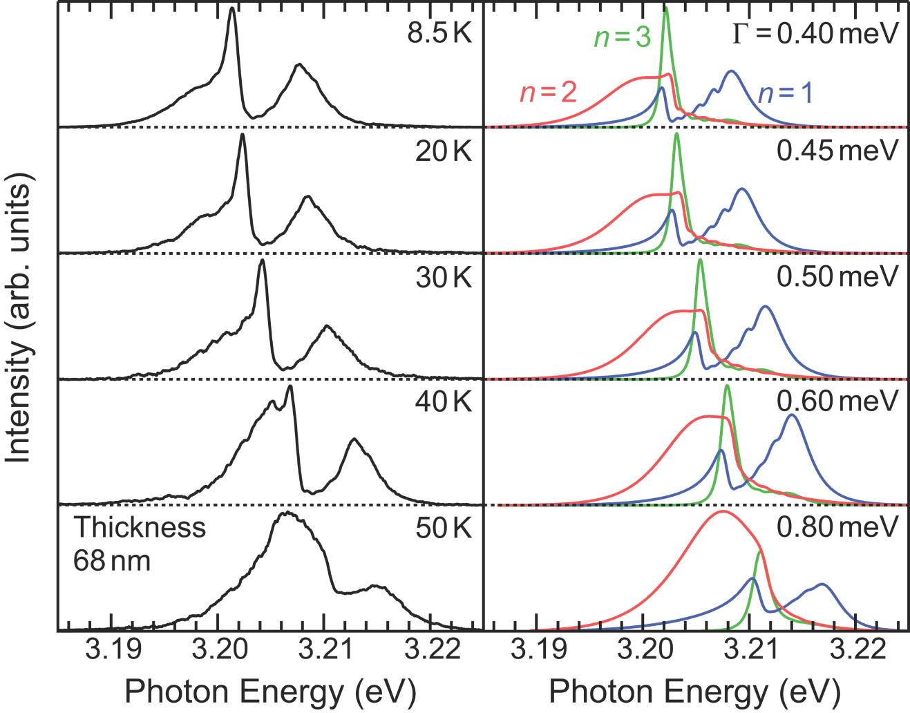
Previous results
Temperature dependence of DFWM spectrum (68 nm)
Calculated induced
polarization spectra
Radiative width (meV)
DFWM spectra
n = 1
n = 2
n = 3
1.8
5.0
0.29
Both spectral dependences are same.
A component for n=2 becomes dominant as the temperature increases.
The excitonic state with the largest radiative width may be observed at high temperatures.

Slide 12
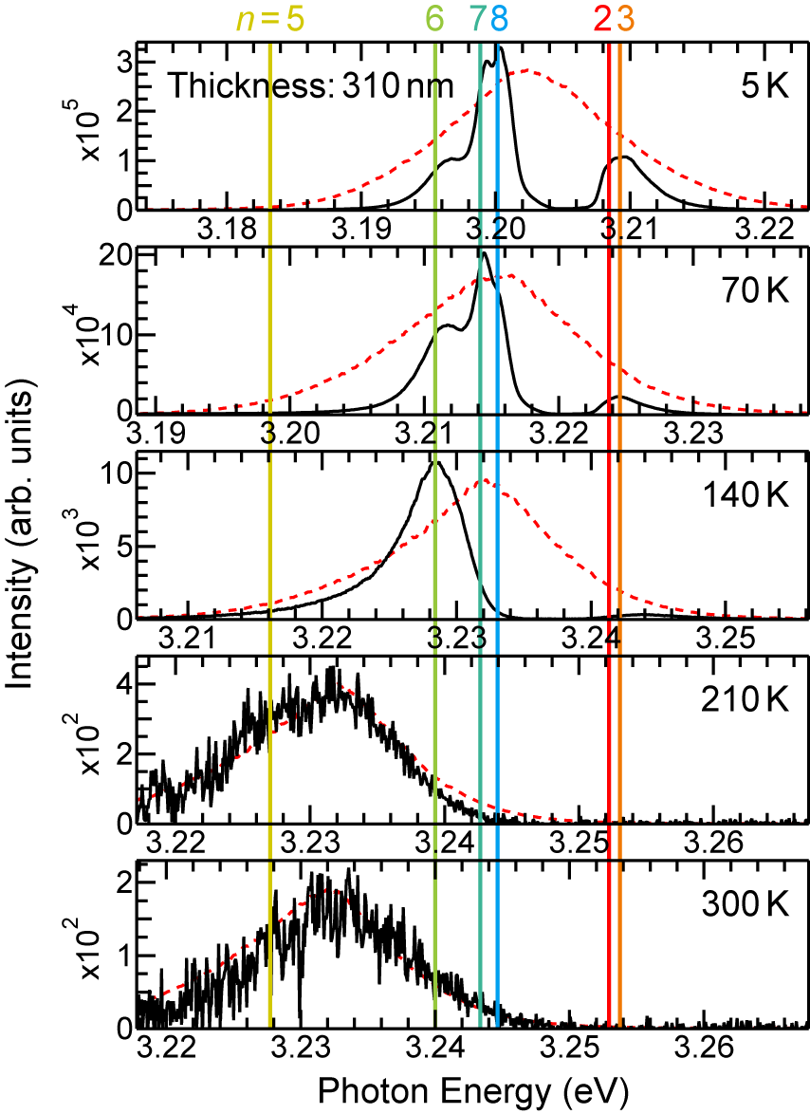
Previous results
Temperature dependence of DFWM spectrum (310 nm)
M. Ichimiya, K. Mochizuki, M. Ashida, H Yasuda, H. Ishihara, and T. Itoh, Phys. Status Solidi B 248, 456–459 (2011)
Radiative width (meV)
n = 5
n = 6
n = 7
n = 8
19
1.4
0.46
0.27
Spectral shape changes as temperature increases.
Components with smaller radiative width disappear at lower temperatures.
A component for n = 5 becomes dominant and only the state is observed above 210 K.
DFWM signal can be observed
at room temperature!

Slide 13
Purpose
Light
Light
Exciton
Exciton
High-quality
Deciding the condition of fabricating CuCl thin film by means of molecular beam epitaxy (MBE) method (329nm)
Fabricating high-quality CuCl thin film on improving the quality
Realizing ultrafast radiative decay by the curtain thickness on large radiative width
Enhancement of DFWM signal on improving the quality of CuCl thin film
Realization of efficient and ultrafast
radiative decay above room temperature

Slide 14
Experimental Procedure
Molecular Beam Epitaxy (MBE) method
pump
melting pot
CuCl layer
329 nm
substrate
CaF₂ buffer lay
40 nm
screen
RHEED
CaF₂(111) substrate
1 mm
shutter
CuCl layer
substrate temperature
: 50~150 ⁰C
growth rate: 0.13 nm/s
oscillator crystal
shutter
CaF₂ buffer layer
substrate temperature
: 600 ⁰C
growth rate : 0.02 nm/s
K-cell
CaF₂
CuCl
Vacuum
1.0×10⁻⁶ ～ 9.0×10⁻⁷ Pa

Slide 15
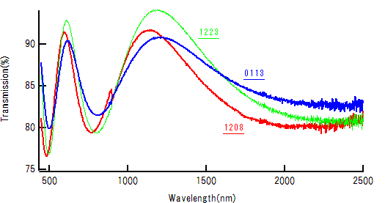
results
Transmission of normal incident light
in the transparent region (150 ℃)
L
$$m_{λ}$$
n = 2
n = 1
Light
$$m_{λ}L= \frac{nλ}{2}$$
 | crystal oscillator |  | measured thickness |  | substrate temperature
’10 12/09 | 150nm |  | ×2.0 | 300nm | 150℃
‘10 12/23 | 162nm |  | ×1.9 | 309nm | 150℃
‘11 01/13 | 172nm |  | ×1.8 | 314nm | 150℃
The difference is not same.
CuCl evaporate
on the substrate again.
Lower substrate temperature

Slide 16
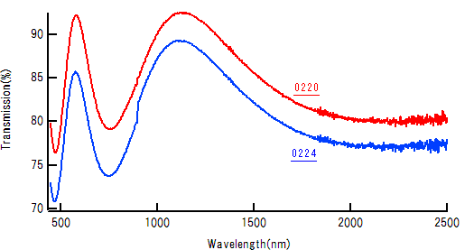
results
Transmission of normal incident light
in the transparent region (130 ℃)
L
$$m_{λ}$$
n = 2
n = 1
Light
$$m_{λ}L= \frac{nλ}{2}$$
 | crystal oscillator |  | measured thickness |  | substrate temperature
’11 02/20 | 172nm |  | ×1.7 | 293nm | 80℃
‘11 02/24 | 172nm |  | ×1.7 | 290nm | 130℃
The differences are same at lower substrate temperature.
What quality does the CuCl thin film have

Slide 17
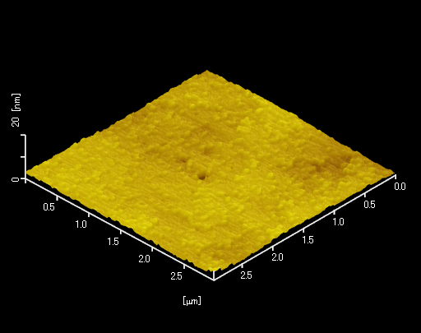
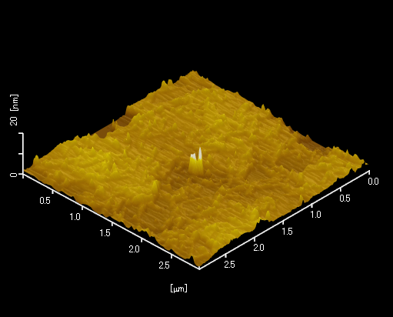
results
AFM image (150℃)
’11 01/13
’10 12/23
20 nm
20 nm
3 μm
3 μm
 | crystal oscillator |  | measured thickness |  | substrate temperature
‘10 12/23 | 162nm |  | ×1.9 | 309nm | 150℃
’11 01/13 | 172nm |  | ×1.8 | 314nm | 150℃
Surface morphology is extremely-good.

Slide 18
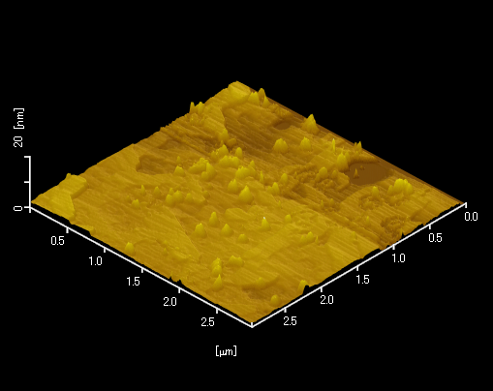
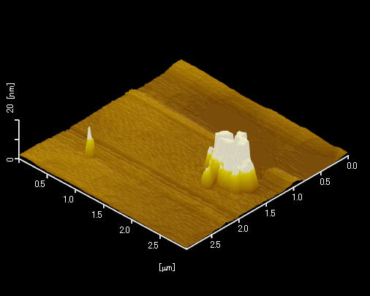
results
AFM image (under 130℃)
’11 02/20
’11 02/24
20 nm
20 nm
3 μm
3 μm
 | crystal oscillator |  | measured thickness |  | substrate temperature
’11 02/20 | 172nm |  | ×1.7 | 293nm | 80℃
‘11 02/24 | 172nm |  | ×1.7 | 290nm | 130℃
Surface morphology is extremely-good.
Which is better,
high substrate temperature or low?

Slide 19
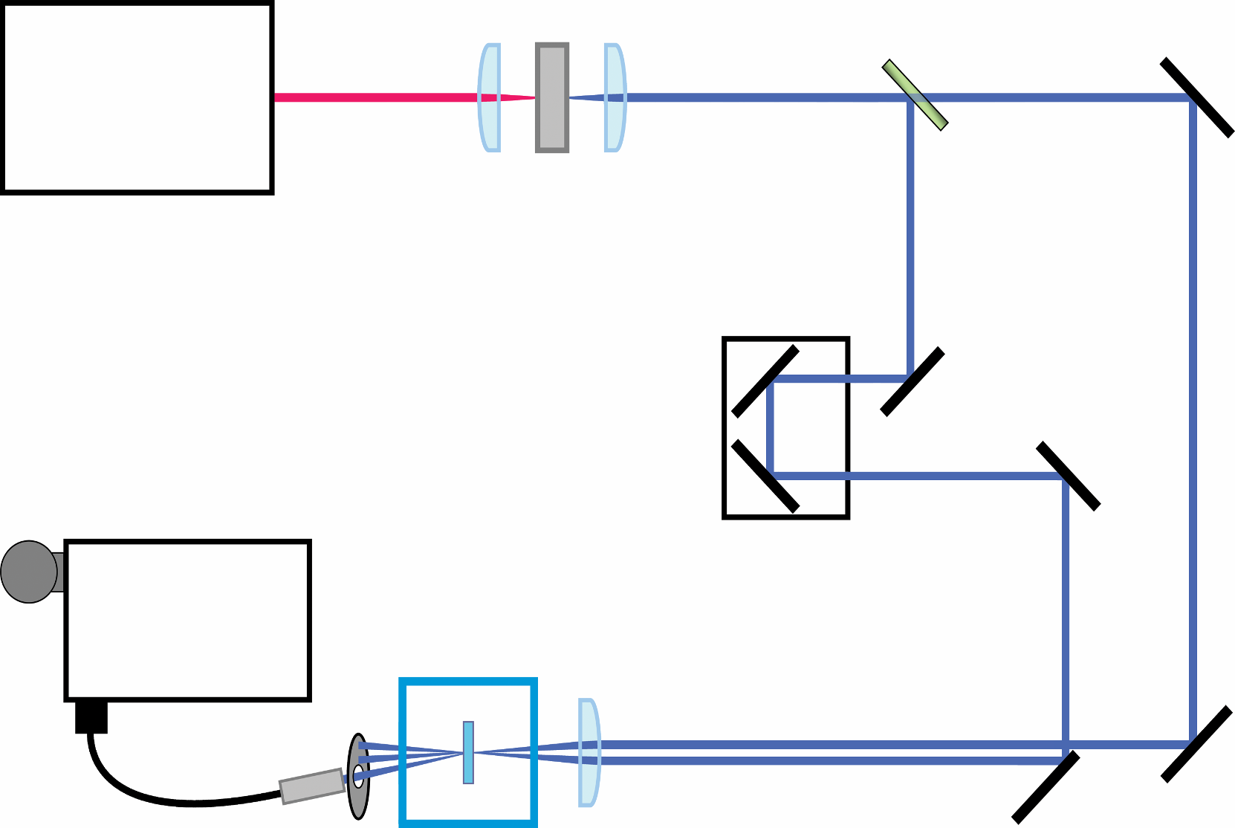
Experimental configuration
Degenerated Four Wave Mixing (DFWM) spectroscopy
SHG crystal
BS
Mode-locked
Ti:sapphire laser
Pulse width:110 fs
Repetition:80 MHz
wavelength：387nm
CCD
Monochro-
mator
Cryostat(6K)
Optical fiber
Sample (CuCl)

Slide 20
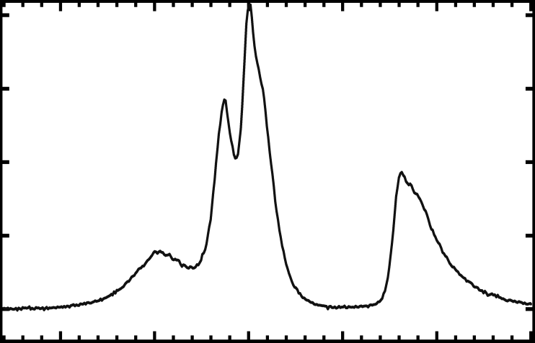
results
DFWM spectrum in high-quality CuCl thin film (150℃)
Thickness
313nm
6K
 | measured thickness | substrate temperature
’11 01/13 | 313nm | 150℃
Photon energy of each peak is in good agreement.
Sharp peak structures appear.
313 nm
High-quality
CuCl thin film

Slide 21
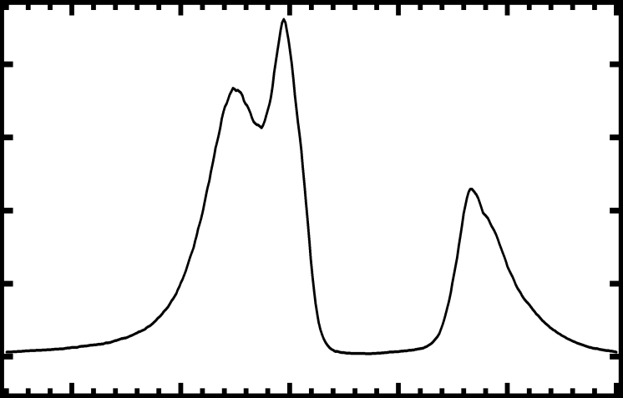
results
DFWM spectrum in high-quality CuCl thin film (50℃)
 | measured thickness | substrate temperature
‘11 02/21 | 235nm | 50℃
Thickness
235nm
6K
DFWM spectrum depends on the thickness of CuCl thin film.
Photon energy of some peak is in good agreement
Peak structures with small radiative width don’t appear
This CuCl thin film is not so high-quality
235 nm
High substrate temperature is important.

Slide 22
Summary
 | thickness | substrate temperature
Best condition | 329nm | 130℃
Evaporation on the substrate of CuCl thin film
The difference between the crystal oscillator and measured thickness is not same (150℃), but it is same (130℃).
Surface morphology
Surface morphologies (150 and 130℃) are extremely-good.
DFWM spectrum
Sharp peak structures appear (150℃).
DFWM spectrum depends on the thickness of CuCl thin film.

Slide 24
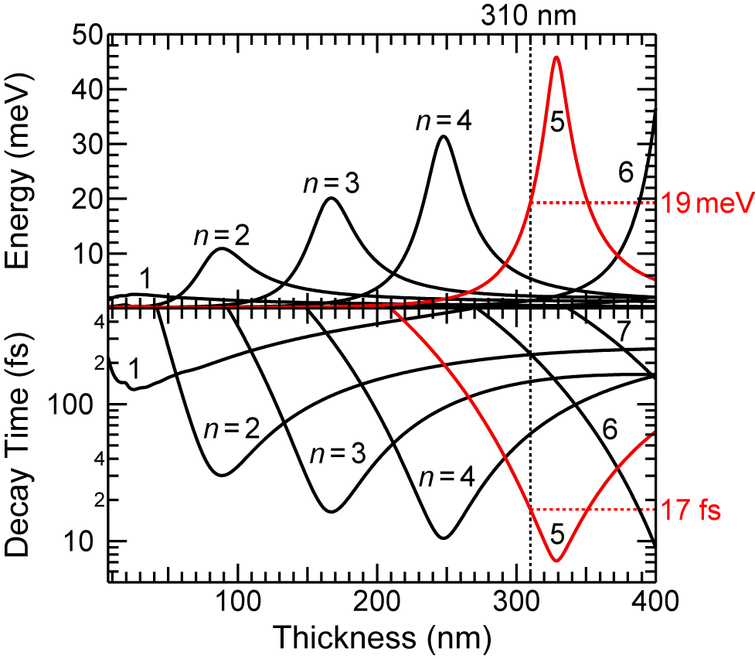
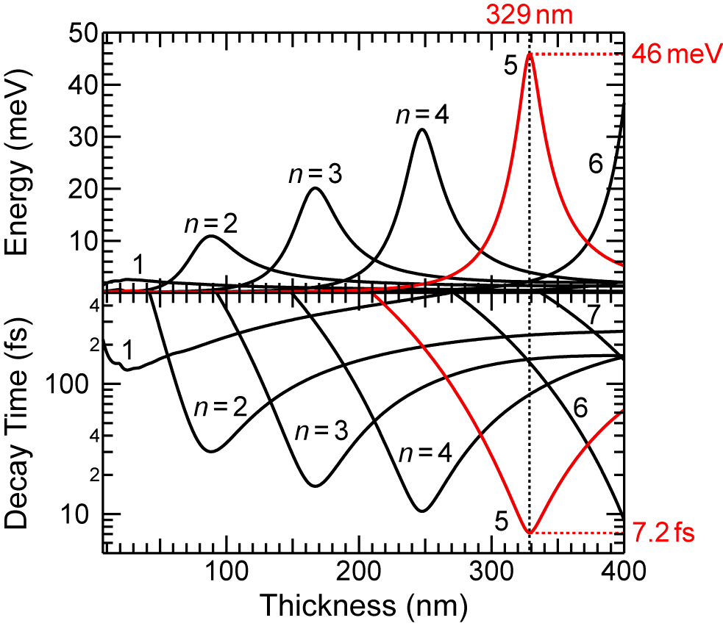
Previous results
Radiative width and decay time (310 and 329nm)
Film thickness dependence
of calculated radiative width
n=5 exciton maintains high efficient radiative decay beyond nonradiative decay.
Optimizing the thickness of CuCl thin film will realize ultrafast radiative response than 10 fs.
Film thickness dependence
of calculated radiative decay time

Slide 25
Reflection High Energy Electron Diffraction (RHEED)
e-beam
substrate
CaF₂ cap layer
40 nm
CuCl layer
e-beam-exposed
CaF₂ buffer layer
40 nm
CaF₂(111) substrate
1 mm

Slide 26
Background
Growth of high-quality CuCl thin films
by e-beam exposed
H. C. Lee et al. Japan J. Appl. Phys. 26. 11. pp. L1834-L1836. 1987
Ga
GaAs
As
F defection
E-beam exposed
CaF₂
F

Slide 27
Background
縮退四光波混合(DFWM)
過渡回折格子
プローブ光
DFWM信号
ポンプ光
２本のポンプ光が入射して、過渡回折格子が生成される。
過渡回折格子によって、プローブ光が回折される。
信号光が観測される。
２本ポンプ光とプローブ光の時間差が０
非線形光学強度
ポンプ光間の時間差が０
過渡回折格子の緩和
Notes:
２本のパルス光を同一箇所に照射すると、干渉によって励起子の励起を起こす。 これが回折格子としての役割を果たすため（過渡回折格子）、入射光の回折による信号光を観測できるようになります。

Slide 28
CuCl CaF₂
Zinc Blend
Fluorite
Cu⁺
Ca²⁺
Cl⁻
F⁻

Slide 29
Future prospect
Fabricating the CuCl thin film (320~340nm, 130℃)
To keep high-quality of sample, fabricating cap layer
Measuring the quality of CuCl thin film by DFWM spectroscopy
DFWM spectrum in a CuCl thin film having cap layer (<10K)
CaF₂ cap layer
40 nm
CuCl layer
329 nm
First
After
CaF₂ buffer layer
40 nm
CaF₂(111) substrate
1 mm
Advantage of cap layer
Saving CuCl thin film from degradation
Repeating experiments
Leaving it out in the air for 30 hours

Slide 30
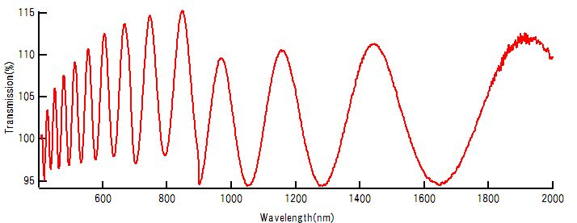
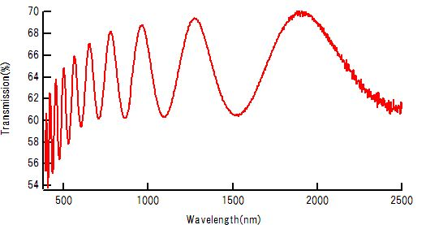
results
Transmission
’10 11/18
 | crystal oscillator |  | measured thickness
’10 11/18 | 250nm |  | ×6.0 | 1500nm
‘10 12/15 | 165nm |  | ×6.0 | 988nm
’10 12/15

Slide 31
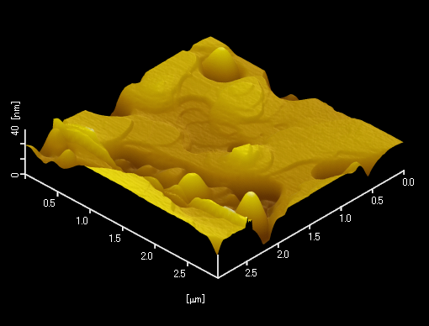
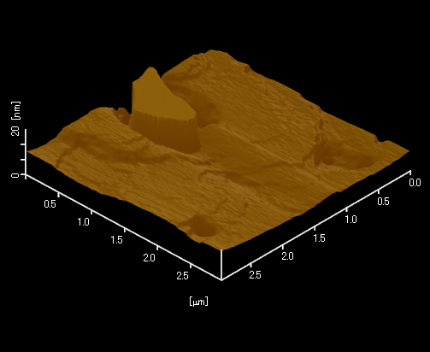
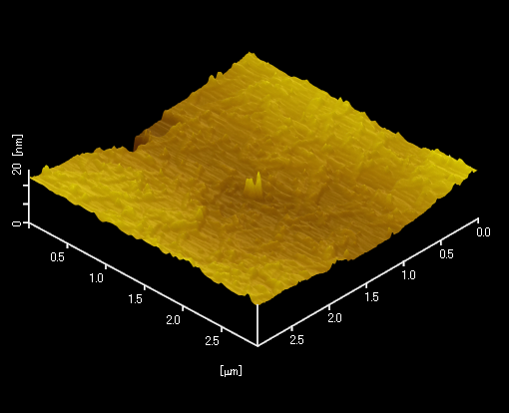
results
AFM image
‘10 11/18
‘10 11/11
40 nm
20 nm
3 μm
3 μm
‘10 12/15
 | crystal oscillator |  |  | measured thickness | growth rate
’10 11/18 | 250nm |  | ×6.0 | 1500nm | 0.32nm/s
‘10 12/15 | 165nm |  | ×6.0 | 988nm | 0.11nm/s
‘10 11/11 | 200nm |  | ×6.0? | 1200nm? | ?
20 nm
3 μm

Slide 32
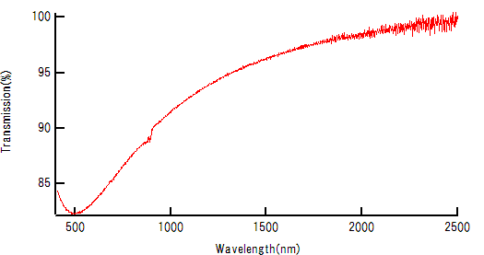
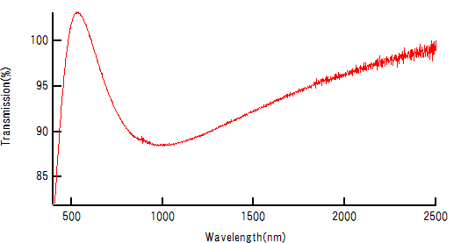
results
Transmission
10,11/30
 | crystal oscillator |  | measured thickness
’10 11/30 | 25nm |  | ×6.0 | 64nm
‘10 12/02 | 60nm |  | ×6.0 | 130nm
10,12/02

Slide 33
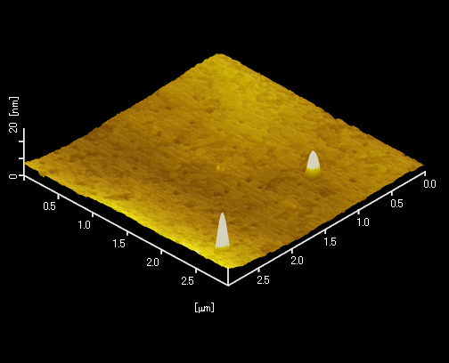
results
AFM image
‘10 12/02
20 nm
3 μm
‘10 12/02
 | crystal oscillator |  | measured thickness |  | growth rate
‘10 12/02 | 60nm |  | ×6.0 | 130nm | 0.06nm/s

Slide 34
