Slide 1
Dynamics and Mechanisms of
the Multiphoton Gated Photochromic Reaction
of the Highly Fluorescent Diarylethene Derivatives
Miyasaka Lab
Kunishi Tomohiro

Slide 2
Contents
Introduction
The definition of the Photochromism
Application and Conditions required for
the photochromic molicules in the application
The highly fluorescent Diarylethene derivative
Results & Discussion
The dynamics of the excited state
Summary
The prospect for the future

Slide 3
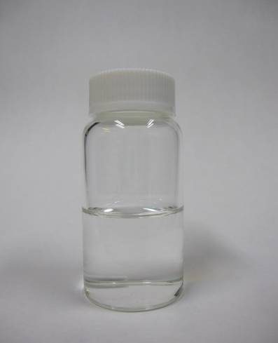
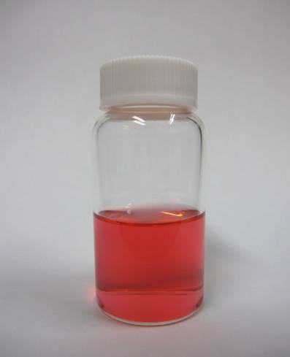
Introduction
1
Photochromism
the reversible photoinduced isomerization reactions
between two isomers
Example (Diarylethene in solution)
UV light
Open form
Vis. light
Closed form

Slide 4
Introduction
2
Application of Photochoromic Molecules
Quick property change
Absoption spectra
Refractive indices
Redox potential
etc.
Application
Photo-electronic devices
Photo-memories
Photo-switches etc.
Fluorescent dyes
for super-resolution microscopy

Slide 5
Introduction
3
Conditions required the Photochromic Systems toward the
Actual Application(memories and switchable fluorescent dyes)
Thermal stability of both isomers
Low fatigue
Rapid response
High sensitivity
Non-destructive performance
<memory>
The colored state should keep its color while it is written in the memory
<switchable fluorescent dyes>
The fluorescent emission should be kept when the molecule is in the ON state of the fluorescence
S₁
hν
fluoresence
Colorless
(OFF) state
Colored (ON )state
But nondestructive performance is in conflict with the non-destructive
performance for the switchable molecular systems.
The gated function with the light intensity
by using multiphoton absorption process

Slide 6
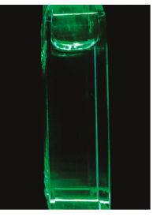
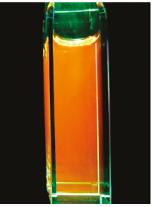
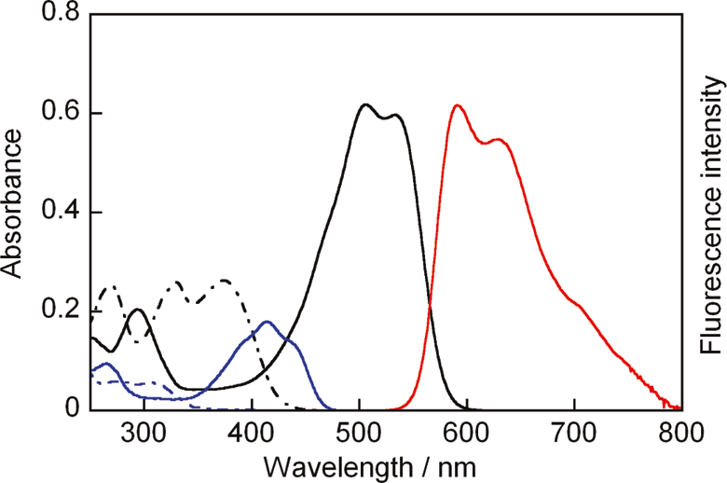
Results & Discussion
4
Diarylethene derivative
Φ=0.21
Open form
Φ<10⁻⁵
Closed form
(non-fluorescent)
(highly fluorescent)
Φ_{F}~0
Φ_{F}=0.78
Absorption spectra
Open form in 1,4-dioxane
(Black dashed line)
Closed form in 1,4-dioxane
(black solid line)
Fluorescence spectra
Closed form under irradiation
with 532 nm light
(red line)
(M. Irie,et al, J. Am. Chem. Soc. 2011,13558.)

Slide 7
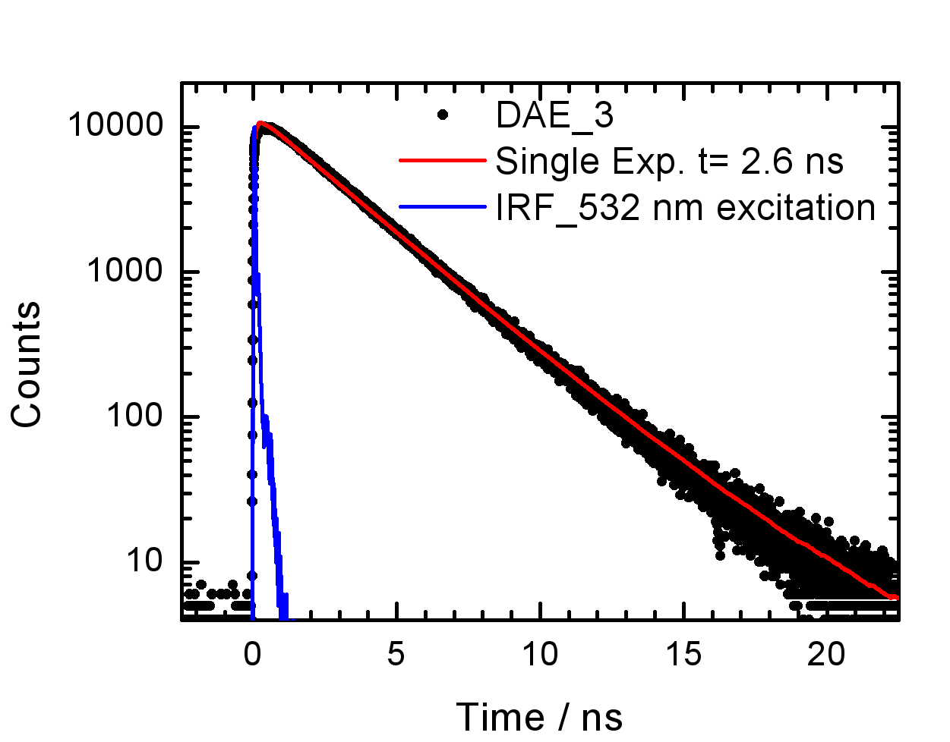
Results & Discussion
5
Diarylethene derivative
Φ=0.21
Open form
Φ<10⁻⁵
Closed form
(non-fluorescent)
(highly fluorescent)
Φ_{F}~0
Φ_{F}=0.78
Fluorescence time profile
Closed form under irradiation
with 532 nm light
fluorescence lifetime = 2.6 ns
(M. Irie,et al, J. Am. Chem. Soc. 2011,13558.)

Slide 8
Results & Discussion
6
Observation of Reaction Dynamics
by Trasient Absorption Spectroscopy
Trasient absorption spectroscopy
pump pulse (532 nm)
photo detector
Δt
sample
monitor pulse (white light)
Drastic enhancement of reaction yield
Closed form
Open form
← Ground state of Closed form
← Excited state of Closed form
ca.10 %

Slide 9
Results & Discussion
7
Excitation intensity dependence : conversion efficiency at 20 ns after the excitation with a 15-ps 532-nm laser pulse.
Conversion Efficiency
-ΔAbs510nm / Abs510nm
slope~2
Conversion efficiency is
quadratically in proportion
with the excitation intensity
Two-photon process is responsible for
the efficient bond breakage.
Conversion efficiency:変換効率

Slide 10
Results & Discussion
8
Two-Photon Absorption Processes
Simultaneous two-photon absorption process
S_{n}
hv
I ：Peak Intensity (photon / cm² sec)
δ : 2-photon absorption cross section
Ng : the number of the ground-state molecules
Ne : the number of the excited state molecules
hv
S₀
Stepwise two-photon absorption process
Re-absorption of intermediate species
The competition of absorption of light
between the ground state molecule and the intermediate species.
Effective in the case where the number of total photon is large.
hv
S₁
hv
S₀
Simultaneous two-photon absorption :同時二光子吸収
Stepwise two-photon absorption :逐次二光子吸収

Slide 11
Results & Discussion
9
Comparison of Picosecond and Femtosecond
Lasers
Laser | Wave length | Pulse Duration (fwhm) | Peak Intensity (I) | Total photon number | Drastic Enhancement of the apparent reaction yield
PS | 532 nm | 15 ps | small | large | ○
FS | 540 ~ 610 nm | 150 fs | large | small | ×
Stepwise two-photon absorption process

Slide 12
Results & Discussion
10
Excitation intensity dependence : conversion efficiency at 20 ns after the excitation with a 15-ps 532-nm laser pulse.
Sn
hv
90 %
10 %
S₁
≈0 %
hv
S₀
closed form
open form
Conversion efficiency:変換効率

Slide 13
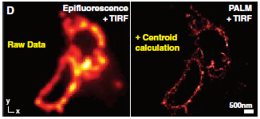
Results & Discussion
11
Future prospect
Super-resolution fluorescence imaging
Stefan W. Hell, et al, Science, 316 (2007) 1153.

Slide 14
12
Super-resolution microscopy (PALM)
VIS
(short pulse)
Perfect OFF
(Two-Photon Absorption)
hv
(activation)
Stochastically ON
(one-photon absorption)
repeatedly
Analysis of the center
of the lighting spot
We can get the good image
more efficiently.

Slide 15
13
Summary
Picosecond pulsed excitation of the closed-isomer of the
diarylethene derivatives led to the drastic enhancement of the
cycloreversion reaction. (Φ<1.0×10⁻⁵→1.0×10⁻¹)
This enhancement is attributable to the production of the higher
excited state with a large reaction yield of the cycloreversion
(ca.10%) attained via a successive two-photon process.
Two-photon gated reaction in opening reaction can be utilized to
the deterministic switching ,which can be applied to
the super-resolution fluorescence imaging.
Thank you for your attention

