Slide 1
Pressure effect on electrical conductivity of Mott insulator “Ba₂IrO₄”
Shimizu lab. ORII Daisuke

Slide 2
Contents
Introduction : H. Okabe et al., Phys. Rev. B 83, 155118(2011)
Mott insulator
Ba₂IrO₄ Mottness
Structure
Magnetic property
High-pressure effect
Motivation
Research
Summary

Slide 3
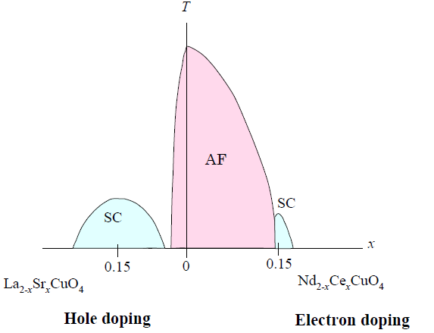
Mott insulator
Introduction
E
E
large
U
E_{F}
On-site coulomb interaction U
Metal
Kitaoka-sensei’s lecture

Slide 4
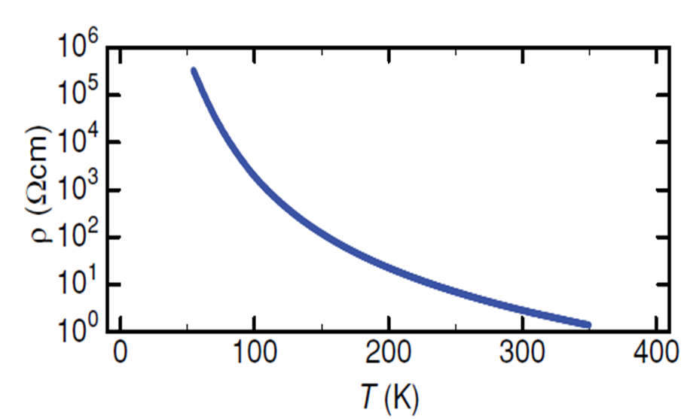
Ba₂IrO₄ : Mottness
Introduction
Insulator ??
Iridium 5d⁵
E
e_{g}
E
Metal??
5d
E_{F}
E_{F}
t_{2g}
Crystal field
SO coupling
B. J. Kim et al., PRL 101, 076402 (2008)

Slide 5
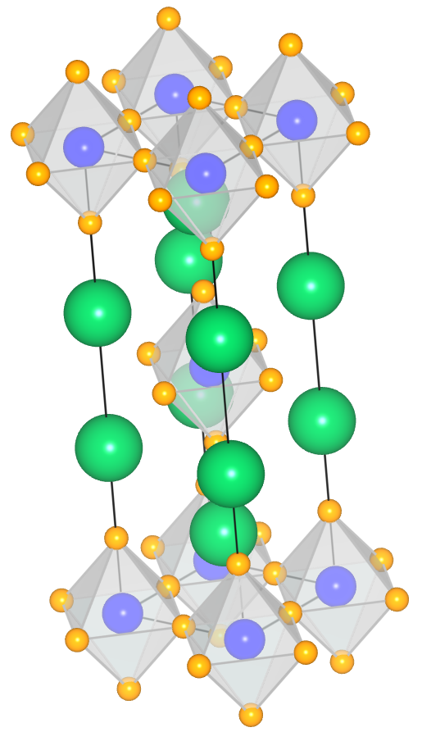
Ba₂IrO₄ : structure
Introduction
Same structure with high-T_{c} materials
Ex.) Sr-La-Cu-O, Ba-La-Cu-O, etc…
Flat IrO₂ square
2 dimensionality
The effect of
spin fluctuation
strongly appears.
The interaction is weaker for lower dimension.

Slide 6
Ba₂IrO₄ : magnetic property
Introduction
 | Magnetic moment (at low temperature) | T_{N}
Ba₂IrO₄ | 0.34 μ_{B}/Ir atom | 240 K
La₂CuO₄ | 0.40 μ_{B}/Cu atom | 220 K
compare
Ba₂IrO₄
La₂CuO₄
D. Vaknin et al., Phys. Rev. Lett. 58, 2802 (1987)
Spin fluctuation
Both oh the magnetic moments are reduced by the spin fluctuation.
Antiferromagnetic order
Neel temperature T_{N} is similar.
Ba₂IrO₄ will be superconductor…?

Slide 7
High-pressure effect
Introduction
Pressure
Transitions
Structural transition
Magnetic transition
M-I transition
etc…
I’m particularly interested in
superconducting transition.
Electronic states change!

Slide 8
Motivation
It is expected that
superconductivity will be observed
in Ba₂IrO₄.

Slide 9
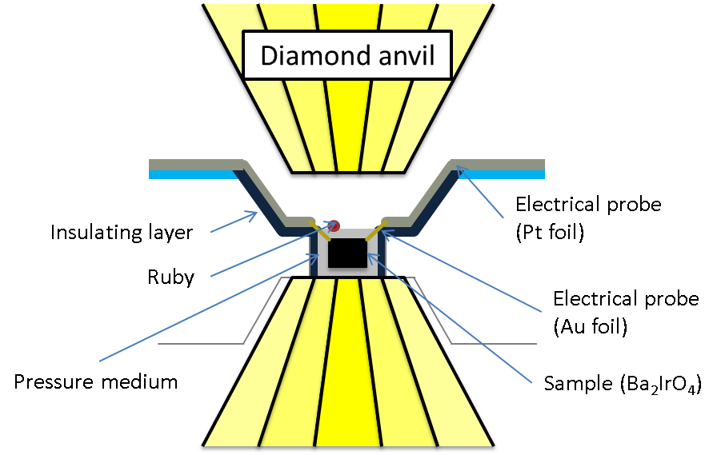
How to make high pressure
Research
Measurement
Electrical resistance;
4-terminal method
Pressure
Ruby fluorescence method
Temperature
V⁺
I⁺
I⁻
V⁻

Slide 10
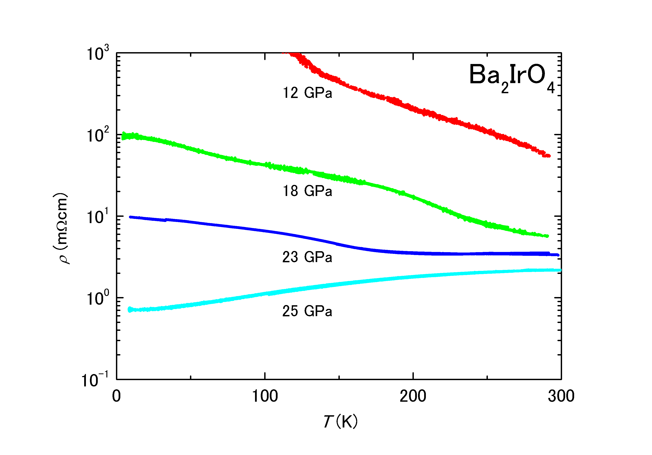
Result
Research
12~23GPa Insulator behavior
Metallic behavior
~10K

Slide 11
Discussion
Research
M-I transition
E
E
?
But the superconductivity phase was not observed down to 10K.
H. Okabe et al., Phys. Rev. B 84, 115127 (2011)

Slide 12
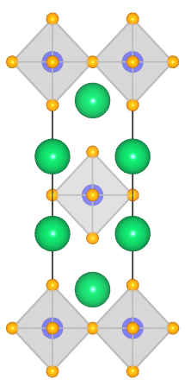
Summary
M-I transition was observed at 25 GPa.
But superconductivity was not observed.

