Slide 1
Magnetic-field-induced charge-stripe order in the high-temperature superconductor YBa₂Cu₃O_{y}
Tao Wu et. al.
Nature 477, 191 (2011).
Kitaoka Lab.
Takuya Kaneda
1

Slide 2
CONTENTS
Introduction
Phase Diagram of Copper Oxides
Variation of YBa₂Cu₃O_{y}
Fermi Surface of Copper Oxides
Experimental Result
⁶³Cu-NMR Spectra
Charge-Stripe Order
Phase Diagram
Summary
2

Slide 3
Introduction

Slide 4
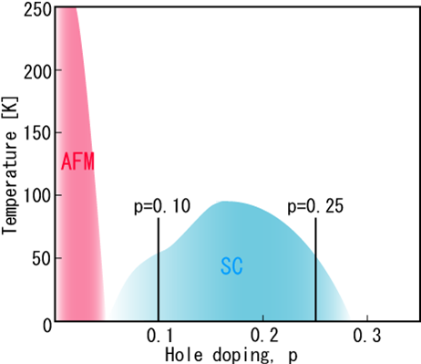
Phase Diagram of Copper Oxides
Introduction
When p = 0,
copper oxides show AFM.
As p is increasing,
AFM phase disappears.
SC phase appears.
T_{c} depends on p.
Phase Diagram
of Copper Oxide Superconductors
Hole concentration: p
Carrier concentration is an important parameter.
※AFM = Anti-ferromagnetism （反強磁性）
3

Slide 5
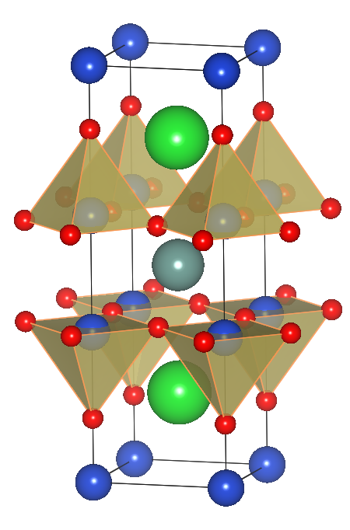
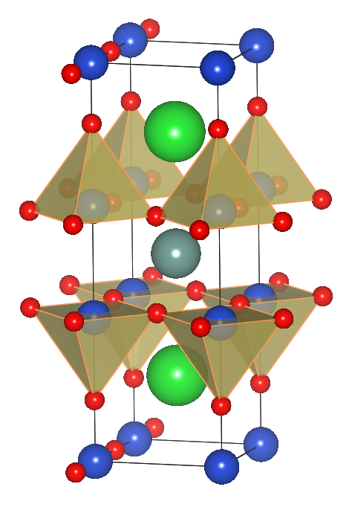
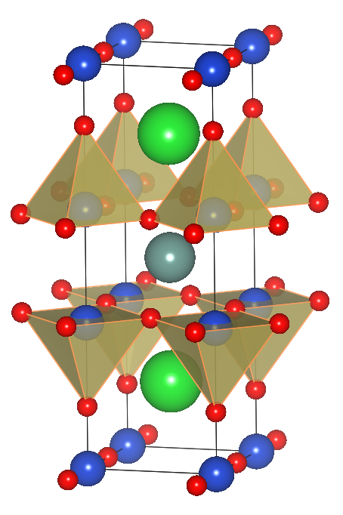
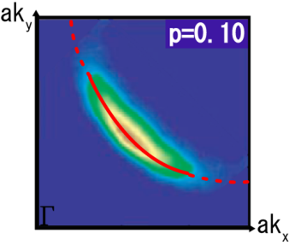
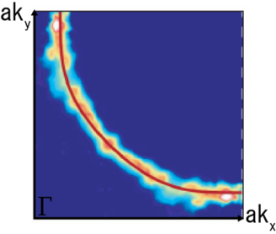
Variation of YBa₂Cu₃O_{x}
Introduction
 | YBa₂Cu₃O₆ | YBa₂Cu₃O_{6.5} | YBa₂Cu₃O₇
Structure
Conductivity | Mott Insulator | Superconductor (under-doped) | Superconductor (optimally doped)
Critical Temperature | × | T_{c} = 60K | T_{c} = 90K
Hole Concentration | p = 0 | p ~ 0.1 | p ~ 0.194
Fermi Surface
4

Slide 6
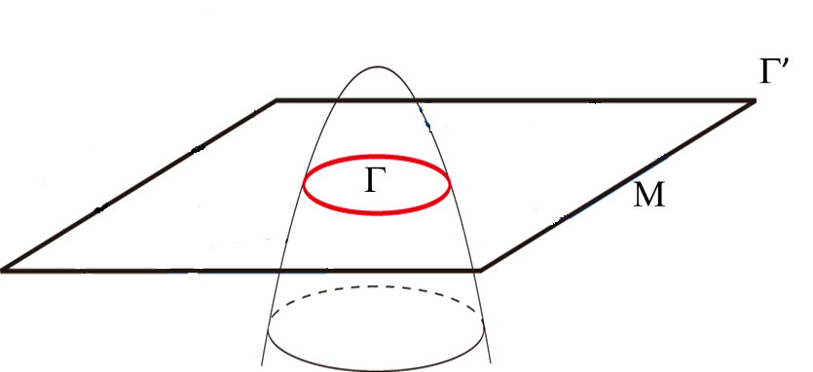
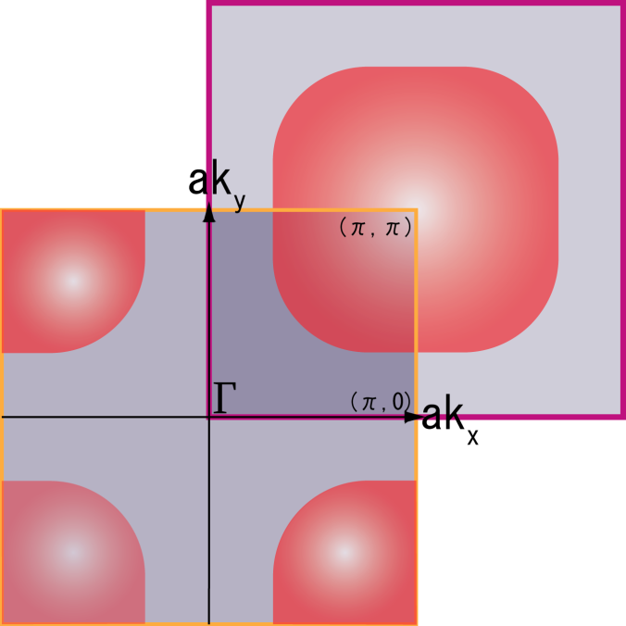
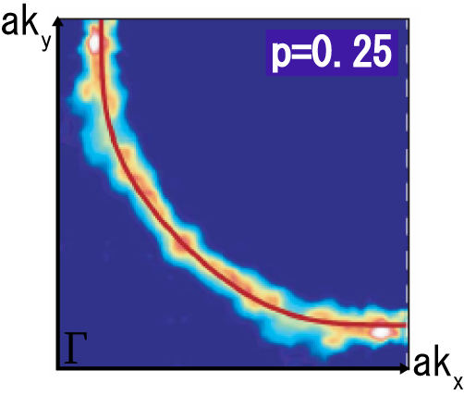
Fermi Surface of Copper Oxides #1
Introduction
From band theory,
the large Fermi surface had been predicted.
in fact…
ARPES Result （角度分解光電子分光法）
Tl2201
N. Doiron-Leyraud et al., Nature 447, 565 (2007).
Hole concentration: p
5
※ ARPES = Angle Resolved PhotoEmission Spectroscopy

Slide 7
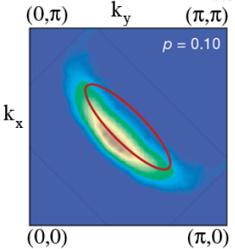
Fermi Surface of Copper Oxides #2
Introduction
ARPES for underdoped copper oxide
fermi arc
Hole concentration: p
Na-CCOC
Shen et al., Science 307, 901 (2005).
In 2007 , quantum oscillation was observed in YBCO.
Fermi pocket
Direct proving for Fermi surface!
In high magnetic field (~30T),
Fermi pocket (red eclipse) was suggested !
※ quantum oscillation （量子振動, ド・ハース振動） 低温, 高磁場, 綺麗な試料が必要。
6

Slide 8
Question
Fermi pocket
By changing the hole concentration p,
what happend?
7

Slide 9
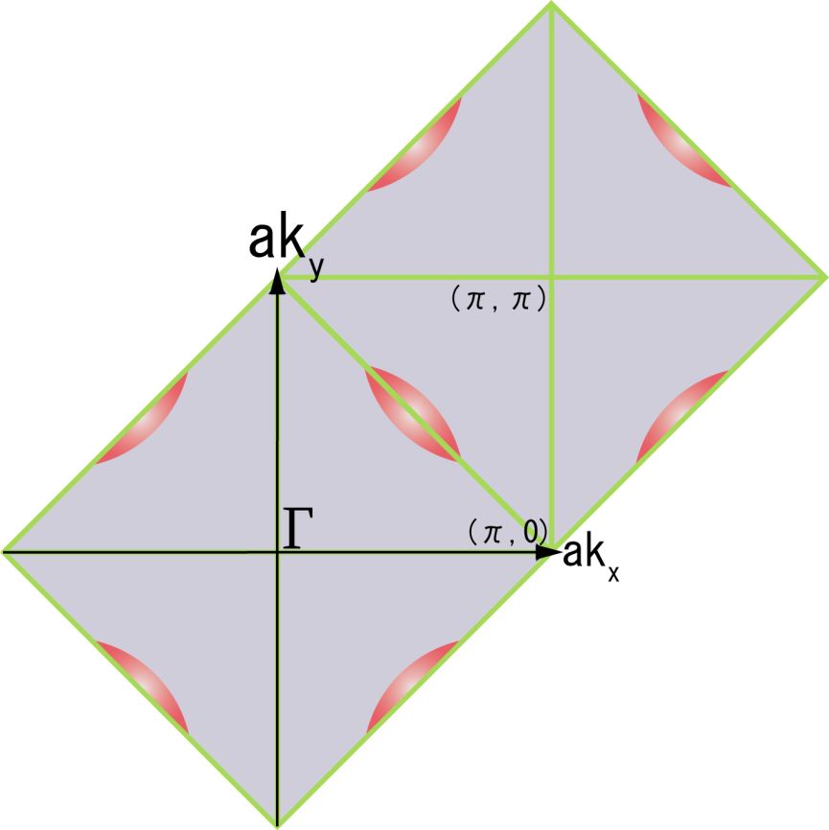
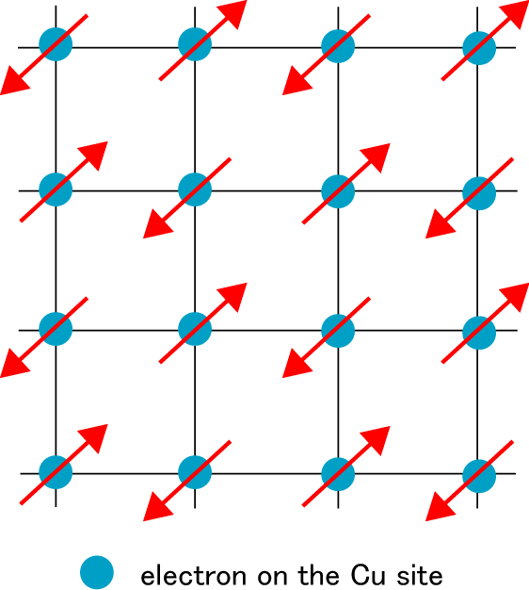
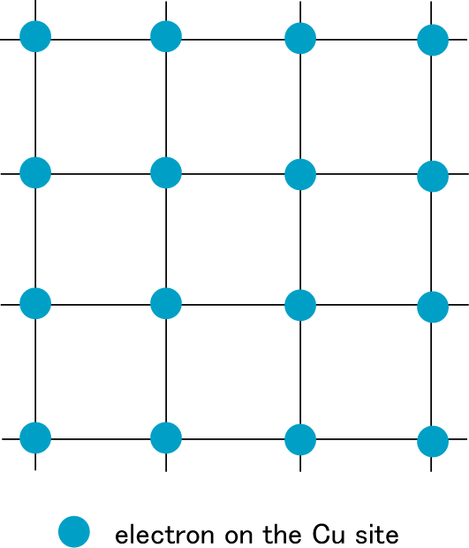
Fermi Surface Reconstruction
Introduction
underdope
overdope
New Brillouin zone !
folding
any translational symmetry breaking?
2a
並進対称性の破れ
(spin and/or charge order ? )
a
8

Slide 10
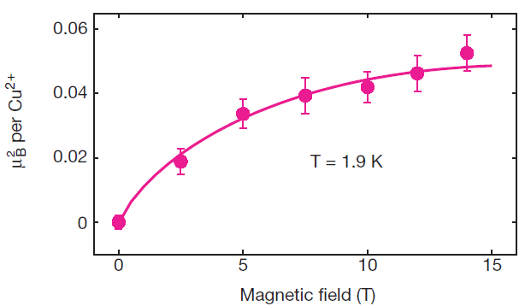
Magnetic-field-induced AFM order of LSCO
La_{1.9}Sr_{0.1}CuO₄ (LSCO)
AFM ordering
B.Lake et al.,
Nature 415, 299-302 (17 January 2002)
Such ordering occurs in YBCO as well ?
9

Slide 11
Experiment

Slide 12
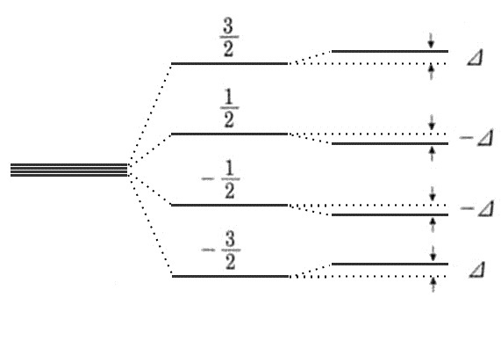
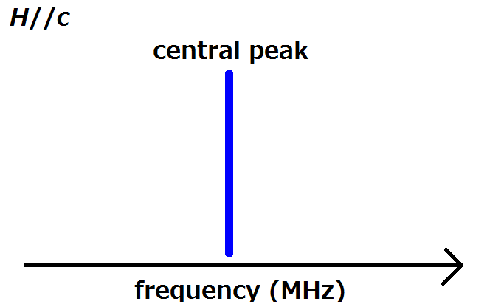
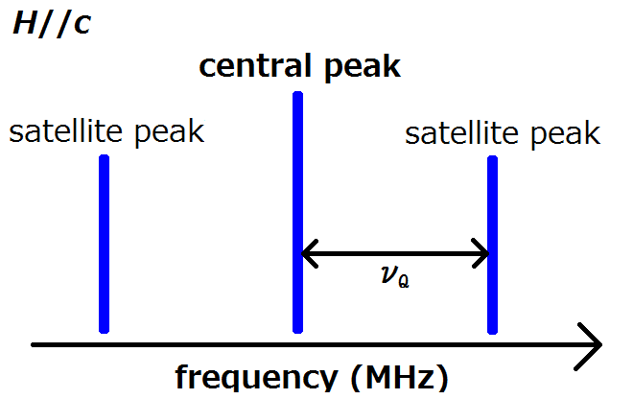
⁶³Cu-NMR
Experiment
⁶³Cu: Spin I = 3/2 ($≥$1)
Quadrupole Interaction （電気四重極相互作用）
(interaction between quadrupole moment and electrical gradient)
Two satellite peaks are also observed!
10

Slide 13
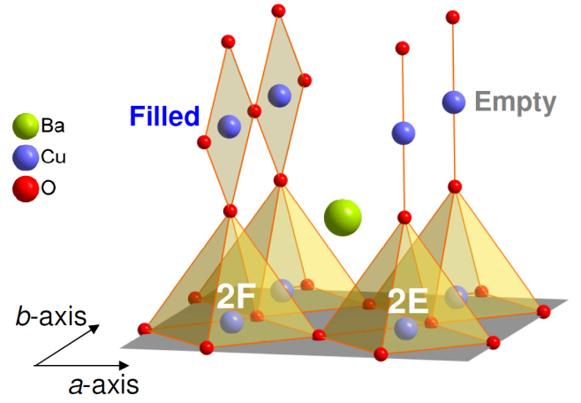
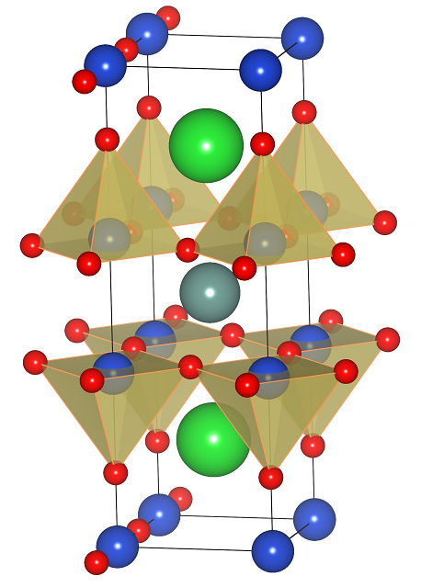
Samples
Experiment
YBa₂Cu₃O_{6.54} (p = 0.108)
YBa₂Cu₃O_{6.67} (p = 0.12)
T_{c} = 61.3K
T_{c} = 66.0K
ZOOM
Cu2F is located below Oxygen-Filled chain.
Cu2E is located below Oxygen-Empty chain.
11

Slide 14
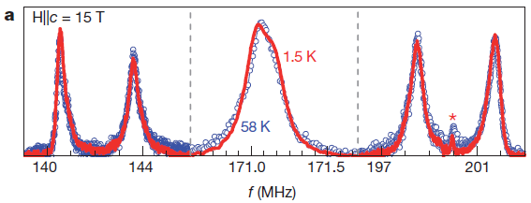
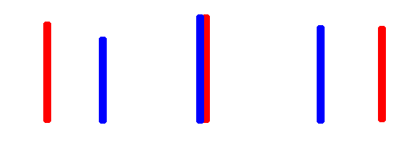
⁶³Cu-NMR Spectra (H = 15T)
Experiment
satellite
central
satellite
Cu2E
Cu2F
frequency (MHz)
No temperature dependence at H = 15T
12

Slide 15
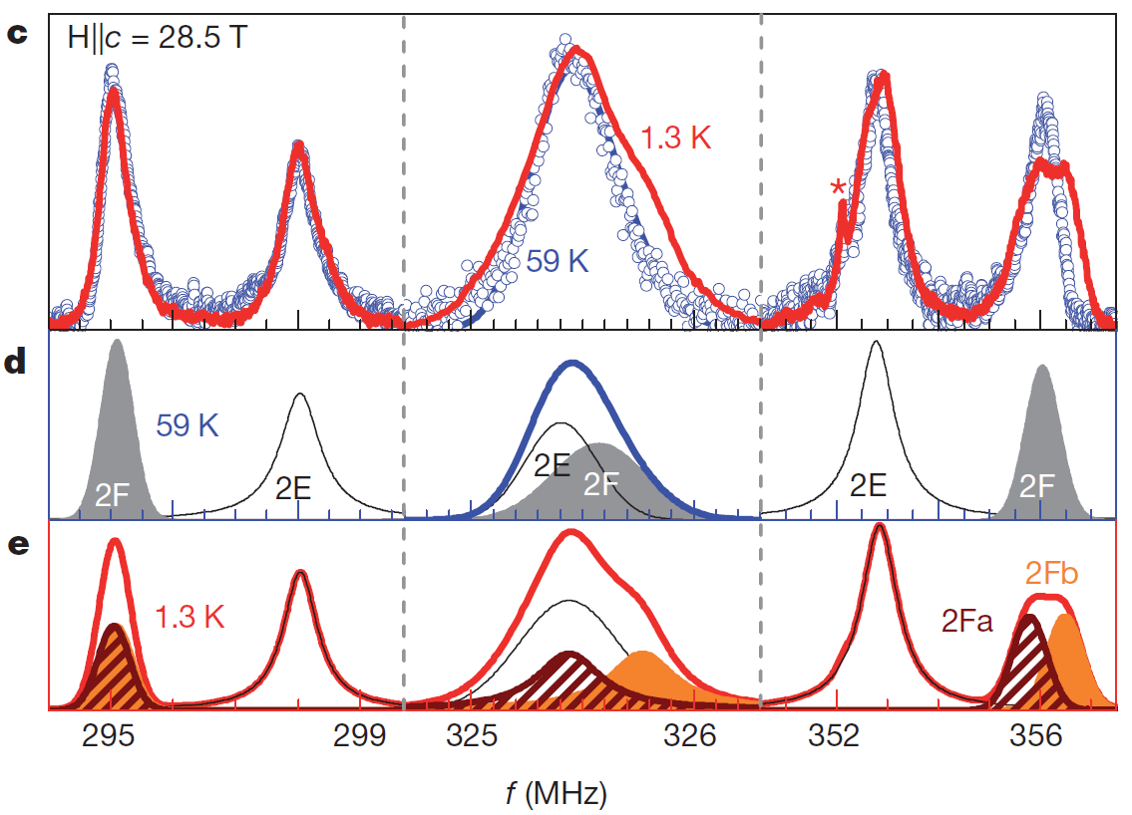
⁶³Cu-NMR Spectra (H = 28.5T)
Experiment
satellite
central
satellite
2E
(ν_{Q} =30.47MHｚ)
2F
59K
2E
2E
2Fb
1.3K
Cu2F peaks are splitting!
2Fa
(ν_{Q} =30.37MHｚ)
(ν_{Q} =30.7MHｚ)
2E
2E
Between Cu2Fa and Cu2Fb,
local environment is different.
Knight Shift
ν_{Q}
13

Slide 16
⁶³Cu-NMR Spectra
Experiment
satellite
central
satellite
H = 15T
H = 28.5T
No broadening of spectrum
Spin order is absent.
14

Slide 17
Charge-Stripe Order
Experiment
YBCO (p = 0.108)
2Fa
2E
2Fb
2E
2Fa
2E
p₀ = 0.108
Δp = 0.03
Fermi surface reconstruction
15

Slide 18
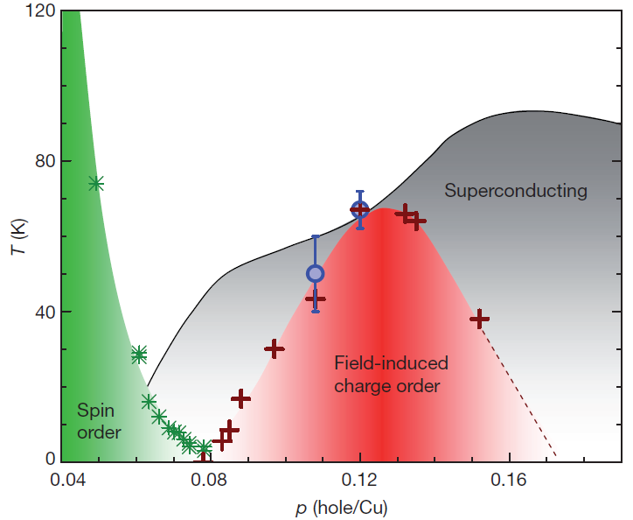
Phase Diagram of YBa₂Cu₃O_{x}
T_{N} (antiferromagnetic order)
T_{charge} (charge order)
T₀ (Fermi surface reconstruc-
tion)
AFM
※ T₀ is defined as the temperature where the Fermi surface reconstruction occurs.
(Hall coefficient R_{H} measurement)
T_{charge} coincides with T₀.
Charge-stripe order is related to the Fermi surface reconstruction.
16

Slide 19
Summary
They carried out ⁶³Cu-NMR to reveal any ordered state.
High magnetic field induces the charge-stripe order instead of spin order.
Fermi surface reconstruction is probably associated with the charge-stripe order because T₀ coincides T_{charge}.
17

Slide 20
Thank you for your attention.
18

