Slide 1
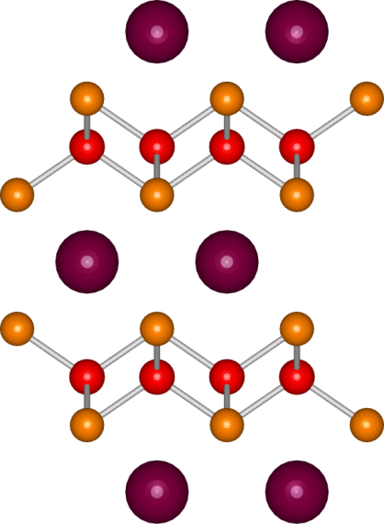
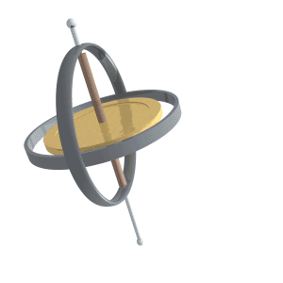
5th October, 2011
M-colloquium
Nodal superconducting gap structure in superconductor BaFe₂(As_{0.7}P_{0.3})₂
Fe
As
Y. Zhang et al., Fudan Univ., Shanghai, China, arXiv:1109.0229v1
Dulguun Tsendsuren
Kitaoka Lab.
Division of Frontier Materials Sc.
Department of Materials Engineering Sc.
Graduate School of Engineering Sc., Osaka Univ.

Slide 2
Contents
Introduction
Introduction
  Brief intro to Superconductivity ^{超伝導}
  Superconducting gaps ^{超伝導ギャップ}
  Experimental method for probing SC gap: ARPES
    Angle Resolved Photo Emission Spectrum ^{角度分解型光電子分光}
Exp. result for BaFe₂(As_{0.7}P_{0.3})₂, by ARPES
  Fermi Surfaces ^{フェルミー面}
  Superconducting gap^{超伝導ギャップ}
Summary
1

Slide 3
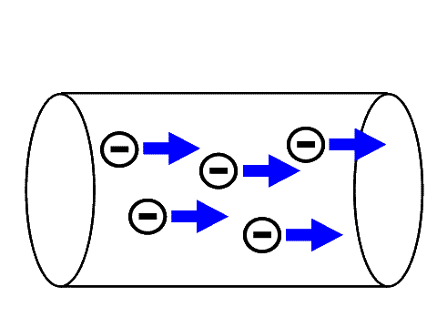
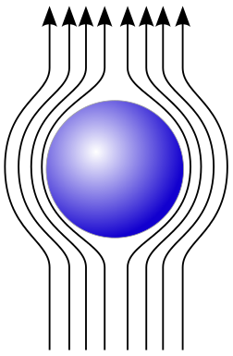

What is Superconductivity?
Introduction
If substance is in superconducting state, which:
  Has no electric resistance ^{電気抵抗}
  Repels magnetic field ^{磁場} from itself
2

Slide 4
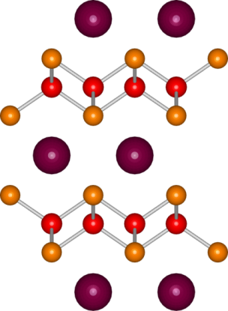
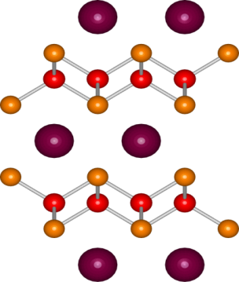
Iron-based SC ^{鉄系超伝導}: Ba122
Introduction
Ba122P
As³⁻→P³⁻
BaK122
Ba^{2＋}→K⁺
T [K]
Ba_{0.6}K_{0.4}Fe₂As₂
BaFe₂(As_{0.66}P_{0.33})₂
Full gap
( T_{c}=38K)
Ba
AFM
Ba/K
Nodal
SC
KFe₂As₂
( T_{c}=30K)
x
T_{c}=30K
0
Ba_{1-x}K_{x}Fe₂As₂
T_{c}=38K
SC
Nodal
hole-doping
Full gap
y
a = 3.92 Å
c ~ 12.8 Å
h_{Pn}~1.32 Å
Matsuda group,
Ishida group
BaFe₂(As_{1-y}P_{y})₂
a ~ 3.92 Å
c ~ 13.3 Å
h_{Pn}~1.38 Å
isovalent-doping
What is
superconducting gap?
Optimum height
Rotter et al. (2008)
3
Notes:
Shrinks only through c-axis. In each cases, a is constant.

Slide 5
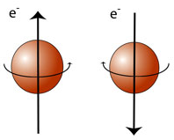
Superconducting gap
Introduction
SC gap appears in low temperature ( < T_{c} ^{転移温度}) at the same time with SC state, due to coupled electrons ^{電子対} (cooper pair ^{クーパー対})
Interaction energy ^{相互作用のエネルギー}: ≈10⁻³[eV]
Interaction distance ^{相互作用の距離}: > 100[nm]
Full
Density of State
BCS superconductors
gap
High T_{c} cuprate superconductors
E_{Fermi}
Energy
Nodal
How to distinguish this two?
What about iron-based superconductors?
Density of State
gap
E_{Fermi}
Energy
4

Slide 6
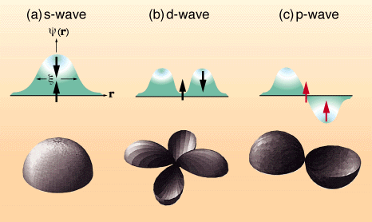
Possible SC order^{秩序} parameters
and their spin-state^{スピン状態}
Introduction
BCS SC
High-T_{c} oxides
CeCu₂Si₂ UPd₂Al₃, CeRIn₅
UPt₃ Sr₂RuO₄
5

Slide 7
SC gap in iron-based SC
Introduction
Full
Nodal
Density of State
Density of State
gap
gap
E_{Fermi}
Energy
E_{Fermi}
Energy
Structure | Substance
122 | Ba_{1-x}Fe_{2-x}Co_{x}As₂
122 | Ba_{1-x}K_{x}Fe₂As₂
122 | K_{x}Fe_{2-x}Se₂
11 | FeTe_{1-x}Se_{x}
Structure | Substance
11 | FeSe
111 | LiFeP
1111 | LaOFeP
122 | KFe₂As₂
122 | BaFe_{2-x}Ru_{x}As₂
122 | BaFe₂(As_{1-x}P_{x})₂
NMR, Penetration Depth,
Thermal Conductivity,
Scan tunneling spectroscopy
Node position in FSs?
6

Slide 8
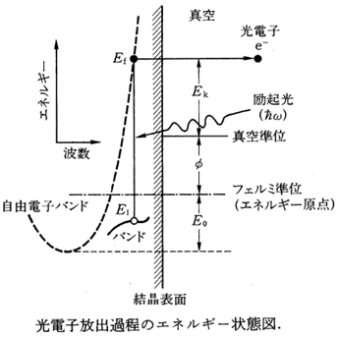
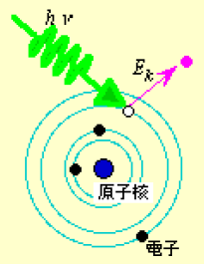
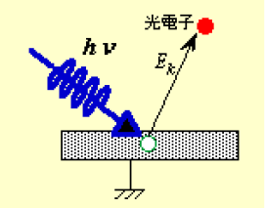
ARPES
Introduction
Based on Photoelectric effect ^{光電効果}
Measures an intensity of released electron energy
  More intensity ⇒ More occupied states^{占有状態}
  Less intensity ⇒ Less occupied states^{占有状態}
In this manner, directly measures DOS^{状態密度}!!!
FSs can be drawn by angle resolved method
7

Slide 9
BaFe₂(As_{0.7}P_{0.3})₂
Exp. results
Zero resistivity
Meissner effect
8

Slide 10
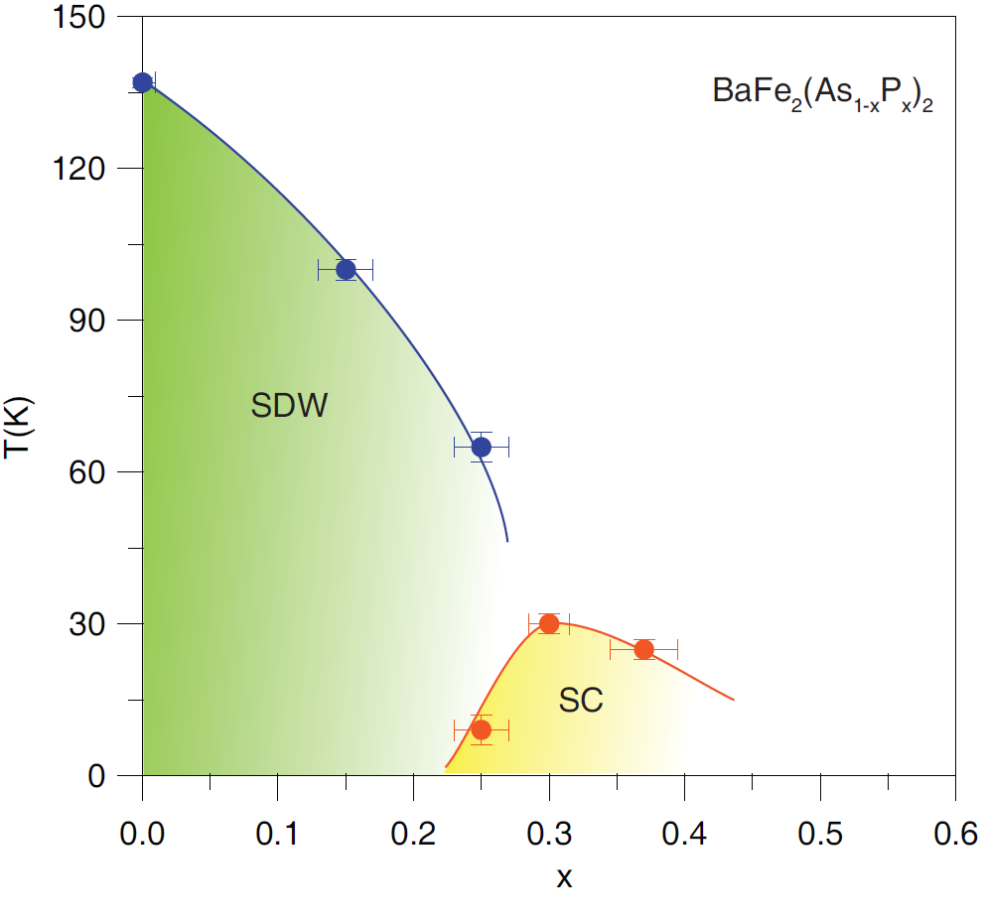
Phase diagram^{相図}
Exp. results
BaFe₂(As_{1-x}P_{x})₂
Fe
As
T_{c} = 30[K] (x = 0.3)
h_{Pn}:
Distance between
Fe layer and As
9

Slide 11
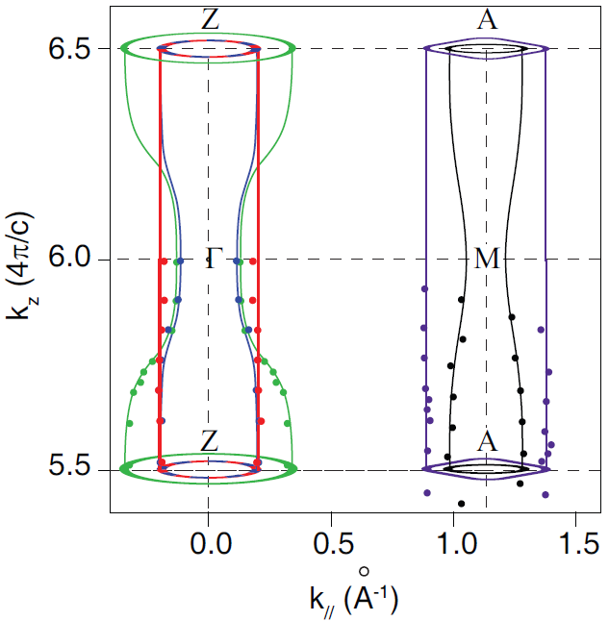
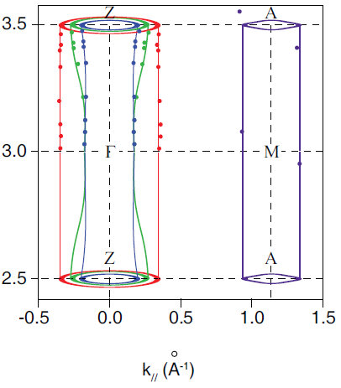
ARPES result on BaFe₂(As_{0.7}P_{0.3})₂
Exp. results
BaFe₂(As_{0.7}P_{0.3})₂
Ba_{0.6}K_{0.4}Fe₂As₂
Z. R. Ye et al., arXiv: 1105.5242v1
10

Slide 12
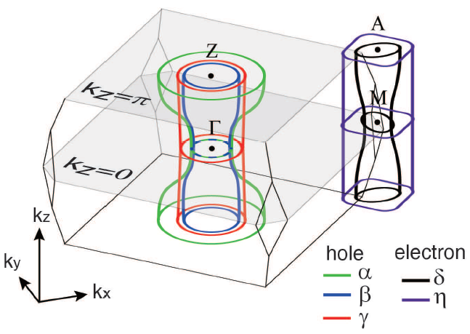
ARPES result on BaFe₂(As_{0.7}P_{0.3})₂
Exp. results
BaFe₂(As_{0.7}P_{0.3})₂
3D view
Z. R. Ye et al., arXiv: 1105.5242v1
11

Slide 13
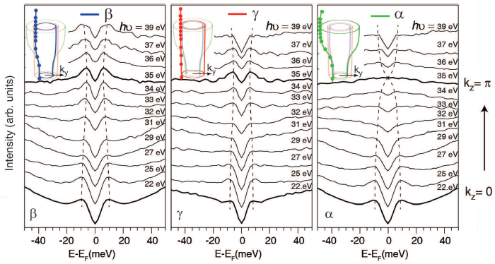
BaFe₂(As_{0.7}P_{0.3})₂: Hole pocket
Exp. results
at 9[K]
12

Slide 14
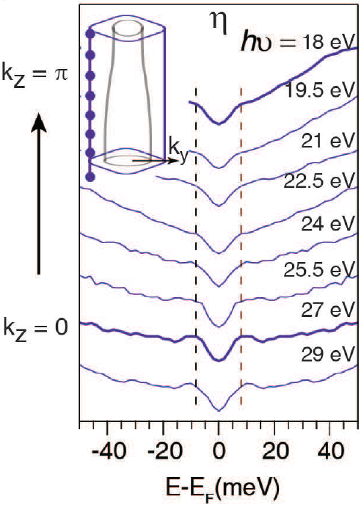
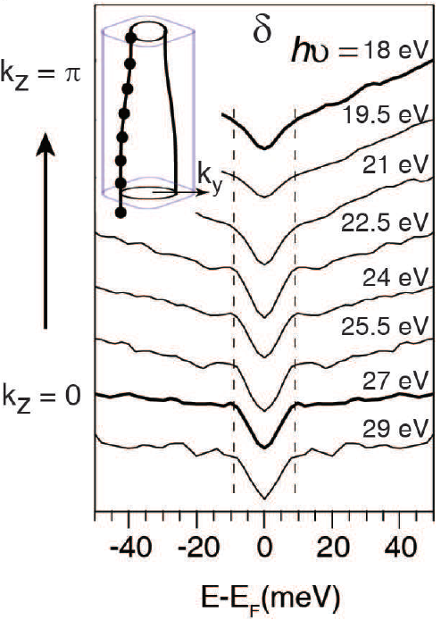
BaFe₂(As_{0.7}P_{0.3})₂: Electron pocket
Exp. results
at 9[K]
13

Slide 15
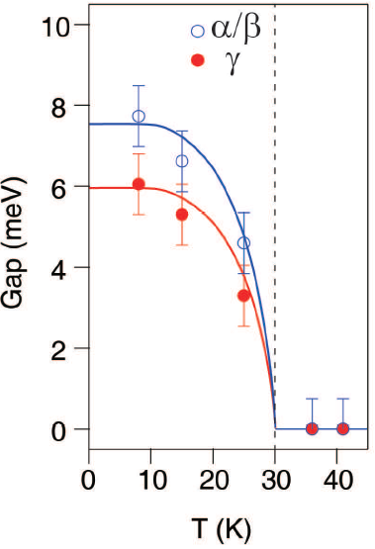
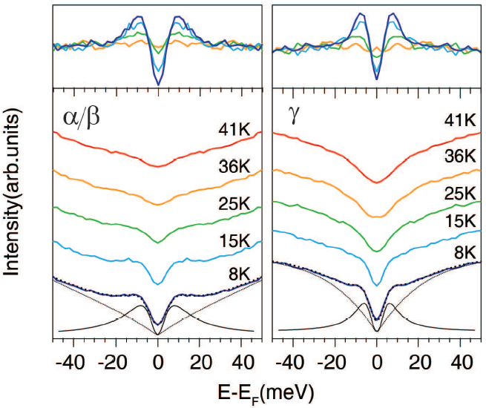
Temperature dependence of gap
Exp. results
Hole pockets^{ホール面}
14

Slide 16
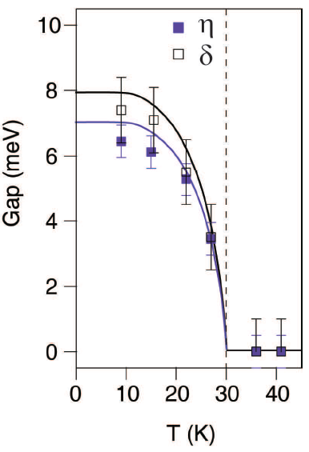
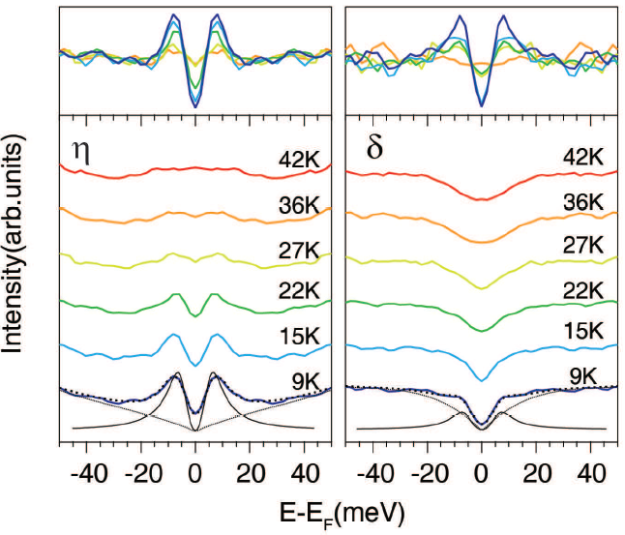
Temperature dependence of gap
Exp. results
Electron pockets^{電子面}
15

Slide 17
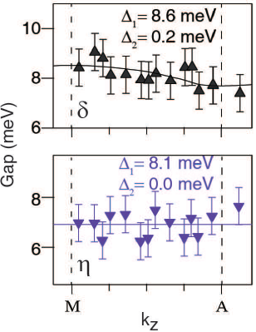
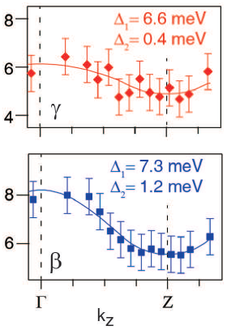
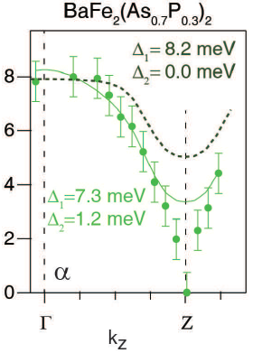
ARPES results on BaFe₂(As_{1-x}P_{x})₂
Exp. results
no Nodes
Node exists on
in Electron pockets^{電子面}
Hole pockets^{ホール面}
16

Slide 18
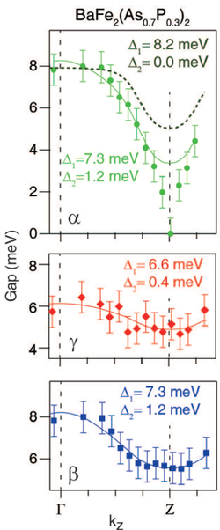
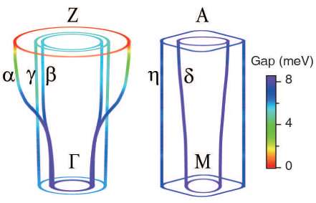
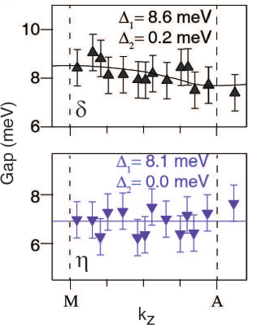
ARPES results on BaFe₂(As_{1-x}P_{x})₂
Exp. results
3D-like FSs around ГZ axis
At Z point, α surface has no energy gap
From ARPES:
SC (line) nodal gap exists
17

Slide 19
ARPES results on BaFe₂(As_{1-x}P_{x})₂
Summary I
Superconducting gap
of each pocket
Type | Pocket | SC gap
Hole | α | Nodal
Hole | β | Full
Hole | γ | Full
Electron | δ | Full
Electron | η | Full
α band mixes with
α and β : δ
γ : η
Nesting between
Γ and M
Nodal gap
18

Slide 20
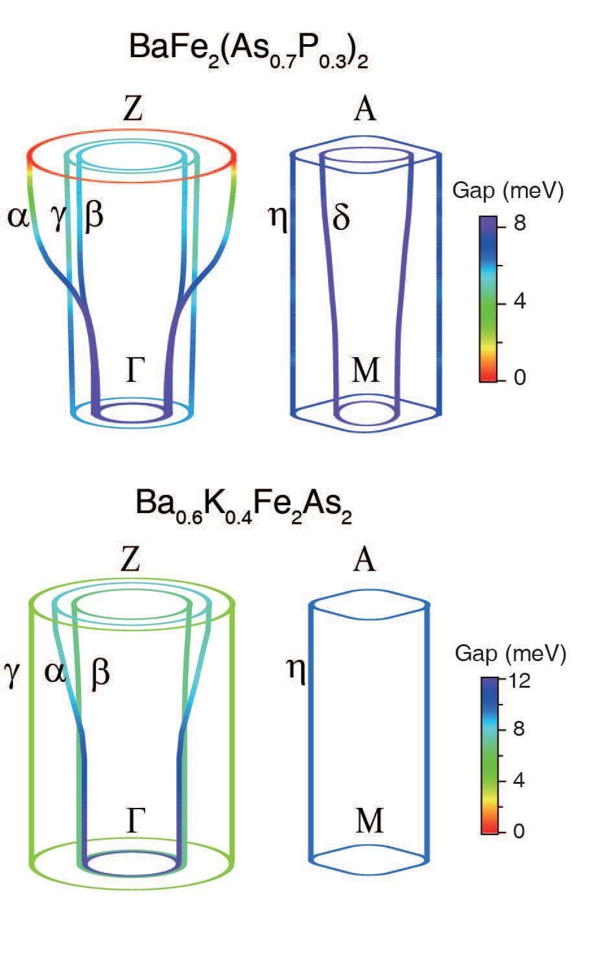
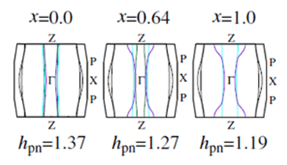
Comparison with Theory
Summary II
As pnictogen height becomes lower, FSs become 3D like.
Even 3D like FSs cause large RDOS, T_{c} is still high enough.
Multiband effect
Suzuki, Usui, Kuroki et al., JPSJ(2011)
BaK122
Ba122P
Y. Zhang et al., arXiv: 1109.0229v1
Sr122P
10
19

Slide 21
Conclusions in this work
The End
This work unifies the seemingly diversified phenomenology of nodal and nodeless superconducting gaps in various iron based superconductors,
and
It provides a discriminator for theories on iron pnictides.
Thank you for your attention

