Slide 1
Metamaterial Emergence of novel material properties
PRL 103, 103907 (2009)
Ashida Lab
Masahiro Yoshii

Slide 2
Contents
Introduction
Metamaterial
Control of refractive index
SRR (Split-Ring Resonator)
Sample fabrication
Transmission spectra for SRR
Electron Spin Resonance (ESR) of GGG
ESR spectra for GGG
results
ESR spectra for GGG with SRR
Transmission spectra for GGG with SRR
Summary
My work

Slide 3
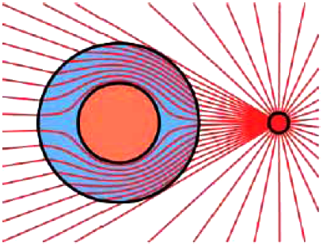
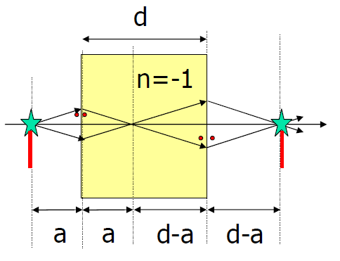
Metamaterial
What is metamaterial?
Metamaterial is artificially designed material
to cause properties cannot be achieved with material
exists in the nature.
metamaterial=artificial atom
1) cloaking
2) negative index medium
3) overcoming the resolution limit of optical devices
Science Vol. 312. no. 5777, p. 1120 (May 26, 2006 )
C.G. Parazzoll et al., Phys. Rev. Lett. 90, 107401 (2003).

Slide 4
Control of refractive index
relative permeability(μ_{r})
refractive index
metal
（ plasmonics ）
impedance
1
relative permittivity(ε_{r})
1
-1
in case of μ_{r}=1 : n・z=1.
-1
magnetic material
perfect lens
third quadrant
negative refractive index
negative refractive index

Slide 5
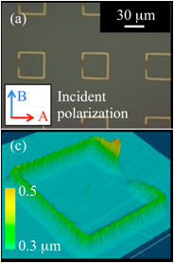
Split-Ring Resonator (SRR)
Split-Ring Resonator
We can see SRR as LC circuit.
L
L : inductance
C : capacitance
C
resonant frequency =
http://www.ile.osaka-u.ac.jp/research/ths/sub2.html

Slide 6
Sample fabrication
Photolithography
①
photoresist film
copper-laminated film
nonconductive substrate
②
UV ray
Split ring
ring size
0.35mm×0.35mm
gap width
0.17mm
lattice constant
0.7mm
thickness
0.56mm
refractive index
n_{s} = 2.07 + 0.04i
③
④

Slide 7
Electron Spin Resonance (ESR) of GGG
the condition to observe the ESR signal
Zeeman splitting
gμ_{B}H=hν
energy difference between the split levels
ǁ
energy of electromagnetic radiation
selection rules
oscillating magnetic field perpendicular to the static magnetic field
static magnetic field
=gμ_{B}H
Gd³⁺
4f , S=7/2
hν=
gμ_{B}H=hν
○
H
h
Gd₃Ga₅o₁₂ , GGG
commercially available
substrates
characteristic size
10×10×0.48mm³
refractive index
n_{GGG} = 3.43 + 0.008i
k
e
×
H
e
k
h

Slide 8
Selection rules
SRR
ESR
H
e
h
○
k
k
h
e
H
h
e
×
k
k
e
h

Slide 9
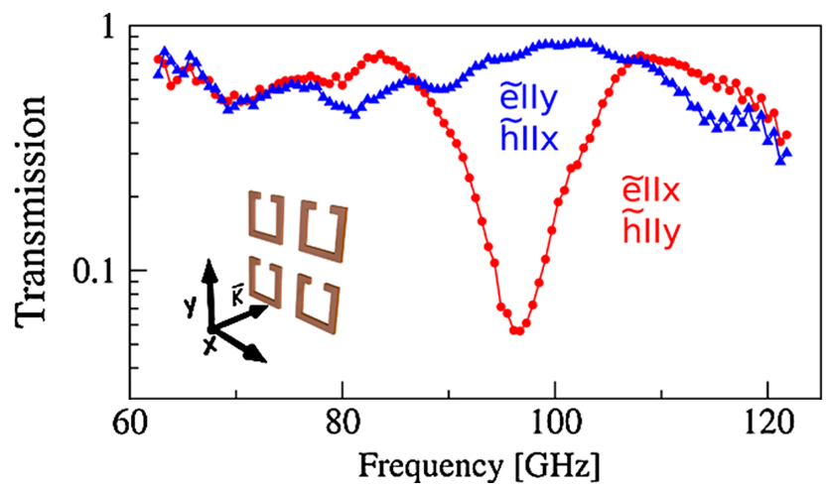
Transmission spectra for SRR
red circles
The resonance is excited for the electric field of the electromagnetic wave parallel to the gap of the split rings.
blue triangles
No resonance is excited and the spectra correspond to a pure response of the substrate.

Slide 10
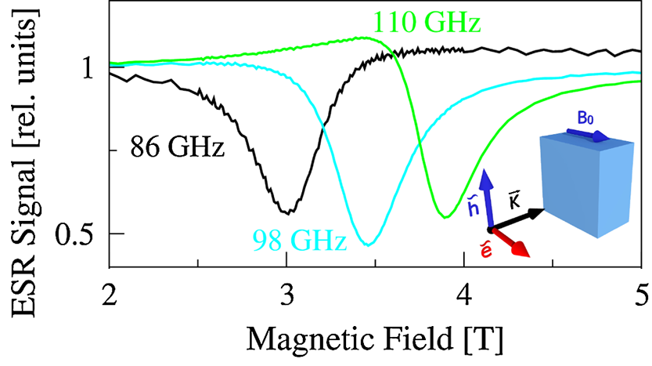
ESR spectra for GGG
The resonance magnetic field is directly proportional to the frequency of the radiation.
rotating the polarization of the electromagnetic wave by 90 degrees
violating the excitation condition and detecting no ESR signal

Slide 11
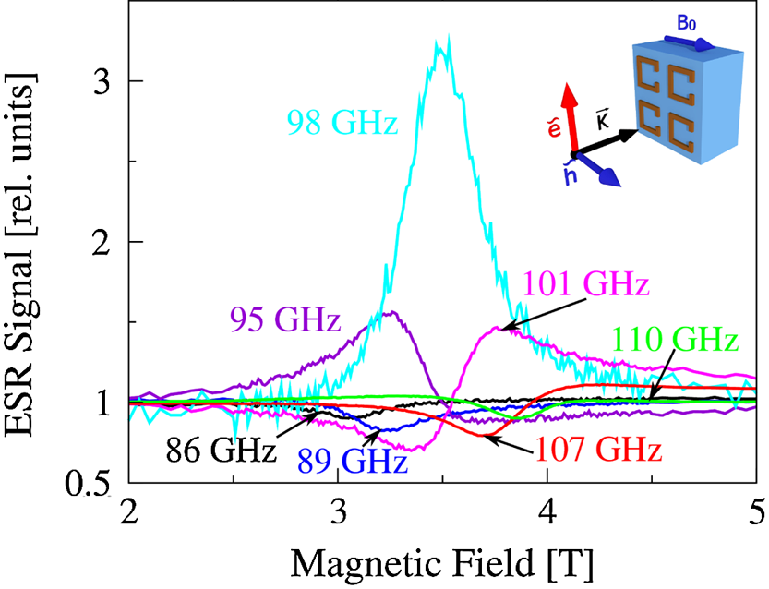
ESR spectra for GGG with SRR
The excitation condition for the ESR signal in GGG is not fulfilled.
black curve for 86 GHz
green curve for 110 GHz
We observe a strong signal, which is the result of the coupling between two systems.
blue curve for 98 GHz

Slide 12
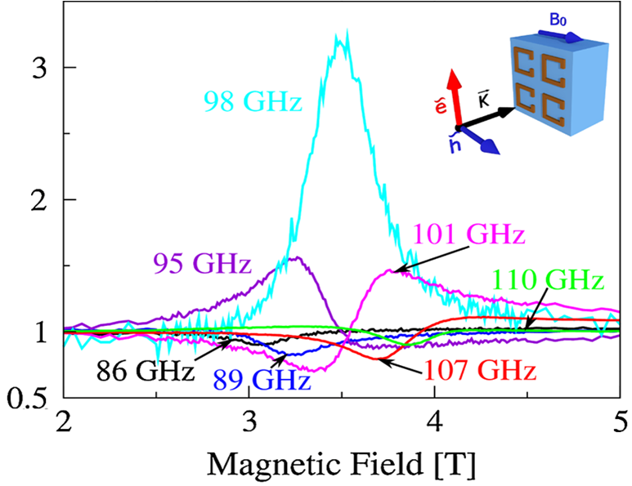
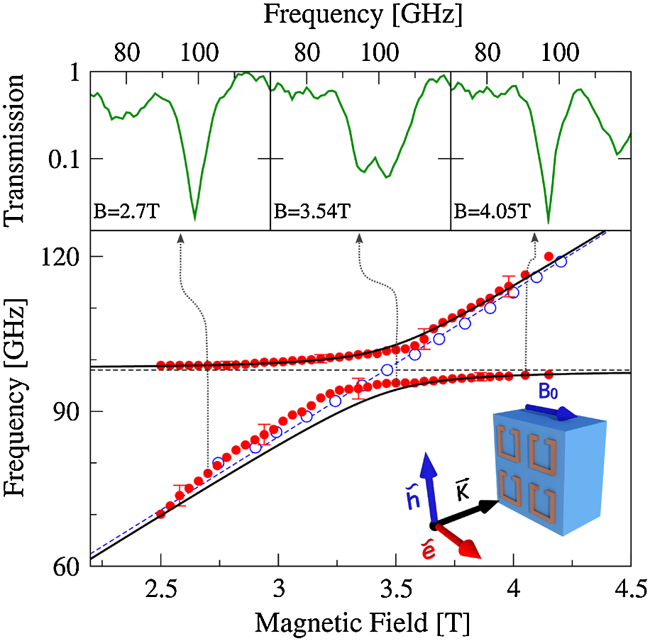
Transmission spectra for GGG with SRR
coupled mode
like
photon polariton=photon+phonon

Slide 13
Summary
We utilize the bianisotropic properties of the split-ring metamaterial to excite the ESR by the electric field of light.
Coupling between GGG and split rings changes the physicality.

Slide 14
My work
I’ll research the properties of metamaterial using THz wave.

Slide 15
Terahertz wave
300km
300m
300mm
300μm
300nm
300pm
300fm
Wavelength
microwave
THz region
visible
X-ray
Frequency(Hz)
10³
10⁶
10⁹
10¹²
10¹⁵
10¹⁸
10²¹
3cm
3mm
300μm
30μm
3μm
300nm
Wavelength
FIR
MIR
NIR
THz region
Frequency(Hz)
0.01THz
0.1THz
1THz
10THz
100THz
1000THz
1THz = 300μm =4.1 meV
gap of low-T_{c} superconductor
mode of collective oscillation of macromolecule

Slide 16
THz metamaterial
Millimeter wave or microwave Metamaterial
We can fabricate metamaterials precisely, because the size of metamaterials are millimeter order.
but
It is very difficult to fabricate metamaterials in large numbers.
Downsizing of metamaterials is very important to practical realization of metamaterials.
THz metamaterial
We can fabricate metamaterials easily by existing methods (ex. lithography).
research of metamaterial in THz frequency region

Slide 17
THz emitter and detector
emitter
detector
photoconductive antenna
photoconductive antenna
-
A
V
+
nonlinear optical crystal
nonlinear optical crystal (Electro-Optical sampling)
light rectification
DFG
balance detector
plasma
Wolaston prism
λ/4 plate
EO crystal
plasma

Slide 18
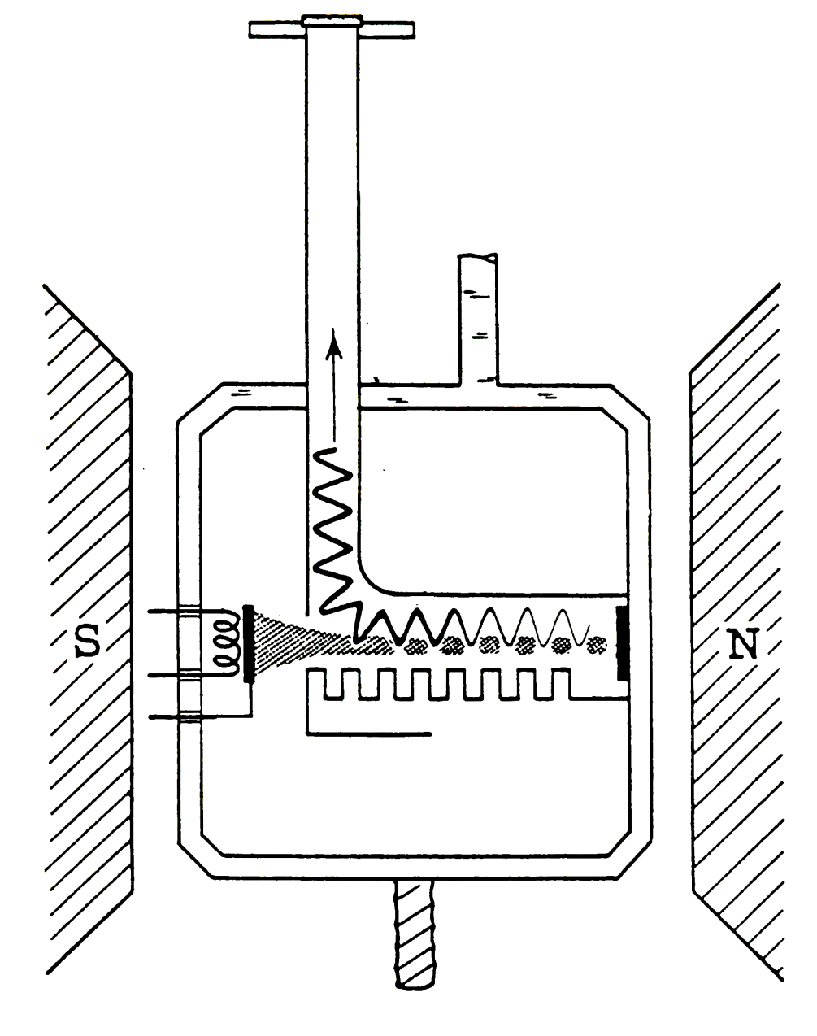
Backward Wave Oscillator (BWO)

Slide 19
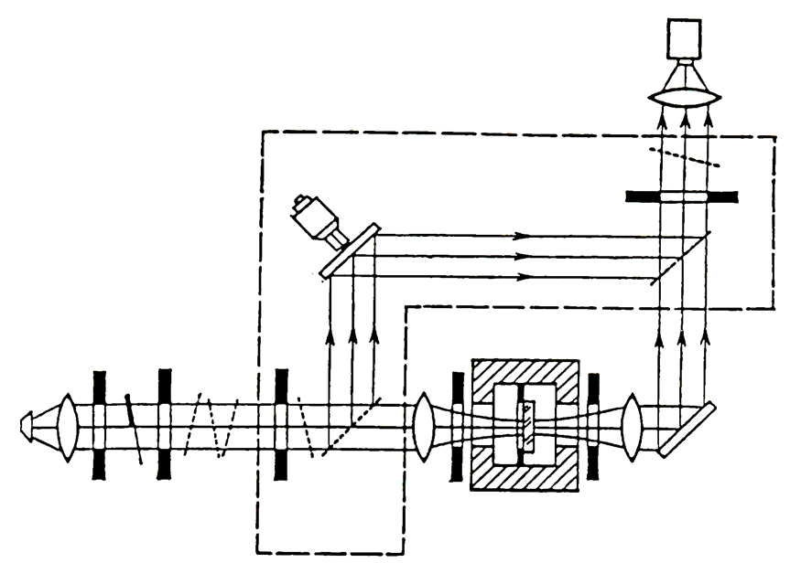
Experimental setup
millimeter wave
wavelength : 0.1～1mm
frequency : 30～300GHz
Mach-Zehnder interferometer
intensity shift
We don’t use the section isolated by the dashed line.
phase shift
The mobile mirror moves all the time, controlled by a feedback tracing system.
superconducting split-coil magnet (～7T)
Millimeter and Submillimeter Wave Spectroscopy of Solids, edited
by G. Gru¨ner (Springer, Berlin, 1998) p. 51.

Slide 20
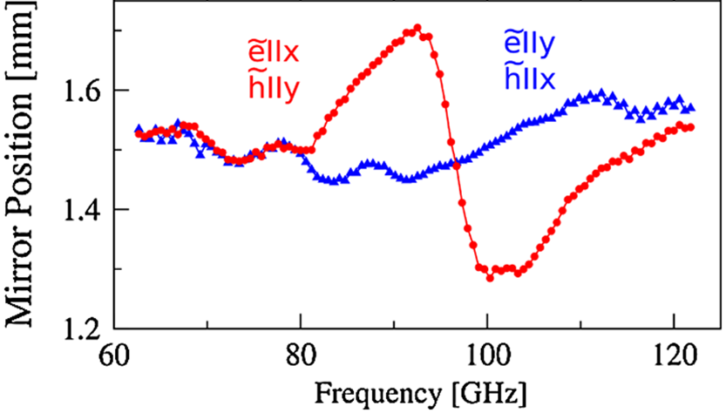
Phase shift of SRR

