Slide 1
M1 colloquium
Possibility of metallic phase and three-dimensional conductance of graphite
Shimizu-group
M1 Daiki Hayashi

Slide 2
Contents
Introduction
metal transition under pressure
about graphite - feature
- under high pressure
- transformation into diamond
- electrical behavior
Works in Shimizu-Lab
electrical behavior of graphite under high pressure and room temperature
Mechanism of c-axis conductance
electrical behavior of graphite under high pressure
Summary & future work

Slide 3
Metal transition under pressure
pressure effect ; shortening of atomic distance
pressure
structural
magnetic
metal-insulator
superconductive
and so on
change of
phase transition
electrical correlation
potential

Slide 4
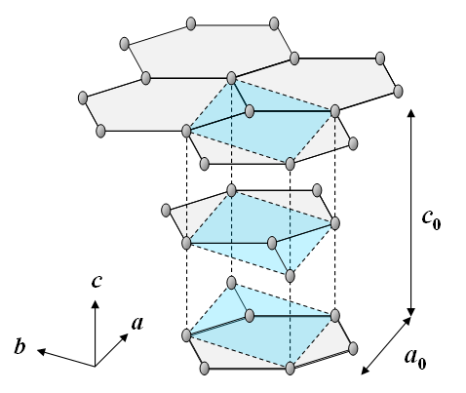
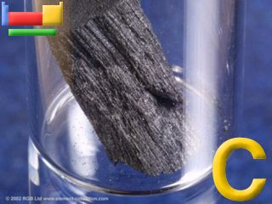
Graphite
semi-metallic material
In-plane・・covalent bonds
Inter-plane・・van der Waals force
a₀ =2.465 Å , c₀ = 6.720 Å
large anisotropy
● ; T. Yagi, et al., Phys. Rev. B. 46, 6031 (1992).

Slide 5
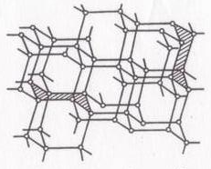
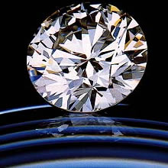
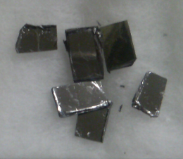
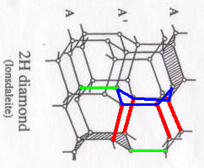
Transformation into diamond
graphite
cubic-diamond
(立方晶)
need high temperature to quench
hexagonal-diamond
(Lonsdaleite)
(六方晶)
ＳＰ^{２} （graphite）
ＳＰ^{３}（diamond）
scarce material in natural
unstable structure

Slide 6
Electrical behavior ⊥c
HOPG (高配向熱分解黒鉛)
(high oriented pyrolytic graphite)
resistance
room temperature
decrease until about 14GPa
decreasing pressure
but, suddenly increase with transition occur
hexagonal diamond
conductor
graphite
×
insulator
increasing pressure
(10 kbar = 1 GPa)
F. P. Bundy and J. S. Kasper, J. Chem. Phys. 46, 3437 (1967)

Slide 7
Our previous works
measurement of a-axis and c-axis resistivity in parallel
Both resistivity decrease and get close
？
three-dimensional conductance
transition into diamond
S. Ona, master thesis, Osaka Univ. (2009).

Slide 8
Temperature dependence
a-axis ; metallic
c-axis ; semi conductive?
K. Matsubara, K. Sugihara, and T. Tsuzuku, Phys. Rev. B 41, 969 ~1990 (1990)

Slide 9
What’s the mechanism of conductance
Sample ; HOPG
size ; φ300 μm * 50~75 μm
resistivity peak at 40 K
below 40 K … metallic
above 40 K … semi-conductive
not shifted with pressure
another method expect carrier-phonon interaction
C. Uher, R. L. Hockey, and E. Ben-Jacob Phys. Rev. B 35, 4483–4488 (1987)

Slide 10
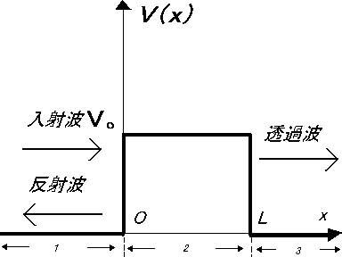
Tunneling model
Stacking faults act reflecting barriers
Stacking fault
used the current-voltage characteristics for a conductor-insulator-conductor junction
conductor
insulator
conductor

Slide 11
Discussion
Fitted by
tunneling
metallic
,g,b,c = constant
best parameters to fit the c-axis resistivity at ambient pressure

Slide 12
Discussion
and g shift higher
affection became small
b and c are relatively independent of pressure
pressure modifies the tunneling probability
difficult to see metallic behavior…

Slide 13
Summary
Graphite has large anisotropy, and c-axis is effected much more than a-axis by pressure
Their resistivity at room temperature gradually become near under pressure
a-axis resistivity has metallic behavior
c-axis resistivity depends so much on structural perfection, and should show metallic behavior in case of single crystal graphite

Slide 14
Future work
observe under more high pressure until just before the transformation
three-dimensional measurement
use single crystalline sample to see metallic behavior

Slide 16
Calculation of single crystal
best synthetically produced graphite
(above 40 K )
from band theory
J. C. Slonczewski and P. R. Weiss, Phys. Rev. 109, 272 (1958)
single crystal graphite
(temperature coefficient of resistivity)
at least below 200 K
high structural perfection is necessary to see metallic behavior

