Slide 1
Three dimensional patterned
MgO substrates
~ fabrication of FZO nanowire structure~
Tanaka Lab. Yasushi Fujiwara

Slide 2
Contents
Introduction of keyword
  3d transition metal oxide & FZO
  Magnetic domain and magnetic domain wall
  Constricted ferromagnetic nanowire structure
  Nano processing procedure for metal oxides
My research
  Sidewall growth method & Fabrication process
  Anneal condition
  Three dimension MgO nanowire structure
  Structure analysis by TEM
  MgO growth mechanism
Conclusion

Slide 3
Contents
Introduction of keyword
  3d transition metal oxide & FZO
  Magnetic domain and magnetic domain wall
  Constricted ferromagnetic nanowire structure
  Nano processing procedure for metal oxides
My research
  Sidewall growth method & Fabrication process
  Anneal condition
  Three dimension MgO nanowire structure
  Structure analysis by TEM
  MgO growth mechanism
Conclusion

Slide 4
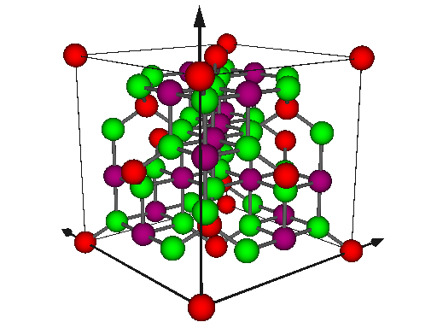
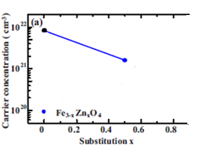
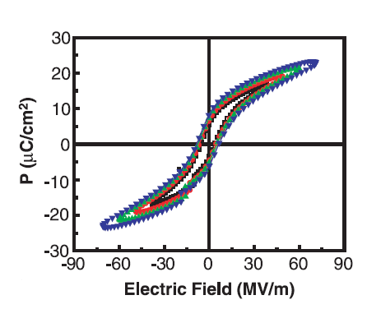
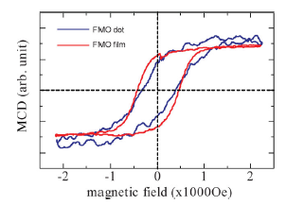
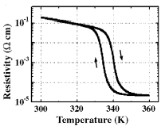
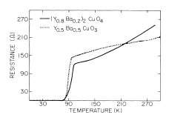
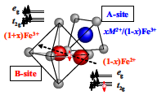
3d transition metal oxide(3d遷移金属酸化物)
Strongly-correlated electron system Variety of function
（強相関電子系）
Ti
Fe_{3-x}Zn_{x}O₄(FZO)
V
Spinel structure
Control of carrier concentrate
High temperature
superconduction
YBa₂Cu₃O₇
Ferromagnetic
Fe₃O₄,Fe_{3-x}Zn_{x}O₄
Ferroelectric
BaTiO₃
Metal-Insulator
transition
VO₂
Fe³⁺
Cr
O²⁻
Mn
Fe²⁺
PRB. 76 205108(2007)
Fe
Ferromagnetic at roomtemperature
and high spin polarization
Co
science 303 661(2004)
Enviromental friendly material
Thin solid films 486 46(2005)
PRL. 58 1574(1987)
small 4 1661(2008)
Ni
Zn
Fe
Clark number
O : (49.5) 1
Fe : (4.70) 4
（環境調和型材料）
Al
O
Cu
O
Si
Fe
PRB. 76 205108(2007)

Slide 5
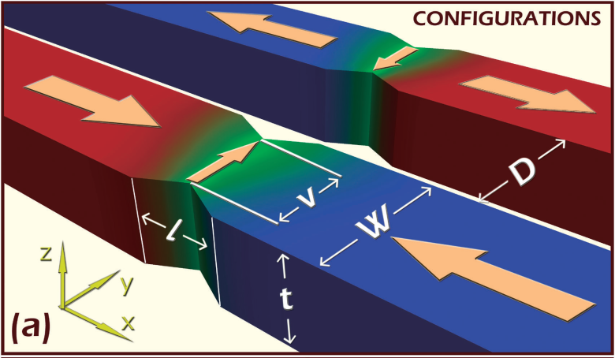
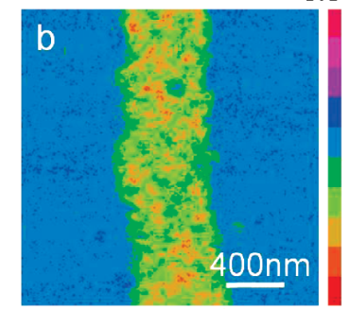
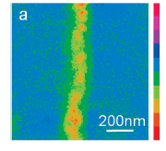
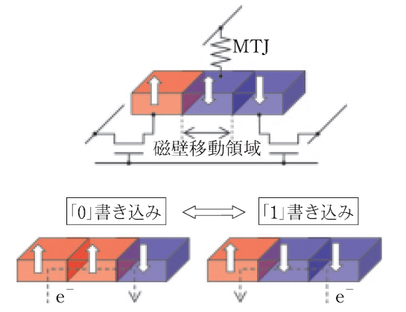
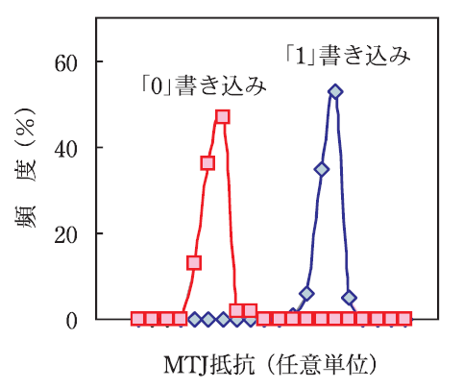
Ferromagnetic nanostructures
Magnetic
domain
Magnitic
domain
wall
Magnetic
domain
Pinning domain wall
50nm
100nm
application
~50nm
~70nm
Applied Physics Express 4 (2011) 033001
Magnetic domain
➞Field of one direction of magnetic moment
Magnetic Domain wall
➞Field of rotation spin among magnetic domain
（磁区）
（磁壁）
Current-driven domain wall motion
in a magnetic constricted nanowire
Fe3-xMnxO4-nanowire MFM image
Merit
Nonvolatile
High speed
High integration
Low consumed power
Unlimitedly write
Unlimitedly read
Nano Lett. 9 1962(2009)
Average of
non-uniform magnetic
Nonconventional giant
nonlinearly response
応用物理 79 1071(2010)

Slide 6
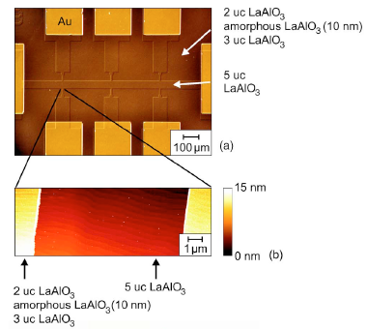
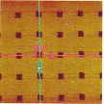
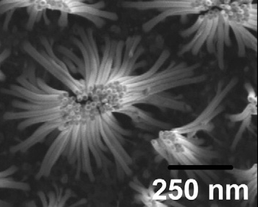
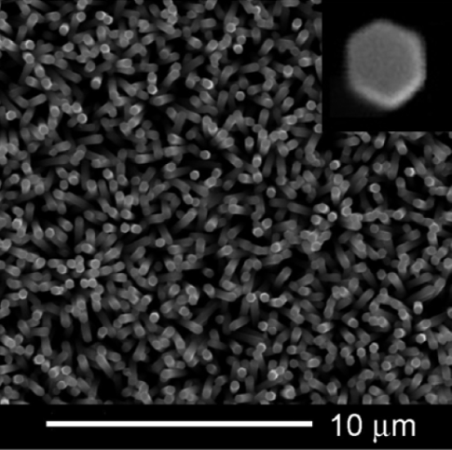
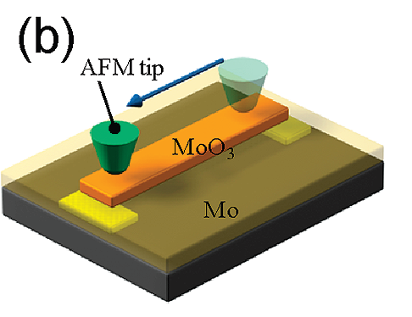
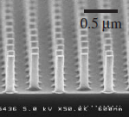
  Nano processing procedure for metal oxides
Oxide has high physical hardness and chemical stability.
It is diffcult to fabricate a few dozen nanometer patterns.
Top down
Bottom up
Photo lithography
FIB lithography
Pulse laser
deposition
chemical vapor
deposition
LaAlO₃
ZnO
Cu₂O₃
ZnO
APL. 89 122101(2006)
APL. 84 5213(2004)
EB lithography
AFM lithography
MoO₃
TiO₂
Appl. Surf. Sci. 253 1758(2006)
Superlattice Microst 46 513(2009)
JJAP. 42 6721(2003)
Nano Lett. 9 1962(2009)

Slide 7
Contents
Introduction of keyword
  3d transition metal oxide & FZO
  Magnetic domain and magnetic domain wall
  Constricted ferromagnetic nanowire structure
  Nano processing procedure for metal oxides
My research
  Sidewall growth method & Fabrication process
  Anneal condition
  Three dimension MgO nanowire structure
  Structure analysis by TEM
  MgO growth mechanism
Conclusion

Slide 8
Combination method
Nanoimprint(NIL)
High processing accuracy of side surface
Control of position and shape
Pulse laser deposition(PLD)
Deposition of thin film from atomic layer
The most suitable method to fabricate thin film of oxide
Excimer laser
  Deposition time and angle
  ➞Control of width
  Shape of substrate
  ➞Control of shape and height of oxide structure
~10nm
substrate
Fabrication of highly ordered nanopattern structures

Slide 9
Purpose
substrate
substrate
Fabrication of highly ordered nanowire structures
Anneal condition of MgO crystalization
Structure analysis by TEM
MgO nanowire growth mechanism

Slide 10
Fabrication process
Three dimension MgO nanowire
MgO
resist
MgO substrate
MgO substrate
MgO substrate
MgO substrate
①cleaning substrate
②nanoimprint
③PLD（MgO）
④removing resist
FZO nanowire
FZO
＜a few dozen nm
MgO substrate
MgO substrate
MgO substrate
⑦removing MgO
⑥PLD(FZO)&ECR
⑤annealing

Slide 11
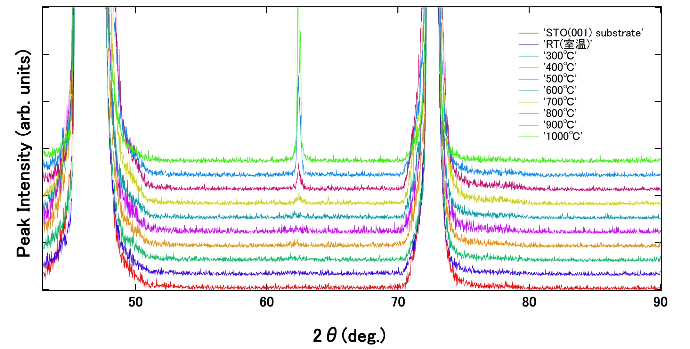
MgO crystallization condition by postanneal
MgO
STO(002)
MgO(022)
STO(003)
STO substrate
STO substrate
MgO was crystallized by postannealing at 1000℃

Slide 12
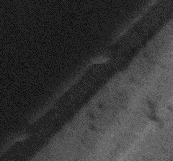
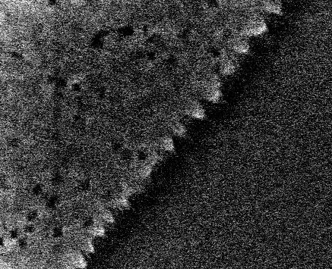
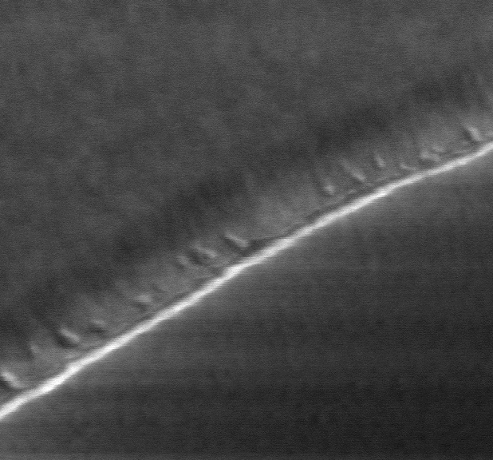
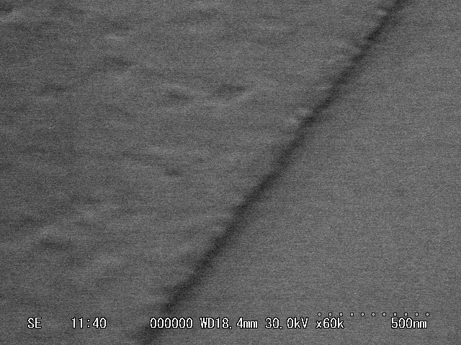
Anisotropy growth of MgO nanowire
Schematic diagram
Before anneal
After anneal (1000℃)
MgO_{nanowire}
MgO_{nanowire}
MgO(001)_{nanowire}
substrate
Zig-Zag line
[010]
[010]
[010]
[010]
MgO(001)_{substrate}
MgO(001)_{substrate}
[100]
MgO_{substrate}
[001]
300nm
[001]
[100]
[001]
[100]
[100]
500nm
MgO_{nanowire}
MgO_{nanowire}
MgO(001)_{nanowire}
Parallel line
[010]
[010]
[010]
MgO(001)_{substrate}
MgO(001)_{substrate}
[100]
MgO_{substrate}
[001]
[100]
300nm
[001]
[100]
500nm
[001]

Slide 13
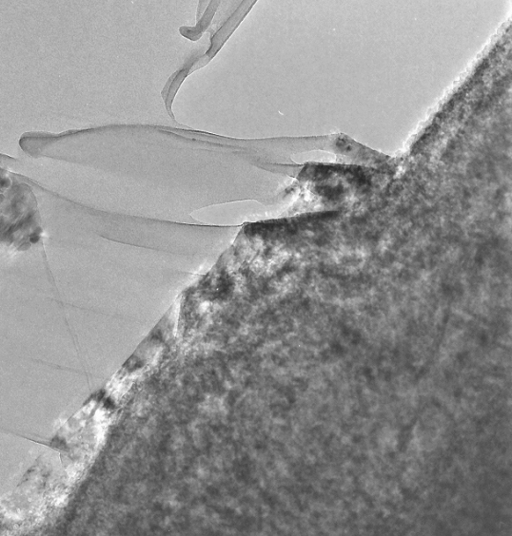

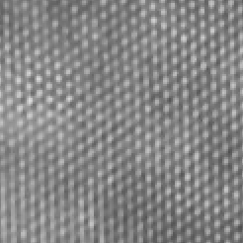
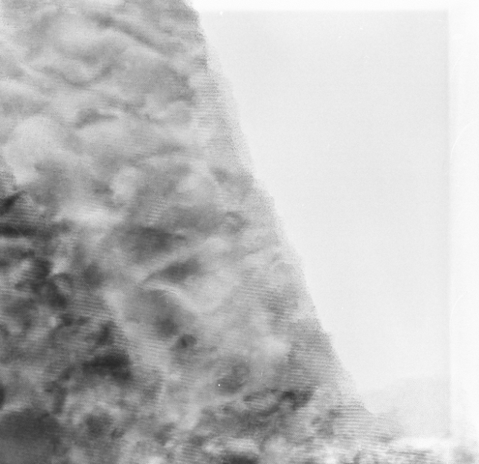

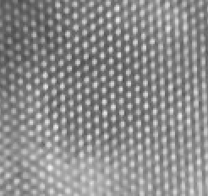
Structure analysis of MgO nanowire (TEM)
MgO nanowire(TEM)
MgO nanowire(FFT)
MgO_{nanowire}
MgO_{substrate}
2nm
200nm
Fracture
direction
MgO substrate(TEM)
MgO substrate(FFT)
[110]
MgO_{nanowire}
MgO_{substrate}
10nm
I confirmed that quality of crystallized MgO nanowires is similar to MgO substrates. MgO grows so that MgO_{nanowire}(001)[100]//MgO_{substrate}(001)[100].
2nm

Slide 14

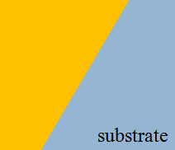
MgO growth mechanism
MgO(001)_{nanowire}
MgO nanowire
substrate
Zig-Zag line
[010]
[010]
[010]
[110]
MgO(001)_{substrate}
[001]
[100]
500nm
[001]
[100]
[100]
Growth
mechanism
MgO(001)_{nanowire}
Flatness line
MgO nanowire
[110]
[010]
[010]
MgO(001)_{substrate}
[100]
500nm
[100]
[001]
[001]
I confirmed that MgO(110) appears in side surface of MgO nanowire.

Slide 15
Conclusion
I tried to fabricate the three dimension MgO nanowire structures.
I confirmed that MgO was crystallized by postannealing at 1000℃.
I confirmed that quality of crystallized MgO nanowires is similar to MgO substrates.
I confirmed MgO growth mechanism by TEM.
I succeed in fabrication of the MgO nanowires structure with flat MgO(110) side surface.
I have been trying to fabricate FZO nanowire structures on the 3D MgO nanowire substrate, and study their magnetic properties.
Future plane

