Slide 1
Switching of Magnetic Ordering in CeRhIn₅ under Hydrostatic Pressure
N. Aso et al., Phys. Rev. B 78, 073703 (2009).
Kitaoka Laboratory
Kazuhiro Nishimoto

Slide 2
Contents
Introduction
- Heavy fermion system
- Motivation
- Crystal and magnetic structure of CeRhIn₅
Measurement
- Neutron diffraction
Result
Summary

Slide 3
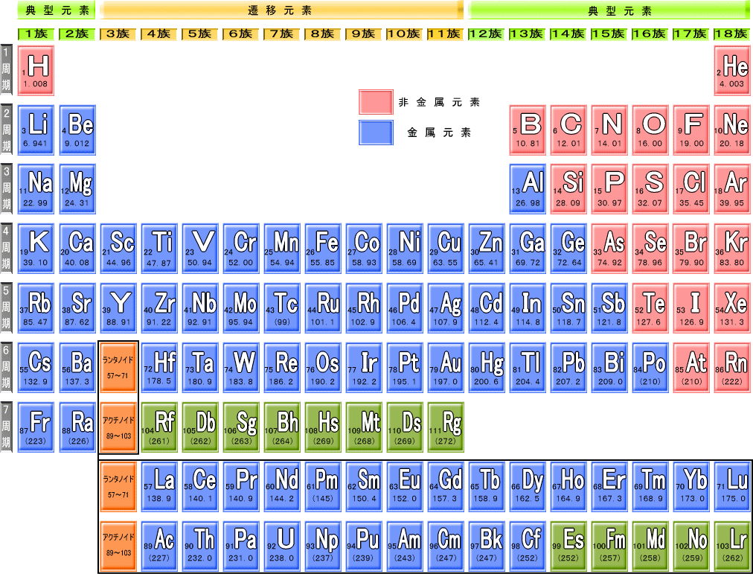
Introduction
Example of Heavy Fermion System
Example of heavy fermion superconductor compounds
CeCu₂Si₂ CePd₂Si₂ CeRh₂Si₂ CeIn₃ CeRhIn₅
UPt₃ UPd₂Al₃
PrOs₄Sb₁₂
PuCoGa₅ etc

Slide 4
Property of f electron
Introduction
Normal metal
Ce³⁺:･･･5s²5p⁶ 4f ¹
＋
＋
＋
closed shell
4f
5p
＋
＋
＋
n(r)
5d
6s
Heavy Fermion system
r
4f
＋
4f
＋
4f
＋
c-f hybridization
Conduction electron
4f
＋
4f
＋
4f
＋

Slide 5
Introduction
What does “Heavy” mean？
“Heavy” ⇒ The effective mass is large
D(ε_{F}) is the electronic density of states at the Fermi energy ε_{F} .
ε
=
m*k_{F}
D
(
)
∝ m* (effective mass)
F
2
π
2
h
2
Specific heat : C =γT [γ = (2/3)π²k_{B}²D(ε_{F})]
Susceptibility : χ = χ₀ [χ₀ = 2μ_{Β} ²D(ε_{F})]
Resistivity : ρ = ρ₀ + AT ^{n} [A ∝ ∝γ²]
γ_{heavy} /γ_{normal} ＝ 100 ~ 1000

Slide 6
Two types of interactions
Introduction
RKKY interaction
Kondo effect
(RKKY:Rudermann-Kittel-Kasuya-Yoshida)
Conduction electron
Conduction electron
Polarization
J_{cf}
J_{cf}
J_{cf}
4f electron (Ce)
4f electron (Ce)
4f and conduction electrons form a spin-singlet state.
The interplay between two 4f electrons mediated by conduction electrons
Magnetic Order
Fermi Liquid
heavy fermion system : 重い電子系

Slide 7
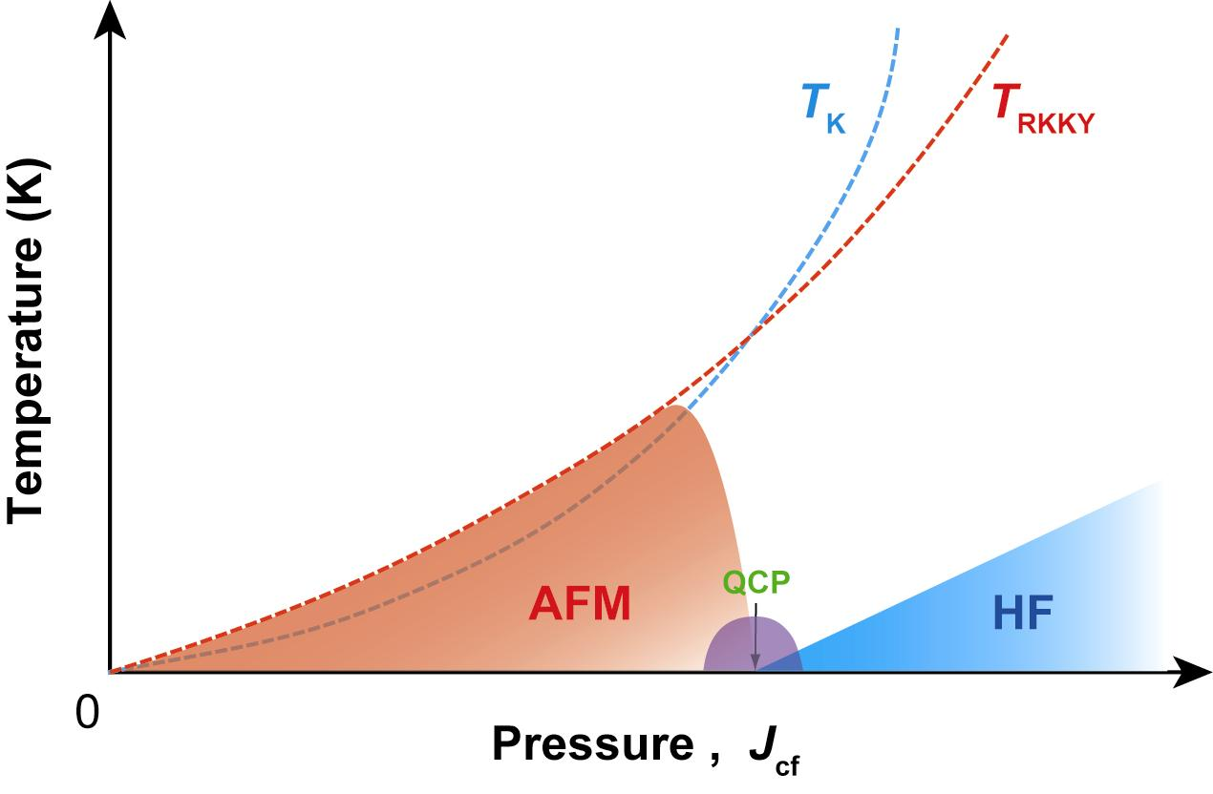
Phase Diagram of HF system
Introduction
T_{K} ∝ W exp(-1/J _{cf} D(ε_{F}))
T_{RKKY} ∝ D(ε_{F}) J_{cf}²
As J_{cf} increases , AFM disappears
and SC appears (near QCP)
AFM : antiferromagnetism(反強磁性)
HF : heavy fermion(重い電子状態)
QCP : quantum critical point(量子臨界点)

Slide 8
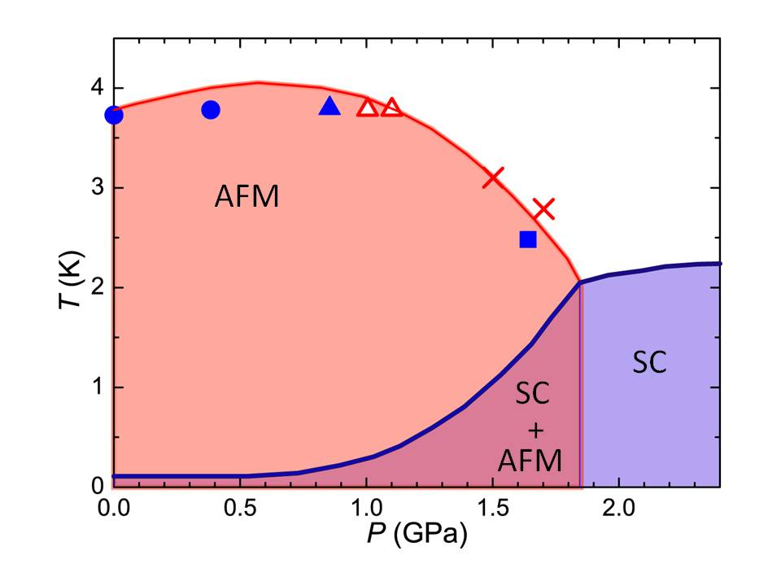
Motivation
Introduction
T-P phase diagram for CeRhIn5
AFM
SC
CeRhIn₅ has a phase that AFM coexists with SC.
Is the AFM order affected by SC?
What happens to magnetic order?

Slide 9
Introduction
Crystal and magnetic structure of CeRhIn5
Propagation wave vector
Q = (0.5, 0.5, ±δ)
Incommensurability : δ
P = 0 GPa: δ = 0.297
Neutron diffraction
P=0 GPa

Slide 10
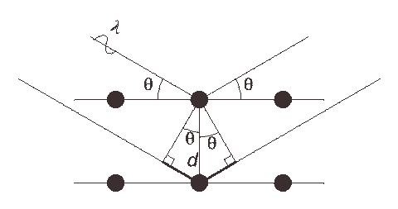
Neutron diffraction
Measurement
X-ray
Brugg reflection
neutron
s = 1/2
Neutron diffraction can
reveal magnetic structure.

Slide 11
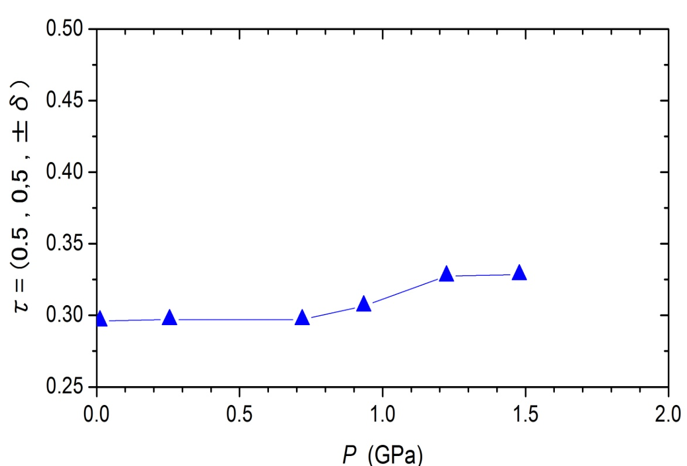
Neutron diffraction along the (0.5, 0.5, L) direction in the non-SC state
Results
(a)
P ～0.25 GPa
T = 0.73 K
4.9K
(c)
●
(b)
P ～0.93 GPa
T = 0.75 K
(a)
(b)
●
●
(c)
P ～1.48 GPa
T = 2.0 K
δ increases with increasing P
in the non-SC state.
How does δ changes in SC state?

Slide 12
Neutron diffraction profiles under P～1.48 GPa
Results
●
●
●
The peak at Q₁ gradually lowers
and completely disappears at 0.75 K.
A new peak (Q₂) emerges at 0.9 K
and becomes large at 0.75 K.

Slide 13
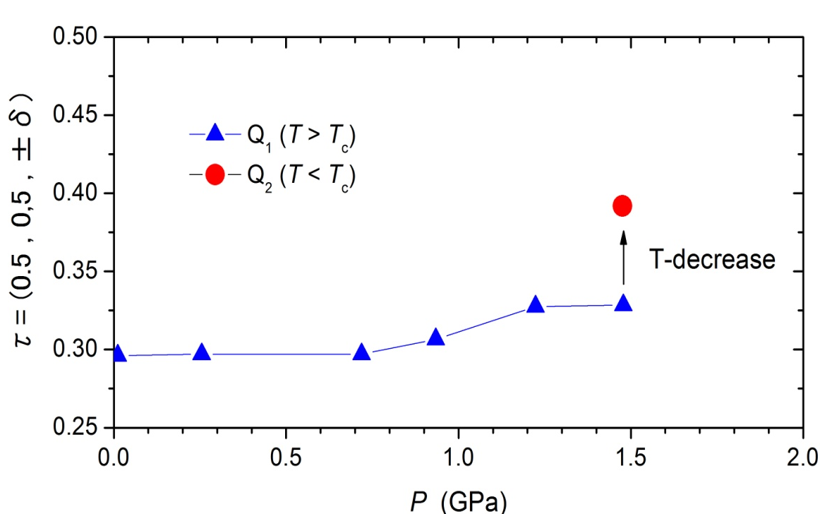
T-dependence of the peak intensities
Results
Pressure evolution of δ
T(K)
Switching of the two magnetic vectors occurs at T_{c}.
It suggests that the AFM order is affected by the SC.

Slide 14
Summary
In CeRhIn₅ , the AFM coexists with the SC under high pressure and low temperature.
Switching of two magnetic ordering vectors (Q₁ & Q₂) occurs at T_{c}.
Switching suggests the possibility that the AFM order is affected by the SC.

