Slide 1
Fabrication of (Fe,Mn)₃O₄ nanowires using a sidewall deposition method
M1 colloquium 8/6/2011
(サイドウォール蒸着を用いた(Fe,Mn)₃O₄ナノワイヤーの作製)
Tanaka lab
Takayoshi Kushizaki

Slide 2
Contents
・background of my research
・the method to fabricate nano wires
・structural analysis of nano wires
・summary
My experiment

Slide 3
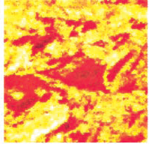
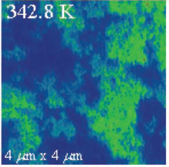
The effect of nano structures
The strongly correlated electron materials oxide
Nano scaled domain structure
(強相関電子系酸化物)
(La,Ca)MnO₃ thin film
VO₂ thin film
Ferromagnetic metal
insulator
Paramagnetic insulator
metal
Science 285, 1540 (1999)
Science 318, 1750 (2007)
Giant physical properties in nano structures

Slide 4
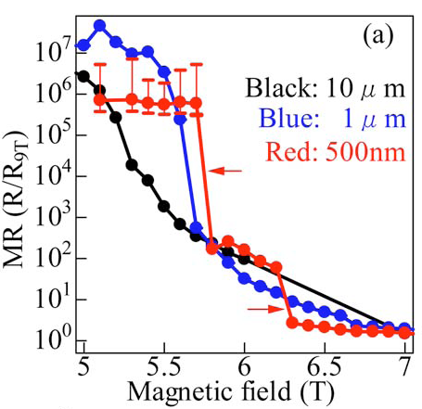
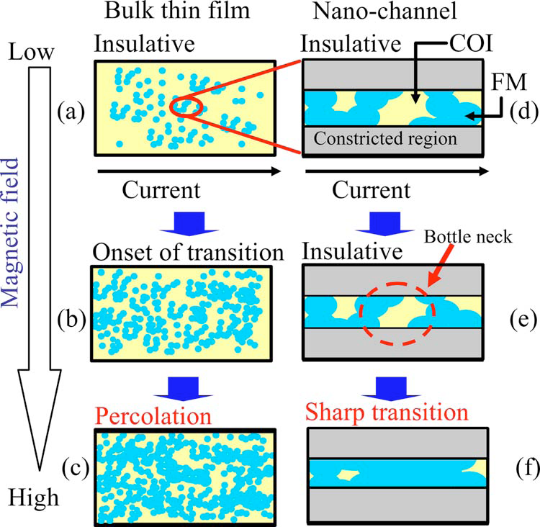
Drastic change by fabricating nano structure
(La,Pr,Ca)MnO₃
J.Appl.Phys. 100, 124316 (2006)
Pick up the intrinsic physical property

Slide 5
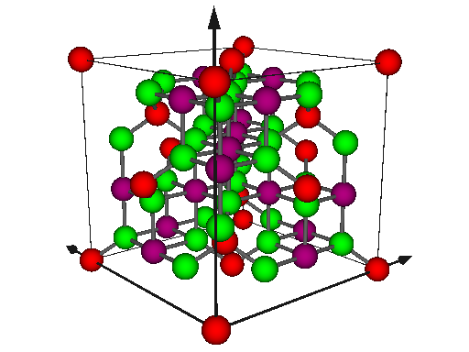
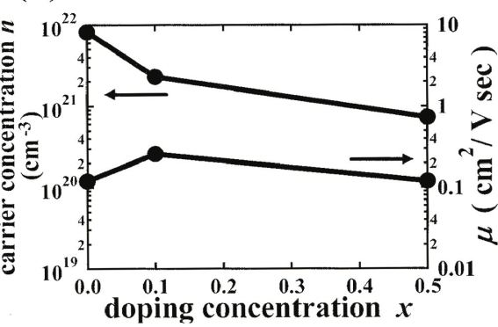
My target : (Fe_{3-x}Mn_{x})O₄
(Fe_{3-x}Mn_{x})O₄ : Mn doped Fe₃O₄
Spinel structure
・high curie temperature(Tc)
・control carrier density by doping Mn
Application for devise
Appl. Phys. Lett. 86, 222504 (2005)
・High spin polaryzation (スピン偏極率)
Large MR
Magnetoresistance(MR):
the phenomenon that resistance changes by applied magnetic field

Slide 6
The method to fabricate nano wires
Sidewall deposition
2.Deposite target
along with the wall
(蒸着する)
3.Remove the wall
1.Fabricate wall
Nano wire
Control height
Control width
It is possible to fabricate nano wires that height and width are 10-100nm easily.

Slide 7
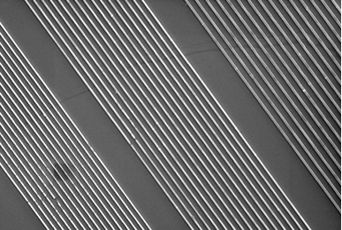
Fabricate wall using nanoimprint
mold
UV
Nanoimprint
resist2
resist1
Al2O3
resist1:stiffening by heat
resist2:stiffening by UV
fabrication pattern(wall)
CF4 plasma
O2 plasma
etching
10μm

Slide 8
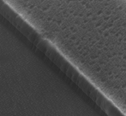
Deposite target and remove the wall
Pulsed laser deposition
Target(FMO)
Pulsed laser
FMO
deposition of FMO
1μm
Ar plasma
FMO nano wire
solution
immersion(浸漬)
milling
annealing

Slide 9
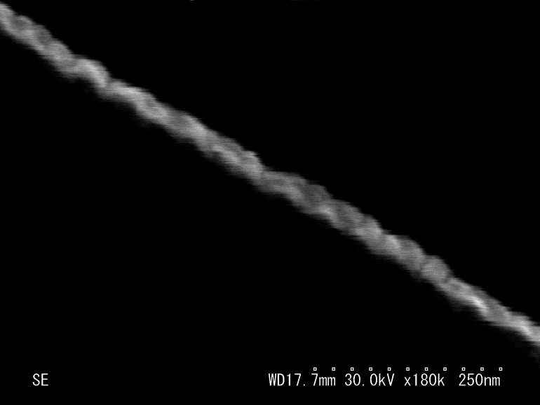
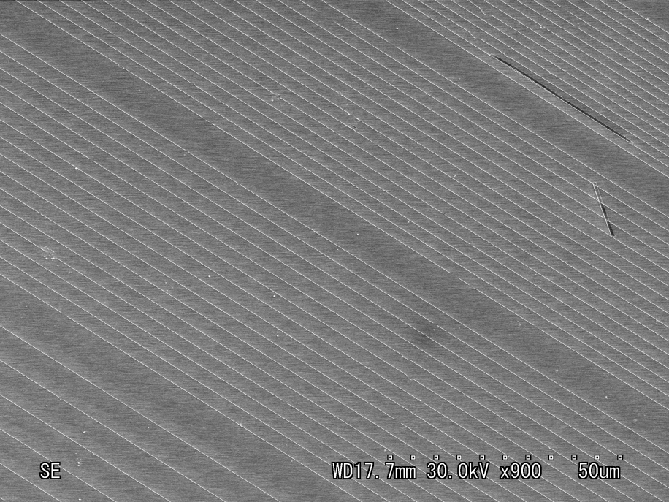
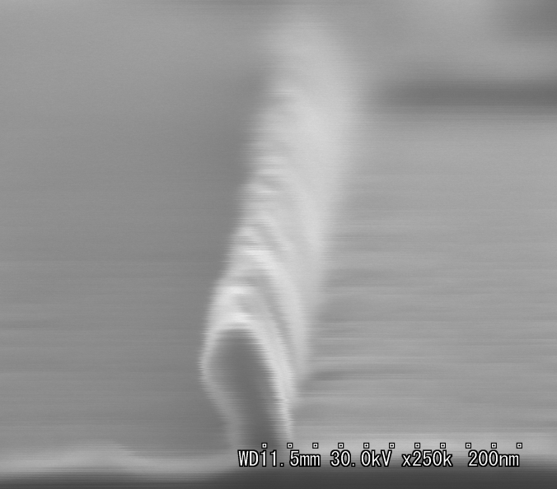
Structure of FMO nano wires(SEM)
Top view
35nm
250nm
Cross sectional view
100nm
50μm
width：30-100nm
height：100-150nm
length：100μm-
140nm
Many wires in large field
40nm

Slide 10
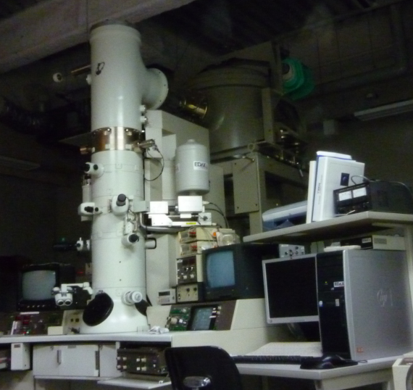
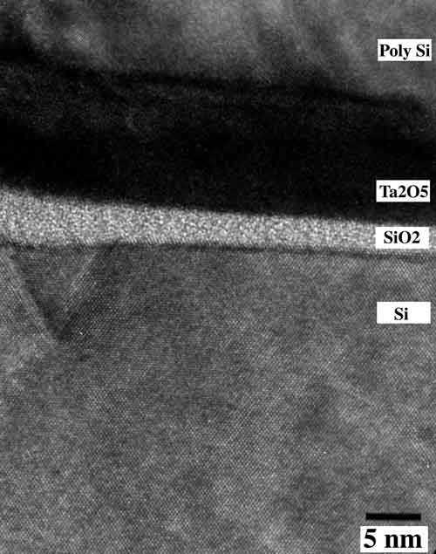
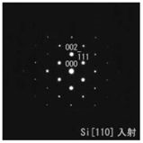
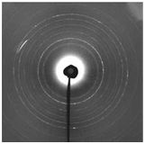
Transmission Electron Microscope(TEM)
(透過型電子顕微鏡)
TEM
・high resolution (0.1nm-)
・diffraction image
→identification of material,
analysis of crystal condition
TEM image
Selected area diffraction image
monocrystal
polycrystal
（Ta2O5）MOS structure

Slide 11
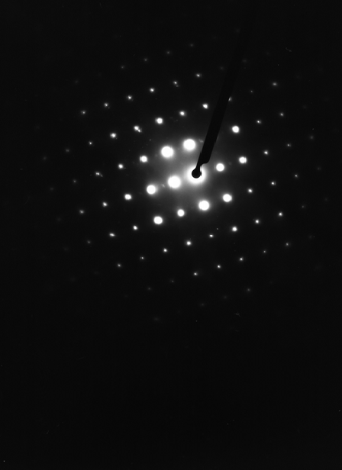
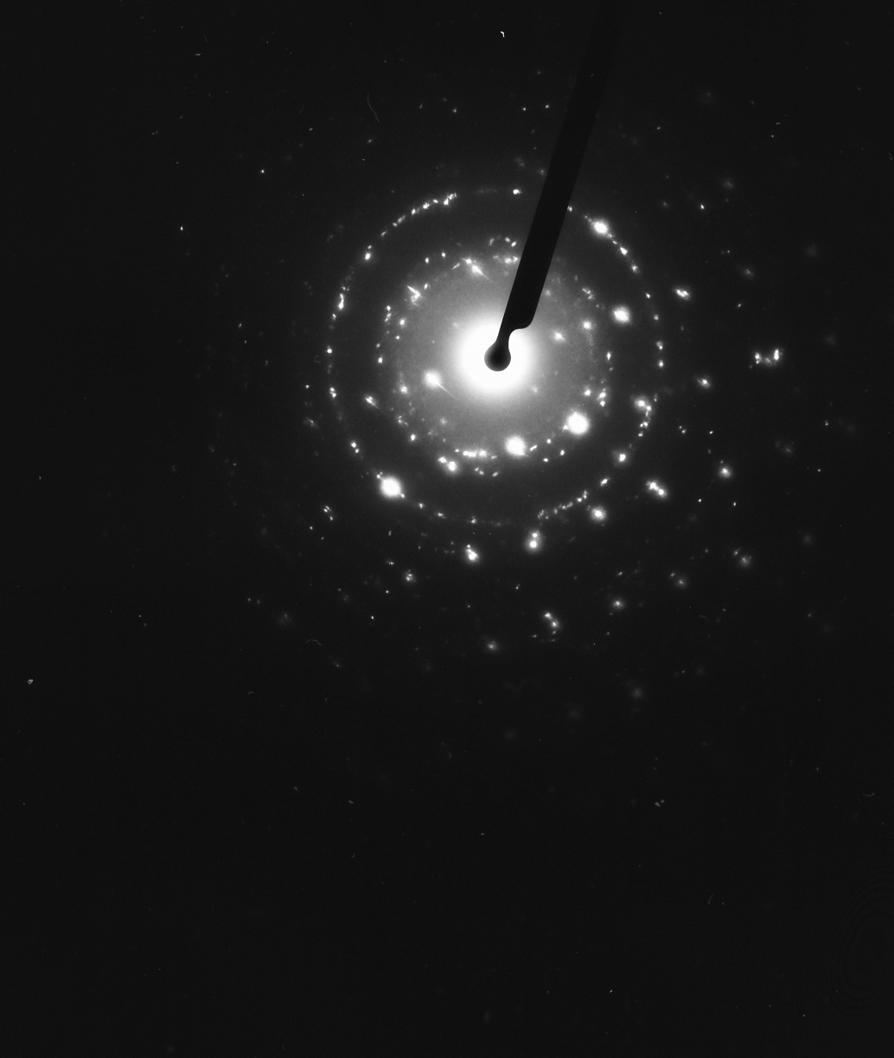
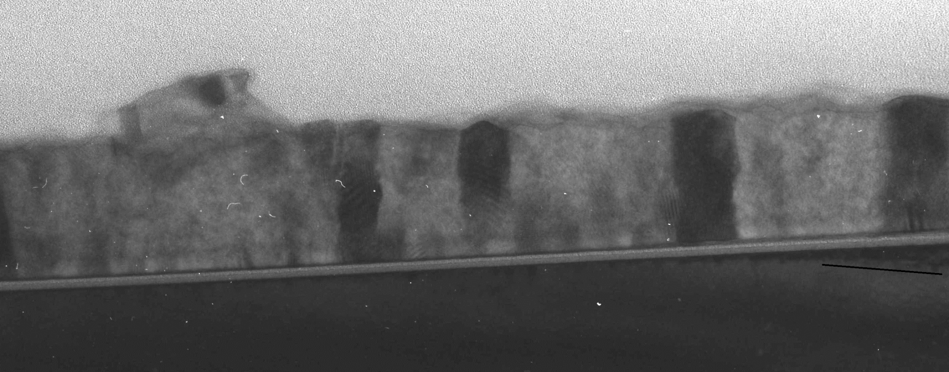
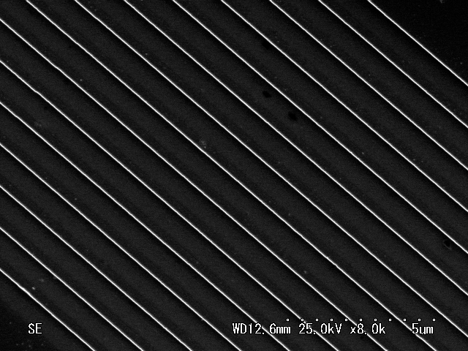
Structural analysis of FMO nanowire(TEM)
FMOナノワイヤーの構造解析
resin(樹脂)
FMO
wires＋Al₂O₃
TED Image
Al₂O₃
Al
Al₂O₃
50nm
(111)FMO
[1100]Al₂O₃
(210)FMO
(310)FMO
(321)FMO
[0001]Al₂O₃
[1120] Al₂O₃
I succeeded in fabrication of polycrystal nano wires.

Slide 12
Summary
・I established the process that fabricates FMO nano wires using a sidewall deposition method.
・I succeeded in fabrication of polycrystal FMO nano wires which were width 30-100nm,height 50-150nm, length100μm over.
I will investigate the MR property of a nano wire.

Slide 13
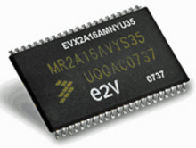
Magnetoresistance(MR)
(磁気抵抗効果)
Magnetoresistance(MR):
the phenomenon that resistance changes by applied magnetic field
TMR junction
ferromagnetics
Application devise
insulator
MRAM
(磁気メモリ)
H
・nonvolatile
・fast reading and writing speed
The ultimate memory
current

Slide 14
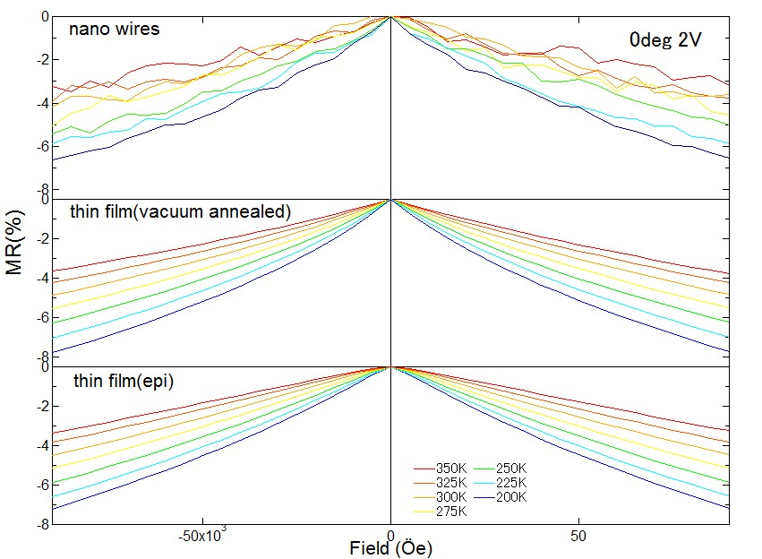
MR (thin film vs wires)
Nano wires have a MR property that is similar to poly and epi films.

