Slide 1
Terahertz spectroscopy of electromagnons excitation in a hexaferrite Ba₂Mg₂Fe₁₂O₂₂
Phy.Rev. B 80, 220406(R) (2009)
Phy.Rev.B 83, 064422(2011)
Ashida Lab.
Tadataka Saito

Slide 2
Contents
Introduction
Polarization and magnetization
Multiferroics
Electromagnon
Method
THzTDS
Results
Conclusion

Slide 3
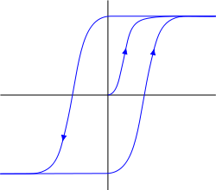
Polarization and Magnetization
Introduction
強誘電性と強磁性
Polarization
分極
Ferroelectric and Ferromagnetic
+
+
-
-
P
E
+
+
+
+
-
-
+
+
Magnetization
磁化
Application for memory devices
H
M
M=0

Slide 4
Multiferroics
Introduction
Multiferroics are materials where ferroelectricity and
ferromagnetism are inherently coupled.
E
P
H
M
The magnetization can be controlled by electric field of light.
The polarization can be controlled by magnetic field.

Slide 5
Magnetoelectric effect (ME effect)
Introduction
In 2003,RMnO₃(R; rare earth element)
Spiral-spin-order
らせんスピン磁性
c
P_{total} //c
b
a
bc-spiral
Polar lattice distortion
Induce Polarization
空間格子の反転対称性の歪み
Antisymmetry
Dzyaloshinskii-Moriya interaction

Slide 6
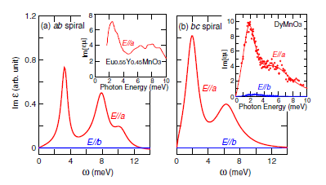
Electromagnon
Introduction
Magnon
Spin wave
Magnon is exited by magnetic field of light.
Multiferroics
Magnon can be excited by electric field of light.
Electromagnon
(2006)

Slide 7
Theory of electromagnon
Introduction
ME effect
P_{total} //c
c
b
a
E^{ω}//a
Symmetric exchange interaction
Mn
O
E
Mn

Slide 8
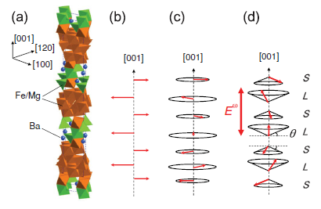
Hexagonal ferrite Ba₂Mg₂Fe₁₂O₂₂
Introduction
六方晶フェライト
Ferri magnetic
proper screw
Conical spin
Room temperature
T<195K
T<50K
By neutron diffraction

Slide 9
Transition of spin phase by magnetic field
Introduction
(001)
(120)
(100)
Proper screw
Longitudinal conical spin
Ferrimagnetic
θ
H(>3T)
H//[001]
Transverse conical spin
Ferrimagnetic
H//[100]
H(＞4T)

Slide 10
Method
Terahertz time-domain spectroscopy (THz-TDS)
THz-TDS enables us to observe a waveform of ”E(t)” directly.
By using THz-TDS , both amplitude and phase of ”E(t)” are directly obtained.
Probe beam
fs pulse laser
Pump beam
THz detector
Delay stage
THz emitter
sample
THz-TDS

Slide 11
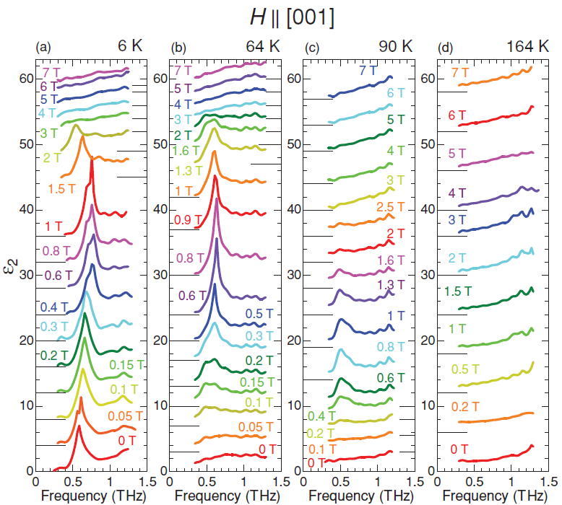
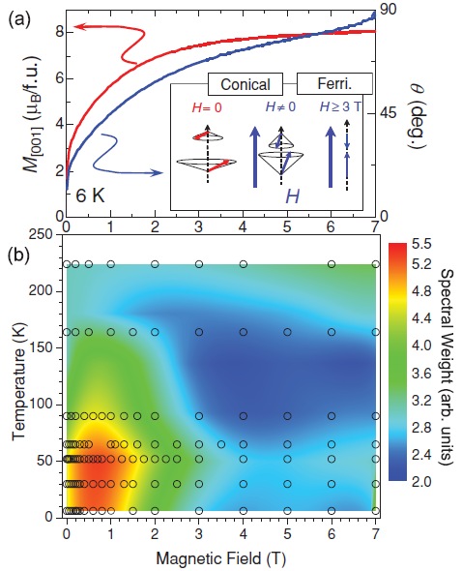
Longitudinal conical form
Results
F
F
F
C
C
Proper
Ferri
Conical
Conical
Proper-screw
Ferri

Slide 12
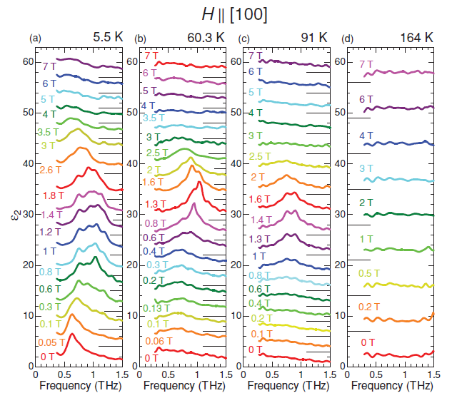
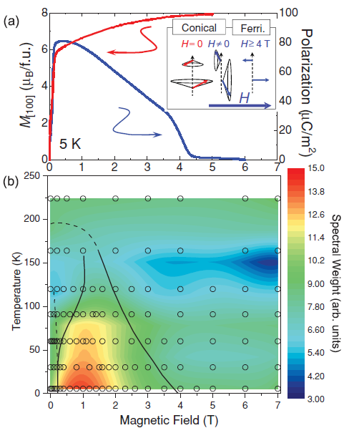
Transverse conical form
Results
F
F
F
C
C
Ferri
Proper
Conical
Conical
Proper-screw
Ferri

Slide 13
Conclusion
Conclusion
・The electromagnon appears only in the conical spin
ordered phase but irrespective of the longitudinal or
the transverse conical form.No electromagnon is
observed in the properscrew or ferrimagnetic phase.
・The symmetric exchange interaction (S_{i}・S_{j}) is dominant
source of the observed electromagnon.
Noncolinear spin structure
Electromagnon
at room temperature
at room temperature

Slide 16
Purpose
・To investigate the situation where electromagnon induced
by changing temperature and external magnetic field
・How the intensity of the absorption by electromagnon
depend on the external magnetic field?
Is it possible to induce electromagnon at room temperature?

Slide 17
Decide optical coefficient
Sample
d
Fourier transformed spectrum
Transmission Fresnel constants

Slide 18
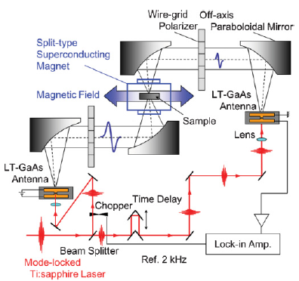
Experimental set up

Slide 19
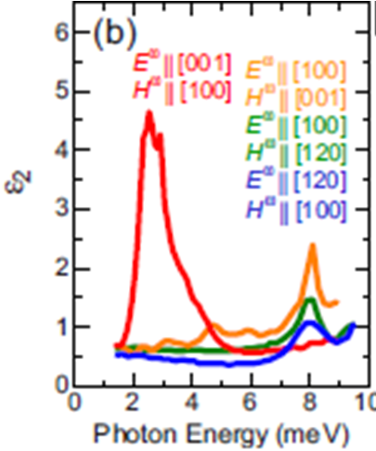
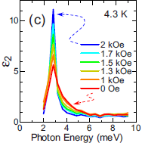
Emergency of electromagnon
Results
depend on the direction of electric field
at conical spin phase(4.3K)
depend on the external magnetic field
(H//[001],4.3K)
Absorption by electromagnon is obserbed around 2.8meV(0.7THz).
Phy.Rev. B 80, 220406(R) (2009)

Slide 20
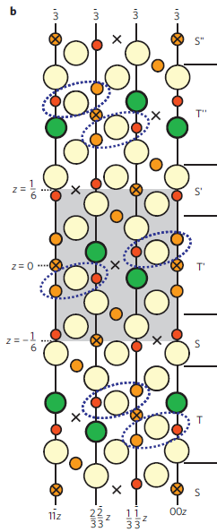
Y-type

Slide 21
Spiral spin structure
時計回り
反時計回り
反転対称性が崩れる
格子歪みによる分極発生

Slide 22
Electromagnon
[001]
L
[100]
・observed at THz region
・depends on the direction of electric field
・The intensity of absorption depend on
the external magnetic field.
S
Magnon
Energy
at THz region
(0.1THz-10THz)
0.41meV-41meV
H
………..
[120]

Slide 23
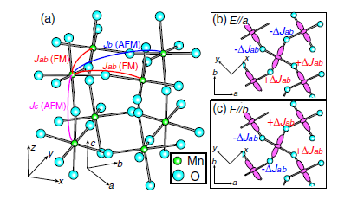
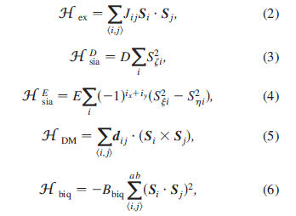
RMnO3 electromagnon

