Slide 1
First-principles calculation of electronic properties of YBa₂Cu₃O_{6+y} by using the self-interaction correction method
Yoshida Lab
Tatsuo Kano

Slide 2
Contents
Introduction
Computational Materials Design
First-principles calculation
DFT(Density Functional Theory)
LDA(Local Density Approximation)
SIC(Self Interaction Correction)
YBa₂Cu₃O_{6+y}
Crystal structure
Phase diagram
Summary
My work

Slide 3
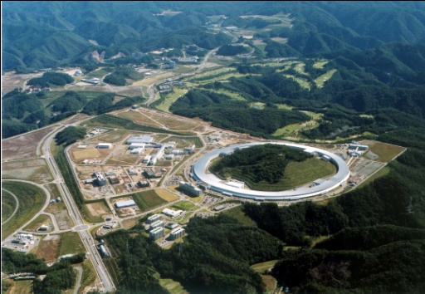
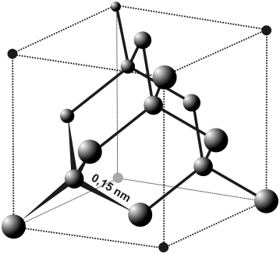
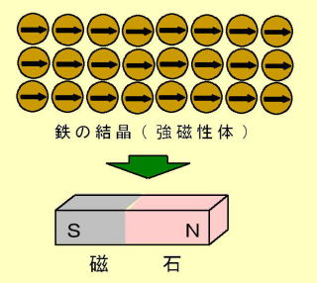
Computational Materials Design
Calculation & Simulation
Experiments
New ideas
Physical properties

Slide 4
First-principles calculation
Predict physical properties of materials ← Input parameters: Atomic Number and Atomic position
No external parameters (experimental values) required.
Advantage
・Low costs
・Extreme conditions
・Ideal environment

Slide 5
DFT(Density Functional Theory)
ψ_{i}(r)
?
veff(r)
Notes:
交換相関エネルギー

Slide 6
LDA(Local Density Approximation)
We do not know the v_{xc} and we need approximate expressions of them to perform electronic structure calculations.
For a realistic approximation, we refer homogeneous electron gas.
Local Density Approximation (LDA)
When the electron density changes in the space, we assume that the change is moderate and the electron density is locally homogeneous.
Notes:
交換相関エネルギー

Slide 7
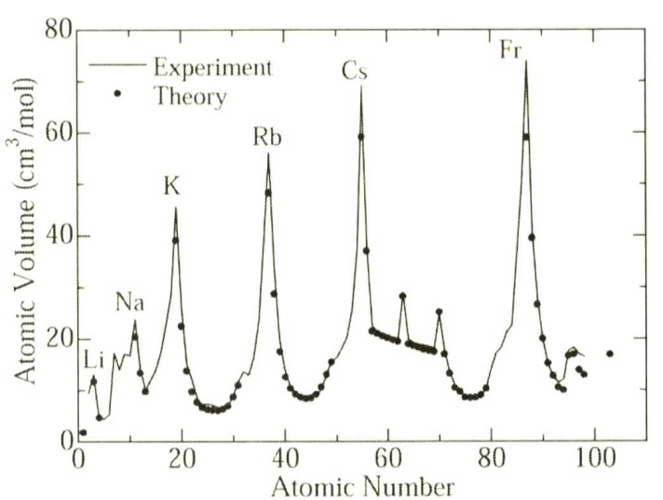
Success of LDA
For almost of all materials, the LDA can describe electronic structures reasonably !
Calculated atomic volume (lattice constant) as a function of atomic number.
E_{total}
E_{min}
笠井英明，赤井久純，吉田博 編 ;
「計算機マテリアルデザイン」（大阪大学出版会）
a
r
(lattice constant)
O

Slide 8
LDA error
LDA(Local Density Approximation) error may occur magnetic and strongly-correlated systems.
Underestimation of lattice constant.
Overestimation of cohesion energy.
Underestimation of band gap energy.
Occupied localize states (d states) at too high energy.

Slide 9
SIC(Self Interaction Correction)
LDA error can be attributed to the presence of the self-interaction (SI) in the LDA energy function.
The SI is present in systems characterized
by spatially localized electron charges such as 2p,3d, and 4f electrons.
SIC is a solution of the error.
A. Filippetti, N. A. Spaldin, Phys. Rev. B67, 125109 (2003)

Slide 10
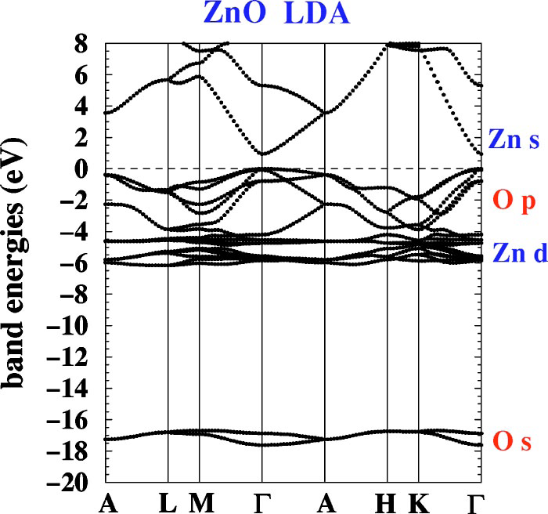
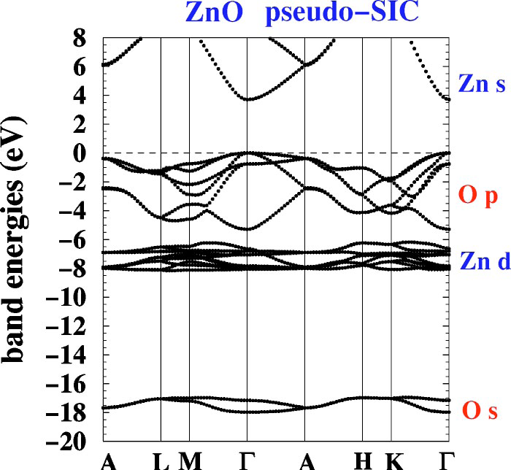
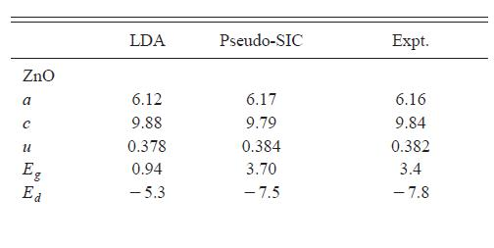
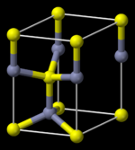
A. Filippetti, N. A. Spaldin, Phys. Rev. B67, 125109 (2003)
Notes:
実験は角度分解光電子分光

Slide 11
YBa₂Cu₃O_{6+y}
La-Ba-Cu-O
Superconductivity
Electrical resistance → ０
Meissner effect
1911 Hg (4.2K)
1986 La-Ba-Cu-O
1987 YBa₂Cu₃O_{6+y} (90K)
J.G.Bednorz and K.A.Muller ; Z.Physik B64,189 (1986)
Notes:
内部磁場 ０

Slide 12
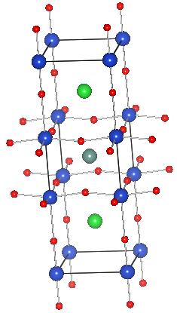
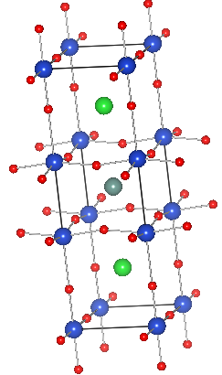
Crystal structure
Y
O
Cu
Ba
YBa₂Cu₃O_{6+y}(simple tetragonal）
YBa₂Cu₃O₇(simple orthorhombic ）
Warren E. Pickett ; Rev. Mod. Phys. 61, 433 (1989)

Slide 13
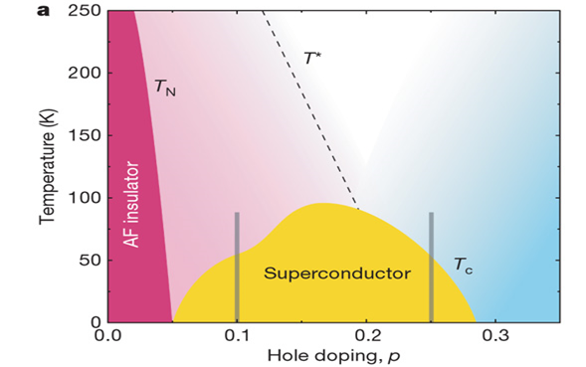
Phase diagram
YBa₂Cu₃O_{6+y}
y
0
0.5
1
M. A. HOSSAIN et al. Nature Phys. 4, JULY (2008)
 | Eg(LDA) | Eg(expt) | M(LDA) | M(expt)
YBa₂Cu₃O₆ | 0.33eV | 1.7eV | 0.02 | 0.48
P. Wei, Z. Qing ; Phys. Rev. B49, 17 (1994)

Slide 14
Summary
LDA is a reasonable method in electronic structure calculations, but error may occur magnetic and strongly-correlated systems.
SIC is a solution of the error.
YBa₂Cu₃O_{6+y} change electronic properties for oxygen doping.

Slide 15
My work
I will calculate electronic properties of YBCO using the self-interaction correction method.
I will observe change of magnetism with doping.

Slide 16
おわり

Slide 17
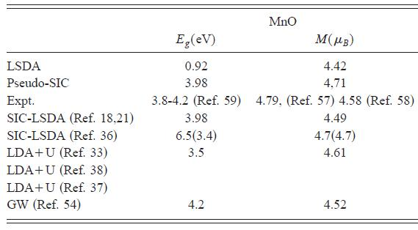
A. Filippetti, N.A. Spaldim ; Phys. Rev. B67, 125190 (2003)

Slide 18
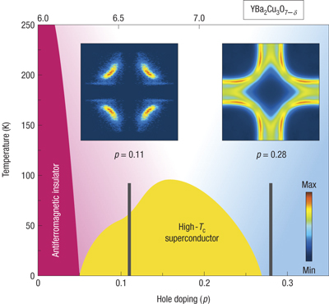
Phase diagram
M. A. HOSSAIN et al. Nature Phys. 4, JULY (2008)

Slide 19
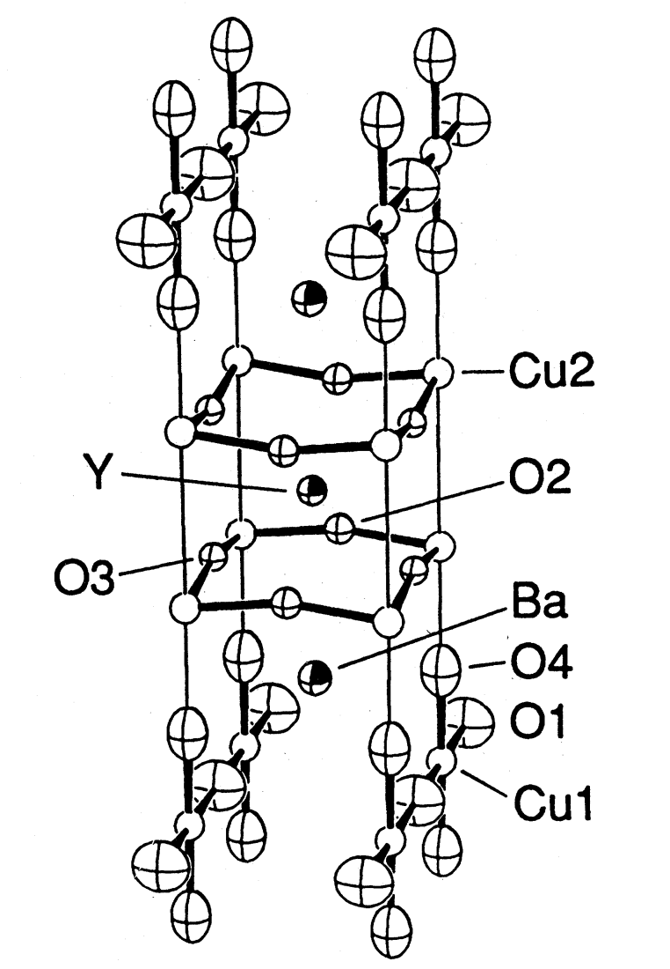
Atomic environment
YBa₂Cu₃O₇
(simple orthorhombic )
a | 3.8591Å
b | 3.9195Å
c | 11.8431Å
z_{Cu2} | 0.3574
z_{O2} | 0.3767
z_{O3} | 0.3804
z_{O4} | 0.1542
z_{Ba} | 0.1895
Warren E. Pickett ; Rev. Mod. Phys. 61, 433 (1989)

Slide 20
Magnetism
Ferromagnetism(強磁性）
Antiferromagnetism(反強磁性）
Paramagnetism（常磁性）

Slide 21
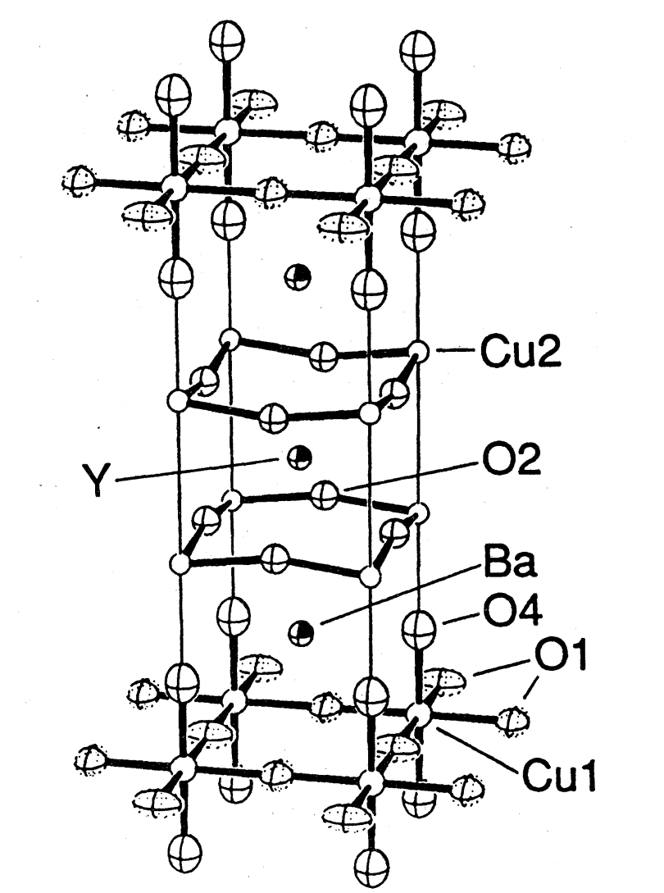
YBa₂Cu₃O_{6+y}
YBa₂Cu₃O_{6+y}(simple tetragonal）
YBa₂Cu₃O₇(simple orthorhombic ）
Warren E. Pickett ; Rev. Mod. Phys. 61, 433 (1989)

Slide 22
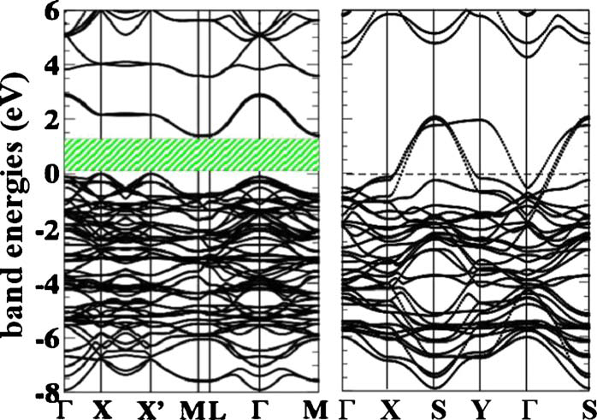
UNDOPED YBCO
AF YBa₂Cu₃O₆
PM YBa₂Cu₃O₇

Slide 23
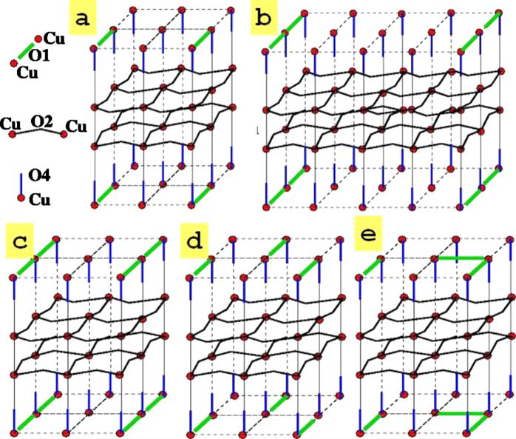
Oxygen doping
super-cell method

Slide 24
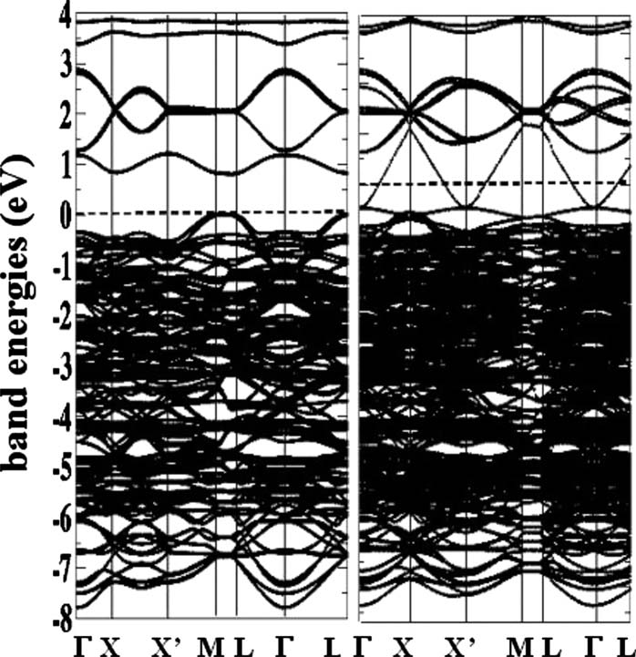
y=1/4(YBa₂Cu₃0_{6.25})
the doping hole forms a dispersed 1.5 eV wide band.
the dispersion is strongly one-dimensional.
a
b

Slide 25
DFT(Density Functional Theory)
n(r) → E

Slide 26
LDA error
LDA(Local Density Approximation) error may occur magnetic and strongly-correlated systems.
Underestimation of lattice constant.
Overestimation of cohesion energy.
Underestimation of band gap energy.
Occupied localize states (d states) at too high energy.
P. Wei, Z. Qing ; Phys. Rev. B49, 17 (1994)

Slide 27
ZnO
wurtzite

