Slide 1
The review of experimental techniques of generating high pressure: search for superconductivity of beryllium under high pressure
Shimizu-lab
M-1 Kubota Kazuhisa

Slide 2
Contents
・ Introduction
About the pressure
In case of H₂O
・Experiments
How to make the high pressure
About DAC
Superconductivity of single elements
Property of beryllium
Experiment
・ Summary

Slide 3
Introduction
What is KYOKUGEN ?
I am researching physicality in this field.
High Pressure
Strong Magnetic Field
Low Temperature

Slide 4
About the pressure
Pressure is one of the important physical quantity.
Ex.
Ideal gas low : PV=RT
Pressure effect
Make some change physical properties!
pressure
・ Volume
・ Some phase transition
Structural phase transition
Magnetic phase transition
etc…

Slide 5
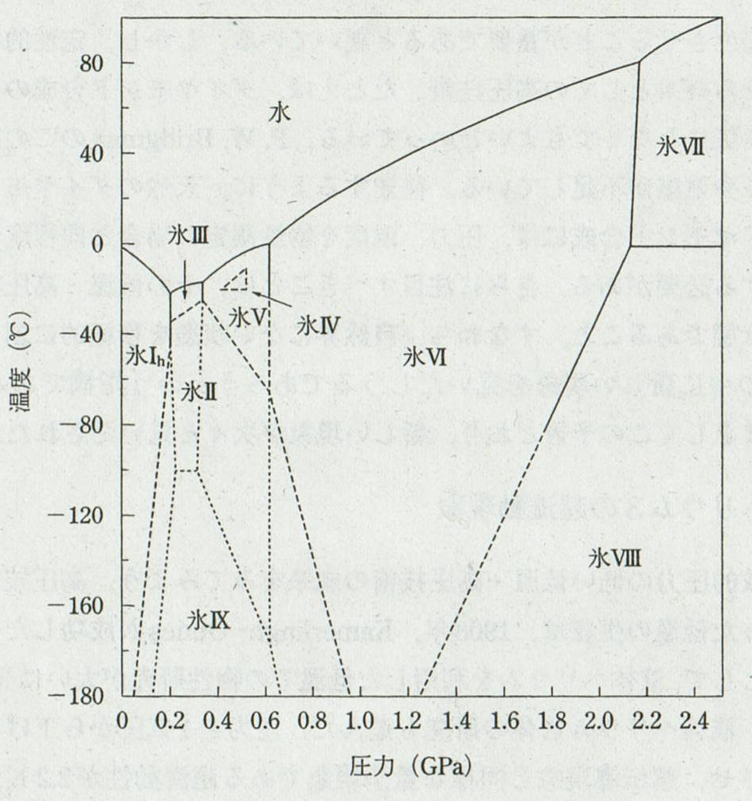
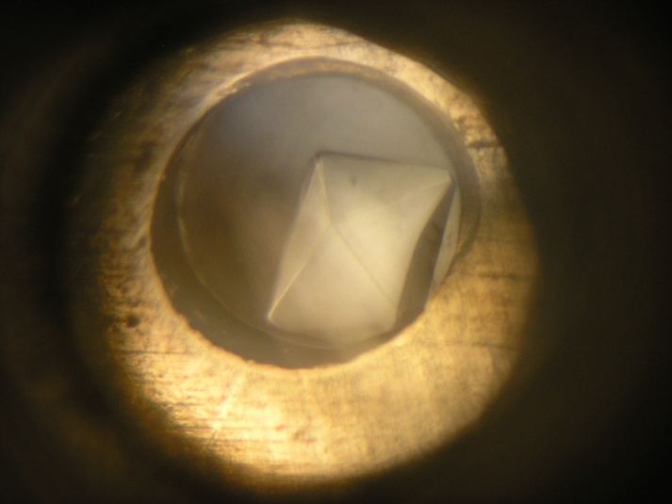
In case of H₂O
At room
Temperature
1気圧 = 1,013 hPa = 101,300 Pa
1 GPa = 1,000,000,000 Pa ≒ 1万気圧
water
Ice(VI)
Ice(VII)
Ice(I_{h})
water
Ice(V)
…
-10 ℃
Phase diagram of H₂O
Ref. Norikazu Maeda, 水の科学, p165, 北海道大学図書刊行会 (1981)
Ice(VI)
Notes:
I_{h}は六方晶系、I_{ｃ}は立方晶系

Slide 6
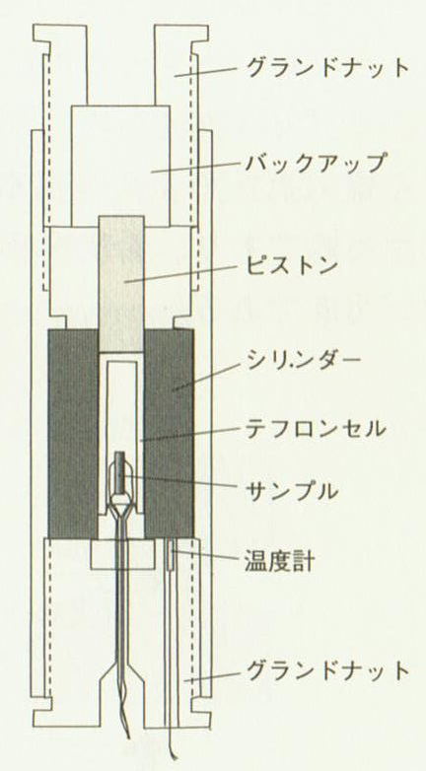
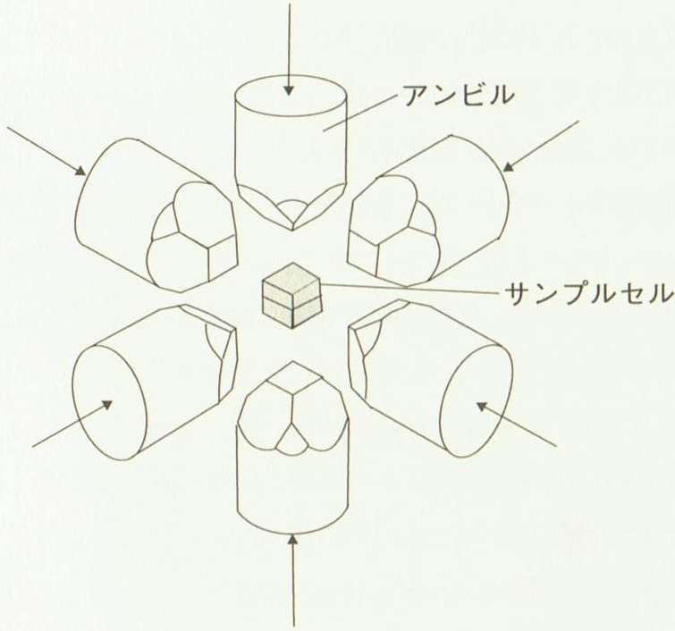
How to make the high pressure
H₂O
Example of hydrostatic pressure
15 mm
3 × 3 mm²
Piston cylinder
Cubic anvil
P < 3 GPa
P < 15 GPa
Ref. 高橋 博樹 ｢マテリアルサイエンスにおける超高圧技術と高温超伝導研究｣

Slide 7
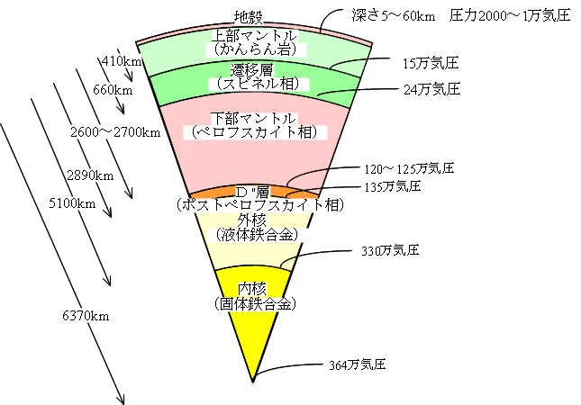
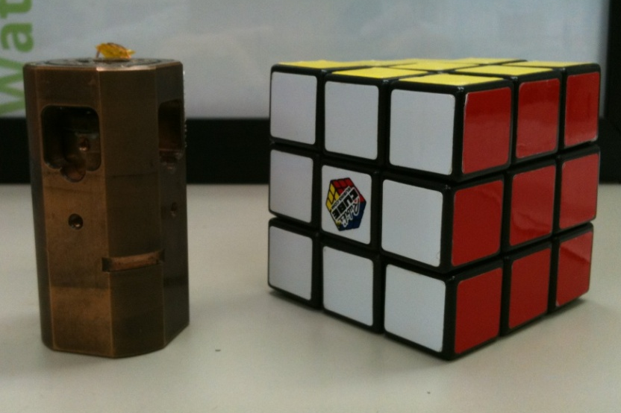
About DAC
Diamond Anvil Cell (DAC)
Maximum P < 360 GPa
DAC & Rubik's Cube
Figure of the Earth's interior
Ref. http://www.s-yamaga.jp/nanimono/chikyu/chikyunokozo-02.htm

Slide 8
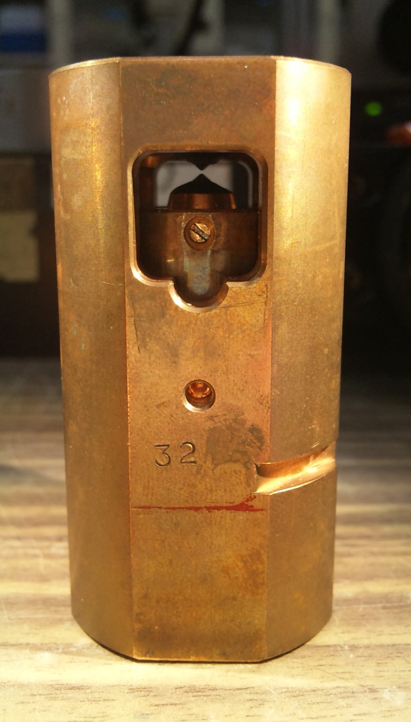
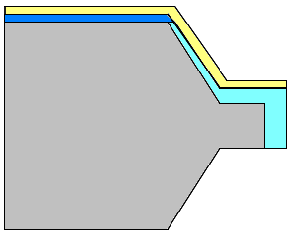
About DAC
diamond
electrode
30～1000 μm
V+
sample
sample
I+
I-
insulated gasket
V-
insulating layer
gasket

Slide 9
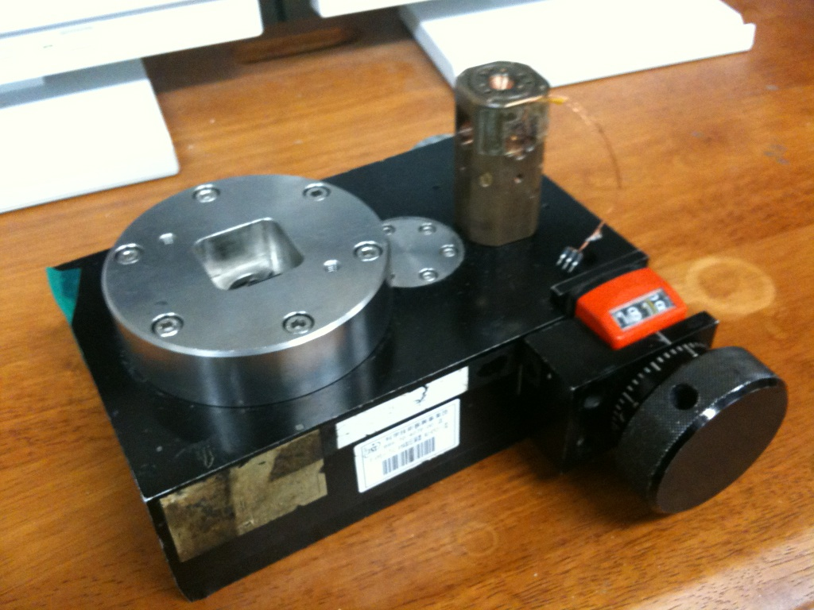
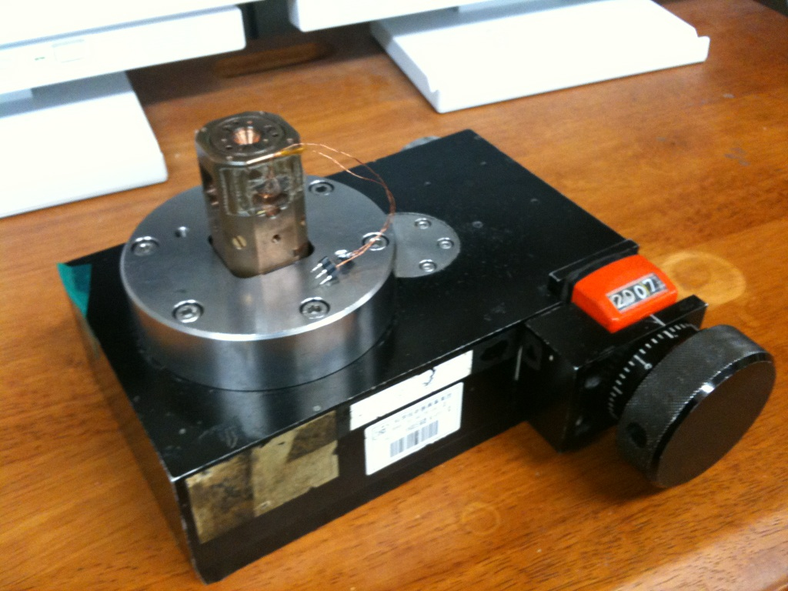
Pressure
Gear Box(加圧台)
Handle
advantages
disadvantages
・ Making very high pressure.
・ The size of DAC is very small.
・ It can use for optical measuring.
・ Making hydrostatic
pressure is difficult.
・ The volume of sample
must be small.

Slide 10
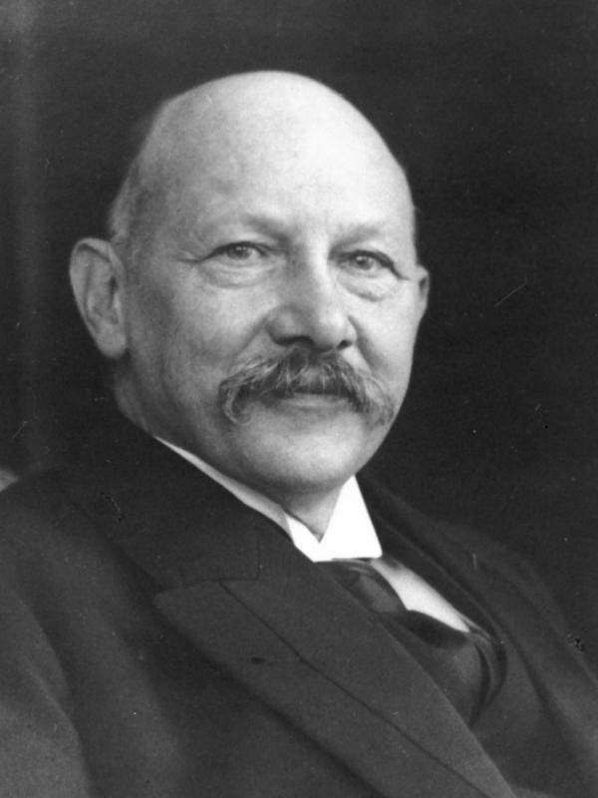
Superconductivity of single elements
Superconductivity ; perfect electrical conductivity : R = 0
perfect diamagnetism (Meissner effect) : H = 0
It is found by Kamerlingh Onnes in 1911 with Hg.
At ambient pressure the highest Tc of single elements is Nb (9.25 K)
Heike Kamerlingh Onnes
Ref. http://ja.wikipedia.org/wiki/%E3%83%98%E3%82%A4%E3%82%B1%E3%83%BB%E3%82%AB%E3%83%A1%E3%83%AB%E3%83%AA%E3%83%B3%E3%82%B0%E3%83%BB%E3%82%AA%E3%83%8D%E3%82%B9

Slide 11
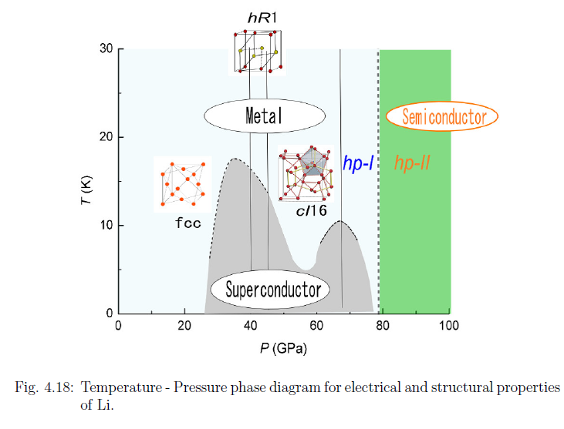
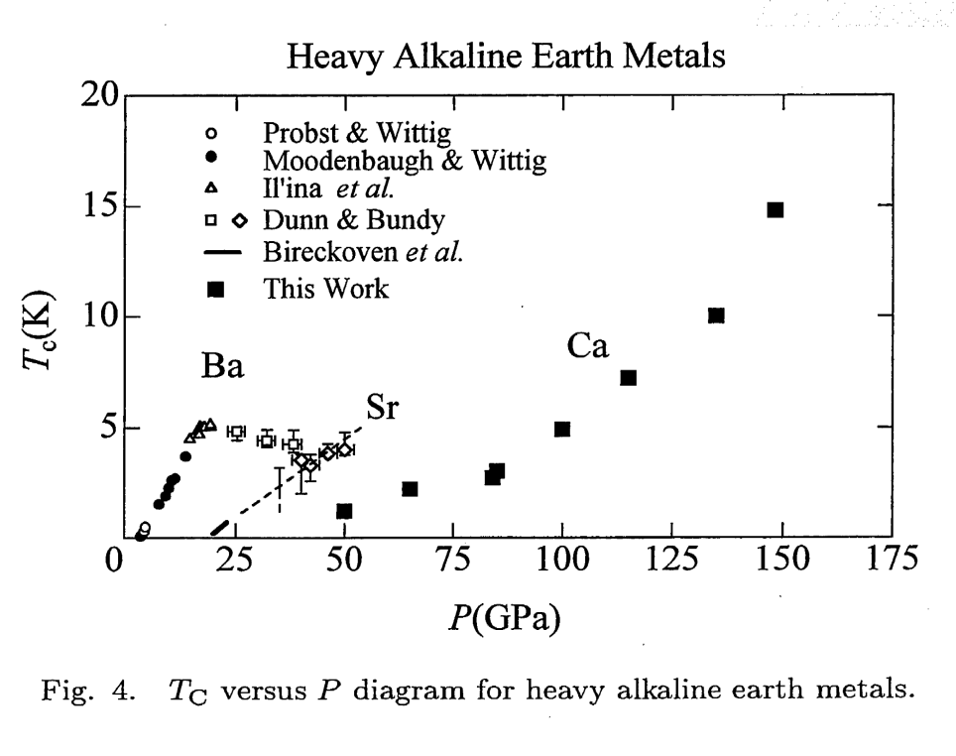
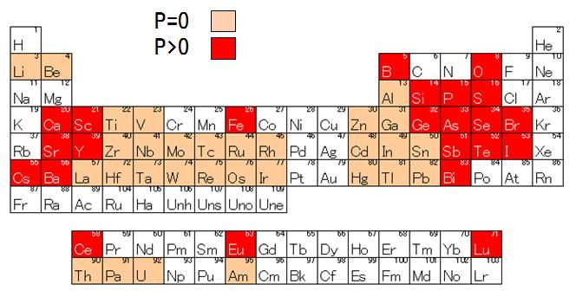
Superconductivity of single elements
Ref. Doctor thesis of
Matsuoka-san (2008)
Ref. S. Okada. et al., J. Phys.
Soc. Jpn., 65, 1924 (1996)
My sample!

Slide 12
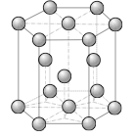
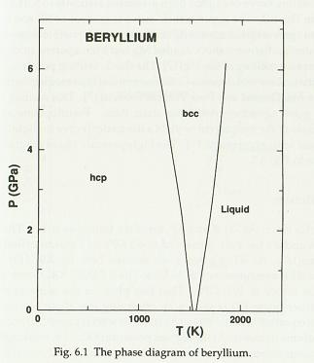
Property of Beryllium
Crystal structure
hcp
Melting point
1551 K
toxic
It is hard
reactive
hard to work
Ref. D. A. Young, Phase Diagrams of the Elements (University of California, 1991), P. 79.

Slide 13
Debye temperature
1440 K
cｆ. diamond → 2230 K
Ca → 230 K
Fe → 470 K
Very high!!
It means phonon interaction
In BCS theory…
T_{c} = 1.14 θ_{D} exp [ -1 / N(0) V ]
θ_{D} : Debye temperature
N(0): Density of electrons near the Fermi surface
V : Interaction between electron and lattice vibration
T_{c} of Be is 24.38 mK at ambient pressure
Too low
Notes:
このデバイ温度1440Kはダイヤモンドの次に高く金属元素としては飛びぬけて高い
これは電子と格子振動の相互関係がかなり大きいということを示す。
BCS理論によると、超伝導は電子と格子振動の相互作用によるクーパー対の形成により出現する。
そこでTcは以下のようにあらわされ、Beはデバイ温度が高く、電子と格子の相互作用が大きいため高いTcが期待できる。
が、ベリリウムの常圧下でのTcは24.38mKと非常に小さく、これはフェルミ面付近での電子状態密度が非常に小さいためであると考えられる。ここで加圧することによりフェルミ面での電子状態密度が増加するのであれば、Tcの上昇が期待できる。
デバイ温度 ： θ_{D} = ℏν/k_{B} ・ (6π²N/V)^{1/3}
ν：音速 N：基本単位格子の数＝音響フォノンモードの総数 V：試料体積＝L^3

Slide 14
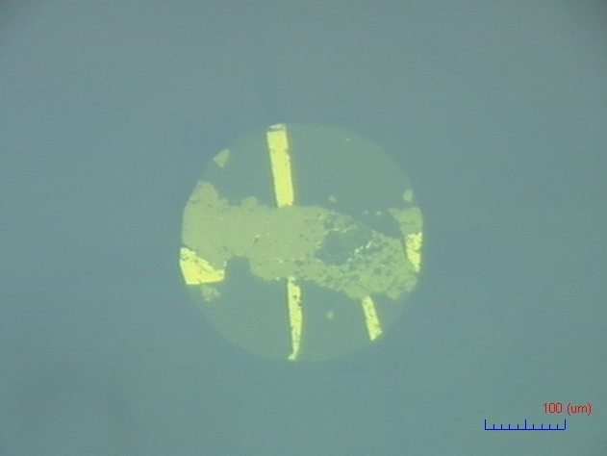
Experiment
four-probe resistance measurements
diamond
Sample setting
Sample: Be (99.9 %)
Cell: 30 mm (Cu-Be)
Diamond anvil: 300 μm
Insulating layer: Al₂O₃
Pressure medium: no
ruby
Alumina
Be
300 µm
tape
Pt
SUS310S
Be
ruby
Sorry, but I’ll show you details on next semester’s presentation.
4.0 GPa
electrode
R vs T at each pressure

Slide 15
Summary
Pressure is very interesting method for changing
physical properties.
DAC is very useful for high pressure experiments.
Beryllium at high pressure seems interesting.
Next time…
More date of experiments.

Slide 17
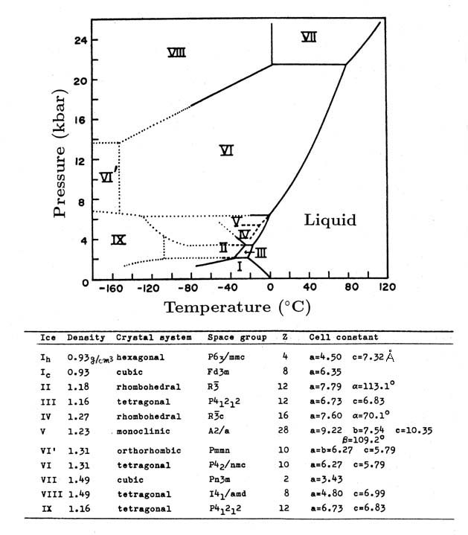
Phase diagram of H₂O
Ref. http://www.sci.osaka-cu.ac.jp/phys/crys/ice/lect6.html

