Slide 1
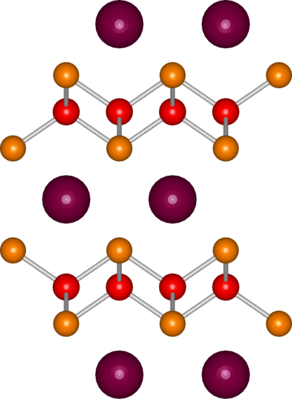
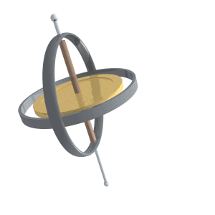
Superconductivity in system AFe₂(As_{1-x}P_{x})₂
Fe
As
A = Ca, Sr, Ba
Evolution from non-Fermi- to Fermi-liquid transport via isovalent doping in BaFe₂(As_{1−x}P_{x})₂ superconductors
Kasahara et. al., Phys. Rev. 81, 184519(2010)
Dulguun Tsendsuren
Kitaoka Lab.
Division of Frontier Materials Sc.
Department of Materials Engineering Sc.
Graduate School of Engineering Sc., Osaka Univ.

Slide 2
History of Superconductivity
Introduction
200
1911
metal
heavy fermion system
Discovery of superconductivity
163
high-T_{c} cuprate
Hg-Ba-Ca-Cu-O
150
iron-based system
（
under high pressure
）
Hg-Ba-Ca-Cu-O
1979
Tl-Ba-Ca-Cu-O
Heavy fermion superconductor
Bi-Sr-Ca-Cu-O
100
Transition temperature (K)
Y-Ba-Cu-O
77
1986
50
SmO
F
FeAs
High-T_{c} cuprate superconductor
MgB₂
0.9
0.11
La-Ba-Cu-O
Nb
Nb
Ge
PuCoGa₅
LaO
0.89
F
0.11
FeAs
Pb
NbN
CeCu₂Si₂
2006
0
Hg
NbC
LaOFeP
1900
1920
1940
1960
1980
2000
2020
Iron-based high-T_{c} superconductor
Year

Slide 3
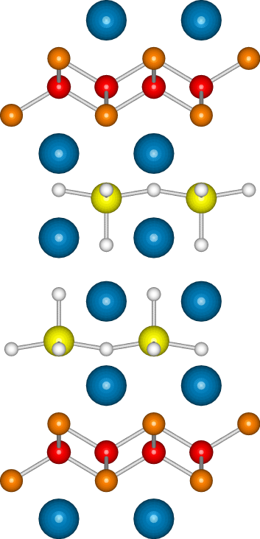
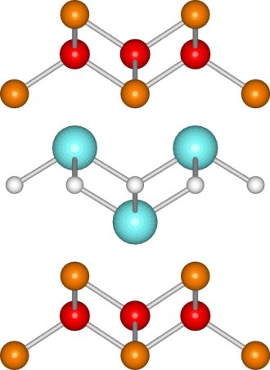
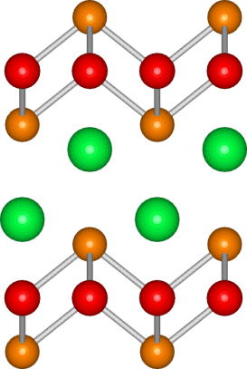
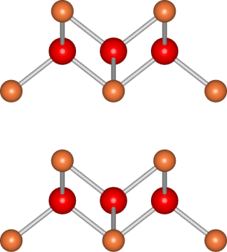
Iron-based Superconductors
Introduction
42226
1111
122
111
11
Fe
As
Today’s talk
Each system has FeAs layer

Slide 4
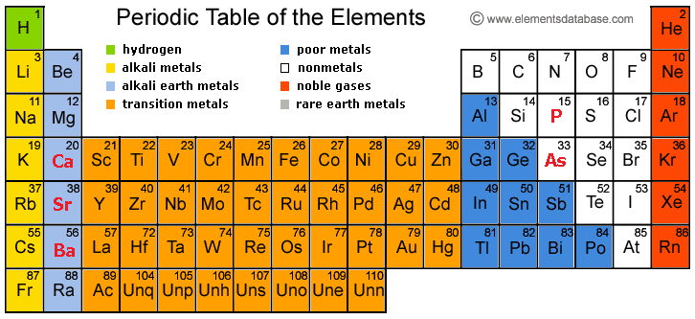
AFe₂As₂ System
Introduction
CaFe₂As₂
SrFe₂As₂
BaFe₂As₂
CaFe₂(As_{1-x}P_{x})₂
SrFe₂(As_{1-y}P_{y})₂
BaFe₂(As_{1-z}P_{z})₂
iso-valent doping
Role of FeAs layer in 122 system

Slide 5
Superconducting gap
Introduction
Full gap
Nodal gap
Density of State
Density of State
gap
gap
E_{Fermi}
Energy
E_{Fermi}
Energy
Structure | Substance | T_{c} [K]
42622 | SrScOFeP | 17
1111 | LaFePO | 5
122 | BaFe₂(As_{1-x}P_{x})₂ | 31
Structure | Substance | T_{c} [K]
42622 | CaAlOFeAs | 27
1111 | NdFeAsO | 55
122 | Ba_{1-x}K_{x}Fe₂As₂ | 38
Structure | Substance | T_{c} [K]
42622 | SrScOFeP | 17
1111 | LaFePO | 5
122 | BaFe₂(As_{1-x}P_{x})₂ | 31
Structure | Substance | T_{c} [K]
42622 | CaAlOFeAs | 27
1111 | NdFeAsO | 55
122 | Ba_{1-x}K_{x}Fe₂As₂ | 38
Spin-Lattice Relaxation Rate (by NMR)
Magnetic Penetration Depth
Thermal Conductivity
Specific Heat
Spin-Lattice Relaxation Rate (by NMR)
Magnetic Penetration Depth
Thermal Conductivity
Specific Heat

Slide 6
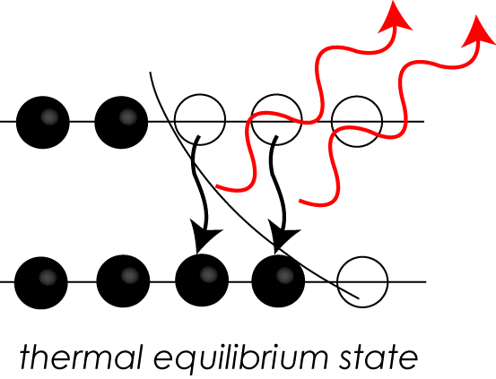
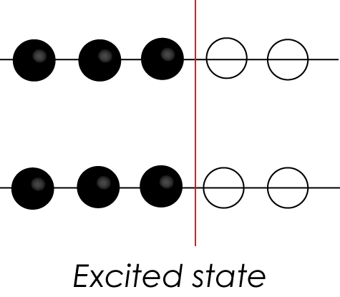
Relaxation rate 1/T₁ by NMR
Introduction
T₁: spin-lattice relaxation time
Releases the energy
Spin-Lattice interaction
nuclear
spin
electronic
spin
Energy Transfers in
almost T₁ time
I
e

Slide 7
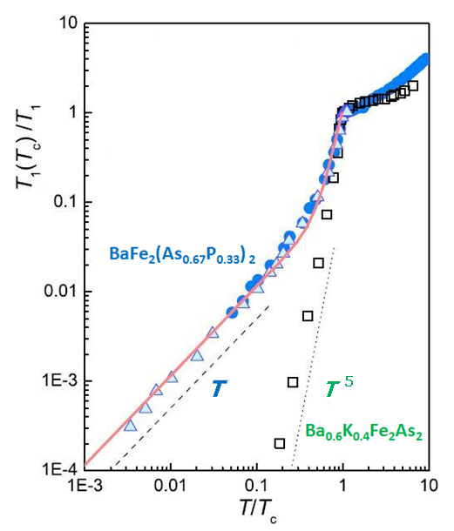
How to verify SC gap?
Introduction
Spin-Lattice Relaxation Rate
(by NMR)
Spin-Lattice relaxation time
Nodal gap:
Temperature
Linear
relation
Full gap:
Temperature
Non-Linear
relation

Slide 8
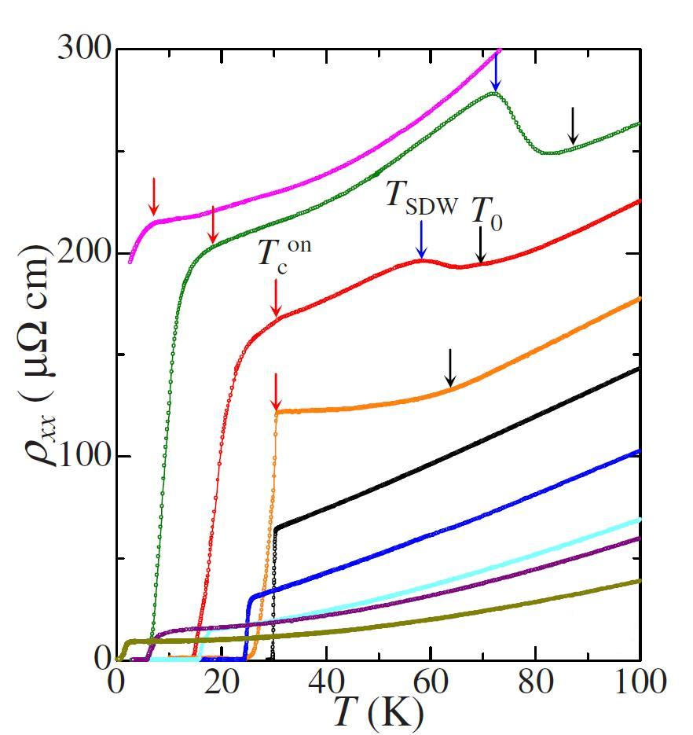
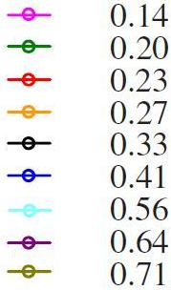
Resistivity of BaFe₂(As_{1-x}P_{x})₂
Exp. Result
Resistivity:
T₀ Structure transition
T_{SDW} AFM Order
T_{c}^{on} Superconductivity appears
Resistivity reflects phase transition clearly as other transport properties

Slide 9
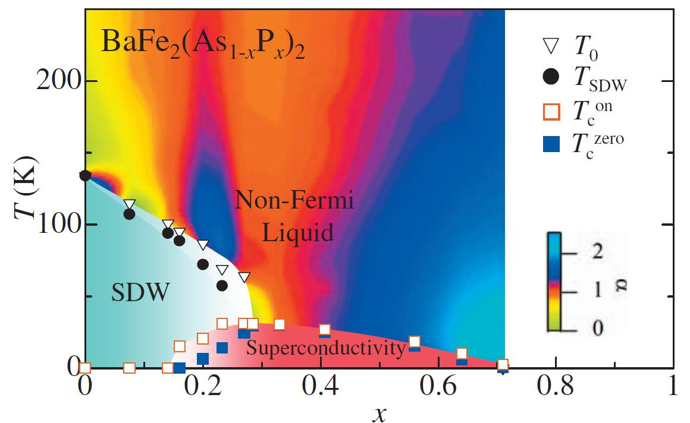
Phase Diagram of BaFe₂(As_{1-x}P_{x})₂
Exp. Result
Transitions:
Structure
SDW
onset T_{c}
Bulk T_{c}
At x = 0.26
T_{c}^{max} = 31 [K]
Doping level (x) of P in BaFe₂(As_{1-x}P_{x})₂

Slide 10
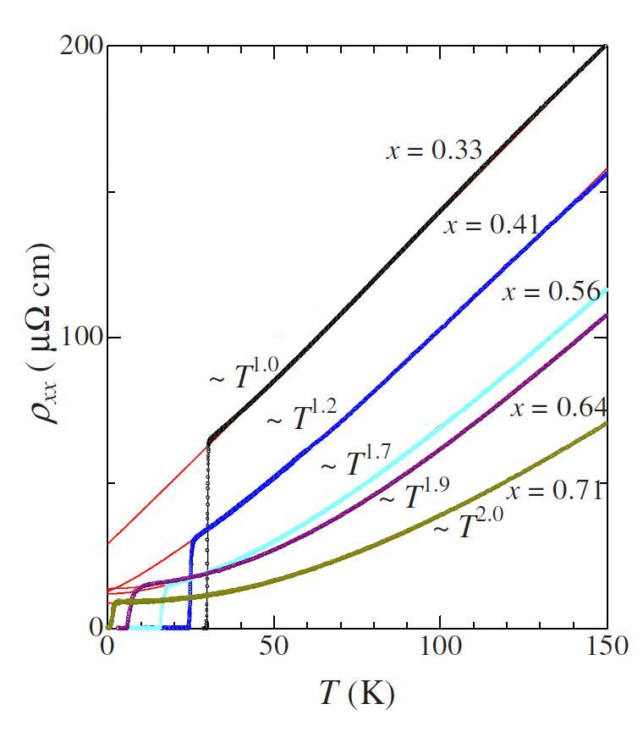
Resistivity of BaFe₂(As_{1-x}P_{x})₂
Exp. Result
Resistivity:
Fermi-liquid:
T_{c} = 0[K]
AFM fluctuation:
T_{c} = 31[K]
(Non-Fermi-liquid)
Highest T_{c} is clearly related
to AFM fluctuation

Slide 11
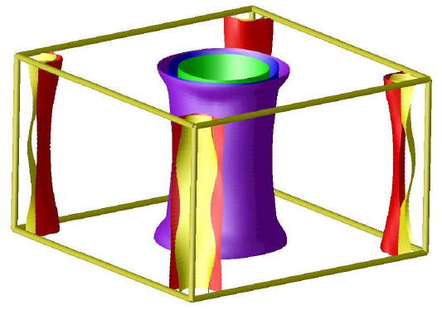
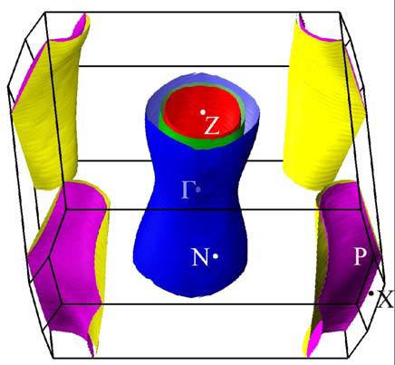
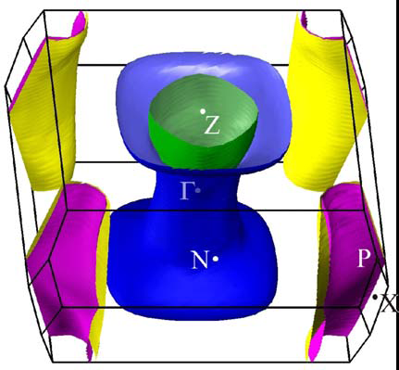
Fermi Surfaces vs. Doping
Calculation
BaFe₂As₂
Ba_{0.8}K_{0.2}Fe₂A₂
BaFe₂P₂
hole doping
(K at Ba)
iso-valent
doping
(P at As)
2D like FS
T_{c}^{max} = 38[K]
T_{c}^{max} = 31[K]
3D like FS
Full gap
Nodal gap
Full gap shows higher T_{c} compared with Nodal gap
With 3D like FSs, SC gap becomes Nodal gap

Slide 12
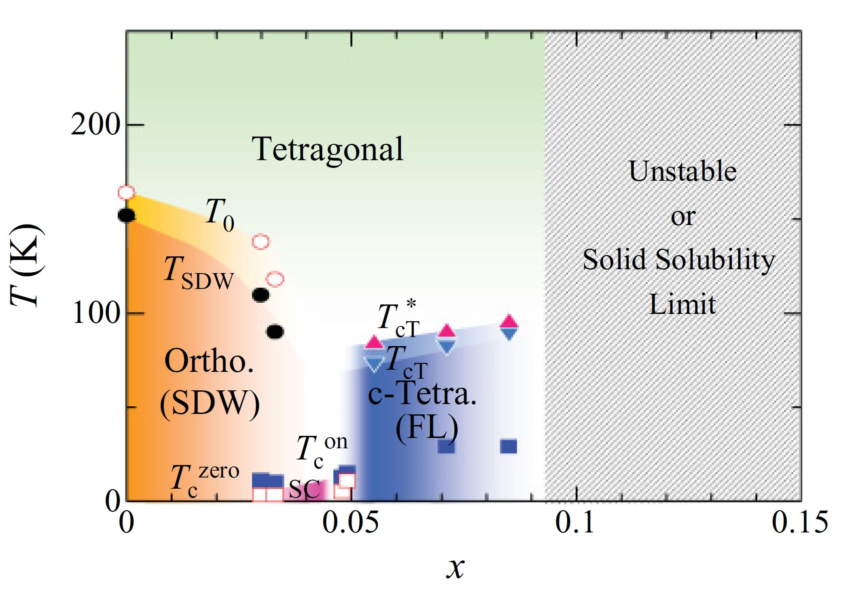
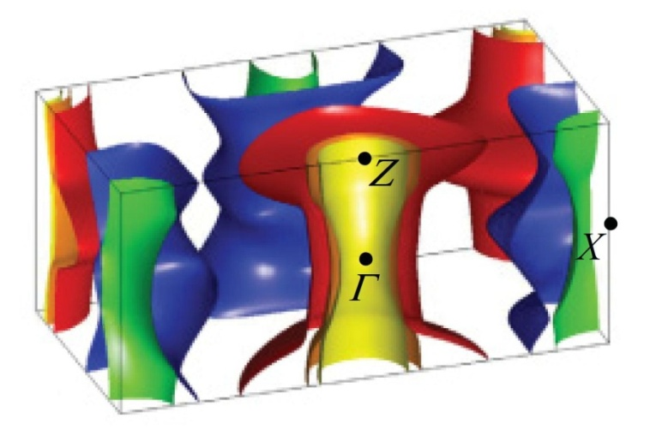
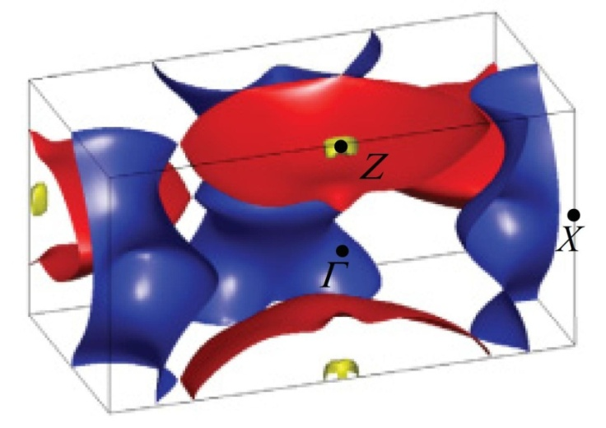
CaFe₂(As_{1-x}P_{x})₂
Exp. Result
Fermi surfaces:
T_{c}^{max} = 15 [K], at x = 0.05
Tetragonal (SC)
c-Tetra. (NC)
SC occurs in tetragonal structure
In c-Tetra., FS changed into 3D
SC disappears in c-Tetra

Slide 13
Summary
Superconductivity occurs:
  AFM fluctuation appears nearby high T_{c} SC region
  With structural change (Orthorhombic to Tetragonal)
Fermi Surface is structure dependent. In most cases, SC occurs when FSs are like 2D
Essence of Full gap is one of promising key to increase T_{c} in Superconductivity

Slide 14
Thank you
for your attention

