Slide 1
Nano-scaled domain in the strongly correlated electron materials
(強相関電子系におけるナノスケール電子相ドメイン)
2011.5.25
First M1 colloquium in 2011
Tanaka Laboratory
Kenichi Kawatani

Slide 2
Contents
・What is the strongly correlated electron system(強相関電子系)?
・domain in the strongly correlated electron system
・the merit of picking up domain
・my research

Slide 3
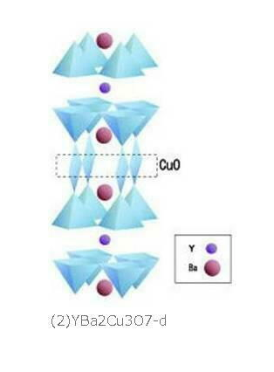
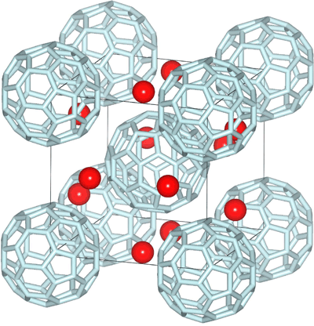
What is the strongly correlated electron system?
3d transiton metal oxides
(3d遷移金属酸化物)
Organic compounds in the π electron system
(π電子系有機化合物)
http://www.tuat.ac.jp/
~naitolab/htsc.html
http://www.spring8.or.jp/ja/news_publications
/press_release/2009/090320
High temperture superconductor
(高温超伝導体)
Organic superconductor
(有機超伝導体)
Various new physical property
Recently researched very hardly

Slide 4
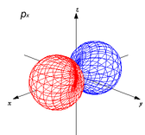
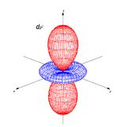
The feature of this system
3d
orbital
restricted
π
Stimulus
Hole-doping
Strong Coulomb interaction
Electron can’t move easily
Decrease of coulomb interaction
Electron can move more easily
change the physical property drastically

Slide 5
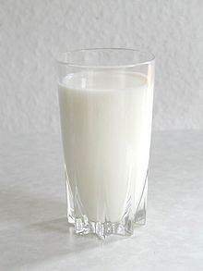
What is domain?
water
Apparently they are ‘milk’,
oil is mixed in the water from micro-scale.
oil
domain
In this system,
In this system,
‘domain’ is mixed
from micro scale.
Insulator
metal
It maybe caused by
‘ununiformity of electrons’.

Slide 6
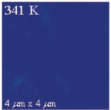
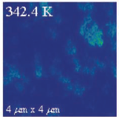
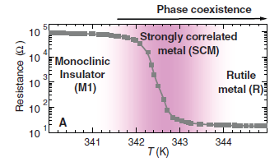
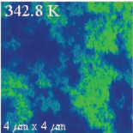
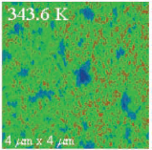
Example of observing ‘domain’
Insulator
Vanadium dioxide (VO2)
・・・metal-insulator transition
M. M. Qazilbash et al.
Science 318, 1750 (2007)
1
1
2
2
3
4
3
4
Metal domain
Coexistance of
insulator and metal phase
Whole physical property
Average of two phase ≠ real physical property

Slide 7
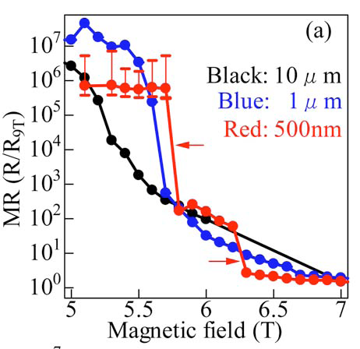
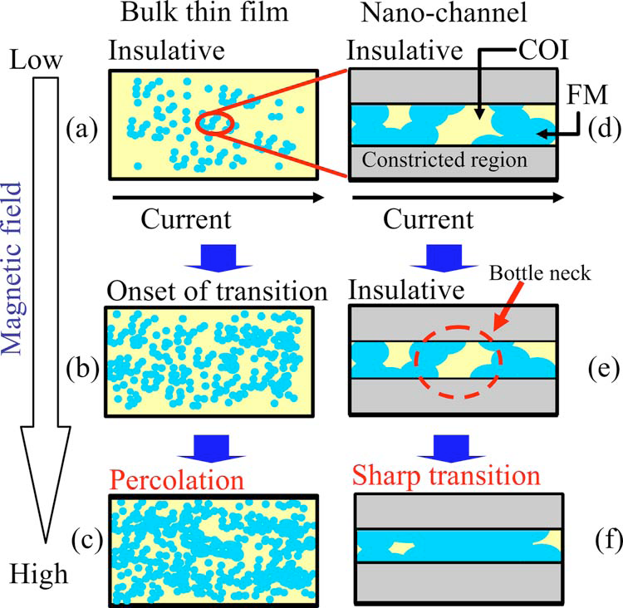
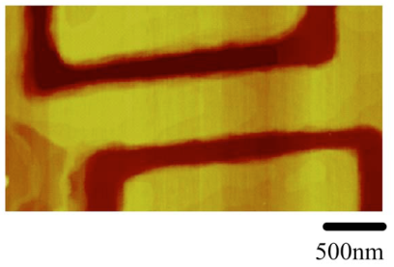
Example of picking up the domain
Change of physical property
by nano-fabrication
10μm
500nm
I
Yanagisawa et al.
Appl. Phys. Lett. 89, 253121 2006
In real,
domain change
drastically!
Change the whole
gently
Drastic change
Picking up the domain
Understand the real physical property

Slide 8
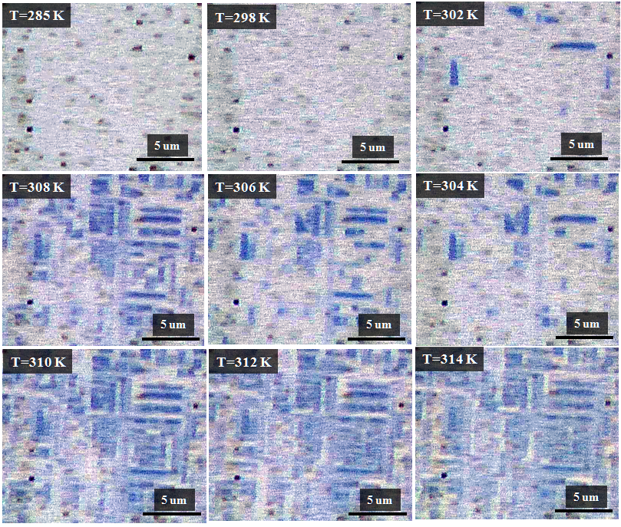
Experimental data
Research theme・・・the behavior of VO2 metal domain
Optical microscope image
Metal domain
？
I’ll pick up the domain by nano-fabrication,
And observe the behavior of VO2 metal domain!
I can observe metal domain!

Slide 9
Application for the electronic device
Control the metal domain
by voltage/current.
Multiple-valued memory(多値メモリ)
・・・It can memorize multiple value.
Next-generation memory

Slide 10
まとめ
In the strongly correlated electron system,
・electrons strongly effect each other
・domain existance by the ununiformity of electron
I will research about the behavior of VO2 metal domain by nano-fabrication.
I can get new information about the strongly correlated electron system!

Slide 11
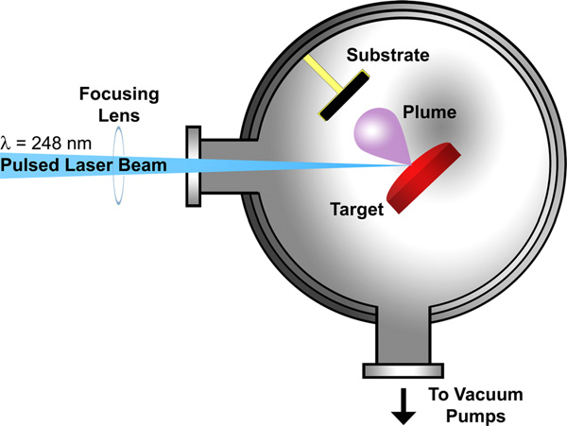
Fabrication method
Pulsed laser deposition method (PLD法)
～nm
Substrate
We can make accuracy very thin films (atomic layer).

Slide 12
Nano-fabrication method
Nanoimprint lithography method
①making VO2 epitaxial thin film
by PLD method
②application of resist
by spincoat method
◎TiO2(001) substrate
resist
VO2
Substrate
③making pattern
by nanoimprint equipment
④RIE(Reactive Ion Etching)
⑤remove the resist
100nm~

