Slide 1
Pulsed Propagation of Polariton Luminescence
18 May.2011
M. Kuwata, T. Kuga, H. Akiyama, T. Hirano, and M. Matsuoka
Phys. Rev. Lett. 61 1226 (1988)
Ashida Lab.
Kenta Kamizono

Slide 2
Contents
Introduction
Exciton
Background
Exciton polariton
Purpose
Experimental setup
Results and Discussion
Conclusion

Slide 3
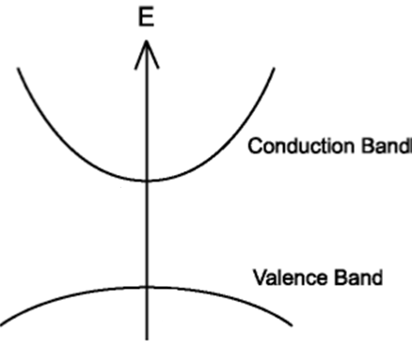
Exciton
Introduction
The lights with the bandgap energy excite a electrons in the valence band to the conduction band.
Holes is created in the valence band.
Coulomb-correlated electron-hole pairs
＋
ー
Exciton: 励起子
Valence band: 価電子帯
Conduction band: 伝導帯

Slide 4
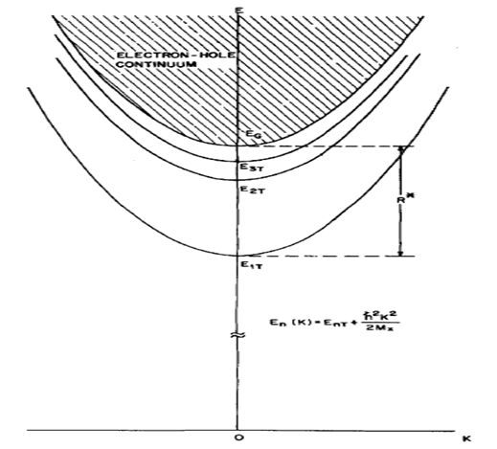
Exciton
Introduction
+
-
E_{ｎ}(K) = E_{G} – R/n² + h²K²/2M_{X}
E_{G} : bandgap energy
R : Rydberg energy
M_{X} = m_{e} + m_{h}
C. Weisbuch and R. G. Ulbrich, in Light Scattering in Solids Ⅲ, edited by M. Cardona and G. Guntherodt, Topics in Applied Physics Vol. 51 (Springer-Verlag, Berlin, 1982), Chap. 7.

Slide 5
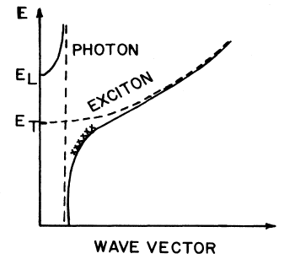
Exciton polariton (EP)
Background
Polaritons relax down to lower-energy.
The polaritons can accumulate in the region, named “bottleneck”
Group velocity v_{g} = dω/dK
bottleneck
F. Askary and P. Y. Yu, Phys. Rev. B 28, 6165 (1983)

Slide 6
Purpose
To clarify the spatial effect
the temporal responses of EP luminescence with the forward and the backward geometry
forward
backward
Luminescence: 発光

Slide 7
Experimental setup
β-BaB₂O₄ crystal
dye laser
cw mode-locked yttrium-aluminum-garnet laser
repetition rate : 82 MHz
average power : 5 mW
Spectral resolution : 0.6meV
time resolution : 80ps
CuCl crystal
synchroscan streak camera
50-cm monochromator
photomultiplier

Slide 8
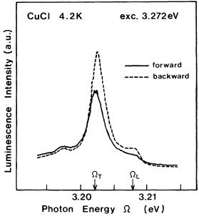
time-integrated spectra
Result
The peak photon energy of the forward (FW) spectrum is slightly lower than that of the backward (BW) spectrum.
Because of the dissipation inside the sample
forward
backward
Dissipation: 散逸

Slide 9
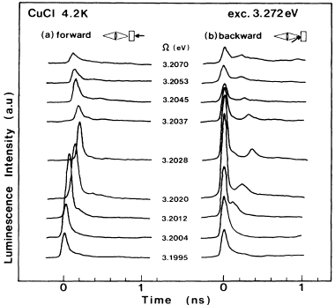
frequency-resolved temporal responses
Result
The curves show pulse type.
In FW geometry, delayed pulses are observed, and their delay times T_{F}.
T_{B} = 2×T_{F}
T_{F}
T_{B}
Excitons travel with v_{g}
Some of polaritons are converted to photons.(T_{F})
The other polaritons reflect and return to the front surface.(T_{B})
The thickness is about 2.6 μm.

Slide 10
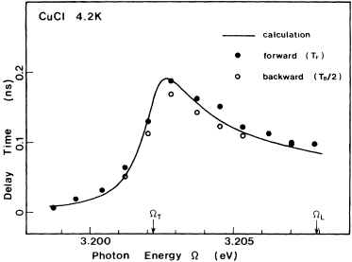
delay time against photon energy
Result
excitons travel in the sample with their polariton group velocities v_{g}.
Delay time is d/ v_{g}
The thickness d is 2.56 μm.
minimum v_{g} : light speed c = 1.3×10⁴ : 3.0×10⁸

Slide 11
Conclusion
The peaks found in the time-integrated spectra do not correspond to the population maximum due to the accumulation of EP’s at bottleneck region.
The propagation character of photocreated excitons can be explained with the polariton propagation.
Time-resolved exciton luminescence spectra do not reflect the population dynamics in general.
The spatial inhomogeneity of the EP distribution is essential important in the study of exciton dynamics from time-resolved emission spectra.

Slide 13
CuCl
Zinc Blend
direct transition semiconductor
E_{g} (2K):3.399eV
Binding energy (77K):197meV
E
Z1,Z2
Z3
Cu⁺
Cl⁻
ｋ

Slide 14
Polariton
Introduction
+
+
+
-
-
-
Mixed state of exciton and photon

Slide 15
Background
Spatially homogeneity
Spatially inhomogeneity
The spatially homogeneous distribution is often assumed for simplicity.
However, the exciton-polariton are inhomogenerously created in space.

